Slide 1
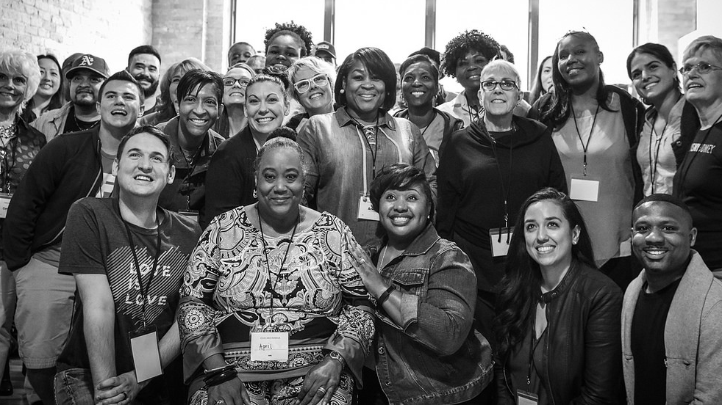


SPRING 2018
Fellows Leaders
We will begin the training at 8 p.m. ET / 7 p.m. CT
Notes:
This work is licensed under the Creative Commons Attribution-NonCommercial 4.0 International License. To view a copy of this license, visit http://creativecommons.org/licenses/by-nc/4.0/ or send a letter to Creative Commons, PO Box 1866, Mountain View, CA 94042, USA

Slide 2
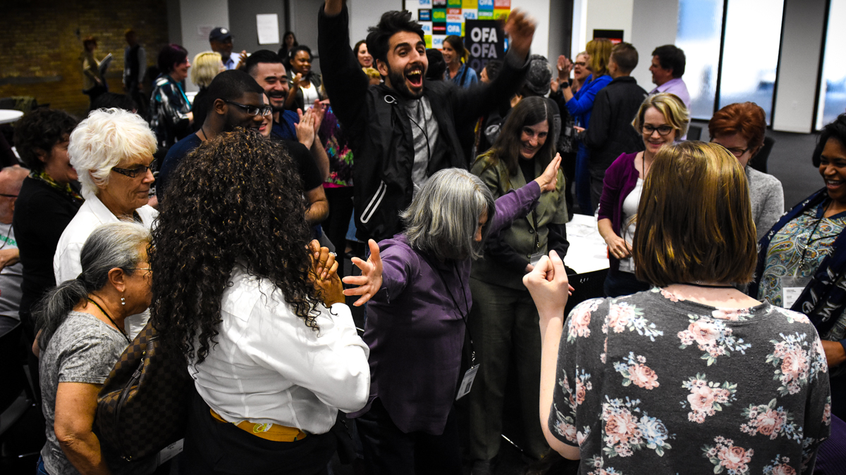
SPRING 2018 OFA FELLOWS LEADERS
Part 3: Servant leadership
Bobby Brady-Sharp / OFA Training Projects Manager

Slide 3


Guided worksheet
Week 3
Bit.ly/training3worksheet

Slide 4
GOALS FOR THIS SESSION
Define the concept of
servant leadership

Slide 5
GOALS FOR THIS SESSION
Relate the principles of
servant leadership to your organizing work

Slide 6
GOALS FOR THIS SESSION
Reflect and weigh your
current leadership style
against the characteristics
of servant leadership

Slide 7

Agenda
Introduction/recruitment update
Defining servant leadership
10 characteristics
Reflection
Close and homework

Slide 8




Logistics
We will meet for 90 minutes
You will need a pen and paper or means of taking notes
A recording of this call will be
available later this week.
Please tweet -- #OFAFellows

Slide 9
Housekeeping items

Slide 10

Defining servant leadership

Slide 11
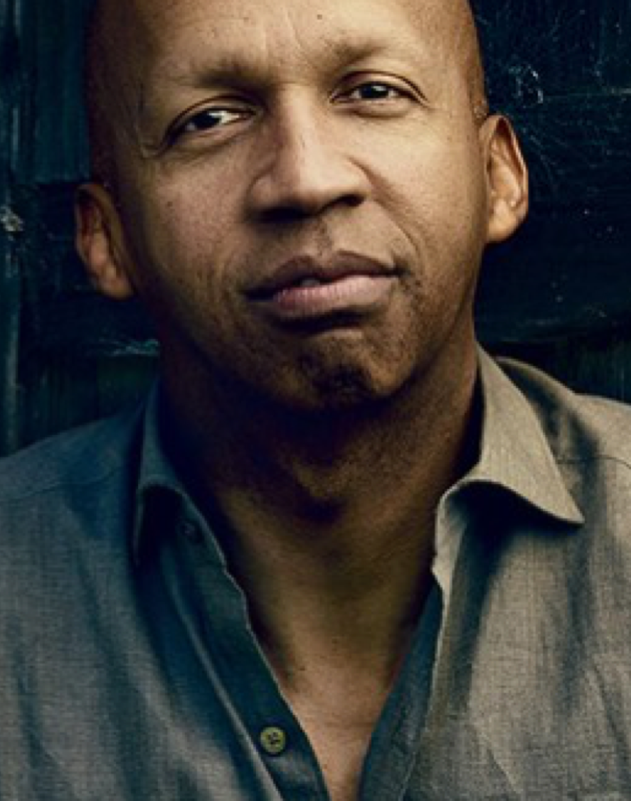
“
Each of us is more than the worst thing we have ever done.”
Bryan Stevenson
Equal Justice Initiative
Notes:
Coercion induces change, while leadership influences change

Slide 12
QUESTION:
How would you define servant leadership?

Slide 13
How can a person be
a leader and a servant at the same time?

Slide 14
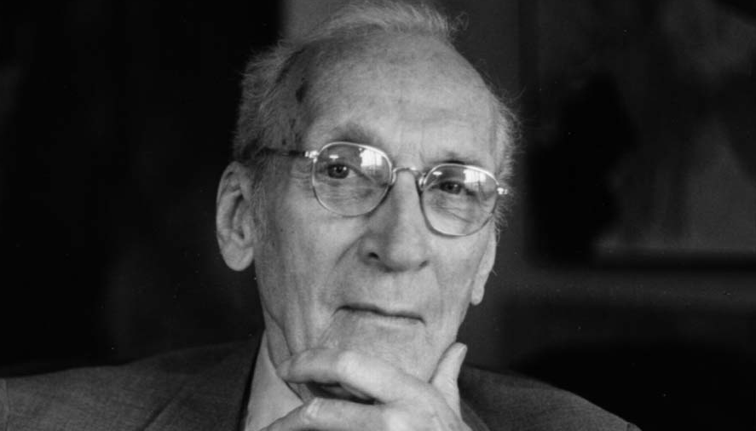

Slide 15
Servant Leadership:
”The natural feeling that one wants to serve first. This conscious choice brings one to aspire to lead…”
Robert K. Greenleaf
(1970, pg. 15)

Slide 16
Servant Leadership:
”…the difference manifests itself in the care taken by the servant —first to make sure that other people’s highest priority needs are being served.”
Robert K. Greenleaf
(1970, pg. 15)

Slide 17
Servant Leadership:
”The best test is: Do those served grow as persons; do they, while being served, become healthier, wiser, freer, more autonomous, more likely to become servants?.”
Robert K. Greenleaf
(1970, pg. 15)

Slide 18
QUESTION:
What makes
Bryan Stevenson a servant leader?

Slide 19
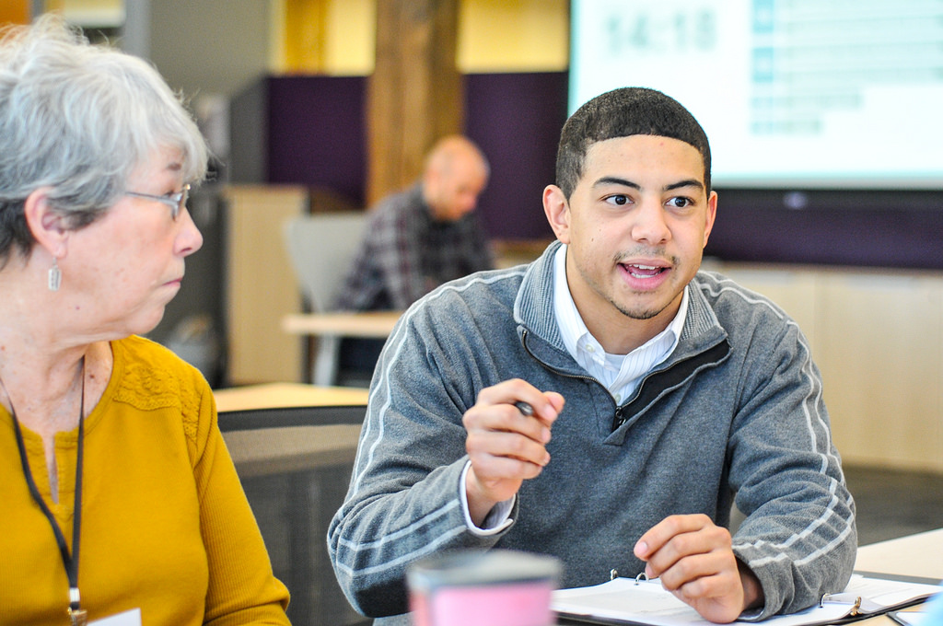
Servant Leadership:
Ten characteristics
(Larry Spears)

Slide 20
TEN CHARACTERISTICS—SERVANT LEADERSHIP:
Listening

Slide 21
TEN CHARACTERISTICS—SERVANT LEADERSHIP:
Empathy

Slide 22
TEN CHARACTERISTICS—SERVANT LEADERSHIP:
Healing

Slide 23
TEN CHARACTERISTICS—SERVANT LEADERSHIP:
Awareness

Slide 24
TEN CHARACTERISTICS—SERVANT LEADERSHIP:
Persuasion

Slide 25
TEN CHARACTERISTICS—SERVANT LEADERSHIP:
Conceptualization

Slide 26
TEN CHARACTERISTICS—SERVANT LEADERSHIP:
Foresight

Slide 27
TEN CHARACTERISTICS—SERVANT LEADERSHIP:
Stewardship

Slide 28
TEN CHARACTERISTICS—SERVANT LEADERSHIP:
Commitment to the growth of people

Slide 29
TEN CHARACTERISTICS—SERVANT LEADERSHIP:
Building community

Slide 30
In fact, many of these qualities may remind you
a bit of this…

Slide 31
Self-Awareness
Emotional Self-Awareness
12 competencies of emotional intelligence – Daniel Goleman
Self-Management
Emotional Self-Control
Achievement Orientation
Positive Outlook
Adaptability
Social Awareness
Empathy
Organizational awareness
Relationship Management
Coach and Mentor
Conflict Management
Inspirational Leadership
Teamwork
Influence

Slide 32
15 minutes
Take 5 minutes to read through the 10 characteristics. Then, take 10 minutes to discuss:
What are the three qualities that come naturally to you? Explain why.
What are the three characteristics you need to work on?
Who is a servant leader you admire, and what characteristics do they demonstrate?
Read/Reflect/Discuss
Worksheet: Bit.ly/training3worksheet

Slide 33
HOMEWORK ASSIGNMENT
Week 3
Bit.ly/training3worksheet

Slide 34
OFA Training
Thank you for joining today’s webinar.
Check the Fellows Leader website for a copy of the material covered
today, including a video and audio recording of the webinar.
Email fellows@ofa.us with any questions.
Bit.ly/servant3

