Slide 1
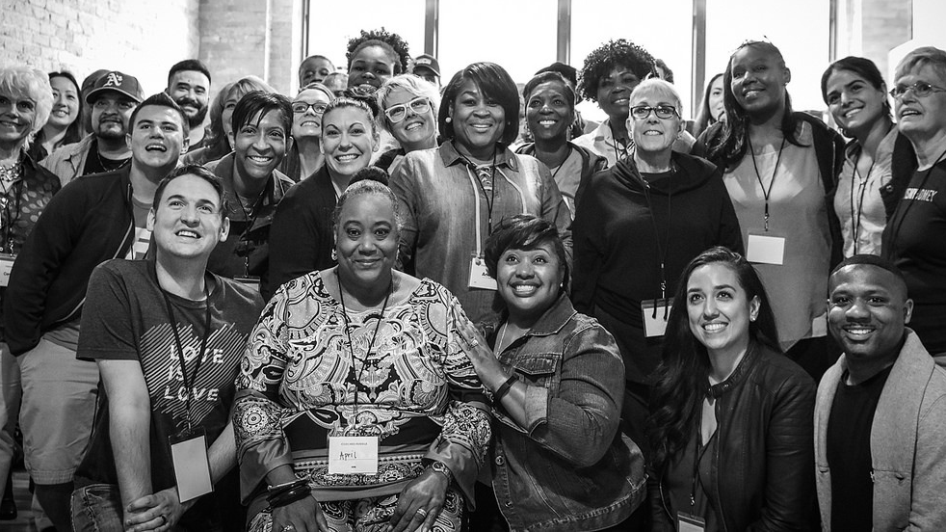


SPRING 2018
Fellows Leaders
We will begin the training at 8 p.m. ET / 7 p.m. CT
Notes:
This work is licensed under the Creative Commons Attribution-NonCommercial 4.0 International License. To view a copy of this license, visit http://creativecommons.org/licenses/by-nc/4.0/ or send a letter to Creative Commons, PO Box 1866, Mountain View, CA 94042, USA

Slide 2
Housekeeping items

Slide 3
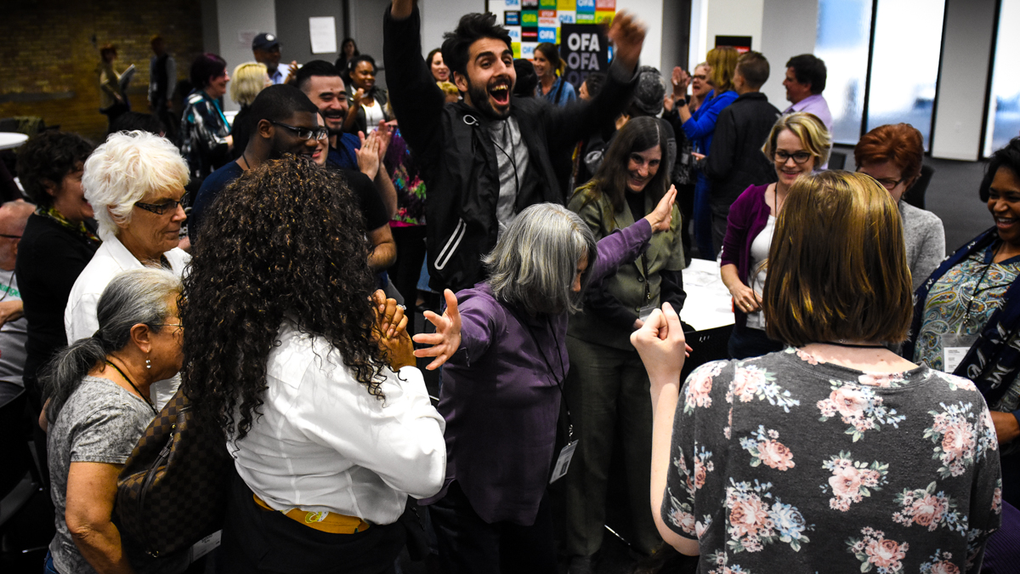
SPRING 2018 OFA FELLOWS LEADERS
Part 5: Transformational Leadership
Bobby Brady-Sharp / OFA Training Projects Manager

Slide 4
#OFAFellows

Slide 5


WORKSHEET
Week 5
Bit.ly/week5worksheet

Slide 6
GOALS FOR THIS SESSION
Define the concept of transformational leadership

Slide 7
GOALS FOR THIS SESSION
Relate the principles of transformational leadership to your work

Slide 8
GOALS FOR THIS SESSION
Compare your current leadership style to the characteristics of transformational leadership

Slide 9


Transformational Leadership

Slide 10
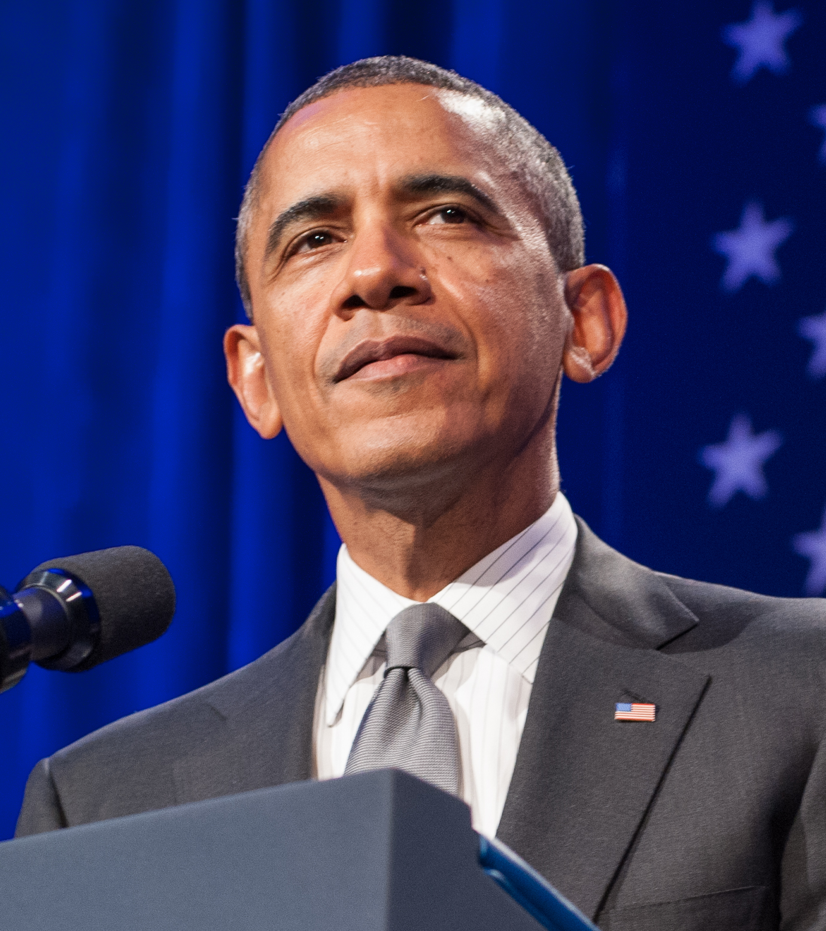
“We choose hope over fear. We see the future not as something out of control, but as something we shape for the better through concerted and collective effort.”
Barack Obama

Slide 11
What is
transformational leadership?

Slide 12
Transformational Leadership:
”The process whereby a person engages with others and creates a connection that raises the level of motivation and morality in both the leader and follower.”
James MacGregor Burns
(1978)

Slide 13
What this leader is…
Attentive to the needs and motives of followers

Slide 14
What this leader is…
Attentive to the needs and motives of followers
Helps followers reach their full potential

Slide 15
What this leader is…
Attentive to the needs and motives of followers
Helps followers reach their full potential
Displays and lives a sense of justice and morality that is not defined by the people that follower or the organization they lead

Slide 16
So what’s so special about it?

Slide 17
The leader and
followers are inextricably
bound together in the transformation process.
Notes:
Ryan White – Teenagers who raised American people’s awareness about AIDS. In the process, became a spokesperson for increasing government support.

Slide 18
A DICHOTOMOUS MODEL
Transformational
Transactional
Process--> leaders and followers are connected in motivation, morality to effect transformative personal and organizational change.
Refers to the bulk of leadership though – focuses on exchanges that occur between leaders and their followers.
&

Slide 19
QUESTION:
What are some examples of transactional leadership?

Slide 20
Examples of transactional leadership
A politician winning votes by promising “no new taxes”

Slide 21
Examples of transactional leadership
A politician winning votes by promising “no new taxes”
A manager who offers promotions to employees who surpass their goals

Slide 22
Examples of transactional leadership
A politician winning votes by promising “no new taxes”
A manager who offers promotions to employees who surpass their goals
Teachers giving their students a grade for work

Slide 23
Transformational leadership characteristics

Slide 24

Characteristics of transformational leadership
IDEALIZED INFLUENCED
The emotional component Leaders act as strong role models for followers Attributional and behavioral—followers emulate
Notes:
Idealized influence -- Nelson Mandela
Inspirational motivation – Sales manager who motivates members of the sales force to excel in their their work through encouraging words, pep talks that clearly communicate the integral role they play in the future growth of the organizational
Intellectual stimulation – Plant manager who promotes workers individual efforts to develop unique way to solve problems that have caused slowdowns in production
Individualized consideration – A manager who spend time treating each employee in a caring and unique way (i.e. situational leadership)

Slide 25
Characteristics of transformational leadership
IDEALIZED INFLUENCED
The emotional component Leaders act as strong role models for followers Attributional and behavioral—followers emulate
INSPIRATIONAL MOTIVATION
Leaders communicate high standards Inspire followers through motivation and shared vision Focuses on team spirit, symbols, emotional appeals
Notes:
Idealized influence -- Nelson Mandela
Inspirational motivation – Sales manager who motivates members of the sales force to excel in their their work through encouraging words, pep talks that clearly communicate the integral role they play in the future growth of the organizational
Intellectual stimulation – Plant manager who promotes workers individual efforts to develop unique way to solve problems that have caused slowdowns in production
Individualized consideration – A manager who spend time treating each employee in a caring and unique way (i.e. situational leadership)

Slide 26
Characteristics of transformational leadership
IDEALIZED INFLUENCED
The emotional component Leaders act as strong role models for followers Attributional and behavioral—followers emulate
INSPIRATIONAL MOTIVATION
Leaders communicate high standards Inspire followers through motivation and shared vision Focuses on team spirit, symbols, emotional appeals
INTELLECTUAL STIMULATION
Stimulates creativity and innovation Challenges long held traditions, beliefs, and values Encourages follower’s creativity, accepts failure
Notes:
Idealized influence -- Nelson Mandela
Inspirational motivation – Sales manager who motivates members of the sales force to excel in their their work through encouraging words, pep talks that clearly communicate the integral role they play in the future growth of the organizational
Intellectual stimulation – Plant manager who promotes workers individual efforts to develop unique way to solve problems that have caused slowdowns in production
Individualized consideration – A manager who spend time treating each employee in a caring and unique way (i.e. situational leadership)

Slide 27
Characteristics of transformational leadership
IDEALIZED INFLUENCED
The emotional component Leaders act as strong role models for followers Attributional and behavioral—followers emulate
INSPIRATIONAL MOTIVATION
Leaders communicate high standards Inspire followers through motivation and shared vision Focuses on team spirit, symbols, emotional appeals
INTELLECTUAL STIMULATION
Stimulates creativity and innovation Challenges long held traditions, beliefs, and values Encourages follower’s creativity, accepts failure
INDIVIDUALIZED CONSIDERATION
Supportive climate that listens to needs Leaders coach and advise Delegates and allows followers to work through challenges
Notes:
Idealized influence -- Nelson Mandela
Inspirational motivation – Sales manager who motivates members of the sales force to excel in their their work through encouraging words, pep talks that clearly communicate the integral role they play in the future growth of the organizational
Intellectual stimulation – Plant manager who promotes workers individual efforts to develop unique way to solve problems that have caused slowdowns in production
Individualized consideration – A manager who spend time treating each employee in a caring and unique way (i.e. situational leadership)

Slide 28
And because both leader and follower transforms, there is an individual component…

Slide 29
Transformative learning:
The process by which people examine problematic frames of reference
to make them more inclusive, discriminating, open, reflective,
and emotionally able to change.
Jack Mezirow
Transformational learning

Slide 30
10 minutes
What are the biggest ways your community needs to transform?
In other words,
What is your vision for transformation?
What characteristics do you need to adopt?
How do you envision your fellows team helping this goal?
Discuss
Worksheet: bit.ly/week5worksheet

Slide 31

After studying situational, servant, and transformational leadership–which one do you identify with the most?
Type in the chat box
Notes:
Remember, there are many different types of leadership theory

Slide 32
QUESTION:
After studying servant and transformational leadership–which one do you identify with the most?

Slide 33
#OFAFellows

Slide 34
Questions?

Slide 35
HOMEWORK ASSIGNMENT
Week 5
Bit.ly/week5worksheet

Slide 36
OFA Training
Thank you for joining today’s webinar.
Check the Fellows Leader website for a copy of the material covered
today, including a video and audio recording of the webinar.
Email fellows@ofa.us with any questions.
Bit.ly/transformeval

