Slide 1
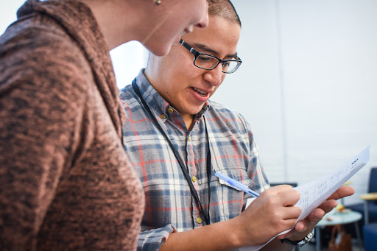


WORKSHOP SESSION
Local Issue Advocacy
Elizabeth Erickson / OFA Training Director
We will begin the training at 8:30 p.m. ET / 5:30 p.m. PT
Notes:
This work is licensed under the Creative Commons Attribution-NonCommercial 4.0 International License. To view a copy of this license, visit http://creativecommons.org/licenses/by-nc/4.0/ or send a letter to Creative Commons, PO Box 1866, Mountain View, CA 94042, USA
Express appreciation for joining, and that I have looked over the homework that some people have sent and am really excited to dig through some of it

Slide 2
“Life’s most persistent and urgent question is, “What are you doing for others?”
MARTIN LUTHER KING, JR.
Notes:
“Life’s most persistent and urgent question is, ‘What are you doing for others?'”

Slide 3

2 minutes
Who is your example of someone who works for others selflessly?
How has that impacted you?
Opening
Notes:
Type answers into the chat box

Slide 4
Participants will narrow from a problem to an issue
Participants will identify the best practices of an issue statement
Participants feel a sense of community with the group, particularly with the members that are working on a similar issue
Goal for
this session
1
2
3

Slide 5


Guided worksheet
BIT.LY HERE

Slide 6
Tonight’s
agenda
 | Opening Organizer continuum Review of indicators of good issues Group norms for workshops Group protocol Closing

Slide 7
#OFAction

Slide 8
Our learning journey
Week 1: Introductions; advocacy overview
Week 2: Workshop
Week 3: Foundations of coalition building
Week 4: Workshop
Week 5: Identifying legislation

Slide 9
Our learning journey
Week 6: Workshop
Week 7: Writing your campaign plan
Week 8: Workshop
Week 9: Running into barriers
Week 10: Closing synthesis and next steps

Slide 10
Tonight’s
agenda
 | Opening Organizer continuum Review of indicators of good issues Group norms for workshops Group protocol Closing

Slide 11
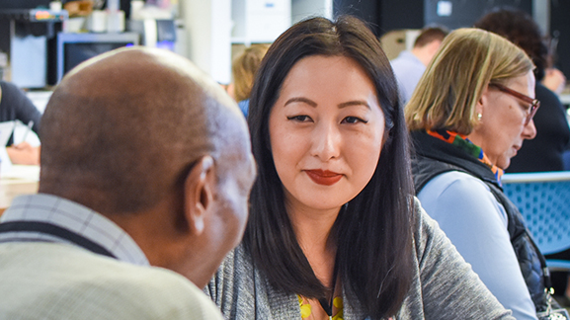
Organizer continuum
Notes:
7:10- 7:11
Why we need to have effective conversations – the time is NOW to understand our neighbors and understand the things that compel them

Slide 12
Organizer continuum
No engagement
Minimal engagement & awareness
Participation
Leadership
Changing the system
Notes:
No engagement: actions, causes, beliefs
Actions
Lack of voting in city/state/federal elections
No reading of news (passive)
Not talking to people with different ideas
Beliefs
“Government doesn’t affect me. I cannot effect government”
“Politics are corrupt anyway”
Causes
Systematically/historically not allowed in politics; disenfranchised. No matter who is in office, status quo doesn’t really change
Minimal engagement/ awareness
Actions
Reading news and alarmed/irritated/aware of what is going on
Likely siloed with news sources
Attends some community events
Beliefs
Change can come, but not for a long time
Thinks about issues that are important in some way
Causes
Reading material that supports their own world view
Lack of understanding of how city government is set up and works
Challenges (none listed, so what do you think challenges are for someone who is “Aware”
OFA programs that are best suited for this level
Participation
Actions
Member of a community group (ie church, alumni, sorority, sports, clubs -- book, quilt, etc)
Regularly attends/participates in events, phone banks, online actions, etc
Know they care
Intimately aware of how their life is set up
Beliefs
Change comes from ordinary people who care
“If not me, who?”
Causes
Believes they are leaders
Educated
Understands the ways to raise their own voice
Leadership
Actions
Recruits people to join them
Lead local chapters for change
Have a theory about change comes to a community
Aware of key change levers
Beliefs
“I am a key change lever”
Causes
Have had some success in getting something passed/changed for a positive impact
Changing the system
Actions
Make laws, policies, decisions that help overall representation in our government
Deep understanding of theory of change, including reasons why groups are disenfranchised
Beliefs
Power sharing is good for a sustainable democracy
Thinks that government is good
Causes
Other people give them authority

Slide 13
Where do you identify yourself on the organizer continuum with your issue?
Notes:
We are not counselors (most of us- shout out to counselors that are on the call). This framework isn’t taking the place of professional counseling, nor is it saying that we should act as counselors when we talk to people

Slide 14
Goals
Notes:
Goals & success: from your above diagnosis -- we want all of us to move from leadership to changing the system
This is why we set this program in place -- we want to dive into how our work on our issues can change the system we are operating in
Share goals/ measures of success for the program -- what we want out of it -- share goals slides

Slide 15
1
Equip individuals with the skills to identify root problems in their community, and propose a campaign plan addressing these root problems.
To identify all the components of successful coalitions, and apply these elements of building a coalition in their community
To explain current legislation surrounding their issue, and take appropriate action
To analyze the barriers and challenges that we face as we implement our campaign plans, and persevere strategically
The develop a community of learners that support, push, challenge, and celebrate each other
2
3
4
5

Slide 16
Success
Notes:
Link to indicators of success on worksheet

Slide 17
Tonight’s
agenda
 | Opening Organizer continuum Review of indicators of good issues Group norms for workshops Group protocol Closing

Slide 18
Indicators of good issues….
Result in the improvement of people’s lives
Make people aware of their own power
Be winnable
Be widely felt
Be deeply felt
Be easy to understand
Have a clear decision maker
Have a clear time frame
Be consistent with your values and vision

Slide 19
Problems =
Broad areas of concern
Examples: unaffordable health care,
pollution, unemployment

Slide 20
Issues =
Solution or partial solution to a problem
Examples: enacting a local
clean energy plan

Slide 21
WE MUST KNOW THESE ANSWERS DEEPLY.
Question | Rating
Who is affected by the issue?
What are the consequences of the issue?
What is the economic impact of the issue?
What are the barriers?
What are the resources?
What is the history of the issue in your community?

Slide 22
Rate yourself
Notes:
Insert continuum 1 – 5
Should be the answers to the above questions/ homework review

Slide 23
Tonight’s
agenda
 | Opening Organizer continuum Review of indicators of good issues Group norms for workshops Group protocol Closing

Slide 24
Group norms

Slide 25
Norm 1:
Develop an ethic of sharing.

Slide 26
Norm 2:
It’s okay to question. Asking
for why; asking for evidence; receive feedback in kind.
Notes:
Be nimble in conversations that require different things

Slide 27
Norm 3:
No one is above critique,
no one is below dignity.

Slide 28
Additions?

Slide 29
Tonight’s
agenda
 | Opening Organizer continuum Review of indicators of good issues Group norms for workshops Group protocol Closing

Slide 30
15 minutes
Groups of three
Decide who is person A, B, C
Person A: You share the context of the problem you are working on, the issue, your timeline, and why you care about it
People B & C: Be ready to share 3 affirmations, 2 questions, 1 underlying assumption
Group Protocol
Notes:
Person A: Sharing context of problem, timeline, issue, and why you deeply care about it
Person B & C: 3 affirmations, 2 questions, 1 underlying assumption that is being made

Slide 31
3 minutes
Person A:
Share:
Context of the problem you are working on
Your issue statement
Timeline of how long you have been working on it
Why you care about this issue
Reflection

Slide 32
2 minutes
Person B & C:
Share:
3 affirmations
2 questions
1 underlying assumption
Reflection

Slide 33
3 minutes
Person B:
Share:
Context of the problem you are working on
Your issue statement
Timeline of how long you have been working on it
Why you care about this issue
Reflection

Slide 34
2 minutes
Person A & C:
Share:
3 affirmations
2 questions
1 underlying assumption
Reflection

Slide 35
3 minutes
Person C:
Share:
Context of the problem you are working on
Your issue statement
Timeline of how long you have been working on it
Why you care about this issue
Reflection

Slide 36
2 minutes
Person A & B:
Share:
3 affirmations
2 questions
1 underlying assumption
Reflection

Slide 37
Group share

Slide 38
Tonight’s
agenda
 | Opening Organizer continuum Review of indicators of good issues Group norms for workshops Group protocol Closing

Slide 39

Debrief
What did I learn today?
What am I leaving committing to
now go, do, understand?

Slide 40

Homework

Slide 41
Next session

Slide 42
Thank you for joining
today’s webinar.
Please fill out the survey below and give us
your feedback on today’s training.
bit.ly/AdvocacyBeliefs
Notes:
Express appreciation, thank them for joining; express importance of joining each time

