Slide 1
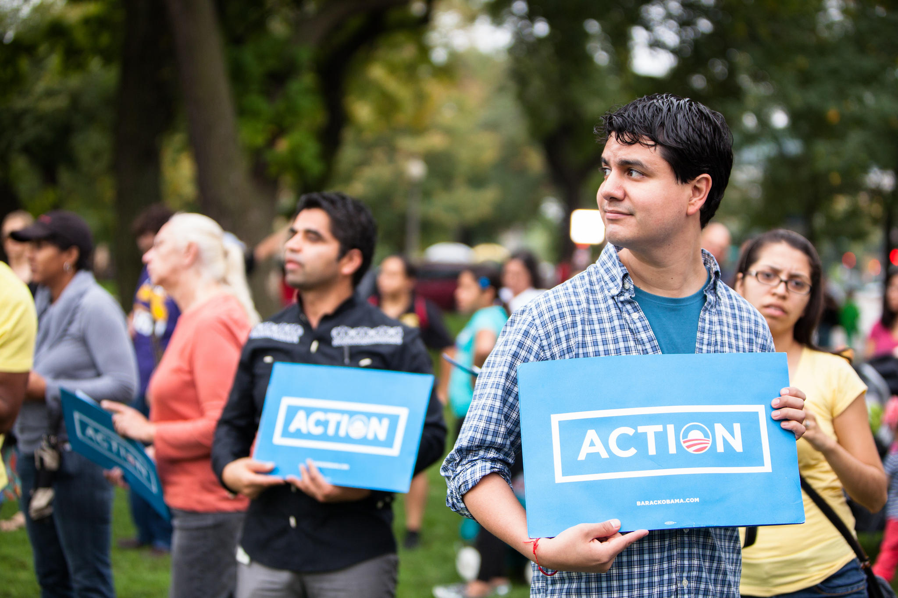


OFA TRAINING
Welcome to today’s webinar.
We will begin shortly.
For audio, please make sure to also join the call.
DIAL-IN HERE
Notes:
This work is licensed under the Creative Commons Attribution-NonCommercial 4.0 International License. To view a copy of this license, visit http://creativecommons.org/licenses/by-nc/4.0/ or send a letter to Creative Commons, PO Box 1866, Mountain View, CA 94042, USA

Slide 2





LOGISTICS
We will meet for 75 minutes
This is an interactive training.
A recording of this video and call will be available on the Bookshelf
It’s cool if you Tweet --
#OFAFellows
Notes:
00:01 – 00:03 [2 min] – Aquiles
Before we get started, let’s review some logistics

Slide 3

DESIGNING UP-FRONTS AND DEBRIEFS
W/ CHELSEY WININGER

Slide 4

CLASS REVIEW
DESIGNING EXPERIENTIAL ACTIVITES
Notes:
CBW – Welcome

Slide 5
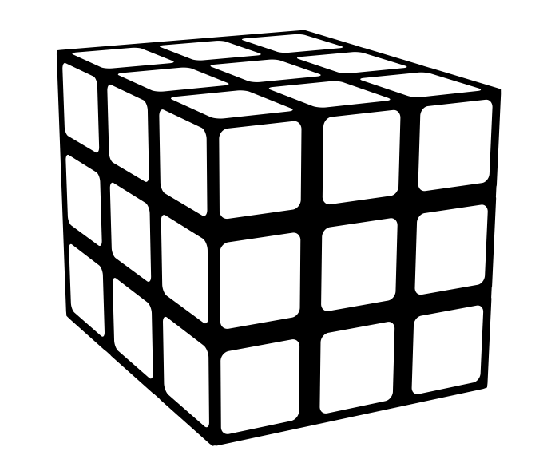
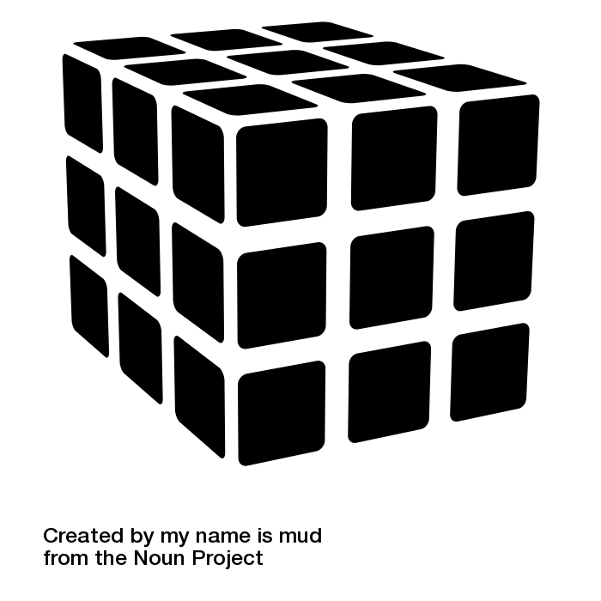
LEARNING OBJECTIVES: Modules, Learning Journey, Program
Training Module
Learning Journey
Training Program

Slide 6
PROCESS TO DESIGN A TRAINING MODULE
1
ESTABLISH LEARNING OBJECTIVES

Slide 7
3
LEARNING OBJECTIVES
KNOWLEDGE
SKILLS
ATTITUDE
Notes:
00:74 – 00:75 [1 min] – Ryanne
Digital campaigns achieve measurable goals, broadcast relevant messaging, integrate all digital platforms, and are consistent.

Slide 8
PROCESS TO DESIGN A TRAINING MODULE
1
2
ESTABLISH LEARNING OBJECTIVES
DESIGN LEARNING EXPERIENCE

Slide 9


What are the characteristics of an experiential activity?
OR
Press 1 on the phone
Type in chat box

Slide 10


EFFECTIVE EXPERIENTIAL ACTIVITIES
Adults are more likely to retain information when they participate in activities that are both psychologically and behaviorally engaging
Notes:
Effective experiential activities combine the two. To be the best hitter out there, I need to be mentally prepared, which I do through reading and watching tape, and physically prepared, which I practice by going to the batting cages.
In training, we want to create experiential activities that are both psychologically and behaviorally engaging because that is where adults learn. The more difficult the concept, the more experiential space there needs to be in your training and the more participants need to work together.
In other words…

Slide 11
PROCESS TO DESIGN A TRAINING MODULE
1
2
3
4
ESTABLISH LEARNING OBJECTIVES
DESIGN LEARNING EXPERIENCE
WRITE UP-FRONT MATERIAL
PLAN A DEBRIEF

Slide 12
DESIGNING UP-FRONTS AND DEBRIEFS
W/ CHELSEY WININGER

Slide 13

CHELSEY WININGER
Deputy Training Director

Slide 14
GOALS FOR TODAY
K
Understand how up-front content and debrief activities complement your experiential activity
S
Be able to write an up-front that gives learners just enough information to complete the experiential activity
S
Be able to plan a debrief that helps your learners crystalize their learning
A
Feel confident designing a training module that revolves around the experiential activity

Slide 15

AGENDA FOR TODAY
Purpose of an Up-Front
Writing Up-Fronts
Purpose of Debriefs
Writing Debriefs
Debrief and Close

Slide 16
ADULT LEARNING THEORY: ADULTS LEARN BY DOING
THE 20-60-20 RULE
20%
Up-Front Content
60%
Experience
20%
Debrief
LEARNING HAPPENS HERE
Notes:
As Ashley said last week, the experience– the combination of psychological and behavioral learning– is where adults learn

Slide 17
An up-front gives just enough information to be able to complete the activity.
Learners will learn the rest by doing.
Notes:
AQ

Slide 18
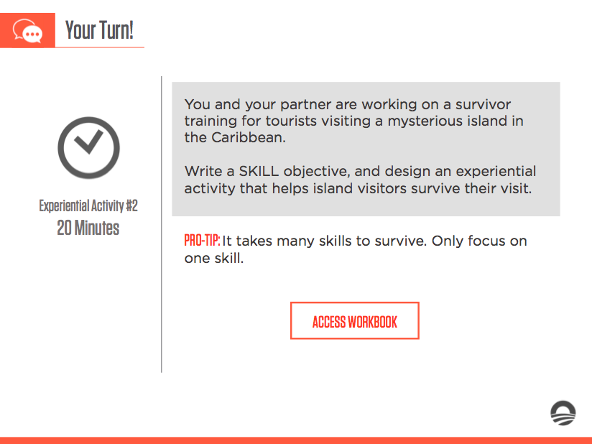
Remember this activity?

Slide 19
What we said.
What you learned.
Adults learn when they are both psychologically and behaviorally engaged with the material.
Adults learn by doing.
Experiential activities must align with the skill goal of your training.

Slide 20
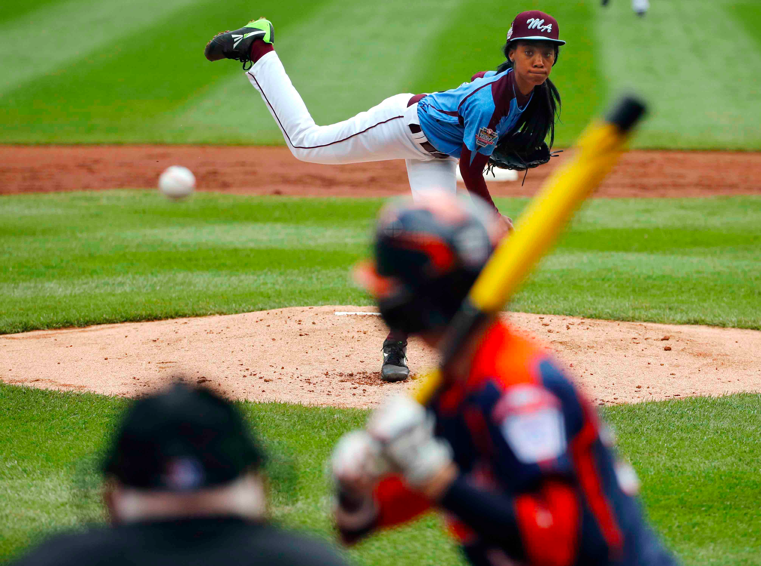
Notes:
Psychological– I can read all about how to hit a baseball, watch tape on how to hit a baseball, but won’t know how to actually do it until I take some swings
Behavioral– I can step into the batters box and try to hit the ball, but I won’t know which pitches to expect, how to be a strategic hitter, etc
I need to practice both to be an effective hitter

Slide 21
AGENDA FOR TODAY
Purpose of an Up-Front
Writing Up-Fronts
Purpose of Debriefs
Writing Debriefs
Debrief and Close

Slide 22

Goals

Slide 23



Goals
Experiential

Slide 24
Ready for your Up-Front?
Goals
Experiential

Slide 25
4
Designing an effective Up-Front
STEP PROCESS

Slide 26
DESIGNING UP-FRONTS
1
PROBLEM
SOLUTION
State the problem in a single sentence or two.
EXAMPLE
ILLUSTRATION

Slide 27
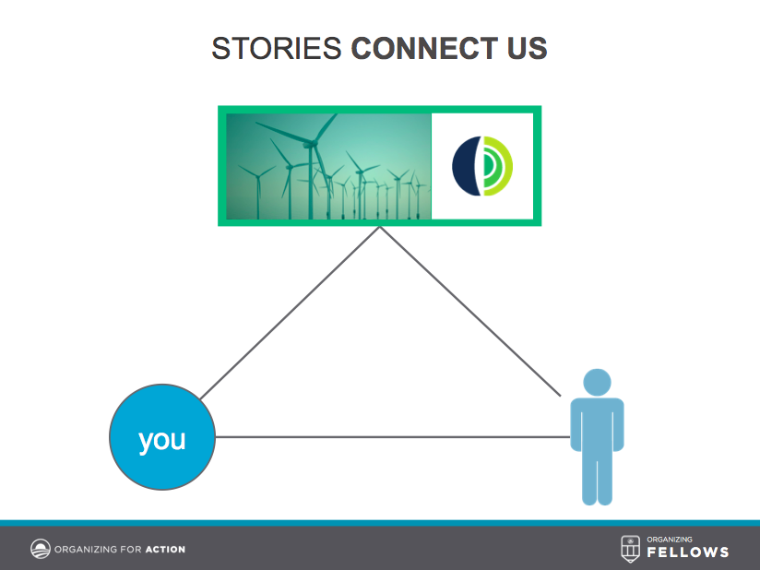
DESIGNING UP-FRONTS
1
PROBLEM
SOLUTION
EXAMPLE
ILLUSTRATION
ANNOTATED AGENDA
Trainer’s Notes: Stories connect us. When we are able to explain who we are, why we care about an issue, and why someone else should, we are able to bring in new people into our organizing.

Slide 28
DESIGNING UP-FRONTS
PROBLEM
2
SOLUTION
Offer your training as a solution to the problem.
EXAMPLE
ILLUSTRATION

Slide 29
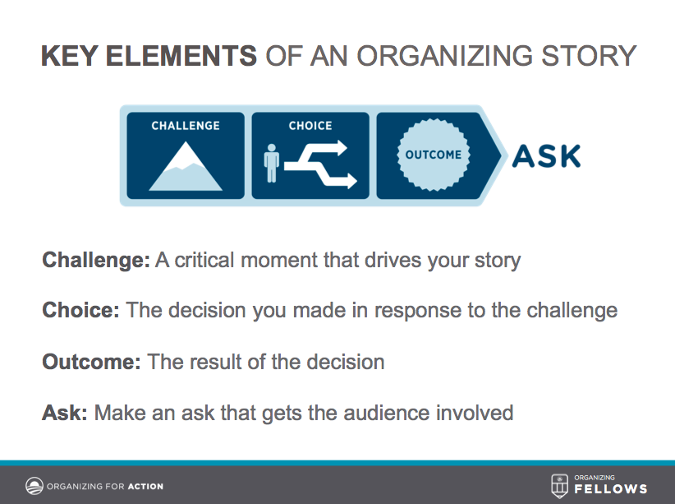
DESIGNING UP-FRONTS
PROBLEM
2
SOLUTION
EXAMPLE
ILLUSTRATE
ANNOTATED AGENDA
Trainer’s Notes: Sharing your personal story following this structure helps you connect with new prospective volunteers.

Slide 30
DESIGNING UP-FRONTS
PROBLEM
SOLUTION
Exemplify the solution by giving concrete examples – “for example.”
3
EXAMPLE
ILLUSTRATION

Slide 31
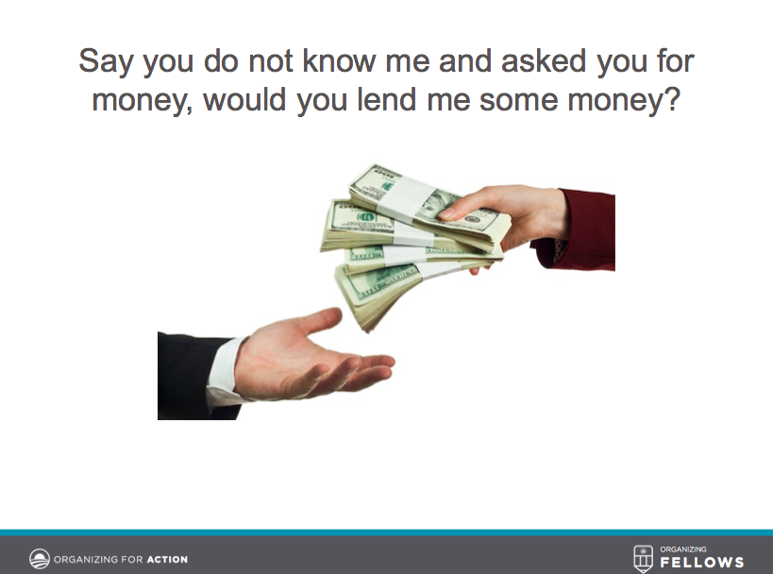
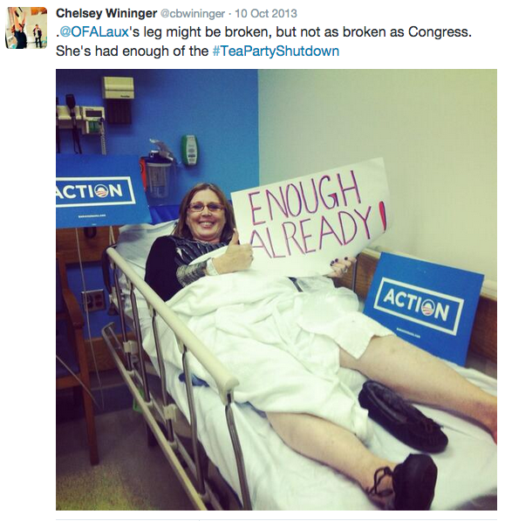
DESIGNING UP-FRONTS
PROBLEM
SOLUTION
3
EXAMPLE
ILLUSTRATION
ANNOTATED AGENDA
Trainer’s Notes: For example, if I would not have built a personal relationship with Cheryl by sharing our personal stories, she would not have done this.

Slide 32
DESIGNING UP-FRONTS
PROBLEM
SOLUTION
EXEMPLE
Illustrate the solution or idea with a picture, diagram, metaphor, or analogy – “it’s like…”
4
ILLUSTRATION

Slide 33
DESIGNING UP-FRONTS
PROBLEM
SOLUTION
EXAMPLE
4
ILLUSTRATION
ANNOTATED AGENDA
Trainer’s Notes: It is like if I asked you, a stranger, for money. You are more likely to give it to me if you know me; if you have a connection with me.

Slide 34

Your Turn!
Your Training Director asks you to produce a training on one-on-one meetings, since some field organizers are not following the one-on-one agenda effectively.
During the experiential activity, learners will role-play a one-on-one meeting with one another following the one-on-one agenda.
Design an up-front content that will prepare learners for the role-play following the framework: PROBLEM, SOLUTION, EXAMPLE, ILLUTRATION.
Experiential Activity #2
15 Minutes
ACCESS WORKBOOK

Slide 35
AGENDA FOR TODAY
Purpose of an Up-Front
Writing Up-Fronts
Purpose of Debriefs
Writing Debriefs
Debrief and Close

Slide 36
ADULT LEARNING THEORY: ADULTS LEARN BY DOING
THE 20-60-20 RULE
20%
Up-Front Content
60%
Experience
20%
Debrief
LEARNING HAPPENS HERE
Notes:
As Ashley said last week, the experience– the combination of psychological and behavioral learning– is where adults learn

Slide 37
Debriefs help adults crystalize what they learned in the training session, why it matters, and how they will use the knowledge.
Notes:
AQ

Slide 38
Debriefs help adults crystalize what they learned in the training session, why it matters, and how they will use the knowledge
WHAT
The “What” helps participants reflect about they learned during the session
Notes:
AP

Slide 39
Debriefs help adults crystalize what they learned in the training session, why it matters, and how they will use the knowledge
WHAT
The “What” helps participants reflect about they learned during the session
SO WHAT
This type of question asks participants to reflect about the importance of what they learned
Notes:
AP

Slide 40
Debriefs help adults crystalize what they learned in the training session, why it matters, and how they will use the knowledge
WHAT
The “What” helps participants reflect about what they learned during the session
SO WHAT
This type of question asks participants to reflect about the importance of what they learned
NOW WHAT
This type question asks participants to identify next steps in their learning, and make a plan to implement what they have learned
Notes:
AP

Slide 41
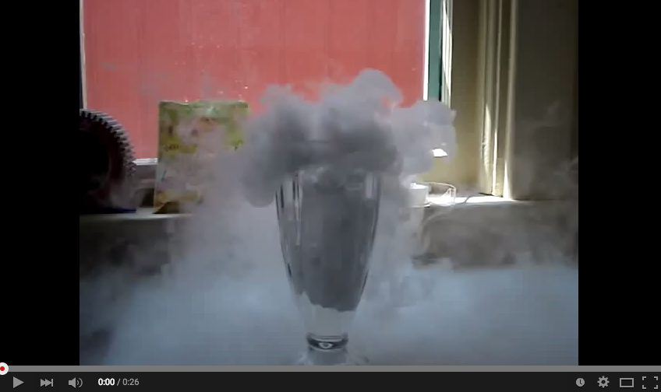

DESIGNING UP-FRONTS
Not debriefing is like….
PROBLEM
SOLUTION
EXAMPLE
4
ILLUSTRATION

Slide 42
AGENDA FOR TODAY
Purpose of an Up-Front
Writing Up-Fronts
Purpose of Debriefs
Writing Debriefs
Debrief and Close

Slide 43
Your Turn!
WHAT:
SO WHAT:
NOW WHAT:
DEBRIEF
OR
Press 1 on the phone
Type in chat box
Notes:
What’s your biggest takeaway?

Slide 44
AGENDA FOR TODAY
Purpose of an Up-Front
Writing Up-Fronts
Purpose of Debriefs
Writing Debriefs
Debrief and Close

Slide 45
GOALS FOR THIS SESSION
KEY TAKEAWAY
Understand how up-front content and debrief activities complement your experiential activity
Your training revolves around the experiential activity, but an effective up-front prepares the learner to complete the activity, and the debrief helps him/her crystalize the lessons.

Slide 46
GOALS FOR THIS SESSION
KEY TAKEAWAY
Understand how up-front content and debrief activities complement your experiential activity
Your training revolves around the experiential activity, but an effective up-front prepares the learner to complete the activity, and the debrief helps him/her crystalize the lessons.
Be able to write an up-front that gives learners just enough information to complete the experiential activity
There is so much you can tell people. But adults learn by doing—not by listening to you talk. The up-front should provide just enough information to complete the experiential activity.

Slide 47
GOALS FOR THIS SESSION
KEY TAKEAWAY
Understand how up-front content and debrief activities complement your experiential activity
Your training revolves around the experiential activity, but an effective up-front prepares the learner to complete the activity, and the debrief helps him/her crystalize the lessons.
Be able to write an up-front that gives learners just enough information to complete the experiential activity
There is so much you can tell people. But adults learn by doing—not by listening to you talk. The up-front should provide just enough information to complete the experiential activity.
Be able to plan a debrief that helps your learners crystalize their learning
Debriefs help learners crystalize what they learned by processing what they learned, its importance, and how they plan to use the knowledge after the training.

Slide 48
GOALS FOR THIS SESSION
KEY TAKEAWAY
Understand how up-front content and debrief activities complement your experiential activity
Your training revolves around the experiential activity, but an effective up-front prepares the learner to complete the activity, and the debrief helps him/her crystalize the lessons.
Be able to write an up-front that gives learners just enough information to complete the experiential activity
There is so much you can tell people. But adults learn by doing—not by listening to you talk. The up-front should provide just enough information to complete the experiential activity.
Be able to plan a debrief that helps your learners crystalize their learning
Debriefs help learners crystalize what they learned by processing what they learned, its importance, and how they plan to use the knowledge after the training.
Feel confident designing a training module that revolves around the experiential activity
Effective up-front content and debriefs are short enough that allow learners to spend most of their time doing.

Slide 49
Next week, we are on a Tuesday and Thursday schedule.

Slide 50
OFA TRAINING
Thank you for joining today’s webinar.
Find the materials we covered, including a video and audio recording of the webinar on the bookshelf.
SEE BOOKSHELF
Notes:
00:00 – 00:00 [General Closing Slide]

