Slide 1



OFA TRAINING
Welcome to today’s webinar.
We will begin shortly.
For audio, please make sure to also join the call.
DIAL-IN HERE
Notes:
This work is licensed under the Creative Commons Attribution-NonCommercial 4.0 International License. To view a copy of this license, visit http://creativecommons.org/licenses/by-nc/4.0/ or send a letter to Creative Commons, PO Box 1866, Mountain View, CA 94042, USA

Slide 2





LOGISTICS
We will meet for 75 minutes
This is an interactive training. You will work in pairs today.
A recording of this video and call will be available on the Bookshelf
It’s cool if you Tweet --
#OFAFellows
Notes:
00:01 – 00:03 [2 min] – Aquiles
Before we get started, let’s review some logistics

Slide 3

DESIGNING A LEARNING JOURNEY
W/ AQUILES DAMIRON-ALCANTARA

Slide 5

CLASS REVIEW
PACKAGING TRAINING MATERIALS

Slide 6


What are the key training materials that give life to your training module?
OR
Press 1 on the phone
Type in chat box

Slide 7




WORKSHEET
ANNOTATED AGENDA
SLIDE DECK

Slide 8
DESIGNING A LEARNING JOURNEY
W/ AQUILES DAMIRON-ALCANTARA

Slide 9
GOALS FOR TODAY
K
Understand why learning is better when topics are presented in chunks
S
Know how to design an agenda that follows an effective learning journey
A
Feel comfortable focusing your training one chunk at a time

Slide 10

AGENDA FOR TODAY
What’s a Learning Journey
Segmenting the Learning Journey
Designing an Agenda
Beyond Training Day
Debrief and Close

Slide 11


Training Module
Learning Journey
Training Program

Slide 12
Training Module
Learning Journey
Training Program

Slide 13
POINT B
POINT A
POINT C

Slide 14
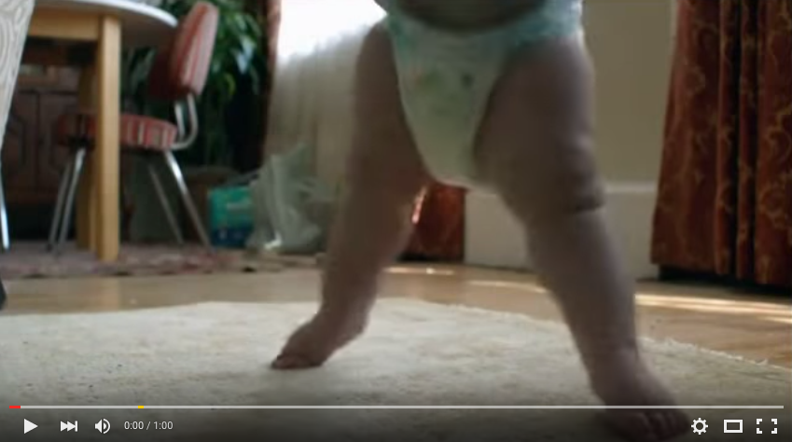
LET’S WATCH A VIDEO

Slide 15

OR
Press 1 on the phone
Type in chat box
Notes:
What’s your biggest takeaway?

Slide 16
POINT B
POINT A
POINT C

Slide 17
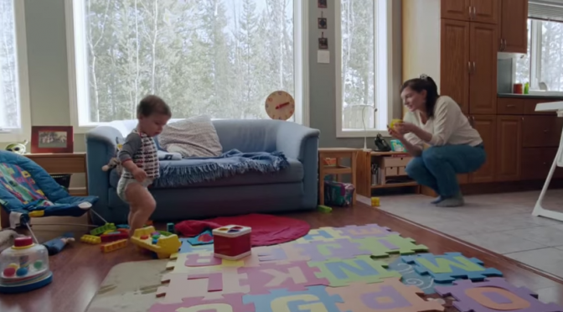
LEARNING JOURNEY

Slide 18



LEARNING JOURNEY
START: Baby
OUTCOME: Olympic athlete

Slide 19
LEARNING JOURNEY
START: Baby
Beginners classes
Minor league competition
Intermediate classes
Intermediate league competition
Olympic training
Olympic Committee competition
OUTCOME: Olympic athlete

Slide 20


LEARNING JOURNEY
START: Professionals with organizing experience
OUTCOME: Professional organizers w/ skills to become training managers

Slide 21
LEARNING JOURNEY
START: Professionals with organizing experience
Your Role as a Training Manager
Adult Learning Theory
Designing Experiential Activities
Writing Up-Fronts and Debriefs
Packaging Training Materials
Designing s Learning Journey
OUTCOME: Professional organizers w/ skills to become training managers

Slide 22
POINT B
POINT A
POINT C

Slide 23
AGENDA FOR TODAY
What’s a Learning Journey
Segmenting the Learning Journey
Designing an Agenda
Beyond Training Day
Debrief and Close

Slide 24
SEGMENTING YOUR LEARNING JOURNEY
1
Determine your START and your OUTCOME

Slide 25
SEGMENTING YOUR LEARNING JOURNEY
1
Determine your START and your OUTCOME
What tool can you use to determine your START?
OR
Press 1 on the phone
Type in chat box

Slide 26
LEARNING JOURNEY
START: Baby
OUTCOME: Olympic athlete

Slide 27
SEGMENTING YOUR LEARNING JOURNEY
1
Determine your START and your OUTCOME
2
Knowing that outcome, determine your learning objectives for the journey

Slide 28
SEGMENTING YOUR LEARNING JOURNEY
1
Determine your START and your OUTCOME
2
Knowing that outcome, determine your learning objectives for the journey
If every module covers one skill, determine what modules you need in order to take your learner from START to your OUTCOME
3

Slide 29
LEARNING JOURNEY
START: Baby
Beginners classes
Minor league competition
Intermediate classes
Intermediate league competition
Olympic training
Olympic Committee competition
OUTCOME: Olympic athlete

Slide 30
LEARNING JOURNEY
START: Professionals with organizing experience
Your Role as a Training Manager
Adult Learning Theory
Designing Experiential Activities
Writing Up-Fronts and Debriefs
Packaging Training Materials
Designing s Learning Journey
OUTCOME: Professional organizers w/ skills to become training managers

Slide 31

Your Turn!
SCENARIO
You are a training director at an issue advocacy organization
Your field director is bringing on 100 new Fellows in September
The Fellows will exclusively help the field staff with volunteer recruitment – that means identifying potential volunteers, meeting them for one-on-one meetings, asking them to volunteer, scheduling them for volunteer actions
The Fellows are using this as an opportunity to learn new organizing skills. Hence, the program is their first interaction with organizing
YOUR TASK
With your team member, design a learning journey to onboard the Fellows and prepare them to meet their responsibilities
Experiential Activity #1
10 Minutes
ACCESS WORKBOOK

Slide 32
Your Turn!
Work with another group to share your learning journey. Each team should take about five minutes to review, share, and offer feedback on each other’s learning journeys.
Experiential Activity #2
10 Minutes

Slide 33

Your Turn!
DEBRIEF
OR
Press 1 on the phone
Type in chat box

Slide 34
Learners are more likely to learn and retain new skills when the training content is divided into chunks that follow an effective order – a journey.

Slide 35
AGENDA FOR TODAY
What’s a Learning Journey
Segmenting the Learning Journey
Designing an Agenda
Beyond Training Day
Debrief and Close

Slide 36
Think about the last training you attended.
What did the agenda look like?
OR
Press 1 on the phone
Type in chat box
Notes:
What’s your biggest takeaway?

Slide 37
AGENDA
Notes:
What’s your biggest takeaway?

Slide 38
DESIGNING AN AGENDA: 5 KEY TRAITS
WELCOME & INTRO
Start your training right!
BREAKS
For every module, one 15-minute break
LUNCH
Very important – 45-60 minutes
DEBRIEF
End of day debrief – 30 minutes
TIME
No more than 480 minutes
Notes:
AQ

Slide 39
Your Turn!
The Fellows at your organization will onboard this coming Saturday. Their onboarding training will take place from 9:00 AM to 5:00 PM.
Working with your team of four, build an agenda for the training that reflects the learning journey you designed previously.
Experiential Activity #3
10 Minutes
ACCESS WORKBOOK

Slide 40
Your Turn!
Present your agenda!
DEBRIEF
OR
Press 1 on the phone
Type in chat box
Notes:
What’s your biggest takeaway?

Slide 41
AGENDA FOR TODAY
What’s a Learning Journey
Segmenting the Learning Journey
Designing an Agenda
Beyond Training Day
Debrief and Close

Slide 43
AGENDA FOR TODAY
What’s a Learning Journey
Segmenting the Learning Journey
Designing an Agenda
Beyond Training Day
Debrief and Close

Slide 44
GOALS FOR THIS SESSION
KEY TAKEAWAY
Understand why learning is better when topics are presented in chunks

Slide 45
GOALS FOR THIS SESSION
KEY TAKEAWAY
Understand why learning is better when topics are presented in chunks
Learners need time to retain new skills one chunk at a time.

Slide 46
GOALS FOR THIS SESSION
KEY TAKEAWAY
Understand why learning is better when topics are presented in chunks
Learners need time to retain new skills one chunk at a time.
Know how to design an agenda that follows an effective learning journey

Slide 47
GOALS FOR THIS SESSION
KEY TAKEAWAY
Understand why learning is better when topics are presented in chunks
Learners need time to retain new skills one chunk at a time.
Know how to design an agenda that follows an effective learning journey
An effective agenda has one module per skill, and also makes time for breaks, lunch, and other non-content activities

Slide 48
GOALS FOR THIS SESSION
KEY TAKEAWAY
Understand why learning is better when topics are presented in chunks
Learners need time to retain new skills one chunk at a time.
Know how to design an agenda that follows an effective learning journey
An effective agenda has one module per skill, and also makes time for breaks, lunch, and other non-content activities
Feel comfortable focusing your training one chunk at a time

Slide 49
GOALS FOR THIS SESSION
KEY TAKEAWAY
Understand why learning is better when topics are presented in chunks
Learners need time to retain new skills one chunk at a time.
Know how to design an agenda that follows an effective learning journey
An effective agenda has one module per skill, and also makes time for breaks, lunch, and other non-content activities
Feel comfortable focusing your training one chunk at a time
Learning can extend beyond the Training Day or training room. Focus on key chunks and plan to continue the journey afterwards.

Slide 50
OFA TRAINING
Thank you for joining today’s webinar.
Find the materials we covered, including a video and audio recording of the webinar on the bookshelf.
SEE BOOKSHELF
Notes:
00:00 – 00:00 [General Closing Slide]

