Slide 1
Welcome!
We will begin at 7:30 PM Central Time.
One more thing—call in for audio.
Check your email for phone number and pin.
ACCESS WORKBOOK

Slide 2





LOGISTICS
We will meet for 90 minutes
This is an interactive training, with peer review engagement.
A recording of this video and call will be available on the Bookshelf
It’s cool if you Tweet --
#OFAFellows
Notes:
00:01 – 00:03 [2 min] – Aquiles
Before we get started, let’s review some logistics

Slide 3
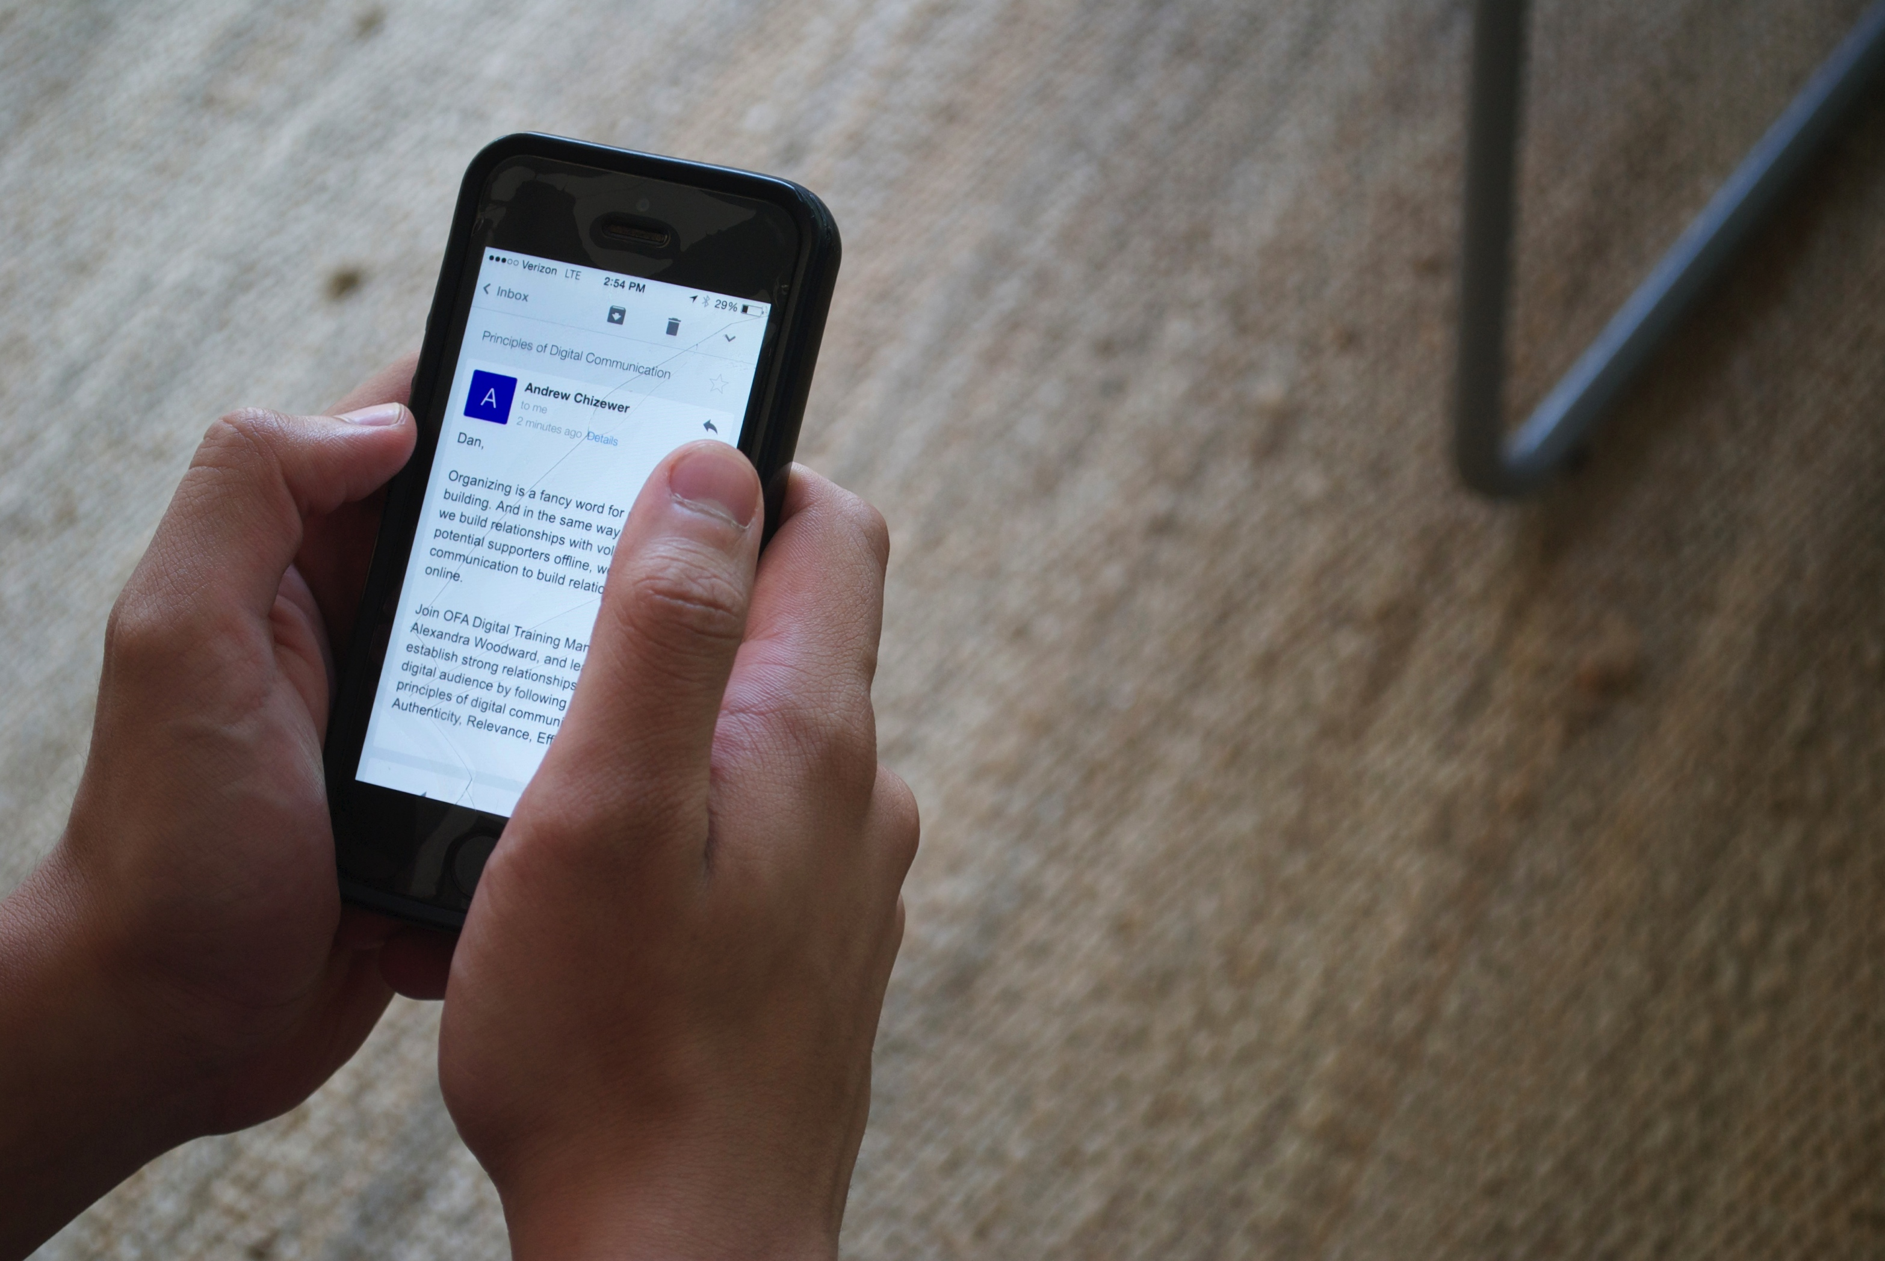

Email Content Production
W/ Christina Oliver

Slide 4
CLASS REVIEW
Email Campaign Strategy

Slide 5
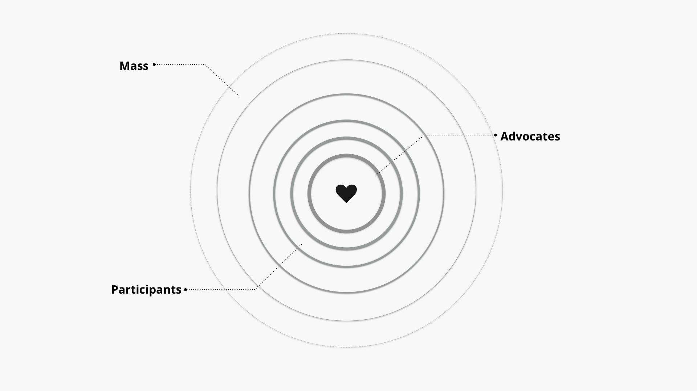
Digital Ladder of Engagement: Email
EMAIL
CLOSER TO YOUR MISSION.

Slide 6

Before you write an email, what steps should you take to prepare your content?
OR
Press 1 on the phone
Type in chat box

Slide 7

CHECKLIST: Email Campaign
Brainstorm Goals
Craft Asks
Design Angles
Begin Writing

Slide 8
GOALS FOR TODAY
1
Learn writing techniques to produce content for an email campaign
2
Be able to follow the structure of an email to produce strategic content for one email
3
Feel confident developing an authentic, relevant, and effective message for email

Slide 9

AGENDA FOR TODAY
Email Draft
Designing Your Email
Drafting Your Email
Peer Review
Debrief and Close

Slide 10
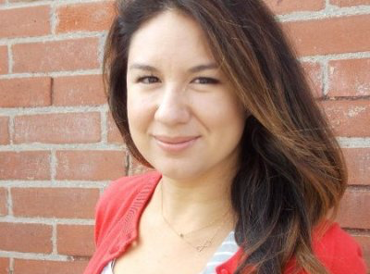
Christina Oliver
Digital Strategist. Technologist. Communicator
Lower Colorado River Authority

Slide 11
AGENDA FOR TODAY
Email Draft
Designing Your Email
Drafting Your Email
Peer Review
Debrief and Close

Slide 12
EMAIL
TAKE A LOOK AT THIS

Slide 13
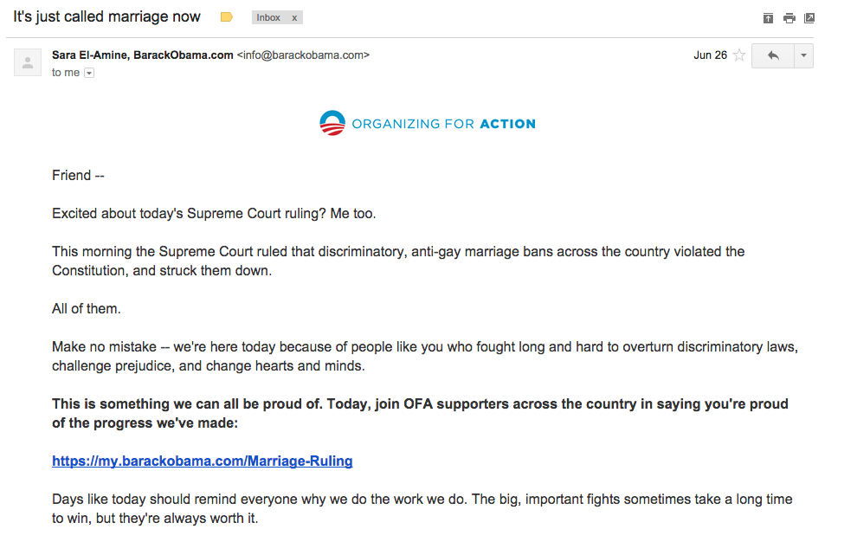
AN EMAIL DRAFT LOOKS SOMETHING LIKE THIS
Friend --
Excited about today's Supreme Court ruling? Me too.
This morning the Supreme Court ruled that discriminatory, anti-gay marriage bans across the country violated the Constitution, and struck them down.
All of them.
Make no mistake -- we're here today because of people like you who fought long and hard to overturn discriminatory laws, challenge prejudice, and change hearts and minds.
This is something we can all be proud of. Today, join OFA supporters across the country in saying you're proud of the progress we've made:
https://my.barackobama.com/Marriage-Ruling
Days like today should remind everyone why we do the work we do. The big, important fights sometimes take a long time to win, but they're always worth it.
Love is love.
Sara
Sara El-Amine
Executive Director
Organizing for Action

Slide 14
AN EMAIL DRAFT LOOKS SOMETHING LIKE THIS
Friend --
Excited about today's Supreme Court ruling? Me too.
This morning the Supreme Court ruled that discriminatory, anti-gay marriage bans across the country violated the Constitution, and struck them down.
All of them.
Make no mistake -- we're here today because of people like you who fought long and hard to overturn discriminatory laws, challenge prejudice, and change hearts and minds.
This is something we can all be proud of. Today, join OFA supporters across the country in saying you're proud of the progress we've made:
https://my.barackobama.com/Marriage-Ruling
Days like today should remind everyone why we do the work we do. The big, important fights sometimes take a long time to win, but they're always worth it.
Love is love.
Sara
Sara El-Amine
Executive Director
Organizing for Action
Greeting/Salutation/Whitelist/”Friend”

Slide 15
AN EMAIL DRAFT LOOKS SOMETHING LIKE THIS
Friend --
Excited about today's Supreme Court ruling? Me too.
This morning the Supreme Court ruled that discriminatory, anti-gay marriage bans across the country violated the Constitution, and struck them down.
All of them.
Make no mistake -- we're here today because of people like you who fought long and hard to overturn discriminatory laws, challenge prejudice, and change hearts and minds.
This is something we can all be proud of. Today, join OFA supporters across the country in saying you're proud of the progress we've made:
https://my.barackobama.com/Marriage-Ruling
Days like today should remind everyone why we do the work we do. The big, important fights sometimes take a long time to win, but they're always worth it.
Love is love.
Sara
Sara El-Amine
Executive Director
Organizing for Action
The Lede

Slide 16
AN EMAIL DRAFT LOOKS SOMETHING LIKE THIS
Friend --
Excited about today's Supreme Court ruling? Me too.
This morning the Supreme Court ruled that discriminatory, anti-gay marriage bans across the country violated the Constitution, and struck them down.
All of them.
Make no mistake -- we're here today because of people like you who fought long and hard to overturn discriminatory laws, challenge prejudice, and change hearts and minds.
This is something we can all be proud of. Today, join OFA supporters across the country in saying you're proud of the progress we've made:
https://my.barackobama.com/Marriage-Ruling
Days like today should remind everyone why we do the work we do. The big, important fights sometimes take a long time to win, but they're always worth it.
Love is love.
Sara
Sara El-Amine
Executive Director
Organizing for Action
Above the fold (ATF)
Notes:
----- Meeting Notes (8/17/16 11:45) -----
ATF- 3rd paragraph -- strating to bring people in

Slide 17
AN EMAIL DRAFT LOOKS SOMETHING LIKE THIS
Friend --
Excited about today's Supreme Court ruling? Me too.
This morning the Supreme Court ruled that discriminatory, anti-gay marriage bans across the country violated the Constitution, and struck them down.
All of them.
Make no mistake -- we're here today because of people like you who fought long and hard to overturn discriminatory laws, challenge prejudice, and change hearts and minds.
This is something we can all be proud of. Today, join OFA supporters across the country in saying you're proud of the progress we've made:
https://my.barackobama.com/Marriage-Ruling
Days like today should remind everyone why we do the work we do. The big, important fights sometimes take a long time to win, but they're always worth it.
Love is love.
Sara
Sara El-Amine
Executive Director
Organizing for Action
The Ask

Slide 18
AN EMAIL DRAFT LOOKS SOMETHING LIKE THIS
Friend --
Excited about today's Supreme Court ruling? Me too.
This morning the Supreme Court ruled that discriminatory, anti-gay marriage bans across the country violated the Constitution, and struck them down.
All of them.
Make no mistake -- we're here today because of people like you who fought long and hard to overturn discriminatory laws, challenge prejudice, and change hearts and minds.
This is something we can all be proud of. Today, join OFA supporters across the country in saying you're proud of the progress we've made:
https://my.barackobama.com/Marriage-Ruling
Days like today should remind everyone why we do the work we do. The big, important fights sometimes take a long time to win, but they're always worth it.
Love is love.
Sara
Sara El-Amine
Executive Director
Organizing for Action
Naked URL

Slide 19
AN EMAIL DRAFT LOOKS SOMETHING LIKE THIS
Friend --
Excited about today's Supreme Court ruling? Me too.
This morning the Supreme Court ruled that discriminatory, anti-gay marriage bans across the country violated the Constitution, and struck them down.
All of them.
Make no mistake -- we're here today because of people like you who fought long and hard to overturn discriminatory laws, challenge prejudice, and change hearts and minds.
This is something we can all be proud of. Today, join OFA supporters across the country in saying you're proud of the progress we've made:
https://my.barackobama.com/Marriage-Ruling
Days like today should remind everyone why we do the work we do. The big, important fights sometimes take a long time to win, but they're always worth it.
Love is love.
Sara
Sara El-Amine
Executive Director
Organizing for Action
Below the fold (BTF)

Slide 20
AN EMAIL DRAFT LOOKS SOMETHING LIKE THIS
Friend --
Excited about today's Supreme Court ruling? Me too.
This morning the Supreme Court ruled that discriminatory, anti-gay marriage bans across the country violated the Constitution, and struck them down.
All of them.
Make no mistake -- we're here today because of people like you who fought long and hard to overturn discriminatory laws, challenge prejudice, and change hearts and minds.
This is something we can all be proud of. Today, join OFA supporters across the country in saying you're proud of the progress we've made:
https://my.barackobama.com/Marriage-Ruling
Days like today should remind everyone why we do the work we do. The big, important fights sometimes take a long time to win, but they're always worth it.
Love is love.
Sara
Sara El-Amine
Executive Director
Organizing for Action
Closing

Slide 21
AN EMAIL DRAFT LOOKS SOMETHING LIKE THIS
Greeting/Salutation/Whitelist/”Friend”
Friend --
Excited about today's Supreme Court ruling? Me too.
This morning the Supreme Court ruled that discriminatory, anti-gay marriage bans across the country violated the Constitution, and struck them down.
All of them.
Make no mistake -- we're here today because of people like you who fought long and hard to overturn discriminatory laws, challenge prejudice, and change hearts and minds.
This is something we can all be proud of. Today, join OFA supporters across the country in saying you're proud of the progress we've made:
https://my.barackobama.com/Marriage-Ruling
Days like today should remind everyone why we do the work we do. The big, important fights sometimes take a long time to win, but they're always worth it.
Love is love.
Sara
Sara El-Amine
Executive Director
Organizing for Action
The Lede
Above the fold (ATF)
The Ask
Naked URL
Below the fold (BTF)
Closing

Slide 22
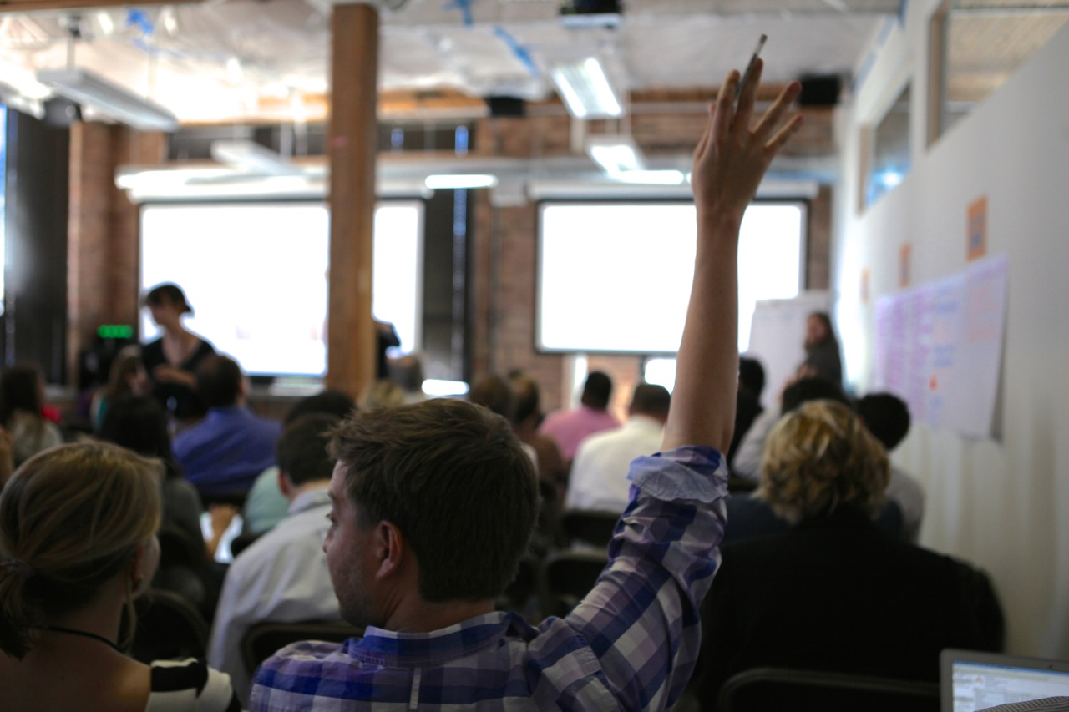
What questions do you have?

Slide 23
AGENDA FOR TODAY
Email Draft
Designing Your Email
Drafting Your Email
Peer Review
Debrief and Close

Slide 24
AN EMAIL DRAFT LOOKS SOMETHING LIKE THIS
Friend --
Excited about today's Supreme Court ruling? Me too.
This morning the Supreme Court ruled that discriminatory, anti-gay marriage bans across the country violated the Constitution, and struck them down.
All of them.
Make no mistake -- we're here today because of people like you who fought long and hard to overturn discriminatory laws, challenge prejudice, and change hearts and minds.
This is something we can all be proud of. Today, join OFA supporters across the country in saying you're proud of the progress we've made:
https://my.barackobama.com/Marriage-Ruling
Days like today should remind everyone why we do the work we do. The big, important fights sometimes take a long time to win, but they're always worth it.
Love is love.
Sara
Sara El-Amine
Executive Director
Organizing for Action
The Lede
The Ask
Naked URL

Slide 25

Your Turn!
One of the world’s most important sentinel sites for measuring levels of carbon dioxide recently reported that levels had recently risen above the symbolically important figure of 400 parts per million. It has been millions of years since atmospheric levels of CO2 have risen so high. Even with all of this information, Climate Deniers in Congress still insist that we should not take any action.
Scientists overwhelmingly agree that acting to curb current global emissions can actually decrease global temperatures. Not acting could contribute to extreme weather, food and water shortage, and global instability.
Climate STRONG would like to deliver a petition to Climate Deniers urging them to act on climate. This email should come from Climate STRONG’s Policy Director, Ernesto Garcia and ask active supporters to sign the petition.
Experiential Activity #1
10 Minutes
Write an email in response to this scenario. Begin with you Ask and then your Lede.
ACCESS WORKBOOK

Slide 26

Your Turn!
Experiential Activity #1
DEBRIEF
OR
Press 1 on the phone
Type in chat box

Slide 27
AGENDA FOR TODAY
Email Draft
Designing Your Email
Drafting Your Email
Peer Review
Debrief and Close

Slide 28
Your Turn!
Follow the email structure you learned to draft an email that delivers your message and ask to your audience. Remember to keep your message authentic, relevant, and effective.
One of the world’s most important sentinel sites for measuring levels of carbon dioxide recently reported that levels had recently risen above the symbolically important figure of 400 parts per million. It has been millions of years since atmospheric levels of CO2 have risen so high. Even with all of this information, Climate Deniers in Congress still insist that we should not take any action.
Scientists overwhelmingly agree that acting to curb current global emissions can actually decrease global temperatures. Not acting could contribute to extreme weather, food and water shortage, and global instability.
Climate STRONG would like to deliver a petition to Climate Deniers urging them to act on climate. This email should come from Climate STRONG’s Policy Director, Ernesto Garcia and ask active supporters to sign the petition.
Experiential Activity #2
20 Minutes
ACCESS WORKBOOK

Slide 29
AGENDA FOR TODAY
Email Draft
Designing Your Email
Drafting Your Email
Peer Review
Debrief and Close

Slide 30
AN EMAIL DRAFT LOOKS SOMETHING LIKE THIS
Subject Line
Friend --
Excited about today's Supreme Court ruling? Me too.
This morning the Supreme Court ruled that discriminatory, anti-gay marriage bans across the country violated the Constitution, and struck them down.
All of them.
Make no mistake -- we're here today because of people like you who fought long and hard to overturn discriminatory laws, challenge prejudice, and change hearts and minds.
This is something we can all be proud of. Today, join OFA supporters across the country in saying you're proud of the progress we've made:
https://my.barackobama.com/Marriage-Ruling
Days like today should remind everyone why we do the work we do. The big, important fights sometimes take a long time to win, but they're always worth it.
Love is love.
Sara
Sara El-Amine
Executive Director
Organizing for Action

Slide 31
Your Turn!
PEER-REVIEW
ARE?
Suggest a subject line
Experiential Activity #3
10 Minutes

Slide 32
Your Turn!
Experiential Activity #2
DEBRIEF
OR
Press 1 on the phone
Type in chat box

Slide 33
AGENDA FOR TODAY
Email Draft
Designing Your Email
Drafting Your Email
Peer Review
Debrief and Close

Slide 34
GOALS FOR THIS SESSION
KEY TAKEAWAY
Learn writing techniques to produce content for an email campaign
Effective email content answers the following questions: What should your reader learn? What should your reader do? Who is your reader?

Slide 35
GOALS FOR THIS SESSION
KEY TAKEAWAY
Learn writing techniques to produce content for an email campaign
Effective email content answers the following questions: What should your reader learn? What should your reader do? Who is your reader?
Be able to follow the structure of an email to produce strategic content for one email
An email follows a clear structure with 7 to 8 steps – from greeting to closing.

Slide 36
GOALS FOR THIS SESSION
KEY TAKEAWAY
Learn writing techniques to produce content for an email campaign
Effective email content answers the following questions: What should your reader learn? What should your reader do? Who is your reader?
Be able to follow the structure of an email to produce strategic content for one email
An email follows a clear structure with 7 to 8 steps – from greeting to closing.
Feel confident developing an authentic, relevant, and effective message for email
Your reader will only respond to your call to action if your message is authentic, relevant, and shows the effectiveness of your ask.

Slide 37
Debrief
OR
Press 1 on the phone
Type in chat box
Notes:
00:73 – 00:74 [1 min] – Caleb
Knowing what you know now, how does this change your perspective of the role a digital department plays at a progressive organization?

Slide 38
TIPS FOR WRITING BETTER
Read often

Slide 39
TIPS FOR WRITING BETTER
Read often
Write often

Slide 40
TIPS FOR WRITING BETTER
Read often
Write often
Practice

Slide 41
Assignment
Review concepts, skills, assignments, and webinars from the entire fellowship this week -- Digital 101 to present. We will not revisit items during Practicum.

Slide 42
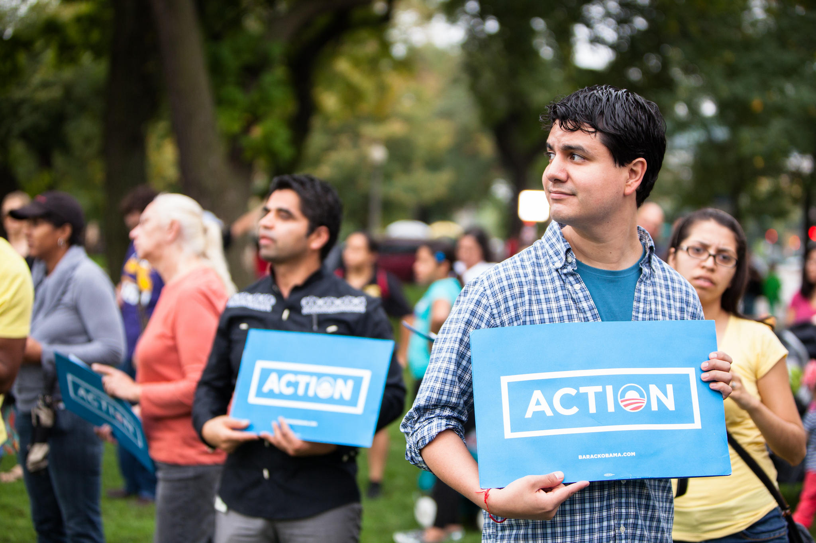
OFA TRAINING
Thank you for joining today’s webinar.
Find the materials we covered, including a video and audio recording of the webinar on the bookshelf.
SEE BOOKSHELF
Notes:
00:00 – 00:00 [General Closing Slide]

