Slide 1



OFA TRAINING
Welcome to today’s webinar.
We will begin shortly.
For audio, please make sure to also join the call.
DIAL-IN HERE
Notes:
This work is licensed under the Creative Commons Attribution-NonCommercial 4.0 International License. To view a copy of this license, visit http://creativecommons.org/licenses/by-nc/4.0/ or send a letter to Creative Commons, PO Box 1866, Mountain View, CA 94042, USA

Slide 2





LOGISTICS
We will meet for 75 minutes
This is an interactive training. You will work in pairs today.
A recording of this video and call will be available on the Bookshelf
It’s cool if you Tweet --
#OFAFellows
Notes:
00:01 – 00:03 [2 min] – Aquiles
Before we get started, let’s review some logistics

Slide 3

MANAGING TRAINING LOGISTICS
W/ CHELSEY WININGER

Slide 4

PROGRAM REVIEW
OUR TRAINING JOURNEY

Slide 5


Training Module
Learning Journey
Training Program

Slide 6
PROCESS TO DESIGN A TRAINING MODULE
1
2
3
4
ESTABLISH LEARNING OBJECTIVES
DESIGN LEARNING EXPERIENCE
WRITE UP-FRONT MATERIAL
PLAN A DEBRIEF

Slide 7




WORKSHEET
ANNOTATED AGENDA
SLIDE DECK

Slide 9
MANAGING TRAINING LOGISTICS
W/ CHELSEY WININGER

Slide 10
GOALS FOR TODAY
K
Learn management strategies and organizational tools to keep your training project on track and on time
S
Be able to build a taskmaster and staffing grid
A
Feel comfortable managing your project before it manages you

Slide 11

AGENDA FOR TODAY
Project Vs. Tasks
Organizational Tool: Taskmaster
Organizing a Staffing Grid
Debrief and Close

Slide 12

Your Turn!
OUTCOME-BASED SCENARIO
This weekend is the Train-the-Trainer Workshop
Work with your partner to write a list of the various actions that need to happen in order for the training to begin, run smoothly, and conclude successfully
Training participants are expected to arrive at 9:00 AM. The training concludes at 5:00 PM
Training participants will go through four modules throughout the day, taught by experts
Experiential Activity #1
10 Minutes
ACCESS WORKBOOK

Slide 13


Your Turn!
DEBRIEF
OR
Press 1 on the phone
Type in chat box

Slide 14
PROJECTS VS. TASKS
Notes:
What’s your biggest takeaway?

Slide 15
PROJECT
TASK
A piece of work with a specific objective and a defined beginning and end
Made up of smaller units

Slide 16
PROJECT
TASK
A piece of work with a specific objective and a defined beginning and end
A piece of work within a project with a defined beginning and end and which contributes to a larger goal
Made up of smaller units
The smallest unit that a project can be broken down into

Slide 17
PROJECT
TASK
One-day training

Slide 18
PROJECT
TASK
Confirm training participants
One-day training

Slide 19
PROJECT
TASK
Place food order
One-day training

Slide 20
PROJECT
TASK
Practice w/ trainers
One-day training

Slide 21
Your Turn!
Review your previous action list
Break your projects into smaller tasks
ACCESS WORKBOOK
Experiential Activity #2
10 Minutes

Slide 22
AGENDA FOR TODAY
Project Vs. Tasks
Organizational Tool: Taskmaster
Organizing a Staffing Grid
Debrief and Close

Slide 23
PROJECT: Digital Fellowship Practicum
TASKS:
Order Approval Stations Signs
Schedule dry-run with Digi Team
Confirm @BO Tweet
Plan food
Order food
Confirm food
Outline: Press Briefing
Write glossary
Buy Food
Press Briefing Email
Friday Evening Email
Peer-Review Checklist
Submission Form
Review Glossary
Review Press Briefing Outline
Create Evaluations for Sat and Sun
The Gaunlet
Design Simulation Guide
Review Simulation Guide
Dry-Run W/ Digi
Develop the Gaunlet
Send "See you tomorrow" Email
Confirm Food
Complete Slides

Slide 24

PROJECT: Digital Fellowship Practicum
TASKS:
Order Approval Stations Signs
Schedule dry-run with Digi Team
Confirm @BO Tweet
Plan food
Order food
Confirm food
Outline: Press Briefing
Write glossary
Buy Food
Press Briefing Email
Friday Evening Email
Peer-Review Checklist
Submission Form
Review Glossary
Review Press Briefing Outline
Create Evaluations for Sat and Sun
The Gunlet
Design Simulation Guide
Review Simulation Guide
Dry-Run W/ Digi
Develop the Gaunlet
Send "See you tomorrow" Email
Confirm Food
Complete Slides

Slide 25
Share a moment when you were overwhelmed with a project and unable to delegate to others who wanted to help.
OR
Press 1 on the phone
Type in chat box
Notes:
What’s your biggest takeaway?

Slide 26
The more organized you are, the more likely others will be able to help you complete a project.

Slide 27
Organizational Tools: Taskmaster
PROJECT: One day training

Slide 28
Organizational Tools: Taskmaster
PROJECT: One day training
DEADLINE

Slide 29
Organizational Tools: Taskmaster
PROJECT: One day training
DEADLINE
8/27

Slide 30
Organizational Tools: Taskmaster
PROJECT: One day training
DEADLINE
TASK
8/27

Slide 31
Organizational Tools: Taskmaster
PROJECT: One day training
DEADLINE
TASK
8/27
Place food order

Slide 32
Organizational Tools: Taskmaster
PROJECT: One day training
DEADLINE
TASK
OWNER
8/27
Place food order

Slide 33
Organizational Tools: Taskmaster
PROJECT: One day training
DEADLINE
TASK
OWNER
8/27
Place food order
Aquiles

Slide 34
Organizational Tools: Taskmaster
PROJECT: One day training
DEADLINE
TASK
OWNER
HELPER
8/27
Place food order
Aquiles
Chelsey

Slide 35
Organizational Tools: Taskmaster
PROJECT: One day training
DEADLINE
TASK
OWNER
HELPER
STATUS
Completed
8/27
Place food order
Aquiles
Pending
Chelsey
In Review

Slide 36
PROJECT: Digital Fellowship Practicum
TASKS:
Order Approval Stations Signs
Schedule dry-run with Digi Team
Confirm @BO Tweet
Plan food
Order food
Confirm food
Outline: Press Briefing
Write glossary
Buy Food
Press Briefing Email
Friday Evening Email
Peer-Review Checklist
Submission Form
Review Glossary
Review Press Briefing Outline
Create Evaluations for Sat and Sun
The Gaunlet
Design Simulation Guide
Review Simulation Guide
Dry-Run W/ Digi
Develop the Gaunlet
Send "See you tomorrow" Email
Confirm Food
Complete Slides

Slide 37
Organizational Tools: Taskmaster
PROJECT: One day training
DEADLINE
TASK
OWNER
HELPER
STATUS
Completed
8/27
Place food order
Aquiles
Pending
Chelsey
In Review

Slide 38
Your Turn!
Work with your partner to assemble your list of tasks into a taskmaster. Your owners and helpers can be arbitrary
You have until Friday to complete all of your tasks. Use this information to determine your deadlines
Experiential Activity #2
10 Minutes
ACCESS WORKBOOK

Slide 39
AGENDA FOR TODAY
Project Vs. Tasks
Organizational Tool: Taskmaster
Organizing a Staffing Grid
Debrief and Close

Slide 40
TASKMASTER VS. STAFFING GRID
Notes:
What’s your biggest takeaway?

Slide 41
TASKMASTER VS. STAFFING GRID
Keeps your entire project on track
Notes:
What’s your biggest takeaway?

Slide 42
TASKMASTER VS. STAFFING GRID
Keeps your training/event day on track
Notes:
What’s your biggest takeaway?

Slide 43
Organizational Tools: Staffing Grid
Training Day
TIME
TASK
OWNER
TIMER
9:00 – 9:30
Set-up breakfast
Aquiles
Chelsey
Notes:
What’s your biggest takeaway?

Slide 44
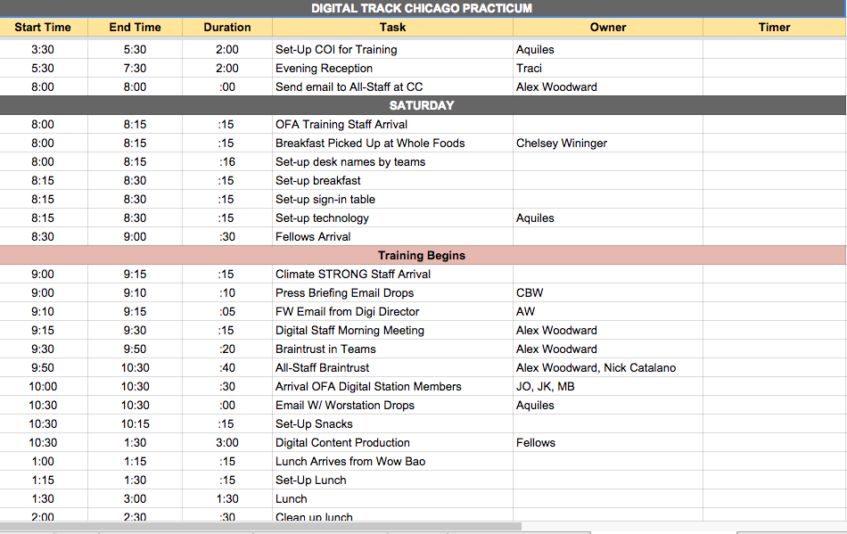
Organizational Tools: Staffing Grid
Notes:
What’s your biggest takeaway?

Slide 45
What tasks should be assigned to an owner on training day?
OR
Press 1 on the phone
Type in chat box
Notes:
What’s your biggest takeaway?

Slide 46
AGENDA FOR TODAY
Project Vs. Tasks
Organizational Tool: Taskmaster
Organizing a Staffing Grid
Debrief and Close

Slide 47
GOALS FOR THIS SESSION
KEY TAKEAWAY
Learn management strategies and organizational tools to keep your training project on track and on time
A taskmaster and staffing grid help managers outline that tasks that need to happen, and delegate accordingly
Be able to build a taskmaster and staffing grid
Taskmasters and staffing grids include: Deadline or time; tasks; owners; timers; status
Feel comfortable managing your project before it manages you
You can only manage your project if your know all the tasks that must happen in order to begin and complete the project

Slide 48
What was your biggest “aha” moment?
OR
Press 1 on the phone
Type in chat box
Notes:
What’s your biggest takeaway?

Slide 49
