Slide 1



OFA TRAINING
Welcome to today’s webinar.
We will begin shortly.
For audio, please make sure to also join the call.
DIAL-IN HERE
Notes:
This work is licensed under the Creative Commons Attribution-Non Commercial 4.0 International License. To view a copy of this license, visit http://creativecommons.org/licenses/by-nc/4.0/ or send a letter to Creative Commons, PO Box 1866, Mountain View, CA 94042, USA

Slide 2





LOGISTICS
We will meet for 90 minutes
This is an interactive training. You will work in pairs today.
A recording of this video and call will be available on the Bookshelf
It’s cool if you Tweet --
#OFAFellows
Notes:
00:01 – 00:03 [2 min] – Aquiles
Before we get started, let’s review some logistics

Slide 3

PACKAGING TRAINING MATERIALS
W/ AQUILES DAMIRON-ALCANTARA

Slide 4
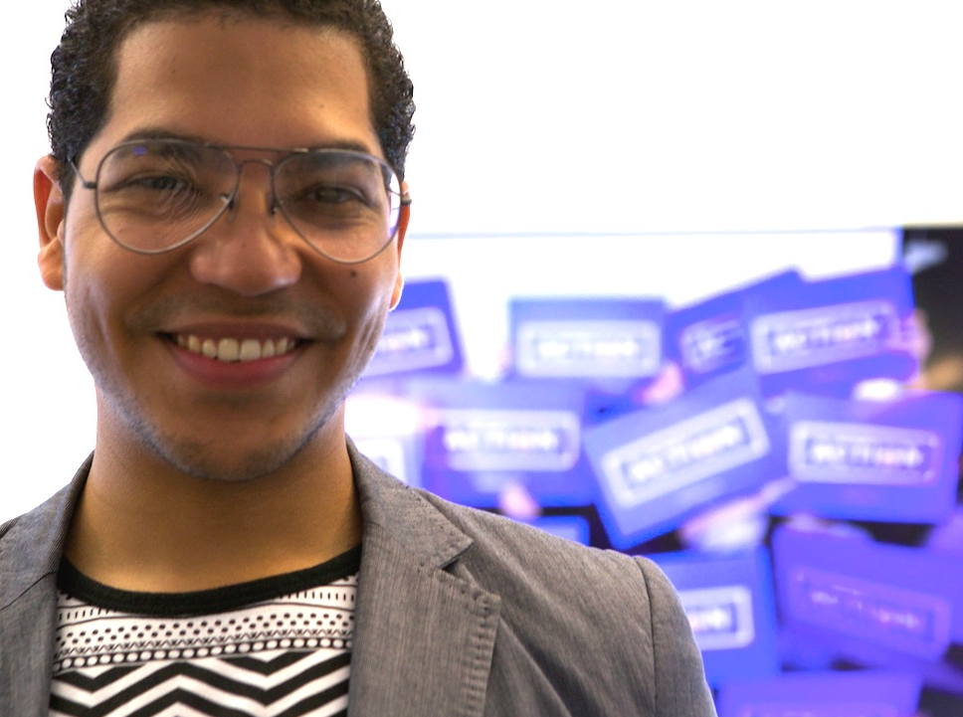
AQUILES DAMIRON-ALCANTARA
Training Programs Manager

Slide 5

CLASS REVIEW
DESIGNING UP-FRONTS AND DEBRIEFS

Slide 6
PROCESS TO DESIGN A TRAINING MODULE
1
2
3
4
ESTABLISH LEARNING OBJECTIVES
DESIGN LEARNING EXPERIENCE
WRITE UP-FRONT MATERIAL
PLAN A DEBRIEF

Slide 7
PACKAGING TRAINING MATERIALS
W/ AQUILES DAMIRON-ALCANTARA

Slide 8
GOALS FOR TODAY
K
Understand the value of the materials that “decorate” a training module
S
Be able to design a worksheet, annotated agenda, and a slide deck for your training module
A
Feel comfortable using training materials to solidify the learning experience

Slide 9

AGENDA FOR TODAY
Packaging Training Materials
Designing Worksheets
Writing Annotated Agendas
Structuring a Slide Deck
Debrief and Close

Slide 10


What does one training module seek to accomplish?
OR
Press 1 on the phone
Type in chat box

Slide 11

K
S
A

Slide 12



WORKSHEET
ANNOTATED AGENDA
SLIDE DECK

Slide 13
AGENDA FOR TODAY
Packaging Training Materials
Designing Worksheets
Writing Annotated Agendas
Structuring a Slide Deck
Debrief and Close

Slide 14
ADULT LEARNING THEORY: ADULTS LEARN BY DOING
THE 20-60-20 RULE
20%
Up-Front Content
60%
Experience
20%
Debrief
LEARNING HAPPENS HERE
Notes:
As Ashley said last week, the experience– the combination of psychological and behavioral learning– is where adults learn

Slide 15
Worksheets help guide the learners through the experiential activity.
Notes:
AQ

Slide 16

Your Turn!
1
With a partner take a look at these worksheets.
WORKSHEETS
Experiential Activity #1
5 Minutes

Slide 17
Your Turn!
Share your experience working with your partner – what did you accomplish?
DEBRIEF
OR
Press 1 on the phone
Type in chat box
Notes:
What’s your biggest takeaway?

Slide 18
Your Turn!
1
With a partner review the worksheets on your workbook
2
Next to each worksheet, together describe the similarities and differences
Experiential Activity #2
5 Minutes
ACCESS WORKBOOK

Slide 19
Your Turn!
How was this experience different from the first partner exercise?
DEBRIEF
OR
Press 1 on the phone
Type in chat box
Notes:
What’s your biggest takeaway?

Slide 20
Worksheets provide learners with clear instructions and just enough supporting information to complete the experiential activity.
Notes:
AQ

Slide 21
You will write a worksheet to accompany your training module as part of your weekly assignment.
Notes:
AQ

Slide 22
AGENDA FOR TODAY
Packaging Training Materials
Designing Worksheets
Writing Annotated Agendas
Structuring a Slide Deck
Debrief and Close

Slide 23
Your Turn!
1
With your partner look through one slide from the Sharing Your Personal Story module
2
Together determine how much time you need to train on each slide
Experiential Activity #3
10 Minutes
3
Together decide how you would facilitate each slide as the trainer
4
Together decide on what learners should do as you train.
ACCESS WORKBOOK

Slide 24
Your Turn!
Facilitate this slide.
DEBRIEF
OR
Press 1 on the phone
Type in chat box
Notes:
What’s your biggest takeaway?

Slide 25



STORIES CONNECT US
you

Slide 26
Your Turn!
Facilitate this slide.
DEBRIEF
OR
Press 1 on the phone
Type in chat box
Notes:
What’s your biggest takeaway?

Slide 27
STORIES CONNECT US
you

Slide 28
Your Turn!
What was different?
DEBRIEF
OR
Press 1 on the phone
Type in chat box
Notes:
What’s your biggest takeaway?

Slide 29
As a training manager you are responsible for producing materials that can be used by others across the organization.
Annotated Agendas give your training module life of its own away from you.
Notes:
AQ

Slide 30
DOWNLOAD ANNOTATED
Notes:
AQ

Slide 31
TIME
Assign time following 20-60-20
Notes:
AQ

Slide 32
TIME
Assign time following 20-60-20
SCRIPT
Write the narrative
Notes:
AQ

Slide 33
TIME
Assign time following 20-60-20
SCRIPT
Write the narrative
TRAINER’S NOTES
Provide guidance
Notes:
AQ

Slide 34
You will write an annotated agenda for your training module as part of your weekly assignment.
Notes:
AQ

Slide 35
AGENDA FOR TODAY
Packaging Training Materials
Designing Worksheets
Writing Annotated Agendas
Structuring a Slide Deck
Debrief and Close

Slide 36
Your Turn!
1
With a partner review the slide deck from the Sharing Your Personal Story module
2
Determine which part of the slide deck shows the learning objectives, up-front content, experiential activity, and debrief
Experiential Activity #4
5 Minutes
ACCESS WORKBOOK

Slide 37
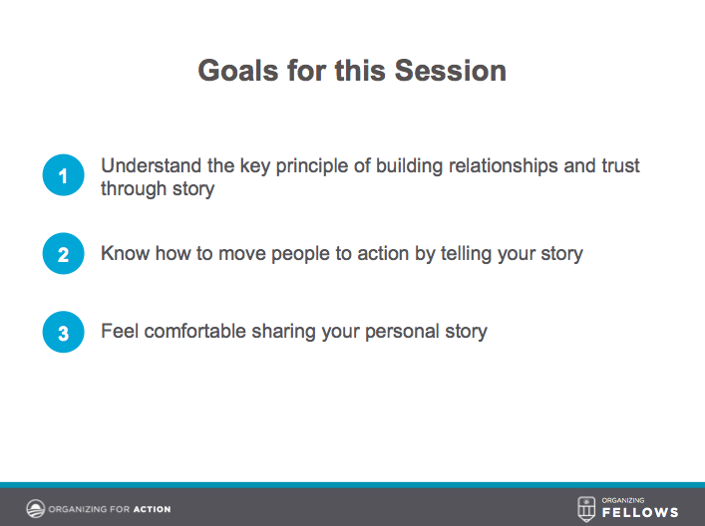
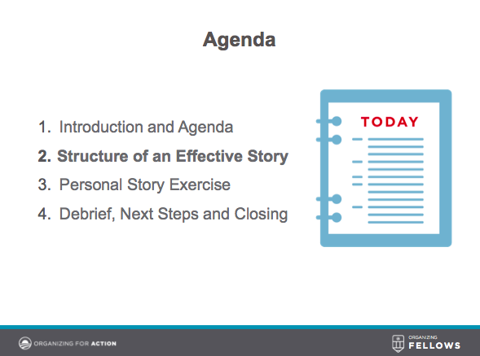
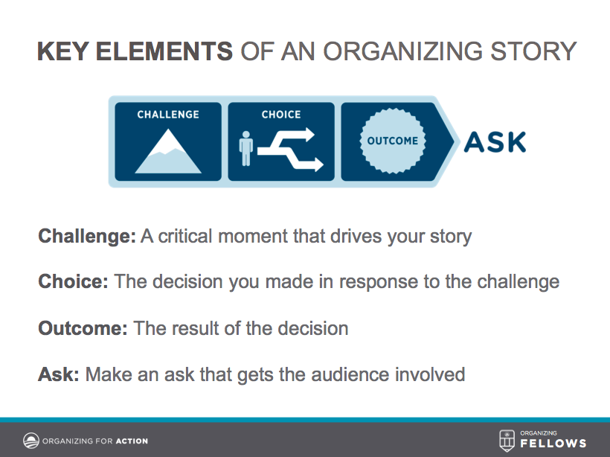
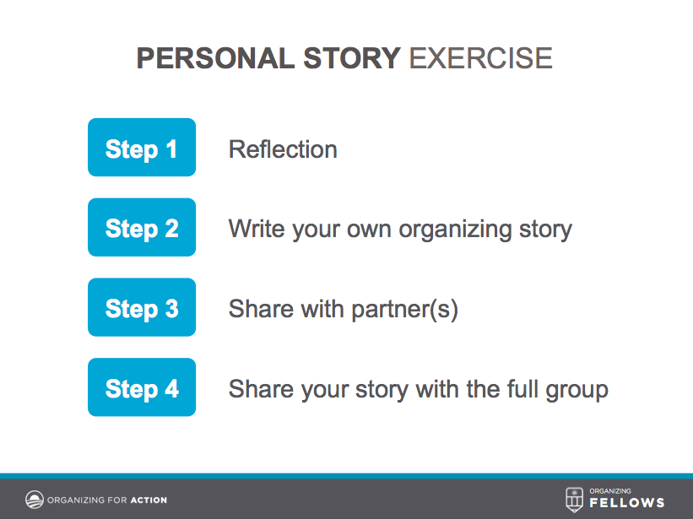
Your Turn!
DEBRIEF
Notes:
What’s your biggest takeaway?

Slide 38
STRUCTURE OF A TRAINING MODULE
GOALS SLIDE: Learning Objectives

Slide 39
STRUCTURE OF A TRAINING MODULE
AGENDA SLIDE: Establish Learning Path

Slide 40
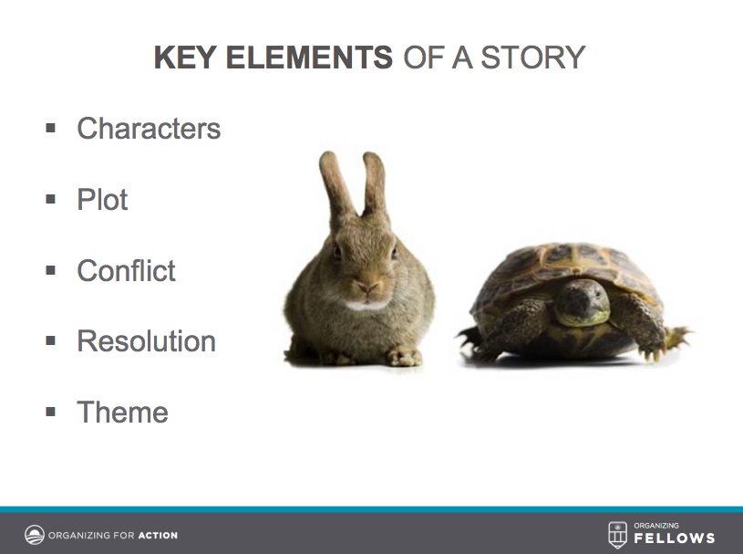
STRUCTURE OF A TRAINING MODULE
Up-Front Content

Slide 41
STRUCTURE OF A TRAINING MODULE
Experiential Activity

Slide 42
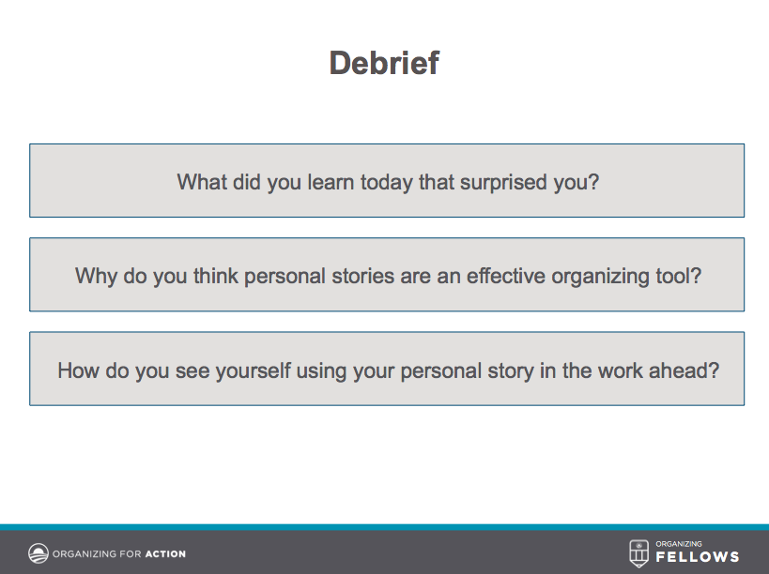
STRUCTURE OF A TRAINING MODULE
Debrief

Slide 43
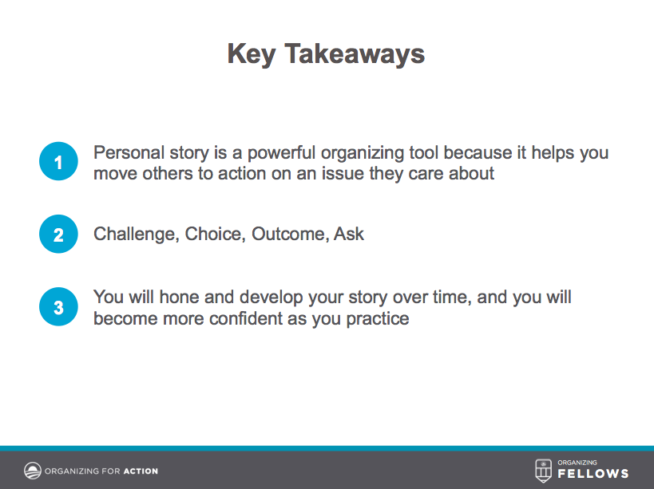
STRUCTURE OF A TRAINING MODULE
Key Takeaways

Slide 44
AGENDA FOR TODAY
Packaging Training Materials
Designing Worksheets
Writing Annotated Agendas
Structuring a Slide Deck
Debrief and Close

Slide 45
GOALS FOR THIS SESSION
KEY TAKEAWAY
Understand the value of the materials that decorate a training module.
Training materials guide your learners through the experiential activity, present visual aids, and help the trainer facilitate the material

Slide 46
GOALS FOR THIS SESSION
KEY TAKEAWAY
Understand the value of the materials that decorate a training module.
Training materials guide your learners through the experiential activity, present visual aids, and help the trainer facilitate the material
Be able to design a worksheet, annotated agenda, and slides for your training module.
A training module is complete when you have a worksheet, an annotated agenda, and a slide deck

Slide 47
GOALS FOR THIS SESSION
KEY TAKEAWAY
Understand the value of the materials that decorate a training module.
Training materials guide your learners through the experiential activity, present visual aids, and help the trainer facilitate the material
Be able to design a worksheet, annotated agenda, and slides for your training module.
A training module is complete when you have a worksheet, an annotated agenda, and a slide deck
Feel comfortable using training materials to solidify the learning experience
Training materials should not be an extra burden, rather effective, necessary support

Slide 48
OFA TRAINING
Thank you for joining today’s webinar.
Find the materials we covered, including a video and audio recording of the webinar on the bookshelf.
SEE BOOKSHELF
Notes:
00:00 – 00:00 [General Closing Slide]

