Slide 1
Welcome!
We will begin at 7:30 PM Central Time.
One more thing—call in for audio.
Check your email for phone number and pin.

Slide 2
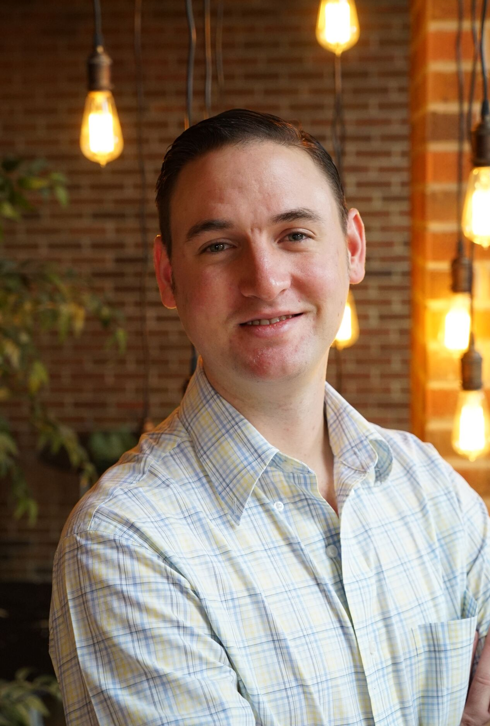

Bobby Brady-Sharp
Program Manager
@bobbyhtx

Slide 3
Week 1
Digital Organizing 101
Amazing things ahead:
Our learning journey
Week 2
Principles of Digital Communication
Week 3
Social Media Strategy
Week 4
Social Media Content Production
Week 5
Email Campaign Strategy
Week 6
Email Content Production
Week 7
Planning a Digital Campaign

Slide 4

LOGISTICS
We will meet every Thursday for 90 minutes.
If you cannot attend, email fellows@barackobama.com

Slide 5



LOGISTICS
We will meet every Thursday for 90 minutes.
This is an interactive training. (Mute your computers and listen on the phone)
OR
Press 1 on the phone
Type in chat box

Slide 6

LOGISTICS
We will meet for 90 minutes
This is an interactive training.
A recording of this video and call will be available on the Fellows Bookshelf tomorrow afternoon.

Slide 7

LOGISTICS
We will meet for 90 minutes
This is an interactive training.
A recording of this video and call will be available on the Fellows Bookshelf tomorrow afternoon.
It’s cool if you Tweet --
#OFAFellows

Slide 8


Principles of Digital Communication
W/ ALEX WOODWARD

Slide 9

Review: Digital 101
What are the three key goals of a digital department and what is an example of each?
OR
Press 1 on the phone
Type in chat box

Slide 10
Review: Digital 101
What are the three key goals of a digital department?
MESSAGE
MOBILIZE
MONEY

Slide 11
Principles of Digital Communication
W/ ALEX WOODWARD

Slide 12
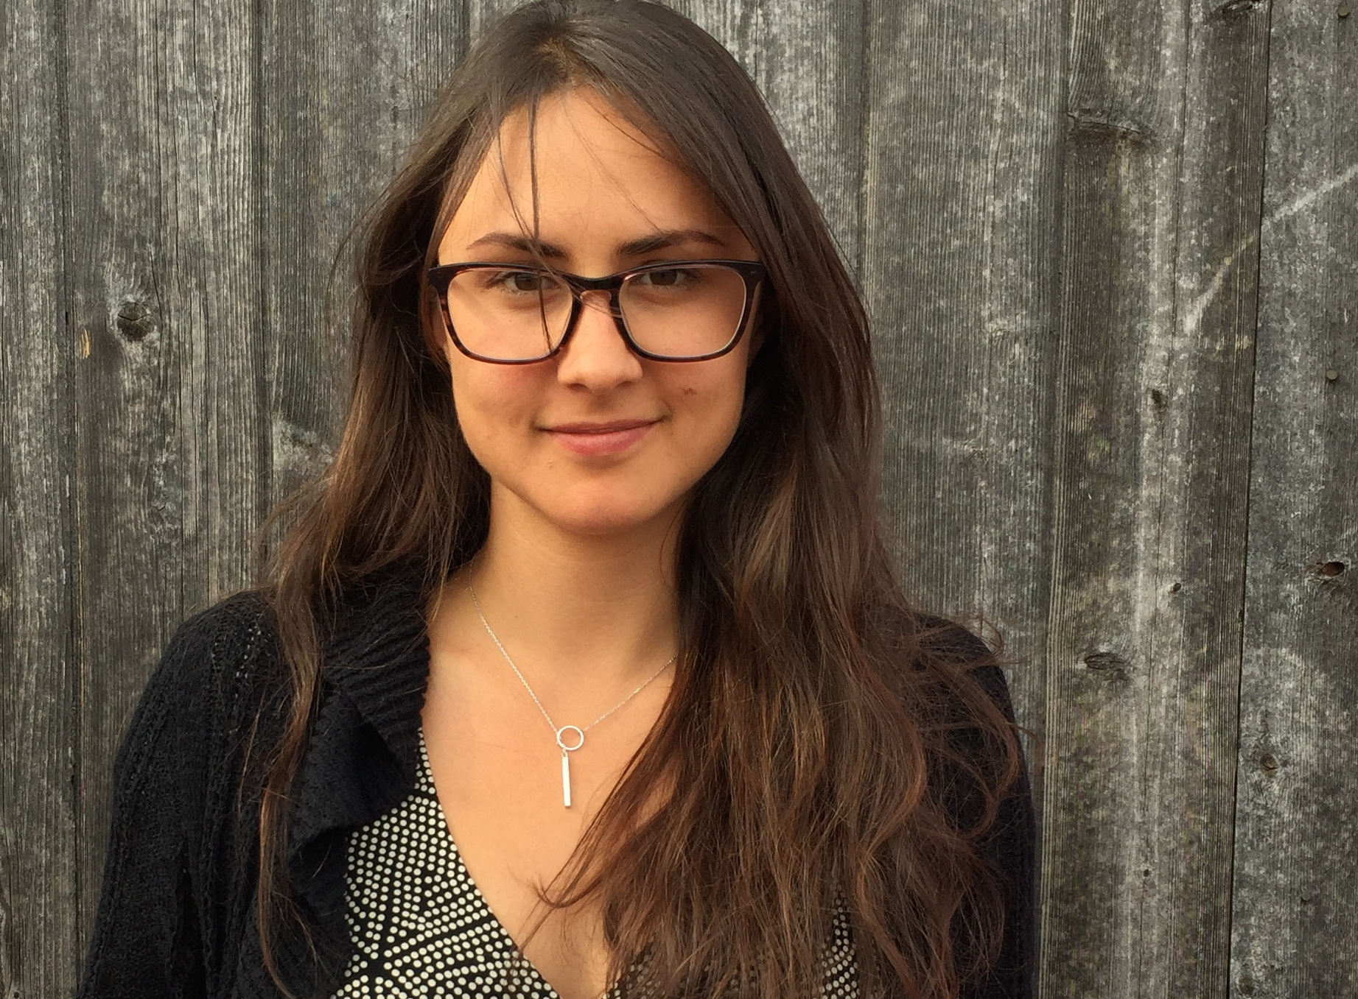
ALEX WOODWARD
Digital Training Manager
Notes:
00:11 – 00:13 [2 min] – Ryanne
Ryanne shares personal story in relation to her job at OFA
Bridge story with tonight’s topic: Digital Campaigns (what is your role in helping envision and develop digital campaigns?)

Slide 13
GOALS FOR TODAY
1
Understand the importance of building trust with your online audience
Be able to build and maintain trust with your online audience by being authentic, relevant, and showing efficacy
2
3
Feel comfortable writing a digital content strategy that builds trust among your online audience

Slide 14

AGENDA FOR TODAY
Building Trust
Authenticity
Relevance
Efficacy
General Principles
Debrief and Close

Slide 15
Principles of Digital Communication
W/ ALEX WOODWARD

Slide 16
AGENDA FOR TODAY
Building Trust
Authenticity
Relevance
Efficacy
Debrief and Close

Slide 17
TRUST
At the core of any relationship there is

Slide 18
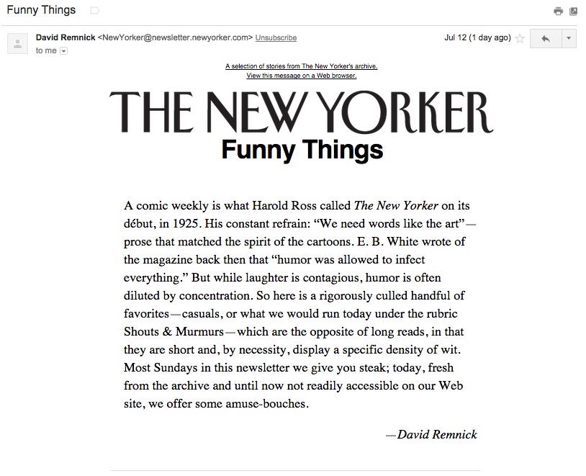
TRUST-METER
HIGHLY TRUST
#1
MAYBE -- TRUST
#2
DO NOT TRUST
#3

Slide 19
TRUST-METER
HIGHLY TRUST
MAYBE -- TRUST
DO NOT TRUST

Slide 20
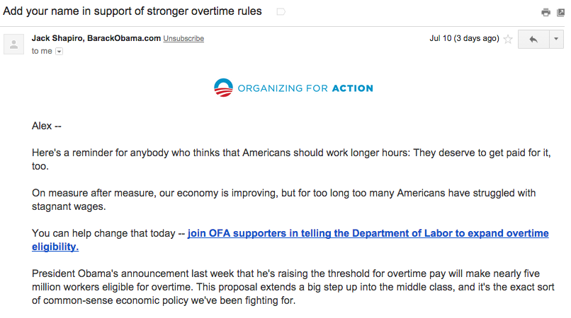
TRUST-METER
HIGHLY TRUST
#1
Alex --
Here's a reminder for anybody who thinks that Americans should work longer hours: They deserve to get paid for it, too.
On measure after measure, our economy is improving, but for too long too many Americans have struggled with stagnant wages.
You can help change that today -- join OFA supporters in telling the Department of Labor to expand overtime eligibility.
President Obama's announcement last week that he's raising the threshold for overtime pay will make nearly five million workers eligible for overtime. This proposal extends a big step up into the middle class, and it's the exact sort of common-sense economic policy we've been fighting for.
Thanks,
Jack Shapiro
National Issues Campaign Manager
MAYBE -- TRUST
#2
DO NOT TRUST
#3

Slide 21
TRUST-METER
HIGHLY TRUST
Alex --
Here's a reminder for anybody who thinks that Americans should work longer hours: They deserve to get paid for it, too.
On measure after measure, our economy is improving, but for too long too many Americans have struggled with stagnant wages.
You can help change that today -- join OFA supporters in telling the Department of Labor to expand overtime eligibility.
President Obama's announcement last week that he's raising the threshold for overtime pay will make nearly five million workers eligible for overtime. This proposal extends a big step up into the middle class, and it's the exact sort of common-sense economic policy we've been fighting for.
Thanks,
Jack Shapiro
National Issues Campaign Manager
MAYBE -- TRUST
DO NOT TRUST

Slide 22
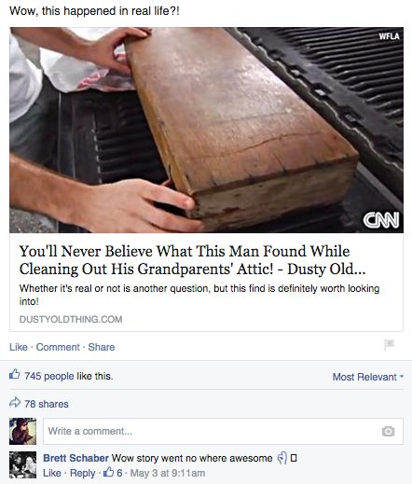
TRUST-METER
HIGHLY TRUST
#1
MAYBE -- TRUST
#2
DO NOT TRUST
#3

Slide 23
TRUST-METER
HIGHLY TRUST
MAYBE -- TRUST
DO NOT TRUST

Slide 24
TRUST
If you do not t a brand, an organization, you are not likely to respond to the ask, or even worse, continue your subscription.

Slide 25
TRUST
If you do not t a brand, an organization, you are not likely to respond to the ask, or even worse, continue your subscription.
AND IF YOUR LIST DOES NOT TRUST YOU
YOU HAVE NO CHANCE

Slide 26
TRUST
But, how do you build ?
Notes:
00:29– 00:31 [2 min] – Caleb

Slide 27
YOUR TONE
RESPECTFUL
How would you explain [this] to your mom?
Notes:
00:29– 00:31 [2 min] – Caleb

Slide 28
YOUR TONE
INCLUSIVE
Your readers are your peers.
Notes:
00:29– 00:31 [2 min] – Caleb

Slide 29
YOUR TONE
NATURAL
Would you read the email or post if you did not work for your organization?
Notes:
00:29– 00:31 [2 min] – Caleb

Slide 30
3 KEY PRINCIPLES TO BUILD TRUST
AUTHENTICITY
RELEVANCE
EFFICACY
Notes:
00:29– 00:31 [2 min] – Caleb

Slide 31
AGENDA FOR TODAY
Building Trust
Authenticity
Relevance
Efficacy
Debrief and Close
Notes:
00:09 – 00:10 [1 min] – Aquiles
We will accomplish these goals by following this agenda

Slide 32
BUILDING TRUST
AUTHENTICITY
RELEVANCE
EFFICACY
You can build trust by showing that you mean what you say -- being authentic.

Slide 33
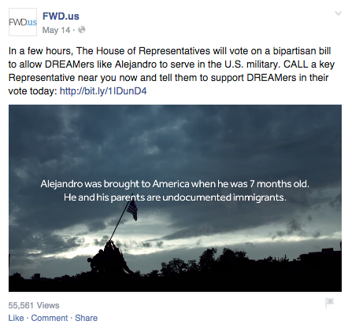
BUILDING TRUST
AUTHENTICITY
RELEVANCE
EFFICACY

Slide 34
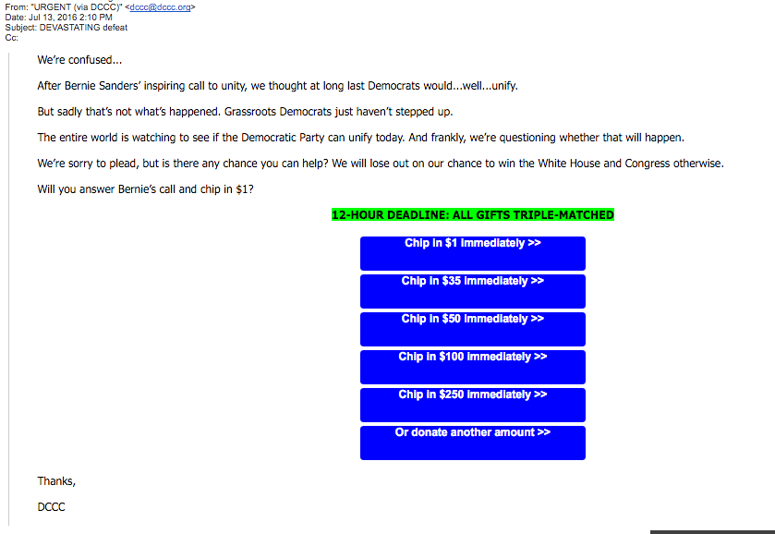
BUILDING TRUST
AUTHENTICITY
RELEVANCE
EFFICACY

Slide 35

BUILDING TRUST
AUTHENTICITY
RELEVANCE
EFFICACY
Your inbox is a personal space. Hence, your digital communication must be real, honest, legitimate.
| DO NOT TRICK YOUR AUDIENCE

Slide 36
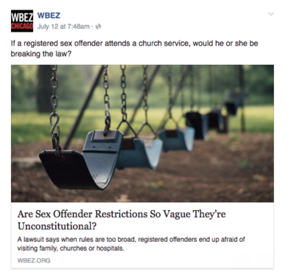
BUILDING TRUST
AUTHENTICITY
RELEVANCE
EFFICACY
BE TRANSPARENT
1

Slide 37
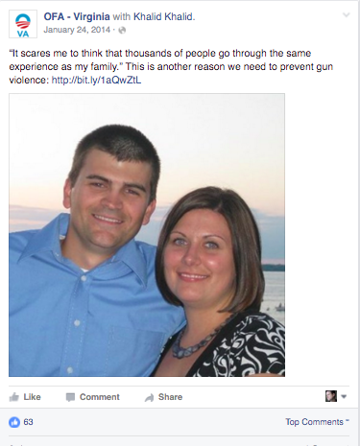
BUILDING TRUST
AUTHENTICITY
RELEVANCE
EFFICACY
2
SHOW HOW THIS AFFECTS REAL PEOPLE – Personal Story

Slide 38

Your Turn!
1
Read through the email in your Workbook
2
Draft four subject lines for the email that are authentic
Experiential Activity #1
6 Minutes
PRO-TIP
Be real, honest, and mean what you say
Story telling increases authenticity
Plain language makes your personable
ACCESS WORKBOOK
Notes:
00:13 – 00:15 [2 min] – Ryanne
Trainer’s Notes: The goal of this activity is to introduce the characteristics of a digital campaign. By not telling learners what these characteristics are, and allowing them to figure it out on their own based on their previous knowledge, we will meet them where they are. Following this activity, we will review the key characteristics of a digital campaign and answer remaining questions
Introduce activity
Instructions:
Together, we will review a total of 5 digital products one at a time
You will have one minute per product to determine:
What is the target audience?
What is the message?
What is consistent?

Slide 39
Your Turn!
Experiential Activity #1
DEBRIEF
OR
Press 1 on the phone
Type in chat box
Notes:
00:13 – 00:15 [2 min] – Ryanne
Trainer’s Notes: The goal of this activity is to introduce the characteristics of a digital campaign. By not telling learners what these characteristics are, and allowing them to figure it out on their own based on their previous knowledge, we will meet them where they are. Following this activity, we will review the key characteristics of a digital campaign and answer remaining questions
Introduce activity
Instructions:
Together, we will review a total of 5 digital products one at a time
You will have one minute per product to determine:
What is the target audience?
What is the message?
What is consistent?

Slide 40
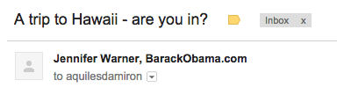
Your Turn!
A trip to Hawaii – are you in?
Experiential Activity #1
DEBRIEF
Notes:
00:13 – 00:15 [2 min] – Ryanne
Trainer’s Notes: The goal of this activity is to introduce the characteristics of a digital campaign. By not telling learners what these characteristics are, and allowing them to figure it out on their own based on their previous knowledge, we will meet them where they are. Following this activity, we will review the key characteristics of a digital campaign and answer remaining questions
Introduce activity
Instructions:
Together, we will review a total of 5 digital products one at a time
You will have one minute per product to determine:
What is the target audience?
What is the message?
What is consistent?

Slide 41
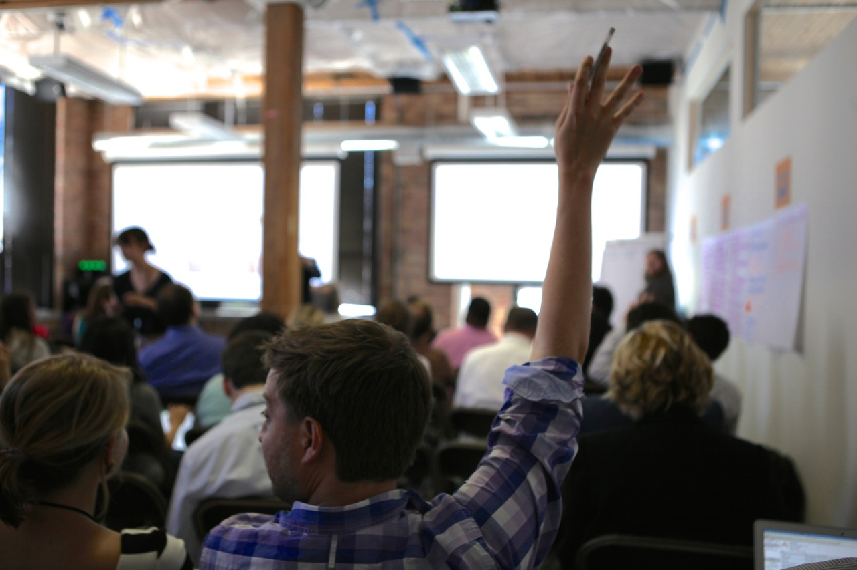
What questions do you have?

Slide 42
AGENDA FOR TODAY
Building Trust
Authenticity
Relevance
Efficacy
Debrief and Close
Notes:
00:09 – 00:10 [1 min] – Aquiles
We will accomplish these goals by following this agenda

Slide 43
BUILDING TRUST
AUTHENTICITY
RELEVANCE
RELEVANCE
EFFICACY
Relevance is tapping into what matters to your audience – it is all about capturing the true feeling of the moment.

Slide 44



BUILDING TRUST
AUTHENTICITY
RELEVANCE
RELEVANCE
EFFICACY
1
KNOW YOUR AUDIENCE

Slide 45
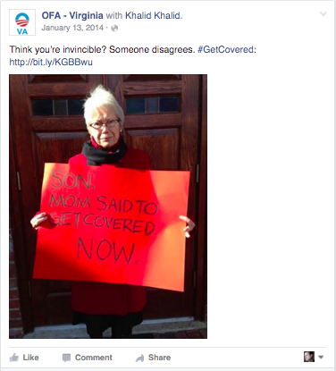
BUILDING TRUST
AUTHENTICITY
RELEVANCE
RELEVANCE
EFFICACY
1
KNOW YOUR AUDIENCE

Slide 46
BUILDING TRUST
AUTHENTICITY
RELEVANCE
RELEVANCE
EFFICACY
2
UNDERSTAND WHAT TALKS TO THEIR HEARTS
How does this problem affect the reader?
What do you want your reader to feel after reading/engaging with your content?

Slide 47
BUILDING TRUST
AUTHENTICITY
RELEVANCE
RELEVANCE
EFFICACY
2
UNDERSTAND WHAT TALKS TO THEIR HEARTS

Slide 48
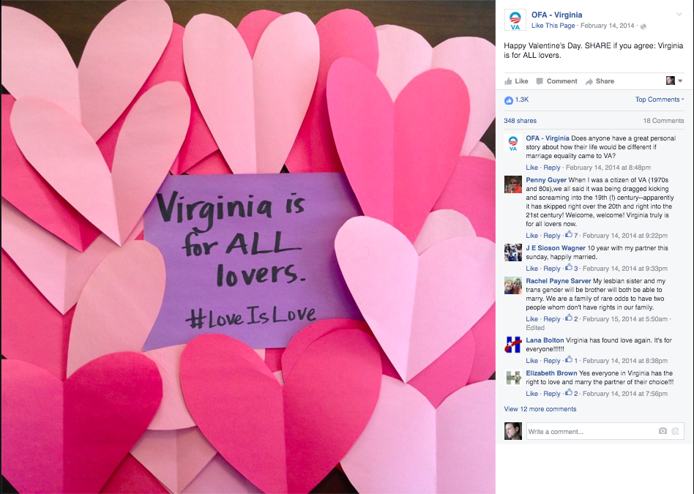
BUILDING TRUST
AUTHENTICITY
RELEVANCE
RELEVANCE
EFFICACY
3
BE AWARE OF THE CONTEXT

Slide 49
Your Turn!
Read the assignment instructions and background on a climate denier campaign Climate STRONG is working on
1
2
Brainstorm an audience based off of the background information, then list how climate change affects the audience, and brainstorm a relevant message
Experiential Activity #2
10 Minutes
PRO-TIP
Messages are relevant when you understand your audience – How does the problem affect them?
A message has a hook and a call to action – which should be authentic and relevant
ACCESS WORKBOOK
Notes:
00:13 – 00:15 [2 min] – Ryanne
Trainer’s Notes: The goal of this activity is to introduce the characteristics of a digital campaign. By not telling learners what these characteristics are, and allowing them to figure it out on their own based on their previous knowledge, we will meet them where they are. Following this activity, we will review the key characteristics of a digital campaign and answer remaining questions
Introduce activity
Instructions:
Together, we will review a total of 5 digital products one at a time
You will have one minute per product to determine:
What is the target audience?
What is the message?
What is consistent?

Slide 50
AGENDA FOR TODAY
Building Trust
Authenticity
Relevance
Efficacy
Debrief and Close
Notes:
00:09 – 00:10 [1 min] – Aquiles
We will accomplish these goals by following this agenda

Slide 51
BUILDING TRUST
AUTHENTICITY
RELEVANCE
EFFICACY
EFFICACY
Efficacy is the capacity for beneficial change as a result of a given action – How will taking X action help solve the issue/problem?

Slide 52
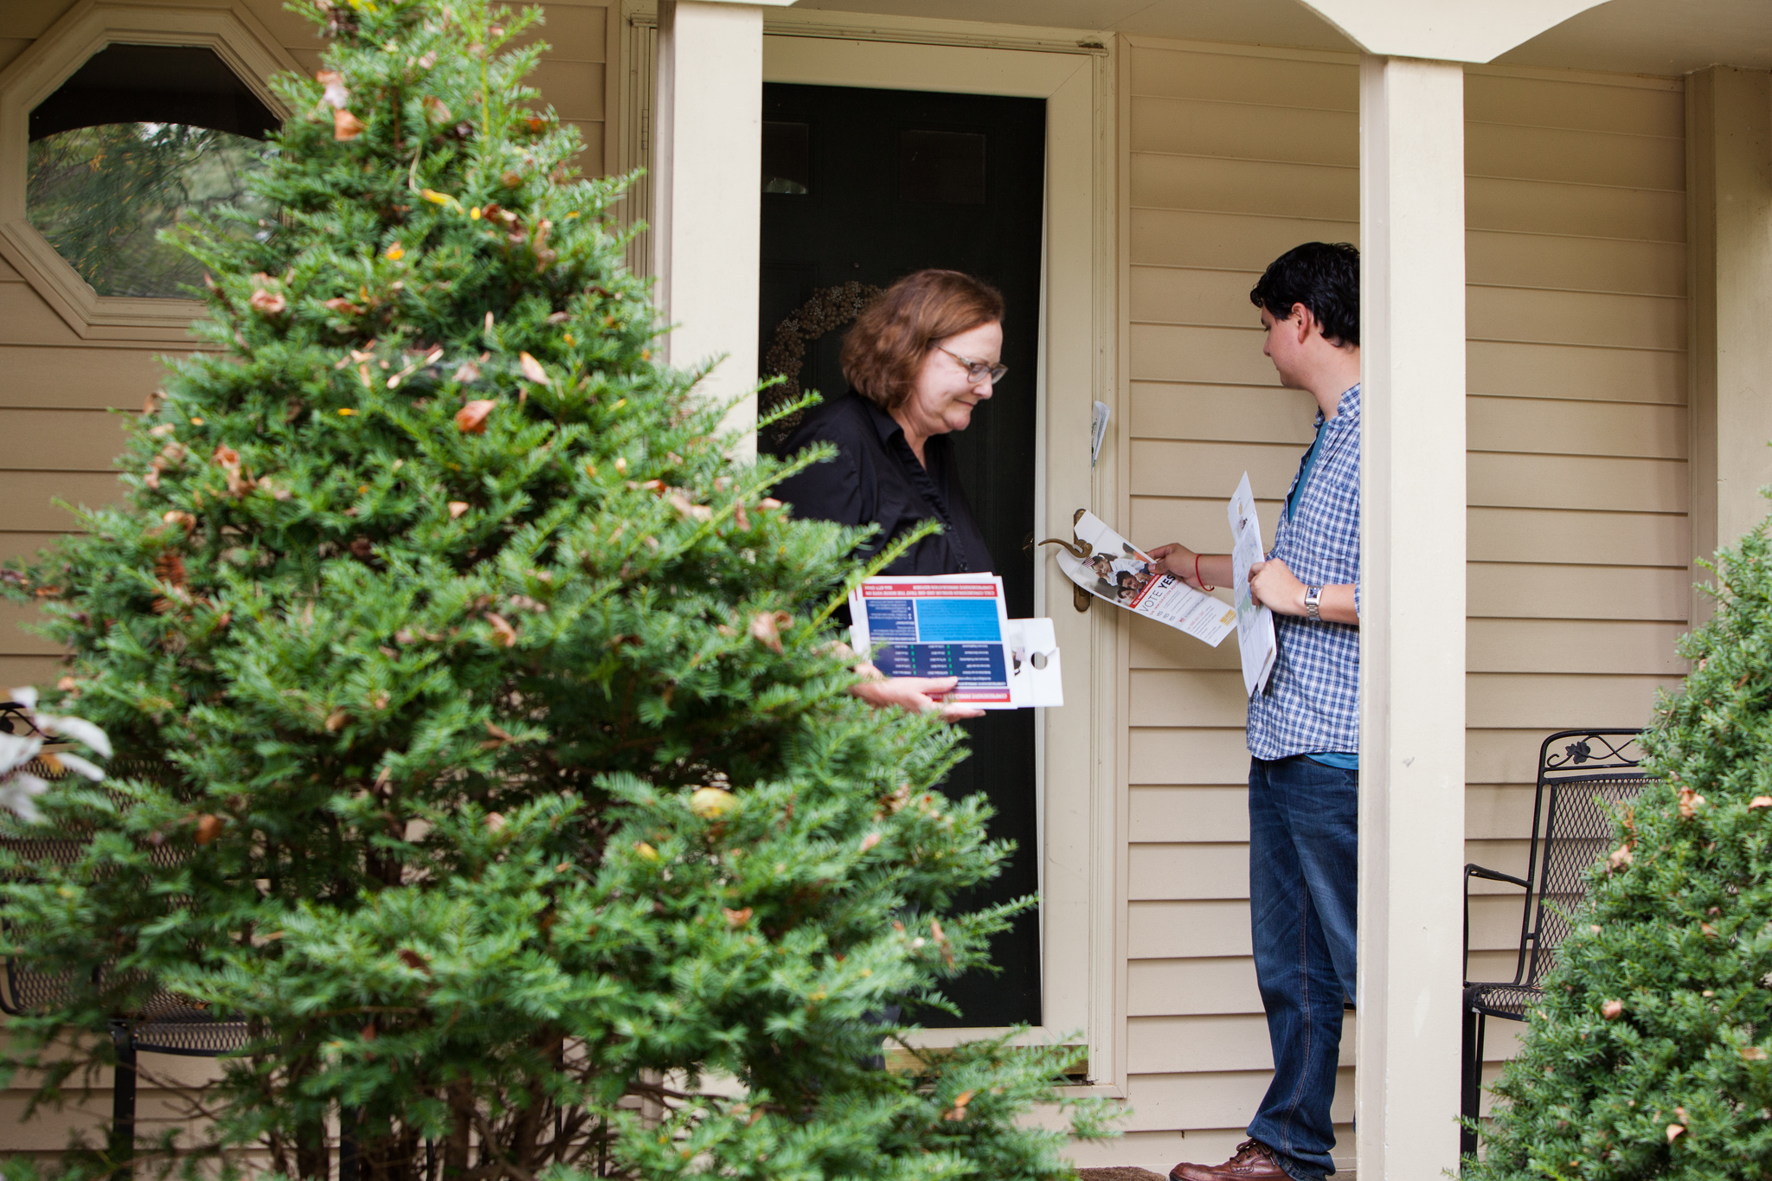
BUILDING TRUST
AUTHENTICITY
RELEVANCE
EFFICACY
EFFICACY
Alex W. 7:17 PM
Hi friend – let’s knock on doors on Saturday. Are you in?
Sent to: Aquiles D.
Aquiles D. 7:22 PM
…maybe?
Sent to: Alex W

Slide 53
BUILDING TRUST
AUTHENTICITY
RELEVANCE
EFFICACY
EFFICACY
Alex W. 7:17 PM
Hi friend – remember Maria from the last time we canvassed together?
Sent to: Aquiles D.
Aquiles D. 7:22 PM
Yes!
Sent to: Alex W
Alex W. 7:23 PM
Well, she just became a vol leader b/c of us. Let’s canvass again this weekend?
Sent to: Aquiles D.

Slide 54

BUILDING TRUST
AUTHENTICITY
RELEVANCE
EFFICACY
EFFICACY

Slide 55
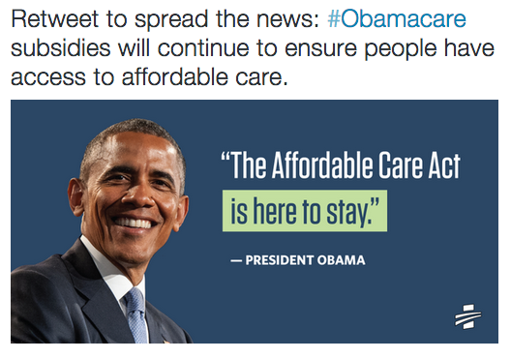
BUILDING TRUST
AUTHENTICITY
RELEVANCE
EFFICACY
EFFICACY

Slide 56
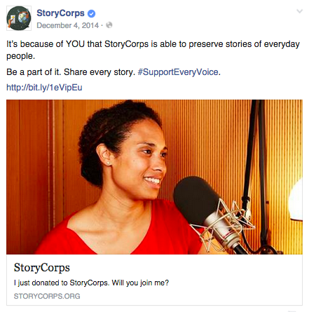
BUILDING TRUST
AUTHENTICITY
RELEVANCE
EFFICACY
EFFICACY

Slide 57
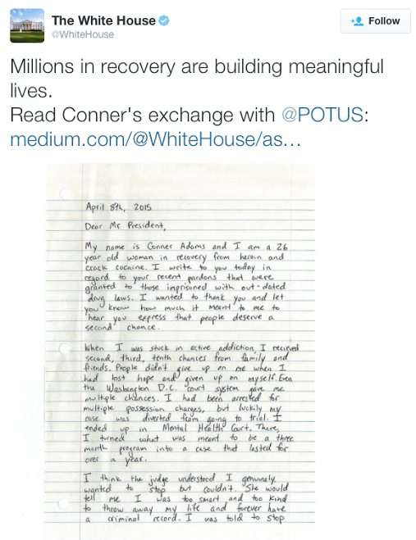
BUILDING TRUST
AUTHENTICITY
RELEVANCE
EFFICACY
EFFICACY

Slide 58
Your Turn!
Review the relevant and authentic message you wrote on Experiential Activity #2. Either revise, or re-write your call to action to enhance its efficacy.
REMEMBER:
Experiential Activity #3
10 Minutes
Efficacy tells your reader/audience how exactly your relevant and authentic call to action will help solve the issue/problem
ACCESS WORKBOOK
Notes:
00:13 – 00:15 [2 min] – Ryanne
Trainer’s Notes: The goal of this activity is to introduce the characteristics of a digital campaign. By not telling learners what these characteristics are, and allowing them to figure it out on their own based on their previous knowledge, we will meet them where they are. Following this activity, we will review the key characteristics of a digital campaign and answer remaining questions
Introduce activity
Instructions:
Together, we will review a total of 5 digital products one at a time
You will have one minute per product to determine:
What is the target audience?
What is the message?
What is consistent?

Slide 59
Your Turn!
Experiential Activity #3
10 Minutes
OR
Press 1 on the phone
Type in chat box
Notes:
00:13 – 00:15 [2 min] – Ryanne
Trainer’s Notes: The goal of this activity is to introduce the characteristics of a digital campaign. By not telling learners what these characteristics are, and allowing them to figure it out on their own based on their previous knowledge, we will meet them where they are. Following this activity, we will review the key characteristics of a digital campaign and answer remaining questions
Introduce activity
Instructions:
Together, we will review a total of 5 digital products one at a time
You will have one minute per product to determine:
What is the target audience?
What is the message?
What is consistent?

Slide 60
AGENDA FOR TODAY
Building Trust
Authenticity
Relevance
Efficacy
Debrief and Close
Notes:
00:09 – 00:10 [1 min] – Aquiles
We will accomplish these goals by following this agenda

Slide 61
Debrief
Tweet with #ofafellows, or type in the chatbox:
What is your biggest takeaway and why?
Press 1 on the phone
OR
Type in chat box

Slide 62
What questions do you have?
Notes:
00:27– 00:29 [2 min] – Caleb
We are going to explore the digital ladder of engagement and how we engage our audience next.
Before we move on – What questions do you have?

Slide 63
KEY TAKEAWAYS
Whether you engage your audience through email or social media, building trust is essential to building an online relationship.
You can build trust by showing that you mean what you say (Authenticity); Tapping into what matters to your audience (Relevance); And demonstrating that taking action has an impact (Efficacy).
Notes:
00:74 – 00:75 [1 min] – Ryanne
Digital campaigns achieve measurable goals, broadcast relevant messaging, integrate all digital platforms, and are consistent.

Slide 64
GOALS FOR TODAY
1
Understand the importance of building trust with your online audience
Be able to build and maintain trust with your online audience by being authentic, relevant, and practicing efficacy
2
3
Feel comfortable writing a digital content strategy that build trust among your online audience
Notes:
00:08 – 00:09 [1 min] – Aquiles
We have three key goals tonight

Slide 65
Class Review and Additional Reading
Review concepts and skills learned today
Read: Your Digital Strategy Shouldn’t Be About Attention and post your key takeaways in the Connect discussion post
DUE TUESDAY, 9/13 AT 5:00PM CT
Notes:
00:72 – 00:73 [2 min] – Aquiles
Review assignment

Slide 66
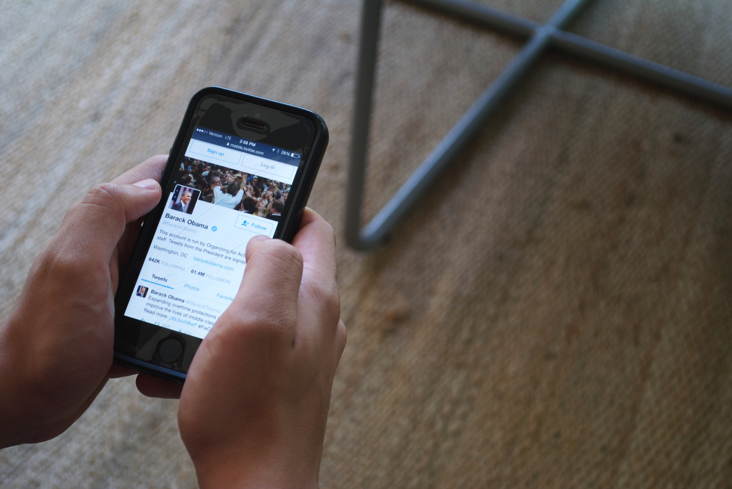
THURSDAY
7:30 PM CT
Social Media Strategy
W/ JONATHAN KIBORT

Slide 67
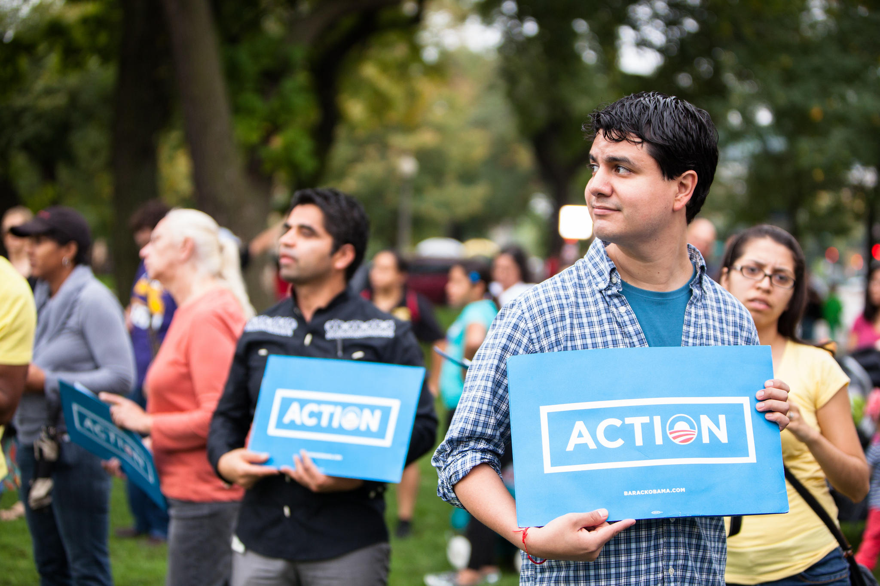
OFA TRAINING
Thank you for joining today’s webinar.
Find the materials we covered, including a video and audio recording of the webinar on the bookshelf.
SEE BOOKSHELF
Notes:
00:00 – 00:00 [General Closing Slide]

