Slide 1




OFA PROFESSIONAL FELLOWSHIP
CHICAGO PRACTICUM
Notes:
This work is licensed under the Creative Commons Attribution-NonCommercial 4.0 International License. To view a copy of this license, visit http://creativecommons.org/licenses/by-nc/4.0/ or send a letter to Creative Commons, PO Box 1866, Mountain View, CA 94042, USA

Slide 2

9:00 – 9:10
Welcome Back
9:10 – 10:30
Field Manager Panel and Speed Dating
Agenda for today
10:30 – 12:30
Resume Workshop
12:30 – 1:30
Lunch and Exit Interviews, Part I
1:30 – 2:00
Debrief and Program Closing
2:10 – 2:30
Exit Interviews, Part II

Slide 3

FIELD MANAGER PANEL
Ashley Pinedo, OFA National Training Director
David Rossini, Director of Impact, Director of Training at The Public Interest Network
Jennifer Warner, OFA Grassroots Organizing Director
Justin Wilkins, former OFA Tennessee State Coordinator

Slide 4


Resume Workshop
Notes:
00:75 – 00:77 [2 min] – Aquiles
Close

Slide 5
RESUME BEST PRACTICES
1
Focus on achievements for the job, not responsibilities

Slide 6
RESUME BEST PRACTICES
1
Focus on achievements for the job, not responsibilities
2
Use strong, impactful action verbs

Slide 7
RESUME BEST PRACTICES
1
Focus on achievements for the job, not responsibilities
2
Use strong, impactful action verbs
Make your language accessible to people who don’t have the same background as you
3

Slide 8
RESUME BEST PRACTICES
1
Focus on achievements for the job, not responsibilities
2
Use strong, impactful action verbs
Make your language accessible to people who don’t have the same background as you
3
One page – no more, no less
4

Slide 9
RESUME BEST PRACTICES
1
Focus on achievements for the job, not responsibilities
2
Use strong, impactful action verbs
Make your language accessible to people who don’t have the same background as you
3
One page – no more, no less
4
If they notice your formatting, you are doing it wrong. Keep the font simple and inconspicuous; keep formatting clean and consistent
5

Slide 10



RESUME WORKSHOP STRUCTURE
WRITE/EDIT
One hour
PEER-REVIEW
20 minutes
SUBMIT
10 minutes

Slide 11
PEER REVIEW ASSIGNMENTS
Partner 1
Adrian S.
Beverly S.
Elizabeth H.
Jeremy T.
Jomar F.
Partner 2
Shivanna H.
Reggie M.
MaryAnn P.
Marielle A.
Jose D.
Partner 1
Andrew G.
Caryn C.
Francesca A.
Jim B.
Partner 2
Ryan A.
Mary D.
Lexie W.
Justin W.
Partner 1
Benjamin G.
Curtis O.
Howard C.
Jimmy L.
Partner 2
Renee H.
Matthew B.
Marika B.
Kevin P.

Slide 12
RESUME WORKSHOP STRUCTURE
WRITE/EDIT
One hour
PEER-REVIEW
20 minutes
SUBMIT
10 minutes

Slide 13

12:30 – 1:30
Lunch
12:40 – 1:30
Exit Interviews, Part I
1:30 – 2:00
Closing
2:00 – 2:30
Exit Interviews, Part 2

Slide 14
EXIT INTERVIEW SCHEDULE & ASSIGNMENTS, PART I
 | Ashley | Chelsey | Jennifer | Justin
12:40 | Andrew | Benjamin | Beverly | Curtis
12:50 | Elizabeth | Francesca | Jeremy | Jimmy
1:00 | Jomar | Jose | Kevin | Lexie
1:10 | Marielle | MaryAnn | Matthew | Reggie
1:20 | Shivanna | Ryan

Slide 15
OFA PROFESSIONAL FELLOWSHIP
CHICAGO PRACTICUM

Slide 16
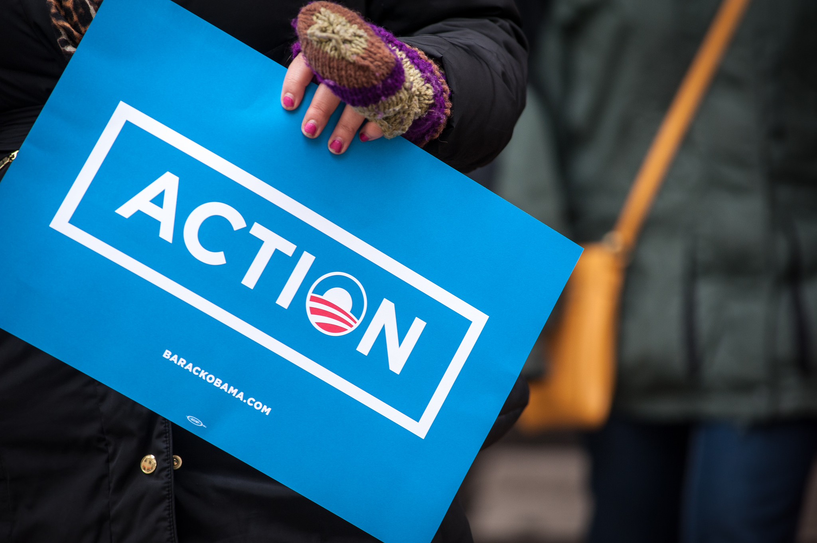
HOW DID IT GO?
bit.ly/Day2Practicum

Slide 17

HOW DID IT GO?
bit.ly/Day2Practicum

Slide 18
9:00 – 9:10
Welcome Back
9:10 – 10:30
Field Manager Panel and Speed Dating
Agenda for today
10:30 – 12:30
Resume Workshop
12:30 – 1:30
Lunch and Exit Interviews, Part I
1:30 – 2:00
Debrief and Program Closing
2:10 – 2:30
Exit Interviews, Part II

Slide 19
DEBRIEF
What was your biggest takeaway today?

Slide 20
DEBRIEF
What was your biggest takeaway today?
What is still challenging?

Slide 21
DEBRIEF
What was your biggest takeaway today?
What is still challenging?
How do you see yourself applying what you learned today?

Slide 22
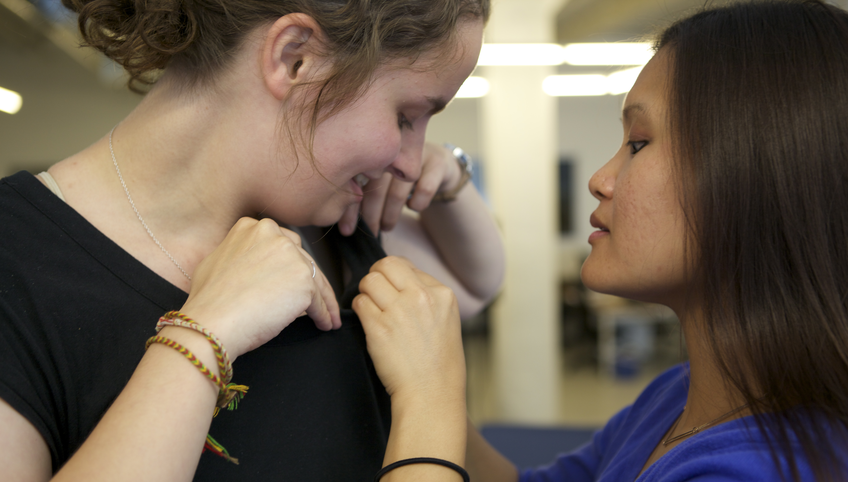
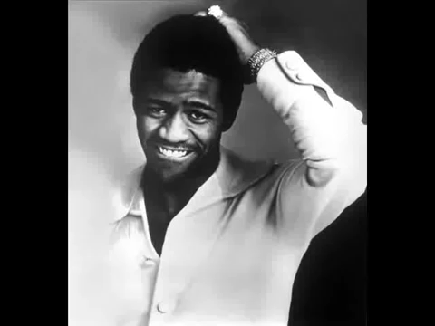
OFA PROFESSIONAL FELLOWSHIP
CHICAGO PRACTICUM

Slide 23
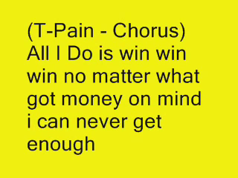
OFA PROFESSIONAL FELLOWSHIP
CHICAGO PRACTICUM

Slide 24
EXIT INTERVIEW SCHEDULE & ASSIGNMENTS, PART II
 | Ashley | Chelsey | Jennifer | Justin
2:10 | Adrian | Caryn | Howard | Jim
2:20 | Jordan | Marika | Mary | Renee

