Slide 1


Notes:
This work is licensed under the Creative Commons Attribution-NonCommercial 4.0 International License. To view a copy of this license, visit http://creativecommons.org/licenses/by-nc/4.0/ or send a letter to Creative Commons, PO Box 1866, Mountain View, CA 94042, USA
9:00 – 9:01 – Traci

Slide 2

Welcome.
We’re excited to be here with you!
Notes:
9:01 – Traci
Share note on logistics – where the restroom is; feel free to get up and get more coffee when you need; we will be with each other for the morning and are excited to dig in

Slide 3
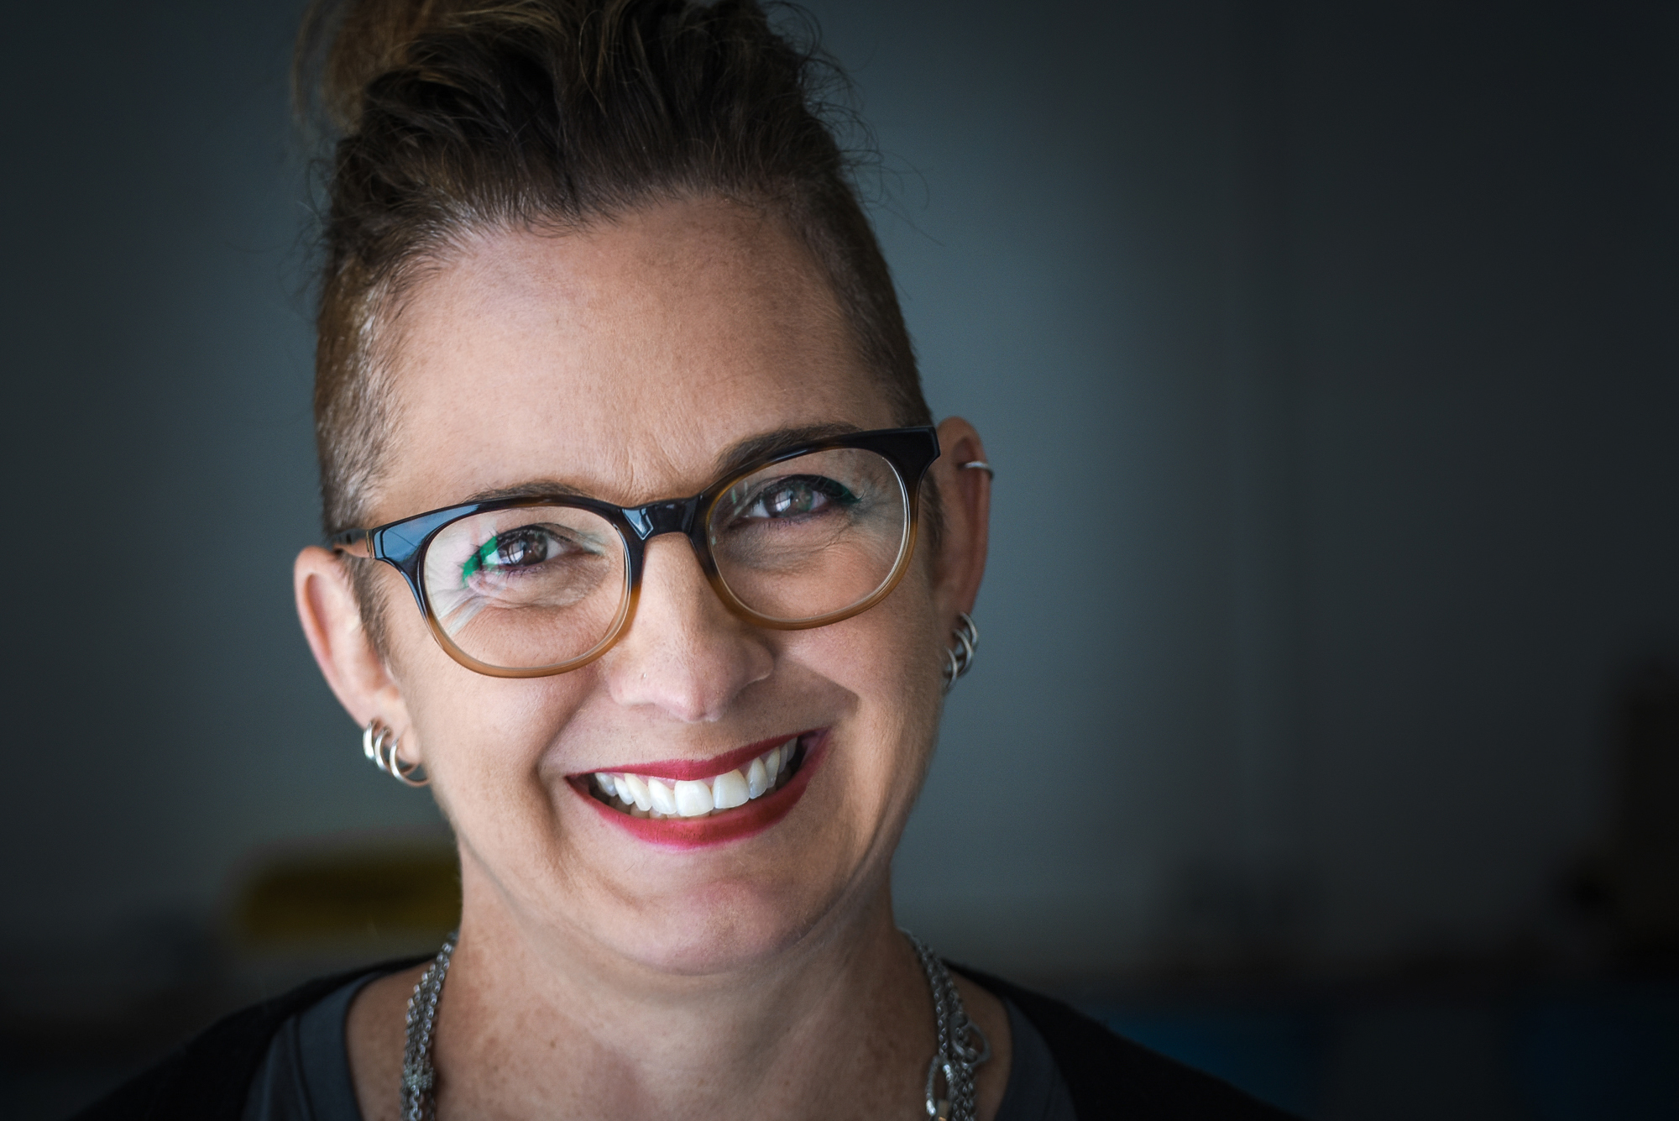

Traci Wile
@twillikers
Notes:
9:01- 9:02 – Traci
Share one thing that you love about your job (or one fun fact)

Slide 4
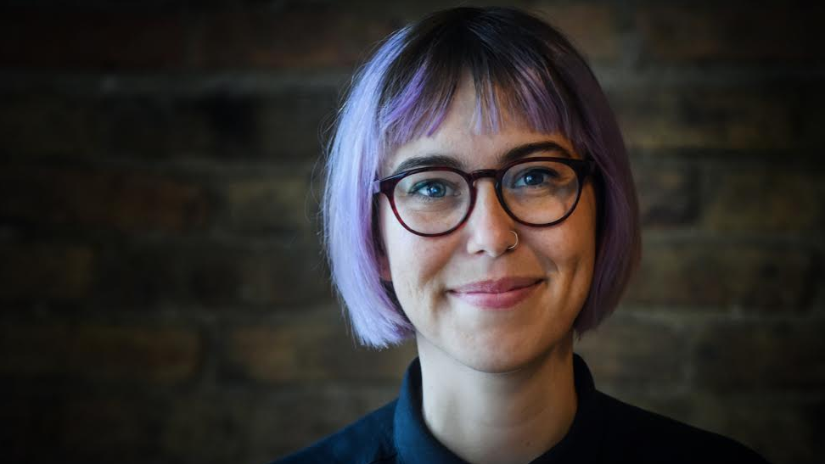
Alexis Conavay
@AlexConavay
Notes:
9:02- 9:03 – Alexis
Share one thing that you love about your job (or one fun fact)

Slide 5
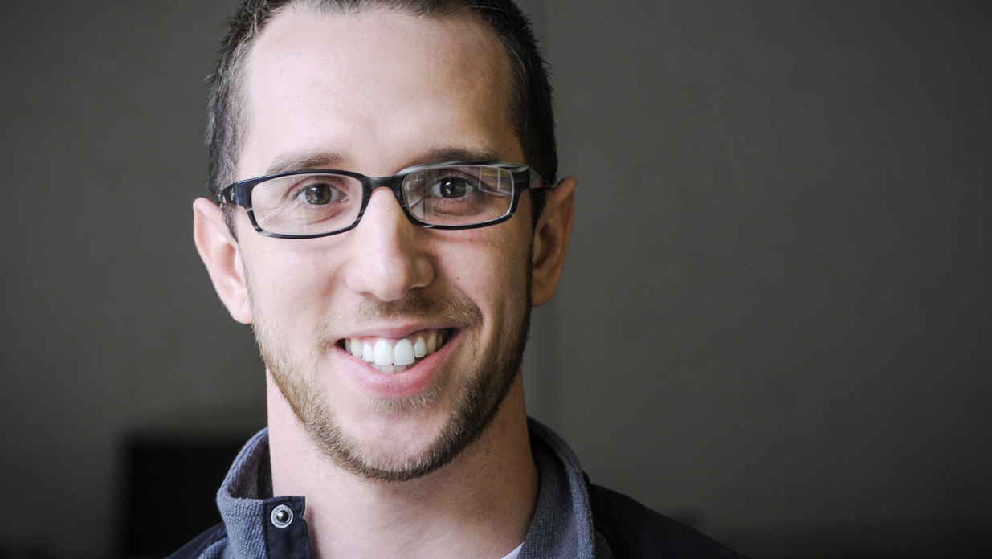
Kevin Lane
@klane228
Notes:
9:03- 9:04 – Kevin
Share one thing that you love about your job (or one fun fact)

Slide 6
#OFAction
#USOW2018
Notes:
9:05 – Traci

Slide 7
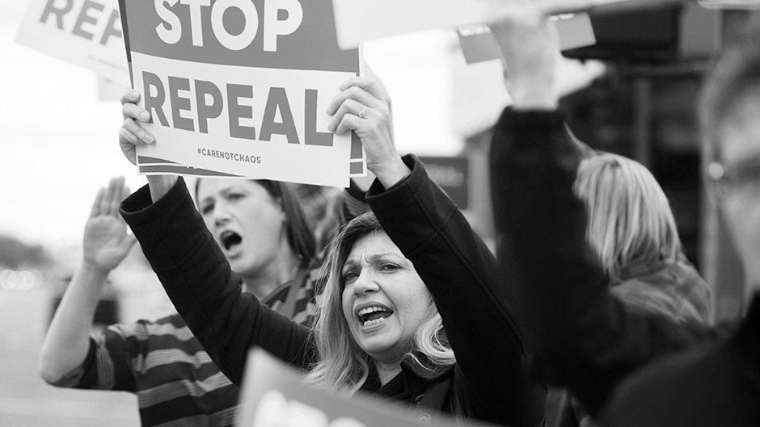
We’re OFA
Notes:
9 :04 – 9:05 Traci
This is our work at OFA – we want to build civic participation because we believe that when people are involved at every level of governing, we are stronger and more represented.

Slide 8
OFA’s mission is to create
a more accessible and participatory democracy
Notes:
9 :04 – 9:05 Traci
This is our work at OFA – we want to build civic participation because we believe that when people are involved at every level of governing, we are stronger and more represented.

Slide 9
4 Goals
of this training
Notes:
9:06- 9:07 Traci
So with this – let’s talk about our goals for the morning

Slide 10
1
Develop a common, engaging understanding of the goals of community organizing.
Notes:
9:07 – 9:10 (for all the goals slides) Traci

Slide 11
2
Identify the unique barriers
facing women and how to
operate from our core strengths when organizing.
Notes:
9:07 – 9:10 (for all the goals slides) Traci

Slide 12
3
Develop a working knowledge
of what it means to be vision-
driven and goal-oriented
Notes:
9:07 – 9:10 (for all the goals slides) Traci

Slide 13
4
Foster a deep confidence and excitement for applying these skills to your organizing work
Notes:
9:07 – 9:10 (for all the goals slides) Traci

Slide 14
Agenda
Welcome and introductions
What is community organizing?
Unique barriers & operating from strengths
Break
Leading with our vision & setting goals
Closing
Notes:
9:10- 9:11 Traci

Slide 15
Meet each
other
Find the nearest person to you
whom you don’t know, and introduce yourself.
Share your name, where you’re from, and why you’re getting involved.
Finally, share what you want to get from the session.
Notes:
9:11 – 9: 15 Traci
(Two minutes per person sharing)

Slide 16
Respect
Empower
Include
Notes:
9:15 – 9:17 – values of OFA – Traci
1. RESPECT -- We take a respectful approach to everything we do, including talking to our elected officials. When we’re respectful, our concerns are taken more seriously. We make sure that we’re respectful of people’s time for those who engage in our organization. We’re not asking folks to do things that we don’t think will actually help move the needle forward or will actually help you build your organization. It means that we respect everyone who comes into this organization, no matter how they get here. Not everyone is a die-hard democrat or progressive, but they still have a place here.
2. EMPOWER – that means that we make sure that we’re not just asking people to take actions, but that we’re training and supporting folks to be leaders in their communities. That doesn’t necessarily mean that you have to be in charge of running everything, but maybe when you talk with your friends, your family, and your neighbors about issues, that you know what those issues are about, you know what’s at stake, and you’re empowered to be a leader in that way.
3. INCLUDE -- We include anyone and everyone who wants to make a difference in the progressive movement. OFA welcomes you, no matter your skill level or income. It is our job to find the ways that people can give—whether they have 5 hours or 5 minutes—whether they have lots of resources or none—everyone has a place in this organization and everyone has a role to play in working to make their communities better.
You will receive all of our training and coaching at no cost to you. And, it doesn’t matter if you’ve never taken action before or if you’re a seasoned community organizer, we have a place for everyone at OFA.
4. Organize! – We’re not just building all of this infrastructure so we can fight today’s fights, but so that we’re here for the long term. Because we know that some of these fights will take years or even decades of work.
We organize because that is how we build long term power.

Slide 17
Agenda
Welcome and introductions
What is community organizing?
Unique barriers & operating from strengths
Break
Leading with our vision & setting goals
Closing
Notes:
9: 20 Traci

Slide 18
What are the goals of community organizing?
Notes:
9: 20 – 9: 21 Traci
As a group, we wanted to get a shared understanding of the goals of community organizing – we hear this term a lot, and we want to develop a group understanding of what the term actually means
We are going to go through 3 different artifacts that we have found to answer that question

Slide 19
Orienting
questions
1
What values do you hear these people speaking to?
2
What outcomes do you see from their work?
3
What are the goals of community organizing that you hear?
Notes:
9: 20 – 9: 21 Traci
As a group, we wanted to get a shared understanding of the goals of community organizing – we hear this term a lot, and we want to develop a group understanding of what the term actually means
We are going to go through 3 different artifacts that we have found to answer that question

Slide 20
“The great social justice changes in our country have happened when people came together, organized, and took direct action. It is this right that sustains and nurtures our democracy today. The civil rights movement, the labor movement, the women's movement, and the equality movement for our LGBT brothers and sisters are all manifestations of these rights.”
DOLORES HUERTA
Notes:
9:27 – 9: 28 : Traci
Read quote

Slide 21
“The young are at the gates.”
LIVINIA DOCK
Notes:
TIMING: 9:28- 9:34 TRACI
https://drive.google.com/file/d/1uxAgSTutewVI7ITmklhyow0mVXF1dwN8/view
Play -- :45 seconds – 5:50 (they have text to follow along with when you get to the reading)

Slide 22
What is the goal of community organizing?
Small group discussion
Notes:
9:34 – 9: 40 – Traci leads

Slide 23
Community organizing has as a core goal of generating durable power for a group of people, influencing key decision-makers on a range of issues over time.
Notes:
9:45 – 9:50
[TRACI SYNTHESIZES WHAT SHE HEARS AND CONNECTS TO THIS DEFINITION]

Slide 24
Community organizers seek to get people a place at the table before important decisions are made.
Notes:
9:45 – 9:50
[TRACI SYNTHESIZES WHAT SHE HEARS AND CONNECTS TO THIS DEFINITION]
Traci then thanks people for getting to that shared definition, and says, “we will use this as we take the next step to think about the unique role of women in community organizing

Slide 25
Agenda
Welcome and introductions
What is community organizing?
Unique barriers & operating from strengths
Break
Leading with our vision & setting goals
Closing
Notes:
9:50 – 9: 51 Alexis
Connecting point – we can’t talk about organizing, and the goals of organizing, without understanding power

Slide 26
What barriers do
women face in community organizing?
Notes:
9:51 – 9: 52 Alexis
Need to get the community to the table before decisions are made --
What are the barriers women face even getting to the table?

Slide 27
Barriers for women in organizing
Decisions are made in male spaces
Government is led by men
Bias; rigid archetypes of leadership
Notes:
9:52- 9:55 Alexis
Decisions are made in male spaces
We know historically women have not been allowed access to power in the United States, through voting, leadership, financially
Government is led by men
Take a look at congress for your best example of who holds positions of power in our country
Bias; archetypes
Latent, subconscious ideas about leadership and who has the right to lead – example of women being interrupted 3X as much as men in the supreme court
Beliefs about what women SHOULD be doing rather than challenging power – ideas of motherhood, being nurturing rather than causing conflict

Slide 28
Anything else?
Notes:
9:55- 10:00 -- Alexis
Ask the group – what have you experienced while organizing that feels uniquely gendered?

Slide 29
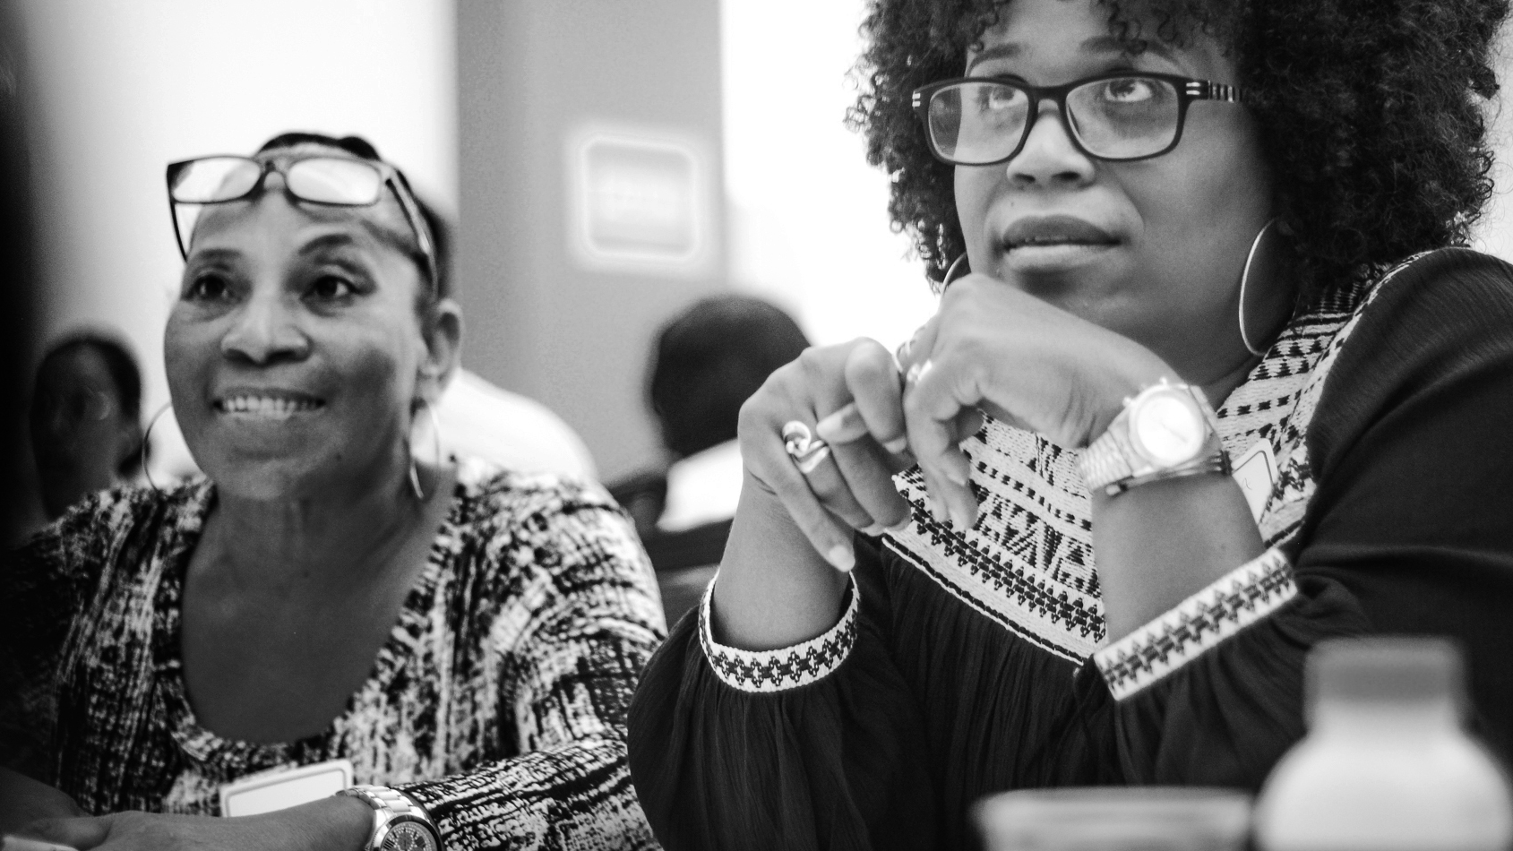
Operating
from strengths
Notes:
10:00 – 10:01 Alexis
Despite the barriers for women, we know something to be true – organizing power is built on the backs of women

Slide 30
40%
71.6%
431
of campaign managers for Democratic congressional candidates are women
of OFA’s current
Fellowship class identify
as female
Women running or
likely to run for the
House in 2018
Notes:
10:01 – 10:03 Alexis
71.6% of current fellows class identifies as female; out over 400 fellows
This year, 40 percent of the campaign managers for Democratic congressional candidates are women, according to the Democratic Congressional Campaign Committee.
At latest count, 431 women were running for or were likely to run for the House nationwide — 339 Democrats and 92 Republicans. At this point in 2016, there were fewer than half that: 212. Likewise, 50 women are running for or likely to run for Senate, compared with 25 at this point in 2016.
Between 3,267,134 and 5,246,670 people participated in the Women's March in the United States,[27] or approximately 1.0 to 1.6 percent of the U.S. population. It was the largest single-day protest in U.S. history.

Slide 31
We have sheroes
to learn from
Notes:
10:03 – 10:05
Despite the many barriers women face in organizing, we have the opportunity to reflect on the things women UNIQUELY bring to organizing that sets them apart to be successful
This is not to negate the real, systemic barriers for women – however, we know that when we operate from a place of personal power, a time is coming when we will occupy places of power to make change we desperately seek
So let’s take some time and look at women that have gotten it done, and the strengths they operated from to get there

Slide 32
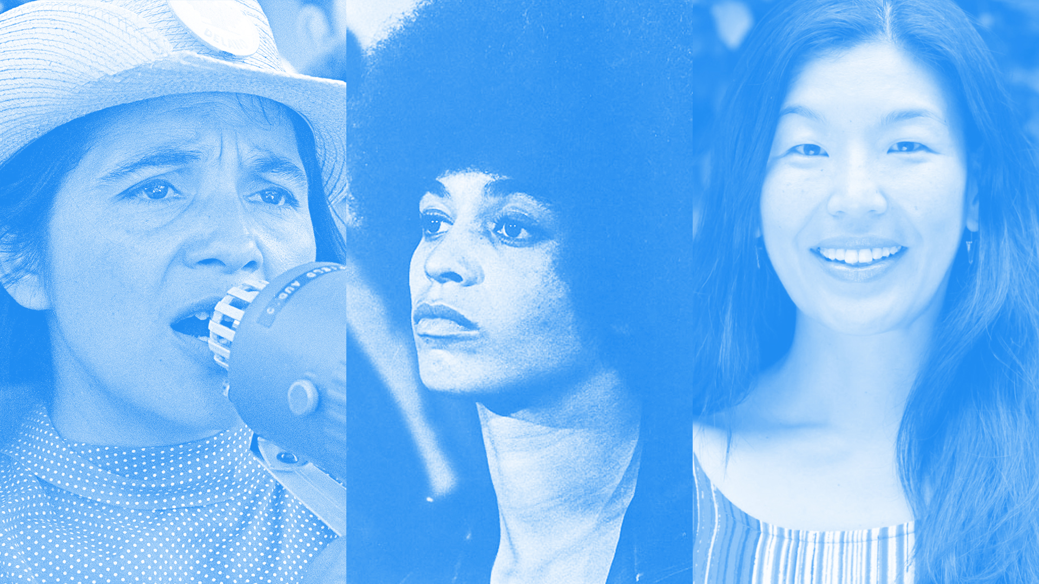
Dolores Huerta
Angela Davis
Ai-jen Poo
Notes:
110:05 – 10:07 Alexis
Women that have come before us

Slide 33
Orienting
questions
What themes do you see across these three women?
1
2
What qualities enabled them to be successful?
3
What qualities do you possess that make you a successful organizer?
Notes:
10:07 – 10:08 Alexis
We have three case studies of women that have had successful organizing careers, despite barriers. As you read through these stories, what trends do you see across the women’s stories? What qualities about these women enabled them to be successful, despite the many barriers? And finally, what qualities do you possess that make you a successful organizer?
This is so important – this helps us to imagine the world we want to create

Slide 34
Agenda
Welcome and introductions
What is community organizing?
Unique barriers & operating from strengths
Break
Leading with our vision & setting goals
Closing
Notes:
10:40 – 10:41 Kevin
Review of morning – goals of organizing, trends we see of successful women getting it done, and now we are going to move into enduring and formative skills you will need to be a successful organizer

Slide 35
We can cut through the clutter when we have conversations that speak to the head and the heart.
Notes:
10:41 – 10:42 Kevin
An enduring skill of organizing is being vision driven - we have to persuade people to join the causes we care about. For example – (next slide is the example)

Slide 36
To speak to the head and the heart, we have to understand our purpose.
Notes:
10:42- 10:46 (Kevin)
Ask the group, ‘values do you hear him communicating?’

Slide 37
Narrowing in on our values
and beliefs aid us in understanding our purpose.
Notes:
10:46 Kevin

Slide 38
One method to try in identifying your vision: Get to the root of our values and beliefs
What issue do you deeply believe in and fight for?
Notes:
10:46 – 10: 48 Kevin

Slide 39
Why is that issue important to you?
(ask yourself this five times)
Notes:
10:48 – 10: 52 (for all the ‘why’ answers) Kevin

Slide 40
Being goal-oriented

Slide 41
Share out!
Why do we set goals in the first place? What is their purpose? How do you incorporate them into your work? Are you someone who writes out your goals, or do you tend to keep them internalized?

Slide 42
How do we set the
right goals?

Slide 43
A GOOD GOAL IS THREE THINGS:
Measurable, realistic,
and solves a challenge

Slide 44
Setting the right goal
Your goals should always be measureable, realistic, and problem-solving.
Measureable: This could be numerical, a yes or no, or something else. You need to be able to know when you’ve achieved the goal.
Realistic: Given the amount of time, resources, energy, and the political landscape, can we realistically achieve this goal with our best efforts?
Problem-solving: Does achieving this goal advance our mission or help unlock a key step towards realizing our vision?

Slide 45
“If it doesn’t challenge you,
it won’t change you.”

Slide 46
“Set goals that excite
you and scare you at
the same time.”

Slide 47
“Be stubborn about your
goals, and flexible
about your methods.”

Slide 48
“Success is not built on success. It’s built on failure. It’s built on frustration. Sometimes it’s built on catastrophe.”

Slide 49
Setting a proper goal
1
Imagine you are a member of a new organization, Climate Action NOW.
Your organization is holding its first planning meeting and deciding on goals for the year.
Read through the goals and analyze them based on if they’re measurable, realistic, and solve a challenge.
Small group activity
2
3

Slide 50
Pass a city-wide resolution that
commits 50% of roof space an all
new buildings and 25% on current buildings for solar panels.
Pass a resolution that forces
the city to divest from fossil fuels
by the end of 2020.
Pass a resolution that commits
the city to using more renewable
energy sources for its power production.
Pass a resolution that forces the
city to analyze its current carbon footprint, publish the results,
and host a town hall.

Slide 51
Pass a city-wide resolution that
commits 50% of roof space an all
new buildings and 25% on current buildings for solar panels.
Pass a resolution that forces
the city to divest from fossil fuels
by the end of 2020.
Pass a resolution that commits
the city to using more renewable
energy sources for its power production.
Pass a resolution that forces the
city to analyze its current carbon footprint, publish the results,
and host a town hall.

Slide 52
Pass a city-wide resolution that
commits 50% of roof space an all
new buildings and 25% on current buildings for solar panels.
Pass a resolution that forces
the city to divest from fossil fuels
by the end of 2020.
Pass a resolution that commits
the city to using more renewable
energy sources for its power production.
Pass a resolution that forces the
city to analyze its current carbon footprint, publish the results,
and host a town hall.

Slide 53
Pass a city-wide resolution that
commits 50% of roof space an all
new buildings and 25% on current buildings for solar panels.
Pass a resolution that forces
the city to divest from fossil fuels
by the end of 2020.
Pass a resolution that commits
the city to using more renewable
energy sources for its power production.
Pass a resolution that forces the
city to analyze its current carbon footprint, publish the results,
and host a town hall.

Slide 54
SETTING A PROPER GOAL
What goal did you choose, and why? Did you make any edits to the goal?
Did you pick something else entirely?

Slide 55
BUILDING IN BENCHMARKS
Benchmark goals are the stepping stones to measure progress and keep you on track.
They also serve to build a proper ramp towards achieving your big, ambitious goal.
Benchmarks take into account: time, capacity, additional resources.

Slide 56
Proper
benchmarks
1
Benchmarks too should be measurable, realistic, and oriented towards solving challenges.
They timelines that make sense given your overarching goal.
They help track performance, and allow you to pace yourself over time.
Are adjustable!
2
3
4

Slide 57
Questions?
Email is at organizing@ofa.us

Slide 58
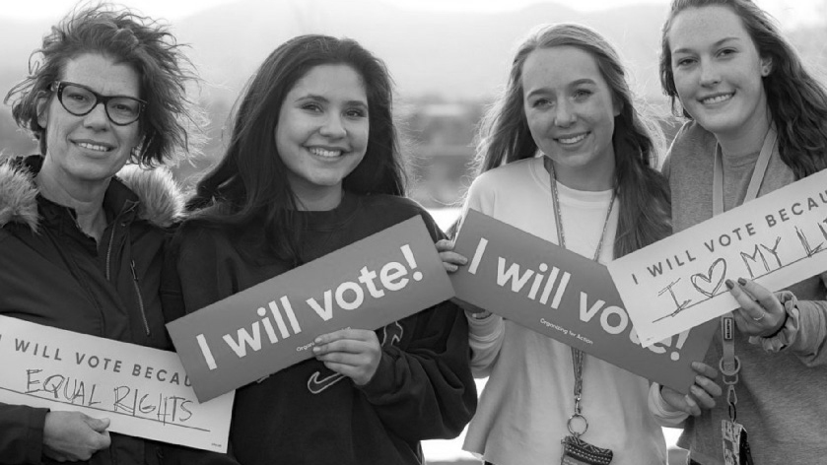
Connecting to OFA
Notes:
11:40 – 11:41 Traci
We have a lot of ways for you to connect with OFA and apply these skills!

Slide 59
Upcoming
In 2018
1
Organizing for ’18
2
  Commit to vote program
3
Online training series
3
Chapter involvement
Notes:
11:41 – 11:45 – Traci
Here are some of the ways we are thinking about this

Slide 60

Debrief
What are your key takeaways?
What are you committing to do or learn? How can OFA support you?
Notes:
11:45 – 11: 50 Alexis
Participants go into work time

Slide 61
Key
Takeaways
1
Women face unique barriers in organizing, but still get it done.
2
When we operate with our strengths and vision, we are more successful.
3
Concrete goals aid us in identifying our progress, and fuel us for the journey ahead.
Notes:
11:55- 11:57 Alexis
Read out key take aways

Slide 62
Thank you for joining
today’s training.
Please fill out the survey below and give us
your feedback on today’s training.
bit.ly/OFA_USOW
Notes:
11:57- 12:00 – whole group appreciation (kevin, alexis, traci)
Reminder to fill out survey; reminder to sign the sign in sheet

