Slide 1
Welcome
We will begin at 7:30 pm Central Time.
Notes:
This work is licensed under the Creative Commons Attribution-NonCommercial 4.0 International License. To view a copy of this license, visit http://creativecommons.org/licenses/by-nc/4.0/ or send a letter to Creative Commons, PO Box 1866, Mountain View, CA 94042, USA

Slide 2
OFA Community
Engagement Fellowship
Spring 2018 / #OFAFellows

Slide 3
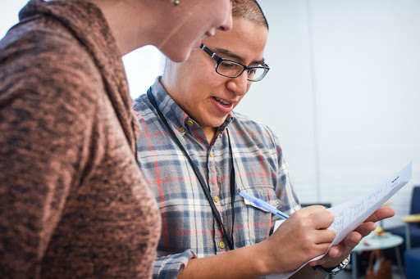
Building coalitions
Identifying and growing partnerships

Slide 4
Tweet today using #OFAFellows
Notes:
Over the span of this week hundreds of fellows will be starting this journey along with you! Using social media to share out your learning and what you are excited about is a great way to build connections that span the country. It is also a super great way to show your personal networks what you’re working on. Who knows, maybe someone will be inspired by you and begin their own organizing journey!

Slide 5
Dana Mayber
Deputy Campaigns Director
@danamayber

Slide 6
Goals for
today
1
Learn strategies for engagement with organizations and partners in your community.
2
Be able to host effective partner meetings that result in actionable next steps.
3
Feel confident being able to grow your organizing work by tapping in to your local community organizations.
Notes:
7:09- 7:10 (1 MINUTE)
[LIZ]
Note--- this is a TYPE of personal story

Slide 7
Agenda for today
Recap from previous week
Establishing new partnerships
Managing partnerships effectively
Practice scenarios
Debrief & next steps
Notes:
7:10- 7:11 (1 MINUTE)
[LIZ]

Slide 8
Week 4: Key takeaways

Slide 9
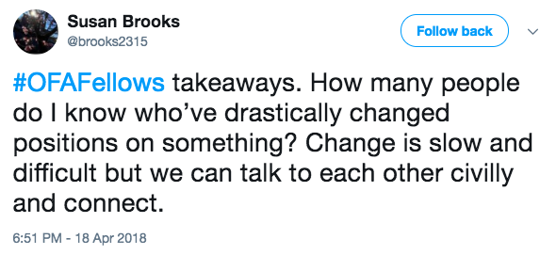
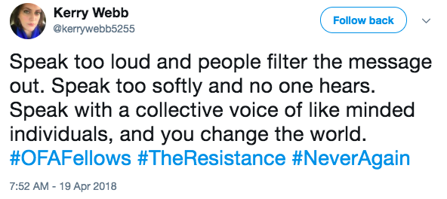
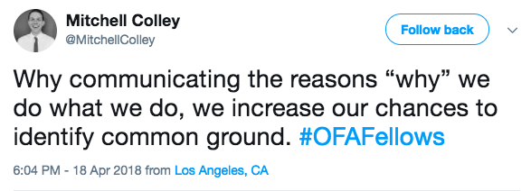
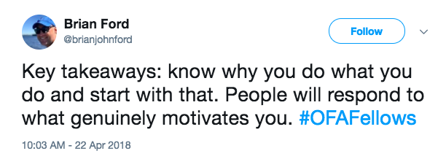
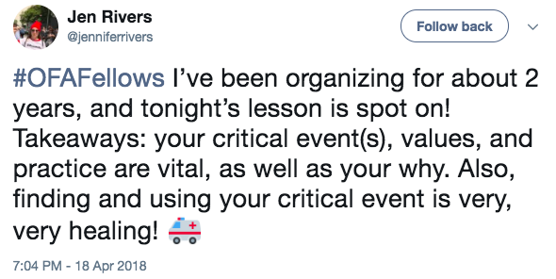

Slide 10
Putting it all together:
The framework of your why
Critical incident
What is a critical incident that leads to what you believe and why?
Values
What values are present underneath your critical incident and why?
Practice
How will you practice communicating your values in way
that resonates with diverse groups of people?
Notes:
ADRIENNE

Slide 11
The Snowflake
Model
1
Structured to empower leadership and delegation of responsibilities.
2
Clear lines of communication and coordination.
3
Working in harmony to accomplish a unifying goal.
Notes:
That’s great! You all have a lot of ideas as to what can happen if you appoint captains to help make your dinner party a success. Here are some ideas, some of which we already covered:
There are clear lines of communication— you are communicating with your captains and getting updates from them. Your captains are making sure their helpers are doing what needs to be done to make your party a success.
There are sustainable ratios—your only have to direct a few people and your captains only have to direct a few people.
The structure can handle change without overwhelming one person. If one of the helpers can no longer attend your dinner party, the captain can make sure that someone else covers for that person. The structure can handle change without overwhelming one person.
It empowers others—people want to help you out! Let them help, but don’t let them overwhelm you by using the snowflake structure.
We call this the Snowflake Model of leadership and this is what OFA uses to organize.
[discussion question] How do you see this being used in the organizing world?

Slide 12
“We’re approaching leadership
as a practice, not leadership as
a position…It’s about accepting responsibility for enabling others to
achieve purpose under conditions
of uncertainty.”
MARSHALL GANZ

Slide 13
Agenda for today
Recap from previous week
Establishing new partnerships
Managing partnerships effectively
Practice scenarios
Debrief & next steps
Notes:
7:10- 7:11 (1 MINUTE)
[LIZ]

Slide 14
Why do we want to partner
with other organizations?

Slide 15
Pooling resources makes
us all more effective!

Slide 16
Every organization has unique strengths and weaknesses.

Slide 17
By partnering strategically,
we can reinforce strengths and minimize weaknesses.

Slide 18
Generally, partnerships create a more vibrant and sustainable movement.

Slide 19
Establishing
partnerships
Do your research
Hold 1:1 meetings
Find coalition tables
Notes:
We’re about to move on to introducing the Snowflake Model, next we will discuss how we use the snowflake model, then we’ll have a debrief and identify key takeaways
So let’s get started!

Slide 20
Establishing
partnerships
Do your research
Hold 1:1 meetings
Find coalition tables
Notes:
We’re about to move on to introducing the Snowflake Model, next we will discuss how we use the snowflake model, then we’ll have a debrief and identify key takeaways
So let’s get started!

Slide 21
Establishing
partnerships
Do your research
Hold 1:1 meetings
Find coalition tables
Notes:
We’re about to move on to introducing the Snowflake Model, next we will discuss how we use the snowflake model, then we’ll have a debrief and identify key takeaways
So let’s get started!

Slide 22
Establishing
partnerships
Do your research
Hold 1:1 meetings
Find coalition tables
Notes:
We’re about to move on to introducing the Snowflake Model, next we will discuss how we use the snowflake model, then we’ll have a debrief and identify key takeaways
So let’s get started!

Slide 23
What is a coalition table?
Recurring meeting of individuals, representative from groups and community organizations with common interests and goals.
Provides space for updates and discussion on messaging, calendars, and tactics.
Concludes with agreed upon actions and next steps.
1
2
Do your research
Hold 1:1 meetings
Find coalition tables
3
Notes:
We’re about to move on to introducing the Snowflake Model, next we will discuss how we use the snowflake model, then we’ll have a debrief and identify key takeaways
So let’s get started!

Slide 24
Joining a coalition table
Identify key decision makers. Ask!
Become a regular and contribute.
Bring the doughnuts or host the space.
Sweep the floor. Do the tough jobs.
Under promise, over deliver.
Hold 1:1 meetings
Notes:
We’re about to move on to introducing the Snowflake Model, next we will discuss how we use the snowflake model, then we’ll have a debrief and identify key takeaways
So let’s get started!

Slide 25
Share out
What are other ways you’ve identified new potential partnerships?
What did you do to nurture and grow these relationships in order to be productive?
What are some of the biggest challenges you’ve faced when meeting new partners?

Slide 26
Agenda for today
Recap from previous week
Establishing new partnerships
Managing partnerships effectively
Practice scenarios
Debrief & next steps
Notes:
7:10- 7:11 (1 MINUTE)
[LIZ]

Slide 27
What does a 1:1 look like?
Face-to-face; or rarely, over the phone.
Notes:
We use the snowflake model because it works!

Slide 28
What does a 1:1 look like?
Face-to-face; or rarely, over the phone.
Scheduled beforehand.
Notes:
We use the snowflake model because it works!

Slide 29
What does a 1:1 look like?
Face-to-face; or rarely, over the phone.
Scheduled beforehand.
Purposeful; 1:1’s always have a clear agenda.
Notes:
We use the snowflake model because it works!

Slide 30
What does a 1:1 look like?
Face-to-face; or rarely, over the phone.
Scheduled beforehand.
Purposeful; 1:1’s always have a clear agenda.
Educational; you should listen as well as guide the conversation.
Notes:
We use the snowflake model because it works!

Slide 31
What does a 1:1 look like?
Face-to-face; or rarely, over the phone.
Scheduled beforehand.
Purposeful; 1:1’s always have a clear agenda.
Educational; you should listen as well as guide the conversation.
Follow-up; they always end with clear next steps.
Notes:
We use the snowflake model because it works!

Slide 32
Understanding the 1:1
What are some of the reasons you’d have a 1:1 meeting?
1
Individual reflection and sharing
2
When would we want to connect with others through 1:1’s instead of in bigger groups?
3
What must we do to consider the 1:1 a successful meeting?
Notes:
We use the snowflake model because it works!

Slide 33
What is the ultimate goal of a 1:1?
1
Develop deep relationships to generate trust and accountability with partners who want to get involved.
2
Better understand the resources, capacity, strength, and challenges our partners face in order to learn how we can work best together.
3
Make the hard ask so that partners will commit to get involved and join our organizing efforts.
Notes:
We use the snowflake model because it works!

Slide 34
Logistics, agenda, and flow

Slide 35
Some logistics to keep in mind
Typically 30-45 minutes long.
In a quiet, sit-down location (café, office, etc.)
Scheduled and purposeful, not general chit-chat.
Gather information, share values.
Create an opportunity to get involved!
Notes:
We use the snowflake model because it works!

Slide 36
The flow of a 1:1
Connect / Respect
1
2
Listen / Empower
3
Ask / Include
Notes:
We use the snowflake model because it works!

Slide 37
The flow of a 1:1
Connect / Respect
Connect their story and your story into the larger story of OFA.
Remind that individual actions will lead to lasting change.
Develop a shared passion into the urgency of acting now.
Weave their local community into the national movement.
1
Notes:
We use the snowflake model because it works!

Slide 38
The flow of a 1:1
Listen / Empower
What change do they want to see in their community, in our national dialogue, in the way we relate to each other?
How do they want OFA and like-minded organizations to play a part in making this change?
How do they view themselves as being the change they seek?
2
Notes:
We use the snowflake model because it works!

Slide 39
The flow of a 1:1
Ask / Include
A 1:1 only leads to real change if the individual chooses to get involved.
Be ready with multiple asks, multiple ways they can get involved.
Specificity and details matter. People want to know what they are signing up for!
We can only make things better if people like you get involved!
3
Notes:
We use the snowflake model because it works!

Slide 40
Sample 1:1
agenda
Align on purpose of the meeting.
Share each other’s personal story.
Make connections—what is their passion? What do we have in common?
Ask for feedback—what do they need to get involved?
Make the hard ask
Next steps!
Notes:
We use the snowflake model because it works!

Slide 41
Managing your partnerships

Slide 42
Managing
partnerships

Slide 43
Managing
partnerships
Reinforce your theory of change
Under promise, over deliver
Negotiate
Know your role
Don’t always be right
Develop trust
Never burn a bridge
Notes:
We’re about to move on to introducing the Snowflake Model, next we will discuss how we use the snowflake model, then we’ll have a debrief and identify key takeaways
So let’s get started!

Slide 44
Agenda for today
Recap from previous week
Establishing new partnerships
Managing partnerships effectively
Practice scenarios
Debrief & next steps
Notes:
7:10- 7:11 (1 MINUTE)
[LIZ]

Slide 45
Partnership scenarios
Shout out!
Scenario 1:
Your campaign has been organizing a rally in an area that is conservative and crucial to your campaign. After almost a month of organizing for the event, another group has asked that your campaign not be listed as an event sponsor because the organization is seen as “too liberal” and could hurt the campaign in such a conservative area of the state.
What would you do?

Slide 46
Partnership scenarios
Shout out!
Scenario 2:
One of your key targets is hosting a town hall event next week. One of coalition partners is proposing that groups show up and intentionally cause disruptions and engage in civil disobedience inside the town hall to derail the event. Based on your target’s motivations and your guiding theory of change, you and several other members of the coalition don’t think this is an appropriate tactic at this point in time.
What would you do?

Slide 47
Partnership scenarios
Shout out!
Scenario 3:
Your campaign and several partner organizations planned a Day of Action several weeks from now. You’re planning several large canvasses to get the word out about your campaign and ask voters for their support. You’re also planning to pitch these canvasses to local press to get earned media for your campaign. Another organization has decided to host a press conference the same morning, featuring teachers who support the same issue you’re working on. They will be inviting all of the major local news outlets to cover the press conference.
What would you do?

Slide 48
Agenda for today
Recap from previous week
Establishing new partnerships
Managing partnerships effectively
Practice scenarios
Debrief & next steps
Notes:
7:10- 7:11 (1 MINUTE)
[LIZ]

Slide 49
Debrief
What questions do you have establishing or managing partnerships?
What questions do you have regarding 1:1 meetings?
How will you apply this to your future organizing work?

Slide 50
What are your key takeaways?
Type in the chat and tweet using #OFAFellows

Slide 51
Weekly assignment: Due Wednesday, May 2
ofa.us/get-trained/fellows-2018-spring-fellowship
1
What organizations do you need to get involved in your work?
What coalition groups or tables can you join?
What will be your hard ask? What resources can you offer partners?
What are your next steps?
2
3
4

Slide 52
Thanks for joining the call!
Please fill out the evaluation on today’s training using the link below.
bit.ly/Spring5-2018
Email fellows@ofa.us with any questions.

Slide 53
Thank you!

