Slide 1

Welcome
We will begin at 7:30 pm Central Time
Notes:
This work is licensed under the Creative Commons Attribution-NonCommercial 4.0 International License. To view a copy of this license, visit http://creativecommons.org/licenses/by-nc/4.0/ or send a letter to Creative Commons, PO Box 1866, Mountain View, CA 94042, USA

Slide 2
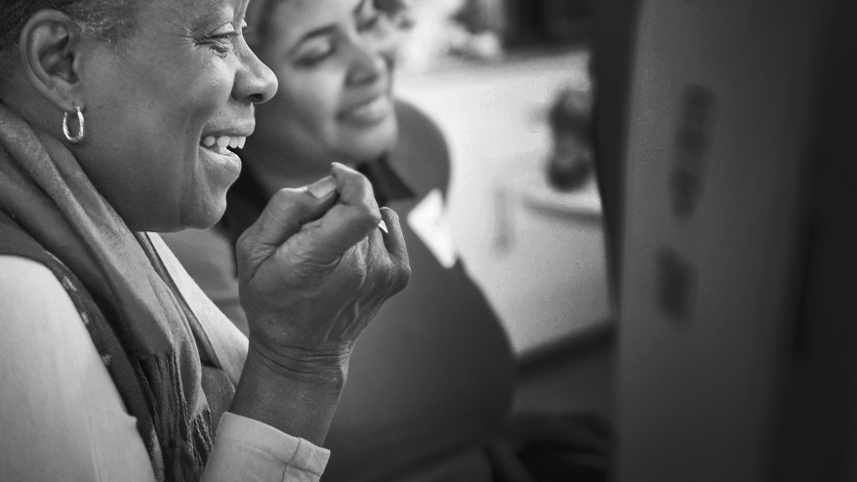

OFA Community
Engagement Fellowship
Summer 2018 / #OFAFellows
Notes:
Deputy director of organizing and community engagement

Slide 3
Tweet today using #OFAFellows

Slide 4
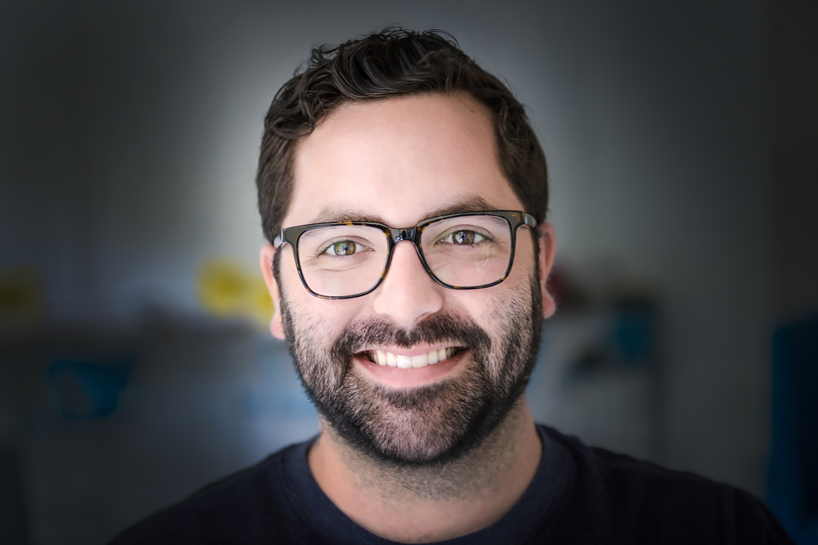
Alex Skozen
OFA Social Media Manager
Notes:
Fun facts –
I’m from Jupiter Florida
Master’s in WGS – I’m really passionate about trying to create a more equitable world
Before coming to OFA – I organized young people in CPS; worked in the education dept of IHMEC; worked as a researcher for DePaul university
Now I teach a pop culture class at one of the community colleges in Chicago
I come from a family of park rangers and teachers and it has fueled my passion for learning and teaching.
I was born in key west.

Slide 5
Slack!
bit.ly/FellowsJoinSlack

Slide 6
Week 3: Key takeaways

Slide 7
Quality vs. Quantity
Notes:
7:27- 7:27 [0 minutes]
Let’s break down the golden circle!

Slide 8
Combine persuasive conversations with voter contact best practices!
Notes:
7:28- 7:28 [0 minutes]
Now let’s talk about the How.

Slide 9

Accountability to vote
Reminds voters of the norm of voting Increases the likelihood that someone will vote
Pledging to vote
Voters who pledge to vote are more likely to turnout than those who don’t intentionally do so
Vote planning
Vote planning effectively cuts past “fast thinking” reactions of voters in conversations. A majority of sporadic voters will say “yes I will vote,” but may not intentionally plan to
Why turnout conversations?
*Source: Analyst Institute

Slide 10


GUIDED WORKSHEET
Digital organizing
Bit.ly/DigiWorksheet
Notes:
If you’d like to follow along, here is a guided worksheet to use. We will also email this out in our recap after this training.

Slide 11
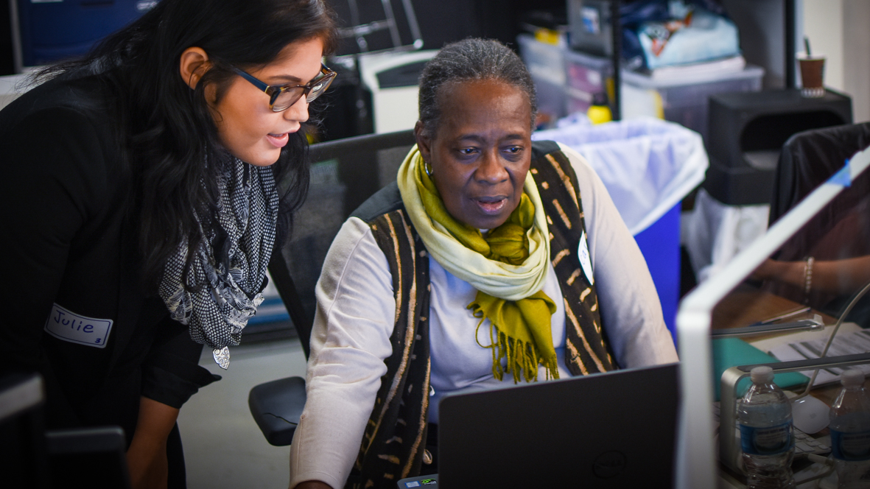
Digital organizing
Recruitment & storytelling

Slide 12
Goals for today
Understand the role social media plays in sharing the story of your organizing online
Be able to tell the story of your work on social media
1
2

Slide 13
Agenda
Why digital?
Producing content
Peer review
Debrief & next steps
Notes:
7:10- 7:11 (1 MINUTE)
This is our agenda for the day! It will help us to accomplish the goals we laid out in the previous slide. First, we’ll talk about what social media is and how organizers can use it to support and amplify their work. Next, we’ll dive into a few best practices for actually creating content. And then we’ll spend some time putting it into practice, giving feedback, and then wrap up and close.

Slide 14

What’s the power of social media?
Type in the chat box
Notes:
Ask first, answer chats, then share below
Social media can be isolating but it can also serve as a way of finding your people. There are thousands of conversations happening in real time all around us. And the platforms we have at our disposal are a way to join those convos, share why that conversation is relevant to you, and be a signal to those who follow you that breaks through the noise.

Slide 15
So what is
“social media”?
Notes:
OK, so maybe it would be helpful to take a step back and actually define what social media is… we all probably have an idea of what it is, but let’s just take a minute to break it down so we can have a starting place for how to use it

Slide 16
Social media are tools or platforms that allow the sharing of information and content and the formation of communities through online and mobile networks of people.
Notes:
So this is the AP Style Book’s definition: Social media refers to tools that allow the sharing of information and content and the formation of communities through online and mobile networks of people.
Why is this perfect for organizers? Because they’re built almost specifically with the tasks of organizers in mind. As organizers, as activists, as community leaders, we’re here to build and strengthen communities, develop relationships, and expand our networks. The larger our networks and the stronger our relationships, the more power we have to mobilize together and effect real, lasting change.

Slide 17

Notes:
There are a ton of different examples of social media and new ones are being developed all the time. But you’ve probably heard of some of the largest and most common.
There are social networks (Facebook and LinkedIn), blogs, micro-blogs (Twitter), Wikis, photo&video-sharing services (Flickr, Instagram, and YouTube), messaging apps (Snapchat, WhatsApp, Groupme), online forums (Reddit, Quora), pinboards (Pinterest), and all sorts of other sites, from dating services to collaborative essay-writing projects.

Slide 18
But why do *you* use social media?
Type in the chat box
Notes:
THIS is an excellent question – vvv excited to hear your answers.

Slide 19
Rings of engagement
Notes:
OK, not those kind of engagement rings. Some of you may have hear the term “ladder of engagement” before in reference to organizing. For those who haven’t, it’s essentially referring to the spectrum of engagement that a person can have within the work of organizing, with a non-participant, unengaged person on one end and a fully-engaged community leader on the other.
I like to imagine the ladder as concentric circles or rings, with the lowest level on the ladder—the lowest level of engagement—as the farthest ring and the most engaged advocates and organizers at the center. Those organizers, those community leaders, those folks running for office.
Our job, as advocates and organizers, is to bring folks closer to the center—to get that casual observer who may potentially be passionate about an issue to start engaging on that issue.
And while social media can play a role on EVERY ring…

Slide 20
Social Media
Notes:
… it has a UNIQUE role on the outer rings. Why? Because that’s where the most people are located and that’s where social media’s strength comes in—millions of people are already there. Just as you want to go fishing where the fishes are, we want to use social media as a tool to connect where our potential target audiences are—people who are watching what’s going on, but may not know exactly what’s happening or what the next steps should be. But you do! You, as organizers, know the next steps for getting involved.
So we use social media not only to stay informed and to connect with others, but to organize. To bring people in and, when the time comes, mobilize them to take action.
QUESTION: Which ring do folks think email would fall on this illustration?

Slide 21
Email
Notes:
ASNWER: Closer to the center.
EMAIL, as an organizing platform, plays a larger role closer towards the center. Why? Because it requires a little more engagement. People have invited you into their personal email. It feels more like a one-on-one conversation. And there’s more room for your message—to explain, persuade, and inspire. Also, instead of just hoping that your followers scroll by your social media post, with email, people can choose to open your note at their convenience.

Slide 22
Social media
strengths
Point of entry
Ready-made tools for grassroots advocacy
Connect with others
Lift each other up
Notes:
Social media is a tool or a set of tools ready-made for grassroots advocacy. So, as organizers, we should try to view it that way. View it as a way to tell our stories, our values, our message. View it as a way to organize AND mobilize.
So… even on social media
On the ladder of engagement, participation is low on the level of difficulty. It’s easy to sign up, it’s easy to follow, like, comment, share. organizers, we show up on social media – and social media provides a public forum for you to do just that. To tell your personal story. To tell truths. To make arguments. For millions of people, social media is one of the best entry points into organizing, into supporting your cause. Let’s use that entry point to our advantage.
Connect – build out your networks, connect with other passionate people, form groups, create lists
Lift each other up – be a good leader by being a good follower. Give other an excuse to join in and help build that momentum. FB and Twitter both have ways to share

Slide 23
Social media
strengths
Point of entry
Ready-made tools for grassroots advocacy
Connect with others
Lift each other up
Notes:
We show up – social media provides a public forum for you to do just that. To tell your personal story. To tell truths. To make arguments
Connect – we use social media not only as a way to complain about airlines, but as a tool to build out our networks, connect with other passionate people, form groups, create lists. One of the best features about Twitter is that you can easily reach people who are not in your immediate network like other platforms. There are millions of conversations happening, gaining momentum, trending. Use these conversations, where folks are discussing issues they care about to engage, connect, share resources, and…
Lift each other up – be a good leader by being a good follower. Give other an excuse to join in and help build that momentum. FB and Twitter both have ways to share

Slide 24
Social media
strengths
Point of entry
Ready-made tools for grassroots advocacy
Connect with others
Lift each other up
Notes:
We show up – social media provides a public forum for you to do just that. To tell your personal story. To tell truths. To make arguments
Connect – we use social media not only as a way to complain about airlines, but as a tool to build out our networks, connect with other passionate people, form groups, create lists
Lift each other up – You can be a good leader by being a good follower. Participate. See something you like? Like it, share it, tag others—get your networks involved. Be an excuse for your friends to join in and help build that momentum. The thing about social media is that it’s super easy to share and most platforms have built in algorithms that will increase the visibility of posts with more engagements. So engage!

Slide 25
Strengths of
Social Media
Uses for
Organizers
Millions of people communicating, sharing, ready to engage.
Public forum, real-time conversations, trending topics, and breaking news.
Low-level engagement like sharing and liking is easy.
An easy point-of-entry for potential supporters.
Gives organizers a platform to tell our stories, make our case, and find shared values.
Connect with folks, build networks, lift each other up, share resources, organize.
Notes:
In review

Slide 26
Agenda
Why digital?
Producing content
Peer review
Debrief & next steps
Notes:
Ok so we talked about the “why” -- now let’s talk about the ”how” and “what”

Slide 27
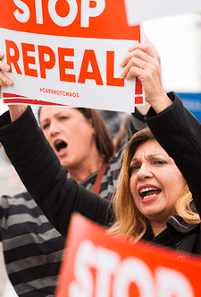
Messaging & Mobilizing
As organizers, our strongest asset is our relationship with the people in our own communities—our own networks.
Digital organizing uses social media and other digital tools to help us strengthen those relationships and expand our networks.
Notes:
This is why Alexis encourages you to use #OFAFellows – you’re building messaging to your followers about what you’re up to, why you care about it, and connecting with others along the way (and so I Alex Skozen can see it, amplify it, and show that people are engaged and IN. IT.)

Slide 28
KEY PRINCIPLES OF DIGITAL ORGANIZING
Authenticity
Relevance
Impact
Notes:
These are relevant to both my work as the voice of an organization, but they’re just as important for you to use in your day-to-day work.
authenticity: as an example, whenever I’m training new employees or volunteers on “tone of voice” for social media, I always say “Speak like a human, tweet like a human.” Which is to say: than an authentic voice (i.e. your voice) is essential. People will tune out if what you’re talking about doesn’t feel genuine. But that’s probably not a problem for y’all, because you wouldn’t be on this call, or in this program, if you didn’t genuinely care about the work you’re doing.
Relevance: we’ve talked about the issues ecosystem (kick to Alexis to recap). From my perspective as someone who looks at metrics and engagement rates and post performance stuff all day, I can tell you that if you want to make an impact, you have to meet the moment. Email team for example. If I can be the first out of the gate on social with breaking news (or a take on that news), other ppl will see that and hopefully carry that conversation forward. Not that you should be tweet-ready constantly, but you should stay as well-informed as possible and plugged into the issues that are happening.
Call-to-action: research shows that progressives feel bogged down and hopeless – OFA tries to always to offer a glimmer of hope through action (sign-ons/call asks/petition signings/etc) – kick back to Alexis, anything I’m missing?

Slide 29
Crafting your message

Slide 30
At the core of any relationship is one thing:

Slide 31
At the core of any relationship is one thing:
Trust.
Notes:
Keep the principles of Authenticity/Relevance/Impact in mind while crafting your message, because the online relationships you have are built on trust.

Slide 32
If you do not trust a brand, or organization, you are likely not going to take action or respond.
Notes:
To the fellows: Any thoughts on social media accounts who DON’T do these things? What do they look like? Please don’t name names, but let us know.

Slide 33
And if your list does not trust you, you have no chance at mobilizing them to action.
Notes:
So going back to the previous question, why do you want to avoid the bad practices we just talked about?

Slide 34
KEY PRINCIPLES OF DIGITAL CONTENT
Keep it short, keep it simple
Show, don’t tell
Include an ask and a hashtag
Notes:
Generally people don’t hop onto Twitter or FB looking to do something else like call their Congressperson – ppl are looking to scroll through. So big blocks of text maybe aren’t always the best. Like when you see a 20-sentence long text message, you get alarmed.
We’ll dig into this a bit more later, but photo and video content have been shown to majorly increase engagement on your posts -- 300% and up on Twitter and I think even more on FB. Not just because ppl will stop and look, but because those platforms KNOW when ppl stop and look, and they want you to stay on their platforms so they promote photo/video/catchy content purposely. Asking ppl to get involved is a big ask, but showing pics makes it far more accessible. Even if YOU don’t think that phone-banking is sexy enough for a photo, I do. ;-)
So we went over the ”ask” or providing-of-resources portion a few slides ago, but including a hashtag is of course another great way to insert yourself into the conversations that are happening and be the signal in the noise

Slide 35
Shout out:
What’s worked? What’s been challenging?
Notes:
This can be tricky/an ongoing practice – what do you folks think?

Slide 36
Let’s dig into an example
Notes:
Social can feel frivolous, but organizing and sharing your personal story is important work. Here’s someone who does it really well.
We’re about to watch a video featuring Kendall Brown, full-disclosure a former OFA-er, and someone who’s incredibly talented at telling her story on social media.

Slide 37


Slide 38
What stands out?
Notes:
(Check chatbox, see what folks are saying)
-We hear her ”why” – this is what’s powerful about it.

Slide 39
THE IMPACT OF SOCIAL MEDIA:
“Using the internet and social media to try to effect change, it really started because I felt like I had...a countdown. I had roughly six months to live. And if they didn’t change their minds in that amount of time, that was it.”
Notes:
This is a direct quote from Kendall. (She’s still here btw)

Slide 40
Let’s review two social
media posts.
What do you like about
them? What do you think
the goal of each post is?

Slide 41
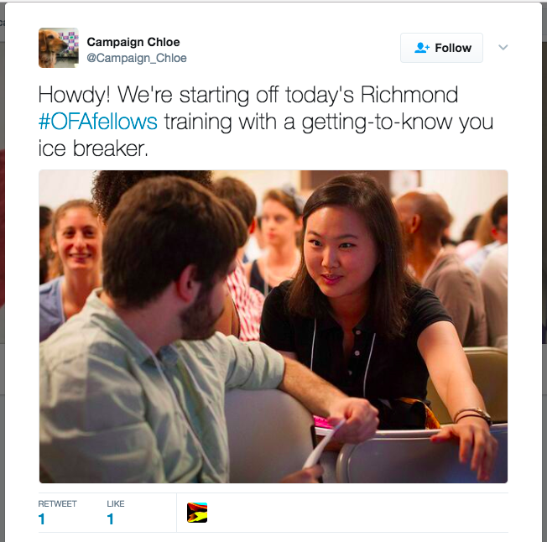
Post 1
Notes:
Pause after this one – what’s good here?

Slide 42
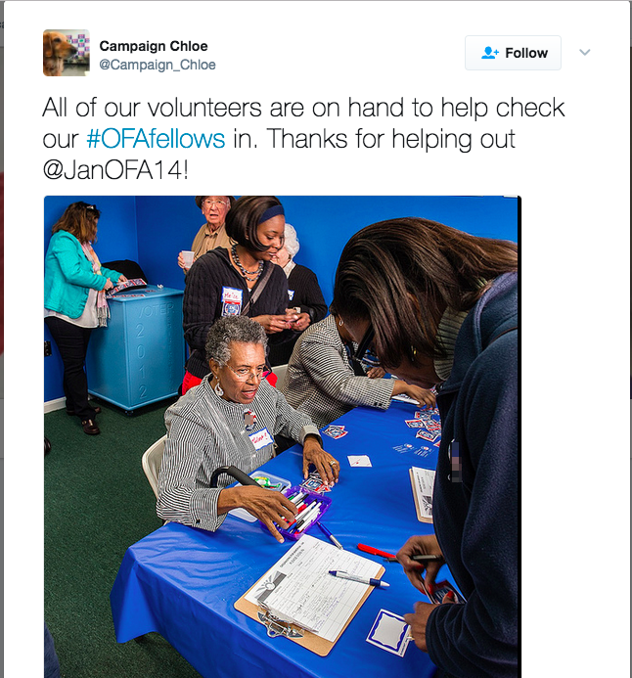
Post 2
Notes:
Anything they could improve on? Pause here as well?

Slide 43
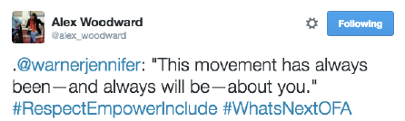
Keep it short
What do you want to say?
Pick one point per post.
Notes:
-touch on the period

Slide 44
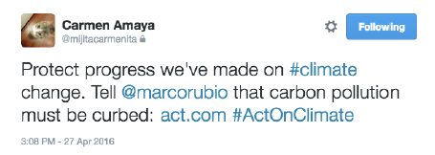
Keep it short
What’s the point of this post?
Notes:
-tagging your rep and applying pressure (just like Kendall did)

Slide 45
Keep it short
What’s the point of this post?
Action: Tell Marco Rubio to act on climate.
Notes:
-and it has an action!

Slide 46
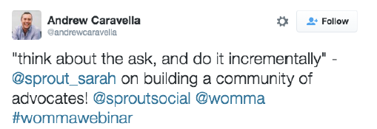
Keep it short
What’s the point of this post?

Slide 47
Keep it short
What’s the point of this post?
Share content of training.
Notes:
This is so meta. We’re in a training, talking about sharing content from a training. (And this is your reminder to tweet using #ofafellows)

Slide 48
What do you want to say?
Pick one point per post.
Notes:
This goes back to our principle of “keep it simple”

Slide 49
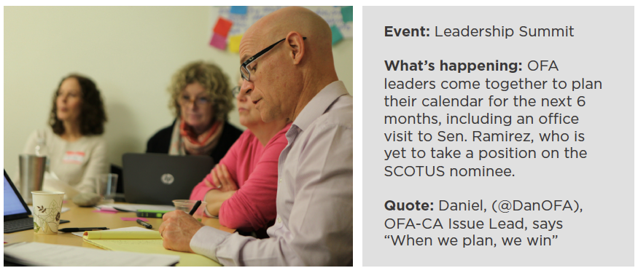
3 minutes
You are at this action planning meeting. Write a tweet that is
short and that shows what is happening at the meeting.
Notes:
Kick it to Alexis for activity time – follow up with some chatbox q&a

Slide 50
You might not be a
professional photographer
But you can be a good one
Notes:
You might not be a professional photographer, but you can be a good photographer—and you don’t need a fancy camera. Combined with free apps, today’s camera phones are convenient enough and perform well enough to capture excellent photos. Our phones make this so easy! Also we fully have a toolkit on this so check it out.

Slide 51
The photographer’s mantra
1
Fill the frame
Notes:
These three rules should guide the photos you take
Make sure the frame (what you see through your viewfinder or on your phone screen) is filled with the elements you want a viewer to see. If an element doesn’t need to be in the photo, make sure it’s out of the frame

Slide 52
The photographer’s mantra
1
Fill the frame
2
Control the background
Notes:
Make sure the background doesn’t distract from the message you’re trying to convey in the image. The background should enhance the image—it should provide a viewer with more information about the place, time, story, or emotion of the scene.

Slide 53
The photographer’s mantra
1
Fill the frame
2
Control the background
3
Wait for moments
Notes:
Once your frame is filled and the background is controlled, wait to take the perfect shot. This could be when a crowd erupts in cheers, when two people hug, or when a speaker passionately raises their arms. If there’s a lot of action in your frame, take multiple shots—or bursts of photos—to increase your chances of catching that perfect freeze-frame.

Slide 54
Adjust for the
lighting in your surroundings.
Notes:
If they’re in front of a window or lamp they’ll come out dark. Move to the side to another angle where they will be better lit. If they’re in front of a window or lamp—or the sun—they’ll come out dark. So you should move to get another angle where they will be better lit. The number one reason by photos turn out blurry is because there isn’t enough light. So if your photos are blurry see what you can do to get where there is more light.

Slide 55
Adjust for the
lighting in your surroundings.
Move yourself to
get varied shots or compose a scene.
Notes:
“Crop with your feet”
Instead of using the zoom functionality of your camera—which can result in grainy or blurry photos—move your feet to get closer to your subject. If there’s something distracting on the side of the frame or in the background, move yourself up, down, le , or right to try to eliminate the distracting element.
Change your angles
Take photos from different heights and different angles. Get low and photograph a crowd of protesters from below. Get up high to show all the contents on a table of letter-writers during a letter-writing event.
Vary your head sizes
One good indicator of photo variety is if head sizes are different between your shots. Focus on getting a mix of detail, medium, and wide shots, crop with your feet, and change your angles to allow for more variety.

Slide 56
Take your best shot
Notes:
The type of photo you take can speak volumes about the action you’re documenting

Slide 57
Detail shots
These are close-up images where the frame is filled with a limited amount of information.
It could be a close-up of rally signs, hands folded in someone’s lap, or pens and petition forms on a table.
Use case: during event set up, before much of the action takes place

Slide 58
Medium shots
These shots show a wider frame of view than details shots, and may include a single subject or a small group. These are shots of conversations, moments between individuals, or interaction amongst a small group.
Use case: these should feel intimate, like the viewer is in the midst of the action.

Slide 59
Wide shots
These shots convey the scale and scope of an event or moment. The size of a crowd, the flurry of action at an event, the energy of the group. They are used to provide context—time of day, season, and geographic and physical location.
Use case: These are less intimate than medium shots, but can convey a sense of awe that medium shots might not.

Slide 60
Portraits
These shots show who the people at your event are. These can be OFA volunteers, community members you’re interacting with, guest speakers, or even members of the media conducting interviews. Portraits focus on a single individual or a small group. A viewer should be immediately drawn to the individual in the photo, and not to other elements in the frame.

Slide 61
Rule of thirds
Imagine your frame is divided into nine equal boxes by two equally spaced vertical and two equally spaced horizontal lines. Placing the subject of your photo at the intersections of these lines (where the orange dots are) can create more visual interest—which helps hold a viewer’s attention.

Slide 62
Need more?
Check out OFA’s Toolkits & Resources
ofa.us/resources

Slide 63
ofa.us/resources
Notes:
More resources available here to make your work even better – we think about these things a lot, okay?

Slide 64
Agenda
Why digital?
Producing content
Peer review
Debrief & next steps
Notes:
Pass it back to Alexis for an activity!

Slide 65

5 minutes
For this activity, draft a tweet to your social media network about the Fellowship.
Keep this in mind:
  Keep it short
  Show don’t tell
  Interact with your network

Slide 66
Let’s check twitter
Notes:
Time for Skozen to jump in talk about what good examples there are out there! (Kick it back to Alexis for debrief and next steps)

Slide 67
Agenda
Why digital?
Producing content
Peer review
Debrief & next steps
Notes:
Alexis wrap-up: see you on Twitter and Slack!

Slide 68
Using your Twitter account,
tweet your biggest takeaway from tonight using #OFAFellows

Slide 69
OFA Training
Thank you for joining today’s webinar.
Email fellows@ofa.us with any questions.
bit.ly/Summer4-2018
Notes:
!!!!
NOW THAT THE TRAINING IS OVER:
-my personal ask to you is that you spread resources as much as you can – we need megaphones all over the place making sure people know how to get registered, where/when/how to vote, get educated on the issues, check out ballotready.org
-GET ON OUT THERE FOLKS

