Slide 1


Welcome
We will begin at 7:30 pm Central Time.
Notes:
This work is licensed under the Creative Commons Attribution-NonCommercial 4.0 International License. To view a copy of this license, visit http://creativecommons.org/licenses/by-nc/4.0/ or send a letter to Creative Commons, PO Box 1866, Mountain View, CA 94042, USA

Slide 2

OFA Community
Engagement Fellowship
Summer 2018 / #OFAFellows

Slide 3
Tweet today using #OFAFellows
Notes:
Over the span of this week hundreds of fellows will be starting this journey along with you! Using social media to share out your learning and what you are excited about is a great way to build connections that span the country. It is also a super great way to show your personal networks what you’re working on. Who knows, maybe someone will be inspired by you and begin their own organizing journey!

Slide 4

Goals for today
1
Be able to synthesize the main takeaways of the community engagement fellowship.
Feel prepared for the next steps of your fellowship.
To begin to formulate your plan for staying involved in the progressive movement.
2
3

Slide 5
Agenda
Review the fellowship learning journey
Discuss graduation requirements
Staying involved with OFA and the progressive movement
Debrief and close
Notes:
00:18 – 00:19 [1 min] – Aquiles
[Broad Goals] Review post-training agenda
We cannot cover everything you will need to know today.
That is why we have a post-training agenda for you
Review key dates and webinars

Slide 6
You’re joining something big.
We accepted over 450 applicants from across the country for the summer fellowship.
Fellows represent 43 states.
Over 47% of fellows are new to organizing (less than 1 year of experience).
You’re joining thousands of OFA training alumni
Notes:
You are part of something bigger
2 Mins
But accomplishing these goals will only happen if you know that you are part of something bigger
Alongside you, this week, we are onboarding fellows in 28 programs and we have fellows from 24 states across the country. Together you make up the spring 2018 OFA Fellowship Class.
Even though you will work locally here, you will join weekly online trainings with the rest of your class.

Slide 7
Notes:
Here is where we come from. If you’ve ever doubted that there are folks across the country who care about what you care about take stock in this map. I read through nearly 900 applications and what I saw was people who were feeling deeply provoked by the gun violence in this country or the familiar separation at the border. Or, more locally, about access to affordable and fresh foods, or economic opportunity for folks historically disenfranchised. Climate change
See this map makes me so certain that the folks in this fellowship are the people that are going to be making a big impact. Like you all are the right people.

Slide 8
Our big goals
1
To equip individuals with the skills to identify the root problems affecting the health of their community.
To illustrate pathways towards making a strategic, local impact on these identified root problems.
To connect the drive to take action with a concept of leadership that empowers individuals to become transformative organizers.
To foster a deep sense of community within the fellowship cohort and OFA at large.
2
3
4

Slide 9
OFA’s core purpose

Slide 10
OFA’s core purpose
To create a more accessible and participatory democracy

Slide 11

5 minute
reflection
Craft a movie title and plot description that reflects your personal experience during the fellowship?

Slide 12

What’s your movie title?
Type in the chat box

Slide 13
Where we’ve been

Slide 14
Your learning journey
Week 1: Welcome to organizing

Slide 15
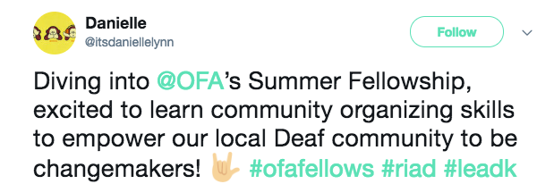
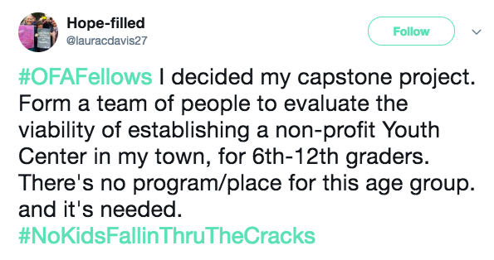
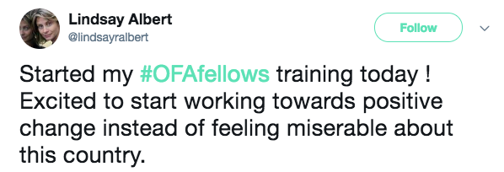
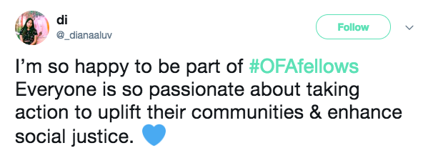
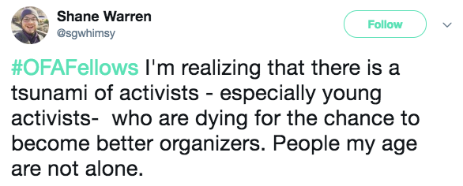
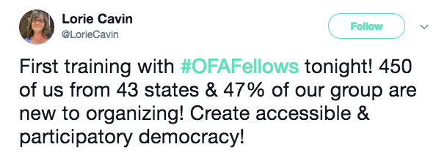
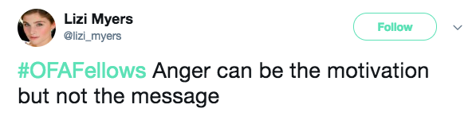
Notes:
Develop a sense of belonging with each other, OFA, and the communities we are forming.
Align on the purpose, scale, and scope for the Fellowship, and the resources you’ll have at your disposal.
Analyze root problems in our community and begin proposing ways to address them.

Slide 16
Finding your thing
Passion
Skill
Need
Notes:
What are you talented at that you can provide to this work?

Slide 17
Four steps to identify a root problem
1
How do we define a healthy community? How do we know it when we see it?
What resources are our communities currently lacking? What challenges are they facing?
Why do they lack these resources? Why are they facing these challenges?
What can we do about it? What resources do we have?
2
3
4

Slide 18
Your learning journey
Week 1: Welcome to organizing
Week 2: Leading with your values & telling your personal story
Notes:
Here is where we will link up your learning and talk about what is next for you. How to stay involved with OFA and how to apply these skills moving forward in your community.

Slide 19
Challenges to persuasion
Personal Anxiety
Interpersonal differences
Fractured political context
The “ask” typically associated
Notes:
7:18- 7:19 [1 MINUTE]
[TRACI]
Personally, I am always terrified by the ask – that’s it’s going to be something I really don’t want to do, like make phone calls. Just in general I don’t really like talking on the phone, especially to strangers, so the thought of making calls is stressful for me. But that is one of the “typical” asks, so – as a personal reflection – think about what you can do to help mitigate that kind of anxiety in your conversation.

Slide 20
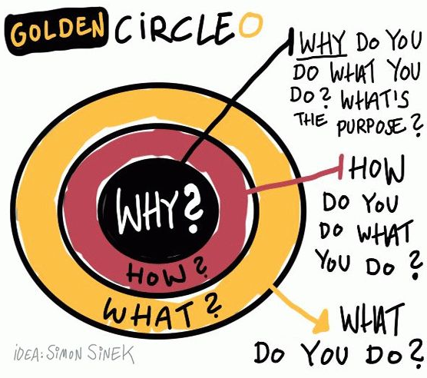
Notes:
7:23- 7:26 [3 minutes]
[TRACI]
Discussion of WHY, HOW, WHAT
What we to convey is that if you start with your belief and communicate your WHY, it will resonate with people in the way a WHAT never can. So, the order is important here as well – you need to start with your WHY in order to be able to start to build a connection based on shared values, then move outward.
Because the WHY is what moves YOU – it is the core thing that makes you tick. It is your reason to get out of bed. It’s the thing that you might have subconsciously operated with but not likely articulated out loud
HOW: ‘How’ is your theory of change – it is the way that you believe your why can come into the world
WHAT: ‘What’ is the thing that you are now doing as a result of your how – it is your specific actions associated with your theory of change.
In politics, we frequently start with WHAT which is not how you can easily connect with people – it tends to be superficial and can feel inauthentic.
If we take this model presented by Simon, then you can see how it shakes out with organizations as well. Here’s a couple of examples to compare and contrast.

Slide 21

Putting it all together:
The framework of your why
Critical incident
What is a critical incident that leads to what you believe and why?
Values
What values are present underneath your critical incident and why?
Practice
How will you practice communicating your values in way
that resonates with diverse groups of people?
Notes:
ADRIENNE

Slide 22
Your learning journey
Week 1: Welcome to organizing
Week 2: Leading with your values & telling your personal story
Week 3: Voter contact best practices
Notes:
Here is where we will link up your learning and talk about what is next for you. How to stay involved with OFA and how to apply these skills moving forward in your community.

Slide 23
Accountability to vote
Reminds voters of the norm of voting Increases the likelihood that someone will vote
Pledging to vote
Voters who pledge to vote are more likely to turnout than those who don’t intentionally do so
Vote planning
Vote planning effectively cuts past “fast thinking” reactions of voters in conversations. A majority of sporadic voters will say “yes I will vote,” but may not intentionally plan to
Why turnout conversations?
*Source: Analyst Institute

Slide 24
A GOTV CONVERSATION FRAMEWORK:
Remind voters of early vote, VBM, etc…
Notes:
This is just for GOTV conversations!!!
You do for other kinds of conversations

Slide 25
A GOTV CONVERSATION FRAMEWORK:
Remind voters of early vote, VBM, etc…
Help voters make a plan
Notes:
This is just for GOTV conversations!!!
You do for other kinds of conversations

Slide 26
A GOTV CONVERSATION FRAMEWORK:
Remind voters of early vote, VBM, etc…
Help voters make a plan
Ask voters to verbalize their reasons
Notes:
This is just for GOTV conversations!!!
You do for other kinds of conversations

Slide 27
A GOTV CONVERSATION FRAMEWORK:
Remind voters of early vote, VBM, etc…
Help voters make a plan
Ask voters to verbalize their reasons
Don’t focus on candidates or issues
Notes:
This is just for GOTV conversations!!!
You do for other kinds of conversations

Slide 28
Your learning journey
Week 1: Welcome to organizing
Week 2: Leading with your values & telling your personal story
Week 3: Voter contact best practices
Week 4: Digital organizing
Notes:
Here is where we will link up your learning and talk about what is next for you. How to stay involved with OFA and how to apply these skills moving forward in your community.

Slide 29
Strengths of
Social Media
Uses for
Organizers
Millions of people communicating, sharing, ready to engage.
Public forum, real-time conversations, trending topics, and breaking news.
Low-level engagement like sharing and liking is easy.
An easy point-of-entry for potential supporters.
Gives organizers a platform to tell our stories, make our case, and find shared values.
Connect with folks, build networks, lift each other up, share resources, organize.
Notes:
In review

Slide 30
ofa.us/resources
Notes:
More resources available here to make your work even better – we think about these things a lot, okay?

Slide 31
Your learning journey
Week 1: Welcome to organizing
Week 2: Leading with your values & telling your personal story
Week 3: Voter contact best practices
Week 4: Digital organizing
Week 5: Event management
Notes:
Here is where we will link up your learning and talk about what is next for you. How to stay involved with OFA and how to apply these skills moving forward in your community.

Slide 32
Leadership is a process by which an individual uses influence with a group for positive change.

Slide 33
Notes:
I want to take a minute and talk about this photo. Why do you think we would show this photo to a new fellowship cohort?

Slide 34
Event goals
1
Why: Purpose—why are we organizing this event?
What: What do we want to do? What does success look like?
When: When will this event happen? Plan A, B, C, D
Where: Where will this event take place? Plan A, B, C, D
Who: Assign roles—who will do what? Who should be involved?
The ask: Always be ready with the next step for your audience for how they can stay engaged and take more action!
2
3
4
5
6
Notes:
Now that you know the basics of your event, it is time to start managing all of the pieces that incorporate your event. What do we mean by managing an event? It means that as an organizer, you are working with your group to make sure you outline and do everything that needs to happen before, during, and after you event in order to meet your goals.

Slide 35
Your learning journey
Week 1: Welcome to organizing
Week 2: Leading with your values & telling your personal story
Week 3: Voter contact best practices
Week 4: Digital organizing
Week 5: Event management
Week 6: Tying it all together
Notes:
Here is where we will link up your learning and talk about what is next for you. How to stay involved with OFA and how to apply these skills moving forward in your community.

Slide 36
Agenda
Review the fellowship learning journey
Discuss graduation requirements
Staying involved with OFA and the progressive movement
Debrief and close
Notes:
00:18 – 00:19 [1 min] – Aquiles
[Broad Goals] Review post-training agenda
We cannot cover everything you will need to know today.
That is why we have a post-training agenda for you
Review key dates and webinars

Slide 37
Fellows project plans

Slide 38
Fellows projects plans
What's the root problem you've identified that is affecting the health of your community?
What organizing issue will you work on to make a measurable impact on this root problem?
What leadership values will you bring to your organizing? What role will you or your team fill on this issue?
What groups and members of the community do you need to engage on this issue? Who does this root problem affect? How will you bring them into your organizing work?
Notes:
You are part of something bigger
2 Mins
But accomplishing these goals will only happen if you know that you are part of something bigger
Alongside you, this week, we are onboarding fellows in 28 programs and we have fellows from 24 states across the country. Together you make up the spring 2018 OFA Fellowship Class.
Even though you will work locally here, you will join weekly online trainings with the rest of your class.

Slide 39
Fellows projects plans
What coalitions and organizations will you reach out to for creating partnerships in your local community?
Please provide a short description of the project itself. What are you working on? Is it an event, a series of events, a sustained plan for raising awareness on the issue? Be concise but thorough.
Given your project description above, what do you need accomplish in the next 6 weeks? 12 weeks? Be specific, list out your goals and strategy for achieving them.
Overall, what is your measure of success? How will you know if you've accomplished the goals of your project? (hint: get creative here)
Notes:
You are part of something bigger
2 Mins
But accomplishing these goals will only happen if you know that you are part of something bigger
Alongside you, this week, we are onboarding fellows in 28 programs and we have fellows from 24 states across the country. Together you make up the spring 2018 OFA Fellowship Class.
Even though you will work locally here, you will join weekly online trainings with the rest of your class.

Slide 40
Graduation requirements:
1
Participate in the fellowship weekly webinars.
Complete a Fellowship project plan detailing what your next 6 and 12 weeks of organizing looks like.
Complete the Graduation form by the Friday, August 31.
2
3

Slide 41
Reporting back:
Please email a recap and pictures of your events and organizing work to fellows@ofa.us.
We love seeing Fellows events and updates on social media so be sure to share pictures and highlights from your event!

Slide 42
Questions about the graduation
requirements or expectations?
Type in the chat box

Slide 43
Agenda
Review the fellowship learning journey
Discuss graduation requirements
Staying involved with OFA and the progressive movement
Debrief and close
Notes:
00:18 – 00:19 [1 min] – Aquiles
[Broad Goals] Review post-training agenda
We cannot cover everything you will need to know today.
That is why we have a post-training agenda for you
Review key dates and webinars

Slide 44
OFA is committed to building
a new generation of progressive
leaders to meet the challenges
of today and prepare for the
challenges in decades to come.

Slide 45
Respect
Empower
Include
Organize
Notes:
At OFA, respect, empower, include guides every interaction we have, which is why you see our organization choosing different tactics than others.
1. We take a respectful approach to everything we do, including talking to our elected leaders. When we’re respectful, our concerns are taken seriously
2. We empower volunteers by meeting them where they are and training, coaching, and building them into community leaders. OFA is dedicated to building progressive power over the long run, and that starts by empowering everyday people to do more than they ever thought possible.
3. We include anyone and everyone who wants to make a difference in the progressive movement. OFA welcomes you, no matter your skill level or income. You will receive all of our training and coaching at no cost to you. And, id doesn’t matter if you’ve never taken action before or if you’re a seasoned community organizer, we have a place for everyone at OFA.
4. We organize because that is how we build long term power. When we train and empower people to be leaders in their community, we build

Slide 46
Staying involved with OFA:
Tomorrow you will receive an email that contains a link to a Graduation form.
Parts I & II of that form will ask you questions about your mailing address and key takeaways from the fellowship.
Part III of the form will ask you if, and how you would like to stay involved with OFA after the fellowship ends.
Hint: There are a ton of ways to say involved with OFA!

Slide 47
STAYING INVOLVED WITH OFA
Organizing ‘18
Notes:
At OFA, respect, empower, include guides every interaction we have, which is why you see our organization choosing different tactics than others.
1. We take a respectful approach to everything we do, including talking to our elected leaders. When we’re respectful, our concerns are taken seriously
2. We empower volunteers by meeting them where they are and training, coaching, and building them into community leaders. OFA is dedicated to building progressive power over the long run, and that starts by empowering everyday people to do more than they ever thought possible.
3. We include anyone and everyone who wants to make a difference in the progressive movement. OFA welcomes you, no matter your skill level or income. You will receive all of our training and coaching at no cost to you. And, id doesn’t matter if you’ve never taken action before or if you’re a seasoned community organizer, we have a place for everyone at OFA.
4. We organize because that is how we build long term power. When we train and empower people to be leaders in their community, we build

Slide 48
STAYING INVOLVED WITH OFA
Organizing ‘18
Chapter development
Notes:
At OFA, respect, empower, include guides every interaction we have, which is why you see our organization choosing different tactics than others.
1. We take a respectful approach to everything we do, including talking to our elected leaders. When we’re respectful, our concerns are taken seriously
2. We empower volunteers by meeting them where they are and training, coaching, and building them into community leaders. OFA is dedicated to building progressive power over the long run, and that starts by empowering everyday people to do more than they ever thought possible.
3. We include anyone and everyone who wants to make a difference in the progressive movement. OFA welcomes you, no matter your skill level or income. You will receive all of our training and coaching at no cost to you. And, id doesn’t matter if you’ve never taken action before or if you’re a seasoned community organizer, we have a place for everyone at OFA.
4. We organize because that is how we build long term power. When we train and empower people to be leaders in their community, we build

Slide 49
STAYING INVOLVED WITH OFA
Organizing ‘18
Chapter development
Digital communications
Notes:
At OFA, respect, empower, include guides every interaction we have, which is why you see our organization choosing different tactics than others.
1. We take a respectful approach to everything we do, including talking to our elected leaders. When we’re respectful, our concerns are taken seriously
2. We empower volunteers by meeting them where they are and training, coaching, and building them into community leaders. OFA is dedicated to building progressive power over the long run, and that starts by empowering everyday people to do more than they ever thought possible.
3. We include anyone and everyone who wants to make a difference in the progressive movement. OFA welcomes you, no matter your skill level or income. You will receive all of our training and coaching at no cost to you. And, id doesn’t matter if you’ve never taken action before or if you’re a seasoned community organizer, we have a place for everyone at OFA.
4. We organize because that is how we build long term power. When we train and empower people to be leaders in their community, we build

Slide 50
STAYING INVOLVED WITH OFA
Organizing ‘18
Chapter development
Digital communications
Issue campaigns
Notes:
At OFA, respect, empower, include guides every interaction we have, which is why you see our organization choosing different tactics than others.
1. We take a respectful approach to everything we do, including talking to our elected leaders. When we’re respectful, our concerns are taken seriously
2. We empower volunteers by meeting them where they are and training, coaching, and building them into community leaders. OFA is dedicated to building progressive power over the long run, and that starts by empowering everyday people to do more than they ever thought possible.
3. We include anyone and everyone who wants to make a difference in the progressive movement. OFA welcomes you, no matter your skill level or income. You will receive all of our training and coaching at no cost to you. And, id doesn’t matter if you’ve never taken action before or if you’re a seasoned community organizer, we have a place for everyone at OFA.
4. We organize because that is how we build long term power. When we train and empower people to be leaders in their community, we build

Slide 51
STAYING INVOLVED WITH OFA
Organizing ‘18
Chapter development
Digital communications
Issue campaigns
Trainings
Notes:
At OFA, respect, empower, include guides every interaction we have, which is why you see our organization choosing different tactics than others.
1. We take a respectful approach to everything we do, including talking to our elected leaders. When we’re respectful, our concerns are taken seriously
2. We empower volunteers by meeting them where they are and training, coaching, and building them into community leaders. OFA is dedicated to building progressive power over the long run, and that starts by empowering everyday people to do more than they ever thought possible.
3. We include anyone and everyone who wants to make a difference in the progressive movement. OFA welcomes you, no matter your skill level or income. You will receive all of our training and coaching at no cost to you. And, id doesn’t matter if you’ve never taken action before or if you’re a seasoned community organizer, we have a place for everyone at OFA.
4. We organize because that is how we build long term power. When we train and empower people to be leaders in their community, we build

Slide 52
What questions about how to
stay involved with OFA?
Type in the chat box

Slide 53

Notes:
The Arena convenes, connects, and supports the next generation of civic leaders.
We convene the next generation of leaders at The Arena Summits, connect them with like-minded collaborators through The Arena Community, and support the most promising candidates we meet through The Arena PAC Fellowship.
We design all of our programs to fit together to ensure that new leaders have a conveyor belt of support as they enter the civic and political world.
WHY?
We need leaders with clear values -- and the courage to engage with people who don’t share those values. Leaders who reflect and represent people without a voice. Leaders who believe in a just, equitable, and inclusive democracy.
But the leaders we need often find political and civic life inaccessible. They may not have a network of donors or connections to receive establishment support. That’s why we work to dismantle barriers to entry for this new generation of leaders.
HOW?
The Arena Summit convenes, inspires, and trains thousands of new civic leaders. Since 2016, we’ve held four Summits around the country -- reaching over 2,000 attendees, many of whom have launched new civic organizations or declared a run for office. Our fifth summit will take place on September 7th and 8th in Philadelphia, and the theme is rededicating ourselves to a politics of Love and Action.
The Arena PAC Fellowship supports promising candidates who represent the next generation of leaders. The Fellowship provides coaching and direct assistance to candidates and focuses on storytelling, campaign leadership, and organizing. We also provide free tools, trainings, and resources for campaign leadership teams via The Arena Toolbox.
Finally, we help bring new talent onto campaigns we believe in. Check out the Arena job board for the most up-to-date opportunities in our community.

Slide 54

Notes:
Blue Institute:
In 2015 we launched BLUE Institute to bring more young people of color to the leadership of progressive campaigns. Diversifying campaign staff to reflect constituencies is critical for winning new voting blocs. Across the South and Southwest, candidates and their campaigns have begun to realize the need to populate their operations with those who reflect the broad spectrum of diversity. Recent results show the value of investing in people of color in the campaign staff structure - but this investment must be broad-based and deep. Yet, too often, campaign staff of color are under-represented, underpaid and under-trained.
This is why we created BLUE Institute.
our process
Recruit
We recruit highly qualified trainees through community and activist organizations throughout the South and Southwestern portion of the United States.
Train
Our rigorous curriculum offers deep insight and training on campaign management and policy with an intentional focus on sociological systems of thought, race, and culture.
Place
BLUE Institute trained alumni leave ready to lead aggressive and inclusive issue and electoral campaigns across local, state and national races.
Uplift
We uplift the communities we serve through our electoral work by embedding our alum in progressive campaigns that leave communities more
empowered and politically engaged.
Next training -- august 25th & 26th in Dallas

Slide 55

Notes:
The Collective PAC
Building black political power
Mission is to build black political power by educating and equipping voters, donors and candidates through trainings, assistance, paid communication and fundraising
Seek representation in public office and will build and entire new generation of black civic leaders on the local, state, and federal level

Slide 56

Notes:
Emerge America
Emerge America is changing the face of politics by recruiting, training and providing a powerful network for Democratic women to run for office. Since our founding in 2005, we have expanded the Emerge program into 25 states—Alabama, Arizona, Arkansas, California, Colorado, Connecticut, Iowa, Kentucky, Louisiana, Maine, Maryland, Massachusetts, Michigan, Nevada, New Jersey, New Mexico, New York, Oregon, Pennsylvania, South Carolina, Tennessee, Vermont, Virginia, Washington and Wisconsin—and trained over 4,000 women.
Why Emerge: The U.S. ranks 100th in the world in terms of women’s representation in government, with women holding less than 20% of elected offices. Women are less likely to self-select themselves as candidates and need to be actively recruited and supported. Women bring unique and varied perspectives to the table—their life experiences are critical to progressive policy making. There are 520,000 elected offices in this country. We need our political leadership to reflect the diversity and talent of our country
The Emerge Difference: Early-stage recruitment with staff on the ground in each state and an intensive, 70-hour curriculum; Exclusive focus on training Democratic women; proven commitment to diversity (37% of our alumnae are women of color); A cohort-based program to build a powerful ongoing network of support; A fifteen-year track record of success—52% of Emerge alumnae have run for office or been appointed, and in 2017, 73% of our candidates won their races
Our 2016 Election Results Ø In 2016, we trained over 350 women; 330 alums ran for office; 214 candidates appeared on the November ballot → 70% of them won! 34% of our 2016 candidates are women of color; 21% are labor-affiliated; 8% identify as LGBTQ; 49% were running for office for the first time!
Here are all of our open applications:
Emerge Arizona - application deadline is October 1st
Emerge California - application deadline is September 1st
Emerge Colorado - application deadline is October 18th
Emerge Iowa - application deadline is November 1st
Emerge Louisiana - application deadline is October 1st
Emerge Maryland - application deadline is November 4th
Emerge Massachusetts - application deadline is November 15th
Emerge Oregon - application deadline is October 12th
Emerge Pennsylvania - application deadline is October 26th
Emerge South Carolina - application deadline is October 1st
Emerge Tennessee - application deadline is August 31st
Emerge Washington - application deadline is October 1st
We will be announcing the application deadlines for the following affiliates shortly:
Emerge Alabama
Emerge Connecticut
Emerge Kentucky
Emerge Louisiana
Emerge Michigan
Emerge Nevada
Emerge New Jersey
Emerge New Mexico
Emerge Vermont
Emerge Virginia
Emerge Wisconsin

Slide 57

Notes:
New Leaders Council
New Leaders Council (NLC) is the hub for progressive Millennial thought leadership. Soon to be the largest voting bloc in American history (~83 million voters) and possessing significant economic power, Millennials will be the generation to truly change our institutions in American society.
Anchored by its six-month training program, the NLC Institute, NLC equips our leaders with the skills to run for office, manage campaigns, create start-ups and networks of thought leaders. NLC leaders take their activism back into their communities and workplaces to impact progressive change.
Unlike most leadership development organizations, NLC isn’t a one-weekend boot camp, but rather six-month intensive learning environment and a lifetime alumni commitment. NLC creates lasting infrastructure in communities, states and nationally to support our fellows and alumni as they become agents of change. NLC provides our community members with opportunities to engage with – and challenge – current policymakers, to create blueprints to tackle current and future policy issues, and to support one another along their individual path to a more progressive political and cultural landscape.
NLC has 50 chapters across the country in red and blue states with nearly 7,000 alumni. NLC is a true reflection of the Millennial generation with 57 percent of our NLC community as non-white and 53 percent women. NLC is one of the few organizations focused on building a new governing coalition.
NLC institute –
2019 application begins in Jan

Slide 58

Notes:
Run for Something will help recruit and support young diverse progressives to run for down-ballot races in order to build a bench for the future — the folks we support now could be possible members of the House, Senate, and maybe even President one day. We aim to lower the barriers to entry for these candidates by helping them with seed money, organization building, and access to trainings needed to be successful. We've endorsed over 500 candidates to date, recruited 18,000, and built a network of 6,000 volunteers. While we only endorse candidates under 40, our team to support them is all ages!
You can sign up to volunteer on our homepage or better yet, sign up to run for office!

Slide 59

Notes:
Wellstone
We Believe
We believe that politics shouldn’t be about money and power games - it should be about the improvement of people’s lives. That’s the kind of politics Paul Wellstone embodied: one where we all do better when we all do better. And with a radical, resurgent conservative movement on the rise, it’s the kind of politics we need now more than ever.
We believe that electoral politics, public policy, and grassroots organizing can be woven together to create progressive change. We call it the Wellstone Triangle, and it anchors everything we do.
We believe that to set this triangle in motion, and sustain change over the long haul, we need to develop a critical mass of diverse leaders with the motivation and expertise to win back our values. So that’s what we do.
We’ve been at it for over 14 years now, and, more than ever, we believe in winning. We believe in Wellstone. And we invite you to join us.
Over the past 14 years, we’ve.. Trained 86k progressive leaders, propelled 1,000 alumni into elected office, guided 4,500 winning campaigns, engaged 400 partner organizations, inspired 26k donors
Get involved
Campaign track -- running for office
Campaign track -- managing a campaign
Movement technology track

Slide 60

Notes:
LGBTQ Victory Institute works to increase the number of LGBTQ people in public office and to provide programming, service and other support to help ensure their success.
LGBTQ Victory Institute was launched as Victory Foundation in 1993 to begin training current and future LGBTQ candidates and campaign workers to ensure a successful career in public service. The Victory Institute expanded its programming to include the Presidential Appointments Initiative – which works to place openly LGBTQ appointees in pro-equality presidential administrations – and the International LGBTQ Leaders Conference, an annual conference that attracts hundreds of openly LGBTQ elected and appointed officials.
In 2013, Victory Institute expanded its footprint to serve LGBTQ communities in developing countries, partnering with the U.S. Agency for International Development in a groundbreaking program to deliver programming in Colombia, Peru and the Balkans. In recent years, the program has expanded to the Dominican Republic, Honduras, India and South Africa.
Trainings -- Sept 29th -- Phoenix; Wednesday December 6th -- DC
Campaign & candidate training
Leadership summits

Slide 61
Questions about our partnerships?

Slide 62
Agenda
Review the fellowship learning journey
Discuss graduation requirements
Staying involved with OFA and the progressive movement
Debrief and close
Notes:
00:18 – 00:19 [1 min] – Aquiles
[Broad Goals] Review post-training agenda
We cannot cover everything you will need to know today.
That is why we have a post-training agenda for you
Review key dates and webinars

Slide 63
Assignment:
Graduation form due Friday,
August 31
Be sure to complete and submit the graduation form to ensure that you receive a fellowship certificate.
This will also be your opportunity to indicate how you want to stay involved in OFA going forward.
Notes:
a

Slide 64
Thanks for an amazing Fellowship!
Email fellows@ofa.us with any questions.

