Slide 1


Welcome
We will begin at 7:30 pm Central Time.
Notes:
This work is licensed under the Creative Commons Attribution-NonCommercial 4.0 International License. To view a copy of this license, visit http://creativecommons.org/licenses/by-nc/4.0/ or send a letter to Creative Commons, PO Box 1866, Mountain View, CA 94042, USA

Slide 2

OFA Community
Engagement Fellowship
Spring 2018 / #OFAFellows

Slide 3
Tweet today using #OFAFellows
Notes:
Over the span of this week hundreds of fellows will be starting this journey along with you! Using social media to share out your learning and what you are excited about is a great way to build connections that span the country. It is also a super great way to show your personal networks what you’re working on. Who knows, maybe someone will be inspired by you and begin their own organizing journey!

Slide 4

Goals for today
1
Be able to synthesize the main takeaways of the community engagement fellowship.
Feel prepared for the next steps of your fellowship.
To begin to formulate your plan for staying involved in the progressive movement.
2
3

Slide 5
Agenda
Review the fellowship learning journey
Discuss graduation requirements
Staying involved with OFA
Leadership pathways
Debrief and close
Notes:
00:18 – 00:19 [1 min] – Aquiles
[Broad Goals] Review post-training agenda
We cannot cover everything you will need to know today.
That is why we have a post-training agenda for you
Review key dates and webinars

Slide 6
You’re joining something big.
We accepted over 400 applicants from across the country for the spring fellowship.
Fellows represent 43 states.
Over 45% of fellows are new to organizing (less than 1 year of experience).
You’re joining thousands of OFA training alumni
Notes:
You are part of something bigger
2 Mins
But accomplishing these goals will only happen if you know that you are part of something bigger
Alongside you, this week, we are onboarding fellows in 28 programs and we have fellows from 24 states across the country. Together you make up the spring 2018 OFA Fellowship Class.
Even though you will work locally here, you will join weekly online trainings with the rest of your class.

Slide 7
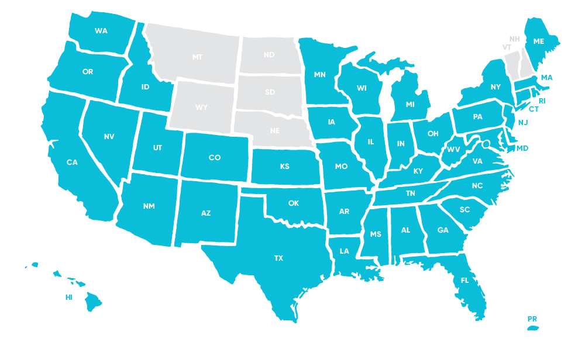
State map – fellows stats

Slide 8
Our big goals
1
To equip individuals with the skills to identify the root problems affecting the health of their community.
To illustrate pathways towards making a strategic, local impact on these identified root problems.
To connect the drive to take action with a concept of leadership that empowers individuals to become transformative organizers.
To foster a deep sense of community within the fellowship cohort and OFA at large.
2
3
4

Slide 9
OFA’s core purpose

Slide 10
CORE PURPOSE
To create a more accessible and participatory democracy

Slide 11

5 minute
reflection
Craft a movie title and plot description that reflects your personal experience during the fellowship?

Slide 12

What’s your movie title?
Type in the chat box

Slide 13
Where we’ve been

Slide 14
Your learning journey
Week 1: Identifying root problems

Slide 15
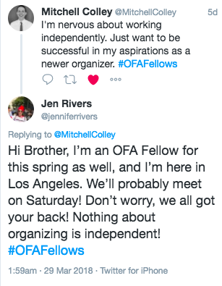
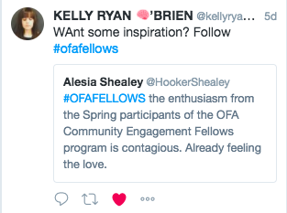
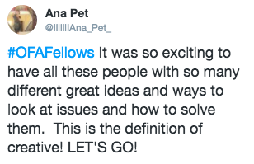

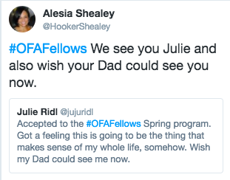
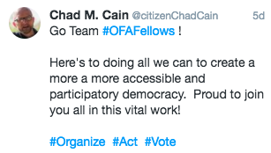
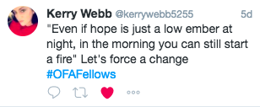

Slide 16
Four steps to identify a root problem
1
How do we define a healthy community? How do we know it when we see it?
What resources are our communities currently lacking? What challenges are they facing?
Why do they lack these resources? Why are they facing these challenges?
What can we do about it? What resources do we have?
2
3
4

Slide 17
Your learning journey
Week 1: Identifying root problems
Week 2: Strategies for local impact

Slide 18
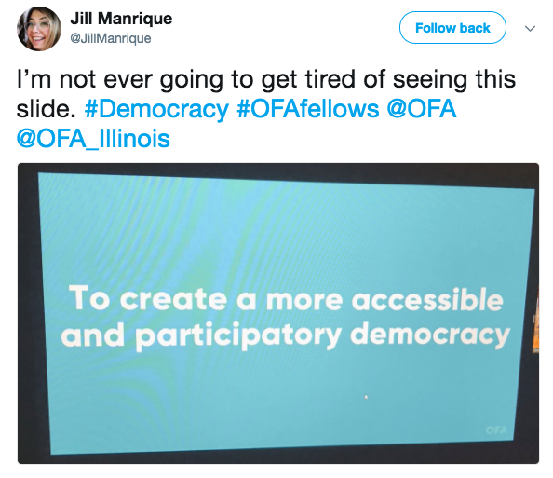
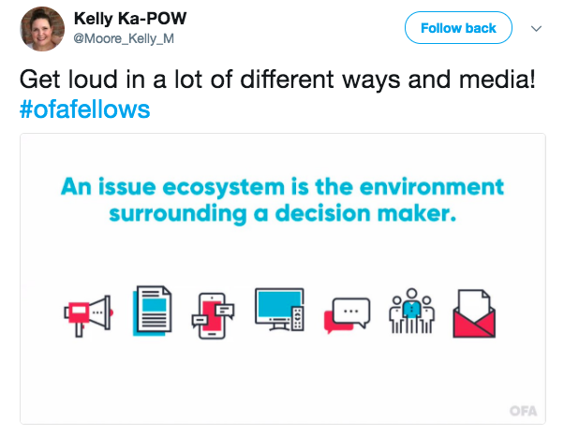


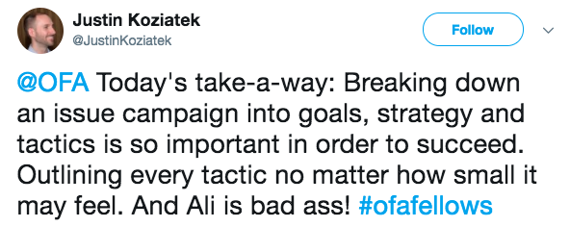

Slide 19
Strategic triangle
Public value: the resource, asset, support, law, behavior, or process you wish to create.
Legitimacy & support: who can authorize you to take action and provide the resources necessary to create and sustain this value?
Operational capacity: the funding, staff, volunteers, infrastructure, technology, resources needed to create the value.
Public value
Operational capacity
Legitimacy & support
Notes:
The Public Value — this is your ultimate goal, to create a new public value
Legitimacy & Support — this is also called the “authorizing authority”, essentially, who do you need to convince and get on your side in order to authorize this public value being created. This can be new laws and legislation, organizations that grant you the funding, or influential individuals who grant you the access you need; or some combination of all three.
Operational Capacity — this is the buicket of resources you need to accomplish and actually create your public value. This can be partnerships with other organizations, money, grants, knowledge, institutional support, etc. The key questions to answer here are how much capacity do we have, what else do we need, and where can we get it.

Slide 20
Building the framework
1
An achievable, measurable, and problem-solving goal.
A strategy that provides the roadmap for success.
Effective tactics that accomplish your goal through the strategy you’ve developed.
2
3

Slide 21
Your learning journey
Week 1: Identifying root problems
Week 2: Strategies for local impact
Week 3: Leadership in action

Slide 22
What values are present
in your list of leaders?
What potential leadership
blind-spots do you see?

Slide 23
Leadership is a process by which an individual uses influence with a group for positive change.

Slide 24
Your learning journey
Week 1: Identifying root problems
Week 2: Strategies for local impact
Week 3: Leadership in action
Week 4: Cultivating community

Slide 25
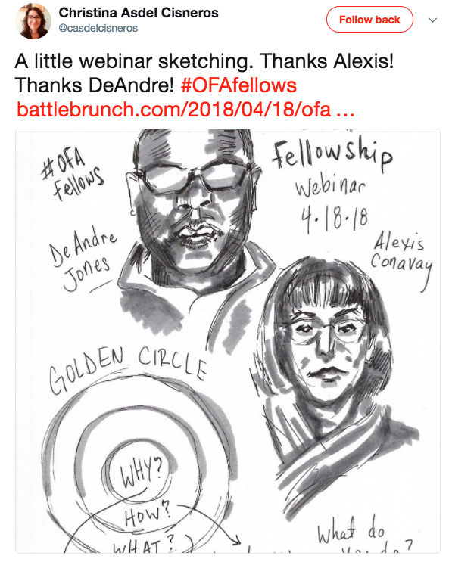
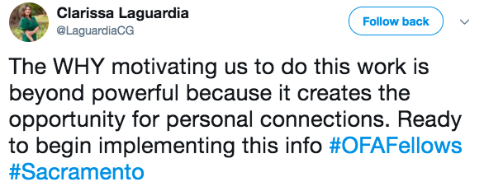
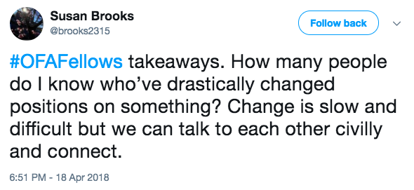

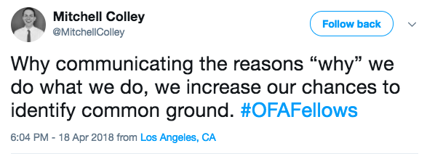
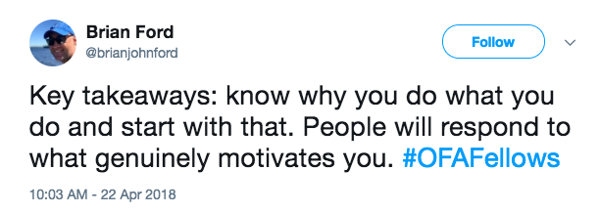
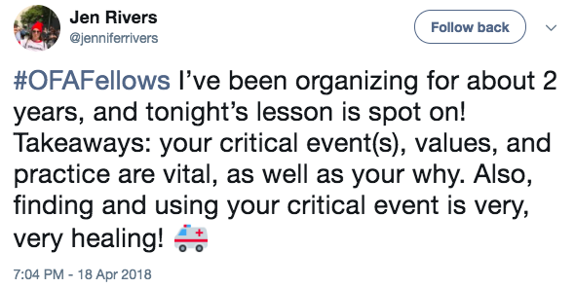

Slide 26
Challenges to persuasion
Personal Anxiety
Interpersonal differences
Fractured political context
The “ask” typically associated
Notes:
7:18- 7:19 [1 MINUTE]
[TRACI]
Personally, I am always terrified by the ask – that’s it’s going to be something I really don’t want to do, like make phone calls. Just in general I don’t really like talking on the phone, especially to strangers, so the thought of making calls is stressful for me. But that is one of the “typical” asks, so – as a personal reflection – think about what you can do to help mitigate that kind of anxiety in your conversation.

Slide 27
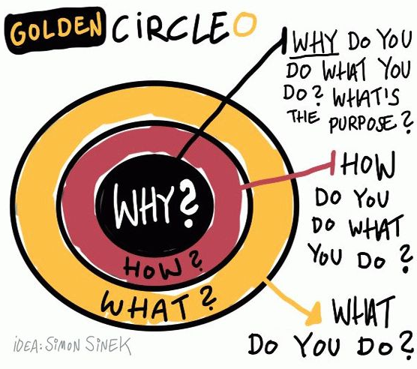
Notes:
7:23- 7:26 [3 minutes]
[TRACI]
Discussion of WHY, HOW, WHAT
What we to convey is that if you start with your belief and communicate your WHY, it will resonate with people in the way a WHAT never can. So, the order is important here as well – you need to start with your WHY in order to be able to start to build a connection based on shared values, then move outward.
Because the WHY is what moves YOU – it is the core thing that makes you tick. It is your reason to get out of bed. It’s the thing that you might have subconsciously operated with but not likely articulated out loud
HOW: ‘How’ is your theory of change – it is the way that you believe your why can come into the world
WHAT: ‘What’ is the thing that you are now doing as a result of your how – it is your specific actions associated with your theory of change.
In politics, we frequently start with WHAT which is not how you can easily connect with people – it tends to be superficial and can feel inauthentic.
If we take this model presented by Simon, then you can see how it shakes out with organizations as well. Here’s a couple of examples to compare and contrast.

Slide 28

Putting it all together:
The framework of your why
Critical incident
What is a critical incident that leads to what you believe and why?
Values
What values are present underneath your critical incident and why?
Practice
How will you practice communicating your values in way
that resonates with diverse groups of people?
Notes:
ADRIENNE

Slide 29
Your learning journey
Week 1: Identifying root problems
Week 2: Strategies for local impact
Week 3: Leadership in action
Week 4: Cultivating community
Week 5: Building coalitions and partnerships

Slide 30
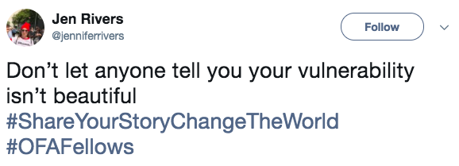
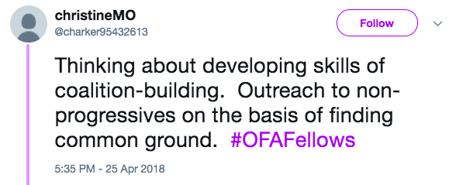
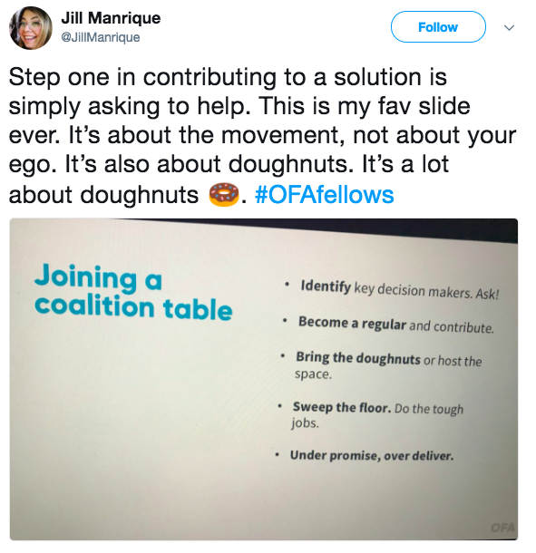
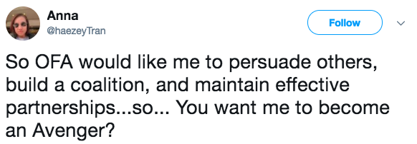
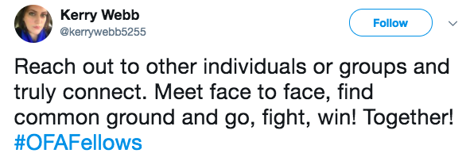

Slide 31
Managing
partnerships
Reinforce your theory of change
Under promise, over deliver
Negotiate
Know your role
Don’t always be right
Develop trust
Never burn a bridge
Notes:
We’re about to move on to introducing the Snowflake Model, next we will discuss how we use the snowflake model, then we’ll have a debrief and identify key takeaways
So let’s get started!

Slide 32
Your learning journey
Week 1: Identifying root problems
Week 2: Strategies for local impact
Week 3: Leadership in action
Week 4: Cultivating community
Week 5: Building coalitions and partnerships
Week 6: Tying it all together

Slide 33
Agenda
Review the fellowship learning journey
Discuss graduation requirements
Staying involved with OFA
Leadership pathways
Debrief and close
Notes:
00:18 – 00:19 [1 min] – Aquiles
[Broad Goals] Review post-training agenda
We cannot cover everything you will need to know today.
That is why we have a post-training agenda for you
Review key dates and webinars

Slide 34
Fellows project plans

Slide 35
Fellows projects plans
What's the root problem you've identified that is affecting the health of your community?
What organizing issue will you work on to make a measurable impact on this root problem?
What leadership values will you bring to your organizing? What role will you or your team fill on this issue?
What groups and members of the community do you need to engage on this issue? Who does this root problem affect? How will you bring them into your organizing work?
Notes:
You are part of something bigger
2 Mins
But accomplishing these goals will only happen if you know that you are part of something bigger
Alongside you, this week, we are onboarding fellows in 28 programs and we have fellows from 24 states across the country. Together you make up the spring 2018 OFA Fellowship Class.
Even though you will work locally here, you will join weekly online trainings with the rest of your class.

Slide 36
Fellows projects plans
What coalitions and organizations will you reach out to for creating partnerships in your local community?
Please provide a short description of the project itself. What are you working on? Is it an event, a series of events, a sustained plan for raising awareness on the issue? Be concise but thorough.
Given your project description above, what do you need accomplish in the next 6 weeks? 12 weeks? Be specific, list out your goals and strategy for achieving them.
Overall, what is your measure of success? How will you know if you've accomplished the goals of your project? (hint: get creative here)
Notes:
You are part of something bigger
2 Mins
But accomplishing these goals will only happen if you know that you are part of something bigger
Alongside you, this week, we are onboarding fellows in 28 programs and we have fellows from 24 states across the country. Together you make up the spring 2018 OFA Fellowship Class.
Even though you will work locally here, you will join weekly online trainings with the rest of your class.

Slide 37
Graduation requirements:
1
Participate in six fellowship weekly webinars.
Complete a Fellowship project plan detailing what your next 6 and 12 weeks of organizing looks like.
Complete the Graduation Off Boarding form by the Thursday, May 17.
2
3

Slide 38
Reporting back:
Please email a recap and pictures of your events and organizing work to fellows@ofa.us.
We love seeing Fellows events and updates on social media so be sure to share pictures and highlights from your event!

Slide 39
Questions about the graduation
requirements or expectations?
Type in the chat box

Slide 40
Agenda
Review the fellowship learning journey
Discuss graduation requirements
Staying involved with OFA
Leadership pathways
Debrief and close
Notes:
00:18 – 00:19 [1 min] – Aquiles
[Broad Goals] Review post-training agenda
We cannot cover everything you will need to know today.
That is why we have a post-training agenda for you
Review key dates and webinars

Slide 41
OFA is committed to building
a new generation of progressive
leaders to meet the challenges
of today and prepare for the
challenges in decades to come.

Slide 42
Respect
Empower
Include
Organize
Notes:
At OFA, respect, empower, include guides every interaction we have, which is why you see our organization choosing different tactics than others.
1. We take a respectful approach to everything we do, including talking to our elected leaders. When we’re respectful, our concerns are taken seriously
2. We empower volunteers by meeting them where they are and training, coaching, and building them into community leaders. OFA is dedicated to building progressive power over the long run, and that starts by empowering everyday people to do more than they ever thought possible.
3. We include anyone and everyone who wants to make a difference in the progressive movement. OFA welcomes you, no matter your skill level or income. You will receive all of our training and coaching at no cost to you. And, id doesn’t matter if you’ve never taken action before or if you’re a seasoned community organizer, we have a place for everyone at OFA.
4. We organize because that is how we build long term power. When we train and empower people to be leaders in their community, we build

Slide 43
Staying involved with OFA:
Tomorrow you will receive an email that contains a link to a Graduation form.
Parts I & II of that form will ask you questions about your mailing address and key takeaways from the fellowship.
Part III of the form will ask you if, and how you would like to stay involved with OFA after the fellowship ends.
Hint: There are a ton of ways to say involved with OFA!

Slide 44
STAYING INVOLVED WITH OFA
Chapter development
Notes:
At OFA, respect, empower, include guides every interaction we have, which is why you see our organization choosing different tactics than others.
1. We take a respectful approach to everything we do, including talking to our elected leaders. When we’re respectful, our concerns are taken seriously
2. We empower volunteers by meeting them where they are and training, coaching, and building them into community leaders. OFA is dedicated to building progressive power over the long run, and that starts by empowering everyday people to do more than they ever thought possible.
3. We include anyone and everyone who wants to make a difference in the progressive movement. OFA welcomes you, no matter your skill level or income. You will receive all of our training and coaching at no cost to you. And, id doesn’t matter if you’ve never taken action before or if you’re a seasoned community organizer, we have a place for everyone at OFA.
4. We organize because that is how we build long term power. When we train and empower people to be leaders in their community, we build

Slide 45
STAYING INVOLVED WITH OFA
Chapter development
Digital communications
Notes:
At OFA, respect, empower, include guides every interaction we have, which is why you see our organization choosing different tactics than others.
1. We take a respectful approach to everything we do, including talking to our elected leaders. When we’re respectful, our concerns are taken seriously
2. We empower volunteers by meeting them where they are and training, coaching, and building them into community leaders. OFA is dedicated to building progressive power over the long run, and that starts by empowering everyday people to do more than they ever thought possible.
3. We include anyone and everyone who wants to make a difference in the progressive movement. OFA welcomes you, no matter your skill level or income. You will receive all of our training and coaching at no cost to you. And, id doesn’t matter if you’ve never taken action before or if you’re a seasoned community organizer, we have a place for everyone at OFA.
4. We organize because that is how we build long term power. When we train and empower people to be leaders in their community, we build

Slide 46
STAYING INVOLVED WITH OFA
Chapter development
Digital communications
Issue campaigns
Notes:
At OFA, respect, empower, include guides every interaction we have, which is why you see our organization choosing different tactics than others.
1. We take a respectful approach to everything we do, including talking to our elected leaders. When we’re respectful, our concerns are taken seriously
2. We empower volunteers by meeting them where they are and training, coaching, and building them into community leaders. OFA is dedicated to building progressive power over the long run, and that starts by empowering everyday people to do more than they ever thought possible.
3. We include anyone and everyone who wants to make a difference in the progressive movement. OFA welcomes you, no matter your skill level or income. You will receive all of our training and coaching at no cost to you. And, id doesn’t matter if you’ve never taken action before or if you’re a seasoned community organizer, we have a place for everyone at OFA.
4. We organize because that is how we build long term power. When we train and empower people to be leaders in their community, we build

Slide 47
STAYING INVOLVED WITH OFA
Chapter development
Digital communications
Issue campaigns
Trainings
Notes:
At OFA, respect, empower, include guides every interaction we have, which is why you see our organization choosing different tactics than others.
1. We take a respectful approach to everything we do, including talking to our elected leaders. When we’re respectful, our concerns are taken seriously
2. We empower volunteers by meeting them where they are and training, coaching, and building them into community leaders. OFA is dedicated to building progressive power over the long run, and that starts by empowering everyday people to do more than they ever thought possible.
3. We include anyone and everyone who wants to make a difference in the progressive movement. OFA welcomes you, no matter your skill level or income. You will receive all of our training and coaching at no cost to you. And, id doesn’t matter if you’ve never taken action before or if you’re a seasoned community organizer, we have a place for everyone at OFA.
4. We organize because that is how we build long term power. When we train and empower people to be leaders in their community, we build

Slide 48
STAYING INVOLVED WITH OFA
Chapter development
Digital communications
Issue campaigns
Trainings
Organizing for ‘18
Notes:
At OFA, respect, empower, include guides every interaction we have, which is why you see our organization choosing different tactics than others.
1. We take a respectful approach to everything we do, including talking to our elected leaders. When we’re respectful, our concerns are taken seriously
2. We empower volunteers by meeting them where they are and training, coaching, and building them into community leaders. OFA is dedicated to building progressive power over the long run, and that starts by empowering everyday people to do more than they ever thought possible.
3. We include anyone and everyone who wants to make a difference in the progressive movement. OFA welcomes you, no matter your skill level or income. You will receive all of our training and coaching at no cost to you. And, id doesn’t matter if you’ve never taken action before or if you’re a seasoned community organizer, we have a place for everyone at OFA.
4. We organize because that is how we build long term power. When we train and empower people to be leaders in their community, we build

Slide 49
What questions about how to
stay involved with OFA?
Type in the chat box

Slide 50

Notes:
At OFA, respect, empower, include guides every interaction we have, which is why you see our organization choosing different tactics than others.
1. We take a respectful approach to everything we do, including talking to our elected leaders. When we’re respectful, our concerns are taken seriously
2. We empower volunteers by meeting them where they are and training, coaching, and building them into community leaders. OFA is dedicated to building progressive power over the long run, and that starts by empowering everyday people to do more than they ever thought possible.
3. We include anyone and everyone who wants to make a difference in the progressive movement. OFA welcomes you, no matter your skill level or income. You will receive all of our training and coaching at no cost to you. And, id doesn’t matter if you’ve never taken action before or if you’re a seasoned community organizer, we have a place for everyone at OFA.
4. We organize because that is how we build long term power. When we train and empower people to be leaders in their community, we build

Slide 51

Notes:
At OFA, respect, empower, include guides every interaction we have, which is why you see our organization choosing different tactics than others.
1. We take a respectful approach to everything we do, including talking to our elected leaders. When we’re respectful, our concerns are taken seriously
2. We empower volunteers by meeting them where they are and training, coaching, and building them into community leaders. OFA is dedicated to building progressive power over the long run, and that starts by empowering everyday people to do more than they ever thought possible.
3. We include anyone and everyone who wants to make a difference in the progressive movement. OFA welcomes you, no matter your skill level or income. You will receive all of our training and coaching at no cost to you. And, id doesn’t matter if you’ve never taken action before or if you’re a seasoned community organizer, we have a place for everyone at OFA.
4. We organize because that is how we build long term power. When we train and empower people to be leaders in their community, we build

Slide 52

Notes:
At OFA, respect, empower, include guides every interaction we have, which is why you see our organization choosing different tactics than others.
1. We take a respectful approach to everything we do, including talking to our elected leaders. When we’re respectful, our concerns are taken seriously
2. We empower volunteers by meeting them where they are and training, coaching, and building them into community leaders. OFA is dedicated to building progressive power over the long run, and that starts by empowering everyday people to do more than they ever thought possible.
3. We include anyone and everyone who wants to make a difference in the progressive movement. OFA welcomes you, no matter your skill level or income. You will receive all of our training and coaching at no cost to you. And, id doesn’t matter if you’ve never taken action before or if you’re a seasoned community organizer, we have a place for everyone at OFA.
4. We organize because that is how we build long term power. When we train and empower people to be leaders in their community, we build

Slide 53

Notes:
At OFA, respect, empower, include guides every interaction we have, which is why you see our organization choosing different tactics than others.
1. We take a respectful approach to everything we do, including talking to our elected leaders. When we’re respectful, our concerns are taken seriously
2. We empower volunteers by meeting them where they are and training, coaching, and building them into community leaders. OFA is dedicated to building progressive power over the long run, and that starts by empowering everyday people to do more than they ever thought possible.
3. We include anyone and everyone who wants to make a difference in the progressive movement. OFA welcomes you, no matter your skill level or income. You will receive all of our training and coaching at no cost to you. And, id doesn’t matter if you’ve never taken action before or if you’re a seasoned community organizer, we have a place for everyone at OFA.
4. We organize because that is how we build long term power. When we train and empower people to be leaders in their community, we build

Slide 54

Notes:
At OFA, respect, empower, include guides every interaction we have, which is why you see our organization choosing different tactics than others.
1. We take a respectful approach to everything we do, including talking to our elected leaders. When we’re respectful, our concerns are taken seriously
2. We empower volunteers by meeting them where they are and training, coaching, and building them into community leaders. OFA is dedicated to building progressive power over the long run, and that starts by empowering everyday people to do more than they ever thought possible.
3. We include anyone and everyone who wants to make a difference in the progressive movement. OFA welcomes you, no matter your skill level or income. You will receive all of our training and coaching at no cost to you. And, id doesn’t matter if you’ve never taken action before or if you’re a seasoned community organizer, we have a place for everyone at OFA.
4. We organize because that is how we build long term power. When we train and empower people to be leaders in their community, we build

Slide 55

Notes:
At OFA, respect, empower, include guides every interaction we have, which is why you see our organization choosing different tactics than others.
1. We take a respectful approach to everything we do, including talking to our elected leaders. When we’re respectful, our concerns are taken seriously
2. We empower volunteers by meeting them where they are and training, coaching, and building them into community leaders. OFA is dedicated to building progressive power over the long run, and that starts by empowering everyday people to do more than they ever thought possible.
3. We include anyone and everyone who wants to make a difference in the progressive movement. OFA welcomes you, no matter your skill level or income. You will receive all of our training and coaching at no cost to you. And, id doesn’t matter if you’ve never taken action before or if you’re a seasoned community organizer, we have a place for everyone at OFA.
4. We organize because that is how we build long term power. When we train and empower people to be leaders in their community, we build

Slide 56

Notes:
At OFA, respect, empower, include guides every interaction we have, which is why you see our organization choosing different tactics than others.
1. We take a respectful approach to everything we do, including talking to our elected leaders. When we’re respectful, our concerns are taken seriously
2. We empower volunteers by meeting them where they are and training, coaching, and building them into community leaders. OFA is dedicated to building progressive power over the long run, and that starts by empowering everyday people to do more than they ever thought possible.
3. We include anyone and everyone who wants to make a difference in the progressive movement. OFA welcomes you, no matter your skill level or income. You will receive all of our training and coaching at no cost to you. And, id doesn’t matter if you’ve never taken action before or if you’re a seasoned community organizer, we have a place for everyone at OFA.
4. We organize because that is how we build long term power. When we train and empower people to be leaders in their community, we build

Slide 57

Notes:
At OFA, respect, empower, include guides every interaction we have, which is why you see our organization choosing different tactics than others.
1. We take a respectful approach to everything we do, including talking to our elected leaders. When we’re respectful, our concerns are taken seriously
2. We empower volunteers by meeting them where they are and training, coaching, and building them into community leaders. OFA is dedicated to building progressive power over the long run, and that starts by empowering everyday people to do more than they ever thought possible.
3. We include anyone and everyone who wants to make a difference in the progressive movement. OFA welcomes you, no matter your skill level or income. You will receive all of our training and coaching at no cost to you. And, id doesn’t matter if you’ve never taken action before or if you’re a seasoned community organizer, we have a place for everyone at OFA.
4. We organize because that is how we build long term power. When we train and empower people to be leaders in their community, we build

Slide 58
Questions about our partnerships?

Slide 59
Agenda
Review the fellowship learning journey
Discuss graduation requirements
Staying involved with OFA
Leadership pathways
Debrief and close
Notes:
00:18 – 00:19 [1 min] – Aquiles
[Broad Goals] Review post-training agenda
We cannot cover everything you will need to know today.
That is why we have a post-training agenda for you
Review key dates and webinars

Slide 60
Assignment:
Graduation form due Thursday,
May 17
Be sure to complete and submit the graduation form to ensure that you receive a fellowship certificate.
This will also be your opportunity to indicate how you want to stay involved in OFA going forward.
Notes:
a

Slide 61
Thanks for joining the call!
Please fill out the evaluation on today’s training using the link below.
bit.ly/Spring6-2018
Email fellows@ofa.us with any questions.

