Slide 1


Welcome
Fall 2017 Campus Organizing Academy
We’ll get started at 8:00 pm Eastern Time
Notes:
This work is licensed under the Creative Commons Attribution-NonCommercial 4.0 International License. To view a copy of this license, visit http://creativecommons.org/licenses/by-nc/4.0/ or send a letter to Creative Commons, PO Box 1866, Mountain View, CA 94042, USA

Slide 2
Passion into action:
Telling your story

Slide 3


5 minutes
Partner Activity
Things to share:
Name and where you’re from
Your major or areas of study
Your favorite story / book

Slide 4
Graduating the program

Slide 5
Program requirements
4/6 online trainings
Connect with campus coach

Slide 6
Submit a graduation request form
Will be sent on Monday, November 13
Due back by Wednesday, November 22
Letters mailed out on Wednesday, November 29
Notes:
00:07 – 00:09 [2 min] – Ashley
[Broad Goals] Present core goals of the Fellowship program.
Today you are standing on the shoulders of giants – some of those giants are in the room today.
The Fellowship program you will run has two core goals:
Coach and train new organizers – the program identifies people who want to earn introductory level organizing skills. Throughout the program they learn tactics and strategies to organize effectively. Many Fellows go on to organize as volunteer leaders with OFA or other organizations. Others become professional organizers. Regardless of where they go next, the program gives them a broad view of organizing.
The second goal is to grow and support chapter structure. If the day after the program ends the fellows are not part of your chapter, or they did not help the chapter meet its goals, then the program failed to meet an important goal. Today you will focus a lot on how to make sure you are running a program that not only trains high quality Fellows, but also helps your chapter meet its goals.

Slide 7
Submit a graduation request form
Will be sent on Monday, November 13
Due back by Wednesday, November 22
Letters mailed out on Wednesday, November 29
All the cool things happen when you graduate
Notes:
00:07 – 00:09 [2 min] – Ashley
[Broad Goals] Present core goals of the Fellowship program.
Today you are standing on the shoulders of giants – some of those giants are in the room today.
The Fellowship program you will run has two core goals:
Coach and train new organizers – the program identifies people who want to earn introductory level organizing skills. Throughout the program they learn tactics and strategies to organize effectively. Many Fellows go on to organize as volunteer leaders with OFA or other organizations. Others become professional organizers. Regardless of where they go next, the program gives them a broad view of organizing.
The second goal is to grow and support chapter structure. If the day after the program ends the fellows are not part of your chapter, or they did not help the chapter meet its goals, then the program failed to meet an important goal. Today you will focus a lot on how to make sure you are running a program that not only trains high quality Fellows, but also helps your chapter meet its goals.

Slide 8

You can view the tracker from the Campus Organizer Backpack
Notes:
00:07 – 00:09 [2 min] – Ashley
[Broad Goals] Present core goals of the Fellowship program.
Today you are standing on the shoulders of giants – some of those giants are in the room today.
The Fellowship program you will run has two core goals:
Coach and train new organizers – the program identifies people who want to earn introductory level organizing skills. Throughout the program they learn tactics and strategies to organize effectively. Many Fellows go on to organize as volunteer leaders with OFA or other organizations. Others become professional organizers. Regardless of where they go next, the program gives them a broad view of organizing.
The second goal is to grow and support chapter structure. If the day after the program ends the fellows are not part of your chapter, or they did not help the chapter meet its goals, then the program failed to meet an important goal. Today you will focus a lot on how to make sure you are running a program that not only trains high quality Fellows, but also helps your chapter meet its goals.

Slide 9
The Personal Story

Slide 10
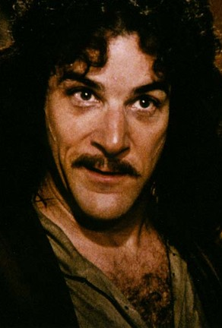
Why use a story?
Personal stories transform an issue from a complicated, abstract policy to a real life experience.
Personal stories are a way of connecting with other volunteers, neighbors, coalition partners, and friends.
When we share our motivations, our challenges, our decisions and their impacts, we tap into a more human place and we begin to build a relationship.
Notes:
Mobilizing is all about turning important moments into action. You’ve seen this around Obamacare– Along with other organizations working locally an nationally, OFA will bring in new people to take action when it’s most needed, ask them to take meaningful action, train them on how to do it well. These organizing moments are important to winning on the issues.

Slide 11
A personal story allows you to connect over shared values and interests. It resonates with the experiences of your audience.

Slide 12
Creating your story

Slide 13
Why do we need to know our “why”?

Slide 14
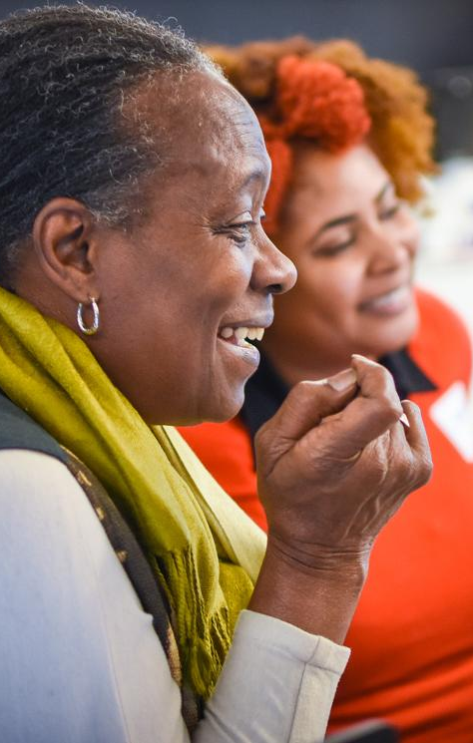
GROUP BRAINSTORM:
Why is it difficult to persuade someone to change?
Notes:
7:15- 7:17 [3 minutes]
Group adds thoughts to NewRow and facilitator reads them out loud as people type. Be ready for people to share on the phone

Slide 15


Notes:
7:13- 7:15
Press play on the left hand corner of the orange square.

Slide 16

Notes:
7:13- 7:15

Slide 17
Challenges to persuasion
Personal anxiety
Interpersonal differences
Fractured situational context
The “ask” typically associated
Notes:
7:17- 7:20 [3 minutes]
Key idea for facilitator to repeat back: when we talk about opposing points of view, we are tapping into values and experiences that someone holds really deeply, and might be unexamined
Key idea for facilitator to repeat back: you do not have to be an experienced policy maker and know all the ins and outs of a bill to discuss your WHY with your neighbors

Slide 18
We can cut through the clutter when we have conversations that speak to the head and the heart.

Slide 19

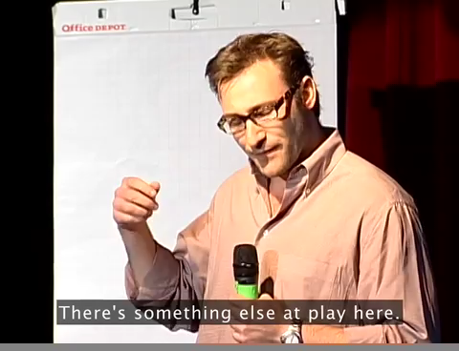
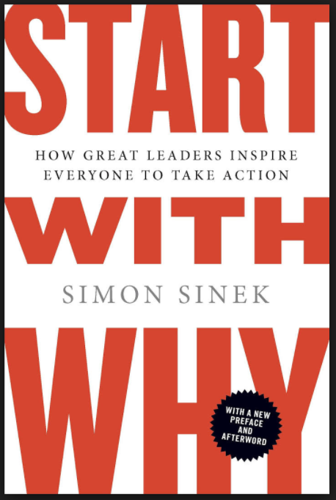
Notes:
7:21- 7:24 [3 minutes}]
1:36- 4:36: Theory of why, how, what and quick example of apple

Slide 20
12 minutes
Individual Activity
For this activity, start brainstorming your personal story by answering these questions:
What issue do you care most about? What is your why?
Why do you want to take action on that issue?
Who else do you want to take action on this issue? What value do you share?

Slide 21
Debrief
Type in the chat box or raise your hand

Slide 22
My story
Listen for the key elements. Try to determine the story structure.

Slide 23
Elements of a personal story
Challenge
Choice
Outcome
Ask

Slide 24
The challenge is the central
reason for taking action. Without challenges, there’s no need to get involved.

Slide 25
The choice is what you did to confront your challenge. What is the choice you made in that moment of adversity?

Slide 26
For most organizers, your choice was action. Your choice was change—to stand up and do something, even if it’s something small.

Slide 27
The outcome shows how taking
action can lead to a positive result. When you’re telling the story to move someone to action, they need to know that taking action can work.

Slide 28
The ask is when you give your audience a chance to join you and become part of the story.

Slide 29
Elements of a personal story
Challenge
Choice
Outcome
Ask

Slide 30
Questions?

Slide 31
12 minutes
Individual Activity
Start writing your personal story. Think of a key life moment–it doesn’t need to be dramatic–where you began to care about the issue from the previous exercise. Consider the following:
What was the specific challenge you faced?
What was the specific choice you made?
What happened as a result of your choice?
How can your listener join you in taking action?

Slide 32
Remember your why!

Slide 33
Share out!
Type in the chat box or raise your hand

Slide 34
The Hard Ask

Slide 35
What ask do you prefer?
1
I am so sorry for bothering you. Is there anyway, perhaps, that you can consider coming to an event I am planning for next month? Again, sorry for bothering you.
We are hosting an event with Rep. Gotham’s on April 20th. We will be discussing his gun violence prevention proposal and how our community can get involved to support that. Can you join us?
I know that you care a lot about crime in our community. I do too! Which is why I am organizing an event with Rep. Gotham’s to better understand his approach on gun violence and what we can do as a community to affect change on this issue. Can I count on you to join me and other members of our community for a conversation with the Congressman on April 20th at 2:00 PM?
2
3
Notes:
00:07 – 00:09 [2 min] – Ashley
[Broad Goals] Present core goals of the Fellowship program.
Today you are standing on the shoulders of giants – some of those giants are in the room today.
The Fellowship program you will run has two core goals:
Coach and train new organizers – the program identifies people who want to earn introductory level organizing skills. Throughout the program they learn tactics and strategies to organize effectively. Many Fellows go on to organize as volunteer leaders with OFA or other organizations. Others become professional organizers. Regardless of where they go next, the program gives them a broad view of organizing.
The second goal is to grow and support chapter structure. If the day after the program ends the fellows are not part of your chapter, or they did not help the chapter meet its goals, then the program failed to meet an important goal. Today you will focus a lot on how to make sure you are running a program that not only trains high quality Fellows, but also helps your chapter meet its goals.

Slide 36
The Five-Step Formula
Know your audience
Build urgency
Specific & strong language
Ask & shut up
Be persistent

Slide 37
The Five-Step Formula
Know your audience
Build urgency
Specific & strong language
Ask & shut up
Be persistent

Slide 38
The Five-Step Formula
Know your audience
Build urgency
Specific & strong language
Ask & shut up
Be persistent

Slide 39
The Five-Step Formula
Know your audience
Build urgency
Specific & strong language
Ask & shut up
Be persistent

Slide 40
The Five-Step Formula
Know your audience
Build urgency
Specific & strong language
Ask & shut up
Be persistent

Slide 41
Your turn!
Type in the chat box or raise your hand

Slide 42
Next steps & close

Slide 43
Next Call:
Thursday, November 16
8pm Eastern Time

Slide 44
Any questions?

Slide 45
Thank you!

