Slide 1


Bienvenidos!
Empezáremos a las 7:00 PM horario zona central.
Notes:
This work is licensed under the Creative Commons Attribution-NonCommercial 4.0 International License. To view a copy of this license, visit http://creativecommons.org/licenses/by-nc/4.0/ or send a letter to Creative Commons, PO Box 1866, Mountain View, CA 94042, USA

Slide 2
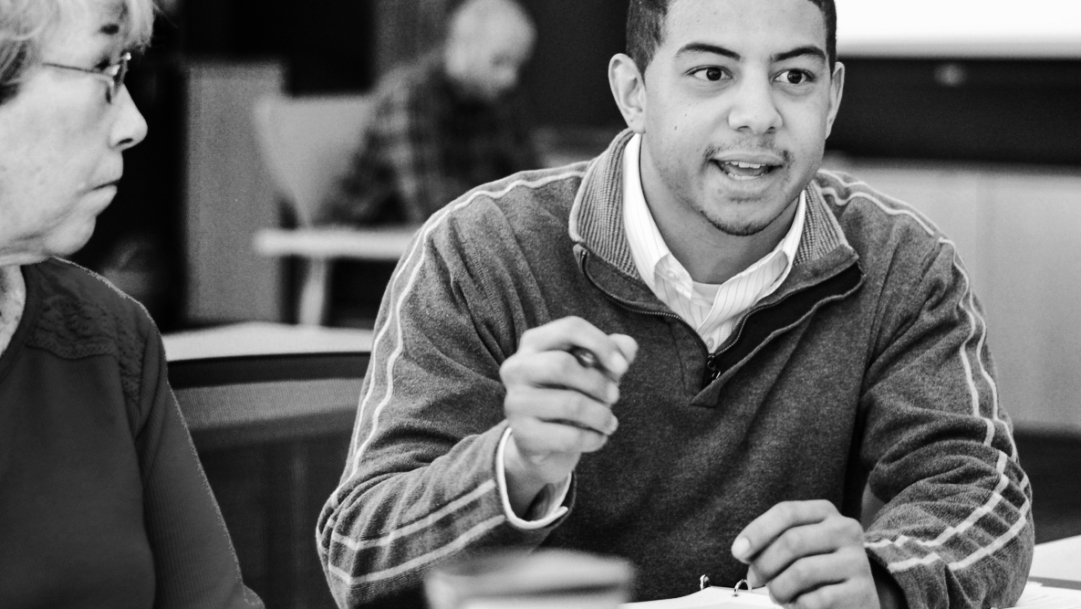
ENTRENAMIENTO DE ORGANIZACIÓN DE CAMPAÑAS
Conversaciones de persuasión
Alex Tornato/ OFA Training Manager / @atornato

Slide 3
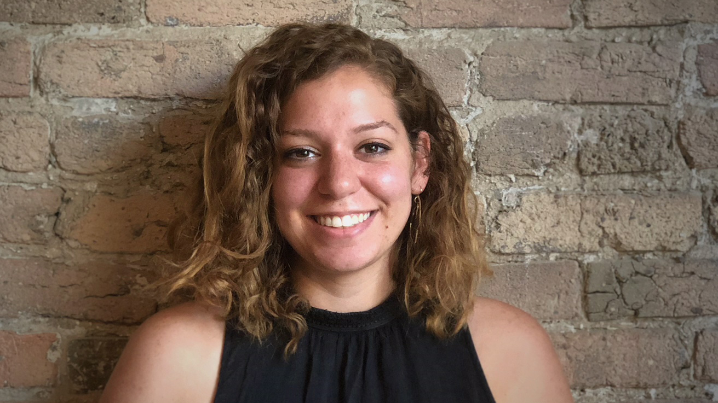
Alex Tornato
OFA Training Manager
@atornato
Notes:
“We have people joining us from all across the country that are wanting to make a difference in their communities. Type in your city and state into the chat box, and give others some appreciation for being on the call!”

Slide 4
Hoja de trabajo:
http://bit.ly/EOCpcsp
Notes:
As we go through this training, don’t be shy and tweet throughout the session using our hashtag. Let us know what you are taking away from this training, what is motivating you to organize, and follow me on twitter at @GriffenSaul

Slide 5
#OFAction
Notes:
As we go through this training, don’t be shy and tweet throughout the session using our hashtag. Let us know what you are taking away from this training, what is motivating you to organize, and follow me on twitter at @GriffenSaul

Slide 6

Nuestra trayectoria de aprendizaje
Semana 1: Conozca su por qué: Historia personal
Semana 2: Conversaciones de persuasión
Semana 3: Conversaciones de participación electoral (GOTV)
Semana 4: Organización digital

Slide 7
Por qué porcentaje gano George W. Bush en el 2004?
Notes:
To get us started, I wanted to take a moment to ask a question that will set the stage for the rest of this training

Slide 8

EN EL CHAT:
Adivine
Notes:
Take a moment to pause and guess your answer

Slide 9
2.46%
Notes:
Folks, decisions are made by those that show up! This slim margin is demonstrative of the fact that every vote does count. Keep this statistic in the back of your mind as we go through our persuasion framework, as it highlights the importance of doing both persuasion and turnout work.

Slide 10
Objetivos para esta capacitación:
1
Describir el marco para tener conversaciones de persuasión efectivas
Describe the framework for effective persuasion conversations

Slide 11
Objetivos para esta capacitación:
1
Describir el marco para tener conversaciones de persuasión efectivas
Describe the framework for effective persuasion conversations
2
Usar el marco de conversaciones de persuasión para hablar con votantes indecisos

Slide 12
Objetivos para esta capacitación:
1
Describir el marco para tener conversaciones de persuasión efectivas
Describe the framework for effective persuasion conversations
2
Usar el marco de conversaciones de persuasión para hablar con votantes indecisos
3
Sentirse motivado para aplicar el marco al trabajo de organización

Slide 13
Agenda
Por qué persuasión?
Marco de persuasión
Practica
Interrogatorio y cierre
Notes:
This is our agenda for the day! It will help us to accomplish the goals we laid out in the previous slide. First, we’ll talk about why persuasion is so important. Next, we’ll deep dive into our effective framework for having persuasion conversations. We’ll then take have an opportunity to practice this framework through a couple different activities. Lastly, We’ll spend a few minutes debriefing the training and wrapping up our discussion.

Slide 14
Siempre necesitamos entender quien es nuestra audiencia
Notes:
Campaigns always need to understand their audience when working for a candidate or ballot initiative. There are several competing narratives about how campaigns should allocate their time, and with a finite amount of time, there are a few strategies campaigns implore to help elect a certain candidate or win on a certain issue. If you are working or volunteering on a ballot initiative or a campaign One of the two different ways to spend your time to get the necessary votes to win is by getting people to turnout to vote who may not be a likely voter during an election cycle. This is known as a GOTV program (which will be discussed in another training that I encourage you to participate in). The other way is by talking to people who are already likely to turn out to vote but aren’t necessarily sure which candidate they will vote for or how they will vote on a specific ballot initiative. In this training we will discuss the ladder.
At the end of the day, research shows that campaigns need to address both groups of people to win, however, in this training we are going to concentrate on the significance of persuasion conversations.

Slide 15
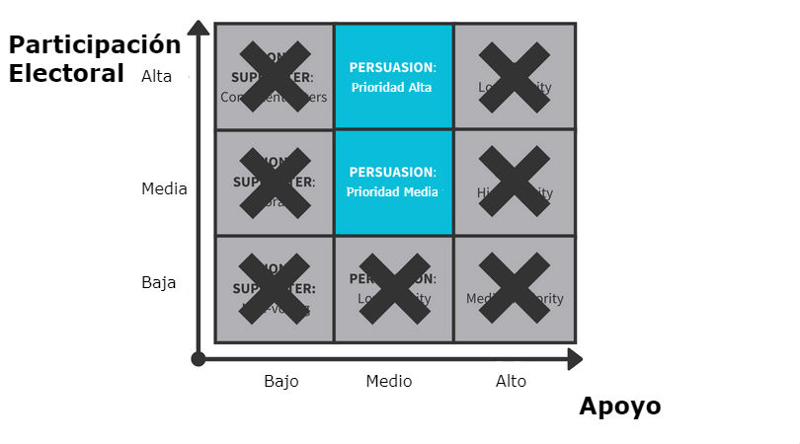
Notes:
So again on the y axis we can see a voter’s likelihood to vote in a election and on the x axis we can see the likelihood of the voter to support the candidate or issue your are canvassing for.
Our persuasion audience is Medium support and high/medium turnout. These are folks who are likely to turnout to vote but aren’t necessarily sure who they plan to support or if they agree with out ballot initiative.
We saw this play out in real life during the fight for marriage equality. In 2008, an LGBTQ+ rights group lost the Proposition 8 campaign, which would have granted Californians the right to same sex marriage. After this loss, volunteers set out to understand where they went wrong and between 2008 and 2009 volunteer-collected data found that values-based conversations were moving 25% of all undecided and opposed voters to be more supportive of marriage equality.
Voters in california and across the US saw the influence of persuasion conversations and why it is so important for canvassers to use. Campaigns started to use this tactics to help push their candidate or ballot initiative across the finish line. Persuasion conversations have the capacity to change opinions on issues people care about in the long term – one of the ways this can manifest is through electing candidates that support your values. Here at OFA we have volunteers who have been working to implement this framework in their everyday organizing, and are seeing real change in the fight for fair democracy.
What really excites me about this is that you are watching this training likely because you want to see change in your community and persuasion conversations are a big way that we can move the needle to affect progress in our communities. So with that, let’s develop more of an understanding for as to why persuasion is so important.

Slide 16
La persuasión es necesaria
Simplemente no hay una cantidad suficiente de votantes para ganar con solo sacar a esa cantidad a votar Los márgenes en muchos estados y distritos son muy pequeños
Persuasión
*Source- Analyst Institute
Notes:
Finally, thoughts on persuasion are still evolving
Creative methods are constantly being tested in the field and organizing best practices are ever-evolving. There is no proven algorithm for persuasion. As people continue to practice persuasion tactics, and as it continues to be studied by groups like the analyst institute, some methods are found not to work, while others are.
Let’s take a look at a picture highlighting the importance of persuasuin

Slide 17
La persuasión es necesaria
Simplemente no hay una cantidad suficiente de votantes para ganar con solo sacar a esa cantidad a votar Los márgenes en muchos estados y distritos son muy pequeños
Persuadir es difícil
Usted esta tratando de cambiar las opiniones y la mentalidad de otras personas El partidismo tiene raíces profundas
Persuasión
*Source- Analyst Institute
Notes:
Finally, thoughts on persuasion are still evolving
Creative methods are constantly being tested in the field and organizing best practices are ever-evolving. There is no proven algorithm for persuasion. As people continue to practice persuasion tactics, and as it continues to be studied by groups like the analyst institute, some methods are found not to work, while others are.
Let’s take a look at a picture highlighting the importance of persuasuin

Slide 18
La persuasión es necesaria
Simplemente no hay una cantidad suficiente de votantes para ganar con solo sacar a esa cantidad a votar Los márgenes en muchos estados y distritos son muy pequeños
Persuadir es difícil
Usted esta tratando de cambiar las opiniones y la mentalidad de otras personas El partidismo tiene raíces profundas
Las estrategias sobre la persuasión todavía están evolucionando!
Métodos creativos están siendo examinados y probados en comunidades Las mejores practicas de organización están en constante evolución
Persuasión
*Source- Analyst Institute
Notes:
Finally, thoughts on persuasion are still evolving
Creative methods are constantly being tested in the field and organizing best practices are ever-evolving. There is no proven algorithm for persuasion. As people continue to practice persuasion tactics, and as it continues to be studied by groups like the analyst institute, some methods are found not to work, while others are.
Let’s take a look at a picture highlighting the importance of persuasuin

Slide 19
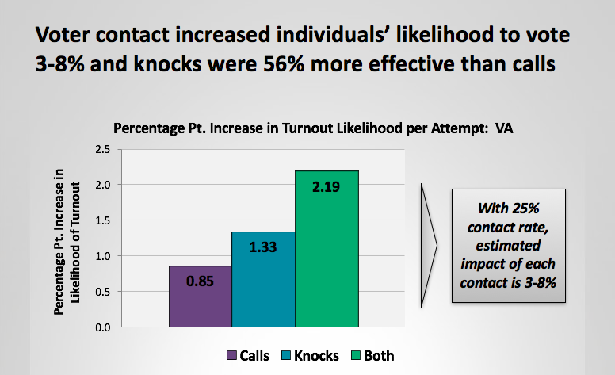
El contacto con votantes aumenta su probabilidad de votar
2.19%
1.33%
0.85%
Llamadas
Tocadas de puertas
Ambas
Notes:
Here we can see a graph that depicts voter contact rates from a Virginia election. On the y-axis we have the percentage point increase in the likelihood of turnout and the x-axis is a key to the bar graph representing three different forms of voter contact making phone calls, knocking on doors, or some variation of both.
This graph is a clear representation for why it is so important we knock doors and make phone calls—studies show that with a 25% contact rate, the estimated impact of each contact increases a voter’s likelihood to vote by 3-8% (with knocking on doors being 56% more effective) This is why traditional voter contact methods are so important. But increasing research shows that having an effective conversation is the most effective thing we can do and Persuasion is one of the best options because it adds two votes to your side (the vote you persuaded and the one you took from the other side), while increasing turnout and registration will only add one vote.
Knowing how important persuasion is to the outcome of an election, let’s start to synthesize that with conversations with voters.

Slide 20
Hagamos la conexión entre conversaciones de persuasión y los votantes
Notes:
In our work as organizers, we want to have conversations with people so we can get them to do something to make a difference. Whether it is convincing a supporter to make phone calls, or urging an elected official to vote a certain way on a piece of legislation or trying to get someone to turn-out or persuade someone to vote for your candidate…whatever the scenario, but we aren’t always successful.
We know from experience how challenging it can be to change someone’s opinion, so here we are going to try and break this down by synthesizing the connection between persuasion conversations and voters

Slide 21
Valores
Notes:
One of the most important responsibilities of a Campaign is to connect the values that drive their campaign to their agenda and the voter. They need to clearly articulate why the voter should care about their candidate or the issue they are supporting.
We’ll walk through a couple of examples too: After a multitude of failures at ballot boxes across the nation, it became clear to marriage equality advocates that their strategy needed to be revamped. In 2009, marriage equality organizations, including Equality California, the Leadership LAB, and the National Gay and Lesbian Task Force, with the assistance of think tanks, such as Grove Insight, set about to study the problems facing the movement and to try to devise a solution. The end result of this process is known as “persuasion canvassing,” which utilizes in-depth, one-on-one conversation and complex messaging designed to target voters’ emotions in order to alter the perceptions and attributions of supporters and opponents alike.

Slide 22
Conectandonos a los valores
Campaña
Usted
Votante
Notes:
To help articulate this idea, consider 3 points of a triangle: you, the up-for-grabs voter, and the candidate.
The line between you and the candidate is strong (that is why you work or volunteer for OFA).
The line between you and the voter is what you are establishing using your personal story and the little person exercise.
Then, you have to use the connection you establish with the voter to establish a connection between the voter and the candidate. In other words, the voter establishes a connection to the candidate through you and with your help via a connection over core values.
Once you have established a connection with the voter, you have to ties that connection to the core traits and values of the candidate.

Slide 23
Conectandonos a los valores
Campaña
Usted
Votante
Notes:
To help articulate this idea, consider 3 points of a triangle: you, the up-for-grabs voter, and the candidate.
The line between you and the candidate is strong (that is why you work or volunteer for OFA).
The line between you and the voter is what you are establishing using your personal story and the little person exercise.
Then, you have to use the connection you establish with the voter to establish a connection between the voter and the candidate. In other words, the voter establishes a connection to the candidate through you and with your help via a connection over core values.
Once you have established a connection with the voter, you have to ties that connection to the core traits and values of the candidate.
Marriage equality: Canvassers were taught that they were most effective when they both used their personal narratives of why marriage for same-sex couples was important to them and listened to and incorporated the personal stories of the individuals to whom they were talking. Persuasion canvasses focused on using individuals’ stories to elicit an emotional response. Their job was to make the issue as human as possible, such that voters could more easily connect with it.

Slide 24
Conectandonos a los valores
Campaña
Usted
Votante
Notes:
To help articulate this idea, consider 3 points of a triangle: you, the up-for-grabs voter, and the candidate.
The line between you and the candidate is strong (that is why you work or volunteer for OFA).
The line between you and the voter is what you are establishing using your personal story and the little person exercise.
Then, you have to use the connection you establish with the voter to establish a connection between the voter and the candidate. In other words, the voter establishes a connection to the candidate through you and with your help via a connection over core values.
Once you have established a connection with the voter, you have to ties that connection to the core traits and values of the candidate.
Marriage equality: Real stories connect better, so canvassers practiced crafting and telling stories about people they knew—whether about themselves, family, friends, or others—in order to appeal to many different kinds of voters. Canvassers even received specific training sessions in which they practiced telling these stories to their colleagues to gauge the emotional impact. All content has potential emotional impact, but knowing how and when to tell which pieces was important. Some voters are deeply touched by narratives that involve the loss of a loved one, while others are moved more by the vision of two people trying to build a supportive, protective home for a child.
The most essential aspect of delivery, however, was the conveyance of authentic emotional ties that the canvasser had to a particular individual. People rarely want to discuss legal codes; instead, they want to hear human stories. In general, the most effective stories centered on the themes of love and commitment, emphasizing that same-sex couples could and did have the same love and commitment for each other that some straight couples did.

Slide 25
Conectandonos a los valores
Campaña
Usted
Votante
Notes:
To help articulate this idea, consider 3 points of a triangle: you, the up-for-grabs voter, and the candidate.
The line between you and the candidate is strong (that is why you work or volunteer for OFA).
The line between you and the voter is what you are establishing using your personal story and the little person exercise.
Then, you have to use the connection you establish with the voter to establish a connection between the voter and the candidate. In other words, the voter establishes a connection to the candidate through you and with your help via a connection over core values.
Once you have established a connection with the voter, you have to ties that connection to the core traits and values of the candidate.
Marriage equality: Clearly, there was a tremendous shift in pro-marriage equality movement’s approach to policy enactment. It went from using the rhetoric of rights and benefits, which appealed to people’s intellects, to language surrounding love and commitment, which was intended to resonate with people emotionally. It also went from trying to solely mobilize supporters to reaching out to opponents, especially those who supported some form of legal recognition, but who were initially hesitant to apply the term “marriage” to same-sex couples. This shift was a product of greater experience in trying to pass legislation. The movement started with a moral vision, developed a particular political goal (i.e. marriage equality), and tried to create organizational forms and tactics that coincided with that vision and that would eventually bring about the realization of that goal.
http://pacificcenter.org/messaging-in-the-movement-for-marriage-equality

Slide 26
Agenda
Por qué persuasión?
Marco de persuasión
Practica
Interrogatorio y cierre
Notes:
This is our agenda for the day! It will help us to accomplish the goals we laid out in the previous slide. First, we’ll talk about why persuasion is so important. Next, we’ll deep dive into our effective framework for having persuasion conversations. We’ll then take have an opportunity to practice this framework through a couple different activities. Lastly, We’ll spend a few minutes debriefing the training and wrapping up our discussion.

Slide 27
UN MARCO PARA LA PERSUASIÓN:
Reconocer y relacionar
Notes:
So let’s deep dive into our framework for effective persuasive conversations
The first step in the framework is to acknowledge what the voter is saying and relate what they are saying to a value

Slide 28
Reconocer y relacionar
Escuche al votante y encuentre algo que tienen en común sobre los temas que le interesan
Use su historia personal para profundizar la conexión. Recuerde su ‘por qué’
Valide la preocupación del votante. El objetivo es generar confianza y buena relación con el votante
Los expertos sugieren: conecte los temas a un contexto local
Notes:
During this step in the framework, you want to make sure you listen to the voter and find common ground on issues that you both care about, use your personal story to deepen the connection – remember your “why”* (and we do have a very powerful training that is a part of this Campaign organizing bootcamp series on developing your personal story and understanding your “why” that will augment your ability to connect with voters. I highly encourage you to check it out if you have not already had the chance).
Also it is important to validate the voter’s concern. The goal is to build trust and rapport with the voter. And as a pro-tip, your conversation will be much more effective if you connect with the voter on issues that are at a hyper-local. What issue(s) have a direct impact on both of your lives? Is it the low access to quality education, racial segregation, water quality, affordable housing? You have an inherent connection with the voter as it relates to the community you both live in! And this will signal to the voter that your are invested in what they have to say.
During these conversations, you want to listen for a piece of information that will allow you to empathize with the vote to some degree. For instance, let’s imagine that I am from Florida, and I am canvassing to try and gain support for the second chance ballot initiative in Florida which would give formally incarcerated men and woman the opportunity to vote after fulfilling their sentence. if someone at the door said to me “I don’t know if I support this ballot initiative, I unsure what the consequences of this legislation would be” I would acknowledge and relate to what they have to say by stating something along the lines of, “I hear what you are saying, and it sounds like you are feeling conflicted about how this will impact our community” … These responses are not formulaic but should give you an idea of the type of things to say if placed in a similar situation.

Slide 29
UN MARCO PARA LA PERSUASIÓN:
Conectar con los valores
Notes:
After you have acknowledged what the voter has to say, the next phase of the framework is to connect on values.

Slide 30
Conectar con los valores
Exponga cuáles son los valores latentes en lo que dice el votante
Enfoque la conversación en torno a los valores que usted escucha al votante expresar y relacione esos valores a usted mismo
Recuerde: ¡usted comprenderá más acerca de quiénes son ellos a través de preguntas, sin prejuicios e inquisitivas, y por medio de compartir su historia personal!
Notes:
When you are connecting on values with an undecided voter, you want to surface the underlying values in what the voter is saying. Focus the conversation around the values you hear the voter expressing and relate those values to yourself. This is the part of the conversation where you’re connecting with the heart of what someone cares about—are they a parent? What values do you have in common? Are they a small business owner? (this is the perfect opportunity to affirm them!)
Remember – you will understand more about who they are through non-judgmental probing questions and sharing your personal story and if you get nervous, just breathe and circle back to your “why.”
To continue modeling the second chance ballot initiative in Florida, I could ask them a probing question like, ”how would you feel if your child or children didn’t have the right to vote?” If the voter gave an answer exclaiming how they would feel discriminated against for example, then I could begin to dissect their answer and affirm them by saying “it sounds like you like care about keeping our democracy safe, that is a value I also care about and really respect you for it.” Again, these are just examples of the types of questions you can ask and you can go about responding to them.

Slide 31
UN MARCO PARA LA PERSUASIÓN:
Pase al lenguaje persuasivo
Notes:
The third step in this framework is to pivot the conversation towards persuasion language

Slide 32
Conecte los valores que ha identificado con el trabajo que está haciendo y el candidato o causa que usted esta promoviendo
Explique los beneficios y el impacto de ‘ganar’ o elegir el candidato X con respecto al votante y sus valores compartidos
Pase al lenguaje persuasivo
Notes:
This is really the heart of the conversation where you explain to the voter why they should support your candidate or ballot initiative. Connect the values you have identified to the work that you’re doing and the candidate or cause.
I would continue my conversation with the voter by stating that “We are better than the worst things that we have done. Our country does not thrive when men and women are left out of the democratic process. We all deserve an opportunity to raise our voice for issues and values we care about. I can sense that you hold similar values, and hope to have your support in preserving the strength of our democracy.”

Slide 33
UN MARCO DE PERSUASIÓN:
Contraste
Notes:
Finally, you want to remember to contrast what will happen if the campaign or ballot initiative you support does not win

Slide 34
Contraste
Presente un contraste apropiado con los candidatos oponentes sobre esos valores y temas
Responda a las preguntas: "¿Qué sucederá si no elegimos al candidato X o no ganamos en nuestro tema? y ¿Cómo afectará los valores que ambos compartimos?"
Notes:
Draw an appropriate contrast with opponent candidates on those values and issues. Answer the questions - What will happen if we don’t elect candidate X, don’t act, don’t vote, do nothing, or the other side wins? How will that hurt the value we share?
To conclude my example, I would tell the voter at the door that If this ballot initiative doesn’t pass we are effectively silencing millions of voters, and the strength of our democracy will be questioned. This why it is so important we support this initiative…..

Slide 35
UN MARCO DE PERSUASIÓN:
1. Reconocer y relacionar
2. Conectar con los valores
3. Pase al lenguaje persuasivo
4. Contraste
Notes:
Let’s bring the entire framework together now. When implementing this framework either at the doors or on the phone, t is important to go through it in this order. So to quickly demonstrate what that looks like, I’d like to share a personal example from my life.
The example I’d like to share is centered around the issue of Healthcare. Imagine I am at the doors canvassing for the affordable care act. I knock on the door and tell the voter I am here canvassing to make sure the affordable care act is protected, and I hope to have your support. They tell me about how confusing and expensive the Healthcare system is. Here is where I dive into the persuasion framework by saying "I hear what you are saying -- the health care system is expensive and it doesn't seem that a lot of it is conducive for patients to navigate. It seems like you do care for other people to have a good experience with health care in our country, and I do too – even before I was born my father was diagnosed with advances Multiple sclerosis. When I was in high school, my dad was in and out of the hospital frequently, and I can say firsthand that it was difficult to navigate, but he wouldn't have been able to sustain the longevity of life he had if it hadn't been for Obamacare. It is really important that all Americans have access to quality, affordable healthcare because if they don’t, then millions of families will be put at risk of losing people they care about”
It may be helpful to pause this video for a moment and try and piece apart the four components of this framework embedded within my example. And just to hammer home this framework, we have a short video that demonstrates this model too.

Slide 36


Slide 37
COMPARTIR COMO GRUPO:
¿Cuales partes del marco usted vio utilizados en el video?
¿Que usted hubiese hecho diferente?

Slide 38
Agenda
Por qué persuasión?
Marco de persuasión
Practica
Interrogatorio y cierre
Notes:
This is our agenda for the day! It will help us to accomplish the goals we laid out in the previous slide. First, we’ll talk about why persuasion is so important. Next, we’ll deep dive into our effective framework for having persuasion conversations. We’ll then take have an opportunity to practice this framework through a couple different activities. Lastly, We’ll spend a few minutes debriefing the training and wrapping up our discussion.

Slide 39
¡Ahora es su turno de practicar el marco de persuasion!
Notes:
We will go through a couple activities that will allow you to practice the framework we just went over for youself.

Slide 40
Escenario 1:
MARCO
“Estoy escuchando todo lo que me estas diciendo... Y realmente no me gusta lo que está pasando, pero la economía parece estar bien. Después de la crisis económica del 2008 en la cual perdí todo, esta es la primera vez que me siento que me esta llendo bien. Me siento que es una decisión difícil.”
Reconocer
Valores
Logros
Contraste
Notes:
This is an example of something that may hear when you are on the phone or at the doors (READ SCENARIO 1) keep the framework on the left hand side of this slide in mind as you are going through this scenario

Slide 41
Escenario 2:
MARCO
”No soporto esta administración o este Congreso en absoluto. Pero realmente no entiendo cómo tu candidato va a mejorar la situación— no parece tener ningún mensaje resonante.”
Reconocer
Valores
Logros
Contraste
Notes:
Continuing to keep this framework in mind and the information you learned from scenario one. Here is another example of what you might encounter at the doors or on the phones (READ SCENARIO 2)

Slide 42
Agenda
Por qué persuasión?
Marco de persuasión
Practica
Interrogatorio y cierre
Notes:
This is our agenda for the day! It will help us to accomplish the goals we laid out in the previous slide. First, we’ll talk about why persuasion is so important. Next, we’ll deep dive into our effective framework for having persuasion conversations. We’ll then take have an opportunity to practice this framework through a couple different activities. Lastly, We’ll spend a few minutes debriefing the training and wrapping up our discussion.

Slide 43

Interrogatorio
ESCRIBA EN EL CHAT:
  ¿Cómo usted adaptará su estilo de comunicación cuando este hablando con votantes?
  ¿Qué usted pronostica que será lo mas difícil en implementar este marco de persuasión?
Notes:
Either individually or In groups, pause for a moment to think about and answer these questions. What are common values in your community that you might here at the door? How how will you adapt your communication style when talking to voters? What do you predict the biggest challenges in implementing this persuasion framework will be?

Slide 44
Proximos pasos
  Continúe practicando el marco de persuasión
  Ensaye con otras dos personas como conectar con valores compartidos y solicite sus opiniones
  Aplique sus habilidades de persuadir a ser un voluntario en una campaña
1
2
2
3
Notes:
Moving forward I hope you continue to practice this persuasion framework and work on connecting on shared values. It is always helpful to rehearse with a partner or small group and ask for feedback. And I hope you will work to apply your persuasion skills on the different campaigns you volunteer for.

Slide 45
Encuesta:
http://bit.ly/EOCpcsps
Notes:
http://bit.ly/2NRACu5

Slide 46

ENTRENAMIENTO DE ORGANIZACIÓN DE CAMPAÑAS
Conversaciones de participación electoral (GOTV)
9/20 @ 7pm CST
Alex Tornato/ OFA Training Manager / @atornato
Notes:
[1 min]
Welcome people to the training

Slide 47
Gracias!
Notes:
Thank you all so much for joining me through this training, I hope you enjoyed it. We at OFA are always looking to improve so if you could please fill out this short survey, I would love to hear your feedback. And finally, Remember to tweet out your key takeaways from today and give me a follow on twitter at @GriffenSaul.
I look forward to seeing all the amazing work you all day!

