Slide 1
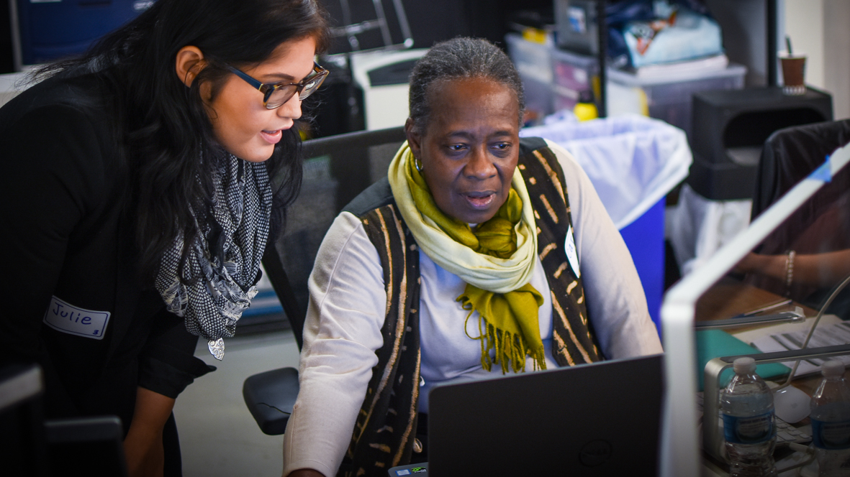
CAMPAIGN ORGANIZING BOOT CAMP
Digital organizing
Alexis Conavay / OFA Deputy Training Director / @AlexConavay
Notes:
Think of Digital organizing as an extension of your community organizing – we’ll dig best practices, including some tips and tricks, to powerfully tell your story online
This work is licensed under the Creative Commons Attribution-NonCommercial 4.0 International License. To view a copy of this license, visit http://creativecommons.org/licenses/by-nc/4.0/ or send a letter to Creative Commons, PO Box 1866, Mountain View, CA 94042, USA.

Slide 2
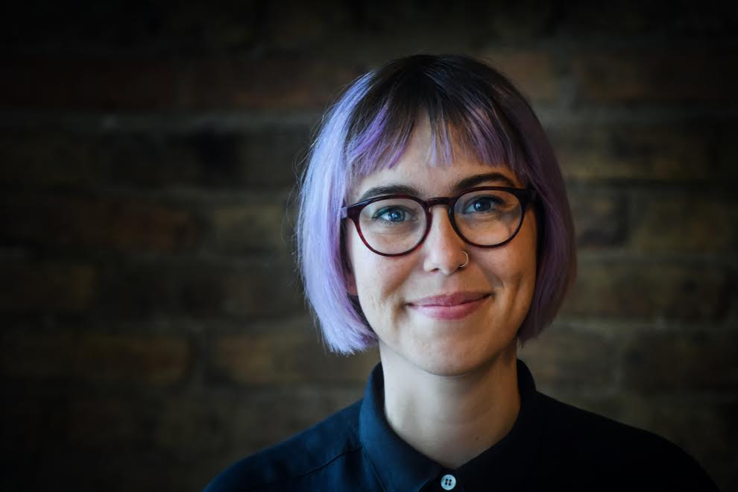
Alexis Conavay
@AlexConavay
OFA Deputy Training Director
Notes:
Fun facts –
I’m from Jupiter Florida
Master’s in WGS – I’m really passionate about trying to create a more equitable world
Before coming to OFA – I organized young people in CPS; worked in the education dept of IHMEC; worked as a researcher for DePaul university
Now I teach a pop culture class at one of the community colleges in Chicago
I come from a family of park rangers and teachers and it has fueled my passion for learning and teaching.
I was born in key west.

Slide 3
#OFAction
#OrganizingFor18
Notes:
As we go through this training, don’t be shy and tweet throughout the session using our hashtag. Let us know what you are taking away from this training, what is motivating you to organize, and follow me on twitter at @GriffenSaul

Slide 4
Goals for today
Understand the unique role social media can play in sharing the story of your organizing online.
1
Notes:
We have two simple goals for today
Think of Digital organizing as an extension of your community organizing – we’ll dig best practices, including some tips and tricks, to powerfully tell your story online

Slide 5
Goals for today
Understand the unique role social media can play in sharing the story of your organizing online.
Be able to tell the story of your work on social media.
1
2
Notes:
We want you to walk away with the tools you need to tell the story of your organizing work on social media.

Slide 6
Agenda
Why digital?
Producing content
Peer review
Debrief & next steps
Notes:
This is our agenda for the day! It will help us to accomplish the goals we laid out in the previous slide. First, we’ll talk about what social media is and how organizers can use it to support and amplify their work. Next, we’ll dive into a few best practices for actually creating content. And then we’ll spend some time putting it into practice, giving feedback, and then wrap up and close.

Slide 7
GROUP SHARE:
What’s the power of social media?
Notes:
Social media can be isolating but it can also serve as a way of finding your people

Slide 8
Pause for group share

Slide 9
So what is
“social media”?
Notes:
OK, so maybe it would be helpful to take a step back and actually define what social media is… we all probably have an idea of what it is, but let’s just take a minute to break it down so we can have a starting place for how to use it

Slide 10
Social media are tools or platforms that allow the sharing of information and content and the formation of communities through online and mobile networks of people.
Notes:
So this is the AP Style Book’s definition: Social media refers to tools that allow the sharing of information and content and the formation of communities through online and mobile networks of people.
Why is this perfect for organizers? Because they’re built almost specifically with the tasks of organizers in mind. As organizers, as activists, as community leaders, we’re here to build and strengthen communities, develop relationships, and expand our networks. The larger our networks and the stronger our relationships, the more power we have to mobilize together and effect real, lasting change.

Slide 11
GROUP SHARE:
But why do *you* use social media?
Notes:
Social media can be isolating but it can also serve as a way of finding your people – share as a group how you use social media
What's important here is that we don't want you to use social media in a way that feels inauthentic but instead, incoperate best practices in your practice

Slide 12
Pause for group share

Slide 13
Rings of engagement
Notes:
Some of you may have hear the term “ladder of engagement” before in reference to organizing. For those who haven’t, it’s essentially referring to the spectrum of engagement that a person can have within the work of organizing, with a non-participant, unengaged person on one end and a fully-engaged community leader on the other.
We like to imagine the ladder as concentric circles or rings, with the lowest level on the ladder—the lowest level of engagement—as the farthest ring and the most engaged advocates and organizers at the center. Those organizers, those community leaders, those folks running for office.
Our job, as advocates and organizers, is to bring folks closer to the center—to get that casual observer who may potentially be passionate about an issue to start engaging on that issue.
And while social media can play a role on EVERY ring…

Slide 14
Social Media
Notes:
… it has a UNIQUE role on the outer rings. Why? Because that’s where the most people are located and that’s where social media’s strength comes in—millions of people are already there. Just as you want to go fishing where the fishes are, we want to use social media as a tool to connect where our potential audiences are—people who are watching what’s going on, but may not know exactly what’s happening or what the next steps should be. But you do! You, as organizers, know the next steps for getting involved.
So we use social media not only to stay informed and to connect with others, but to organize. To bring people in and, when the time comes, mobilize them to take action.
Think for a scedond: Which ring do folks think email would fall on this illustration?

Slide 15
Email
Notes:
ASNWER: Closer to the center.
EMAIL, as an organizing platform, plays a larger role closer towards the center. Why? Because it requires a little more engagement. People have invited you into their personal email. It feels more like a one-on-one conversation. And there’s more room for your message—to explain, persuade, and inspire. Also, instead of just hoping that your followers scroll by your social media post, with email, people can choose to open your note at their convenience.

Slide 16
Social media
strengths
Point of entry
Ready-made tools for grassroots advocacy
Connect with others
Lift each other up
Notes:
Social media is a tool or a set of tools ready-made for grassroots advocacy. So, as organizers, we should try to view it that way. View it as a way to tell our stories, our values, our message. View it as a way to organize AND mobilize.
So… even on social media
On the ladder of engagement, participation is low on the level of difficulty. It’s easy to sign up, it’s easy to follow, like, comment, share. organizers, we show up on social media – and social media provides a public forum for you to do just that. To tell your personal story. To tell truths. To make arguments. For millions of people, social media is one of the best entry points into organizing, into supporting your cause. Let’s use that entry point to our advantage.
Connect – build out your networks, connect with other passionate people, form groups, create lists
Lift each other up – be a good leader by being a good follower. Give other an excuse to join in and help build that momentum. FB and Twitter both have ways to share

Slide 17
Social media
strengths
Point of entry
Ready-made tools for grassroots advocacy
Connect with others
Lift each other up
Notes:
We show up – social media provides a public forum for you to do just that. To tell your personal story. To tell truths. To make arguments
Connect – we use social media not only as a way to complain about airlines, but as a tool to build out our networks, connect with other passionate people, form groups, create lists. One of the best features about Twitter is that you can easily reach people who are not in your immediate network like other platforms. There are millions of conversations happening, gaining momentum, trending. Use these conversations, where folks are discussing issues they care about to engage, connect, share resources, and…
Lift each other up – be a good leader by being a good follower. Give other an excuse to join in and help build that momentum. FB and Twitter both have ways to share

Slide 18
Social media
strengths
Point of entry
Ready-made tools for grassroots advocacy
Connect with others
Lift each other up
Notes:
We show up – social media provides a public forum for you to do just that. To tell your personal story. To tell truths. To make arguments
Connect – we use social media not only as a way to complain about airlines, but as a tool to build out our networks, connect with other passionate people, form groups, create lists
Lift each other up – You can be a good leader by being a good follower. Participate. See something you like? Like it, share it, tag others—get your networks involved. Be an excuse for your friends to join in and help build that momentum. The thing about social media is that it’s super easy to share and most platforms have built in algorithms that will increase the visibility of posts with more engagements. So engage!

Slide 19
Strengths of
Social Media
Uses for
Organizers
Millions of people communicating, sharing, ready to engage.
Public forum, real-time conversations, trending topics, and breaking news.
Low-level engagement like sharing and liking is easy.
An easy point-of-entry for potential supporters.
Gives organizers a platform to tell our stories, make our case, and find shared values.
Connect with folks, build networks, lift each other up, share resources, organize.
Notes:
In review

Slide 20
Agenda
Why digital?
Producing content
Peer review
Debrief & next steps
Notes:
Now let’s dig into how to produce content –

Slide 21
Messaging & Mobilizing
As organizers, your strongest asset is the number of people you can mobilize to advocate your message.
To mobilize effectively, we need a dependable and large list of people highly willing to take action with us.
Digital organizing allows you to a grow a vast list of supporters so that you can mobilize to broadcast your message.
Notes:
Mobilizing is all about turning important moments into action. You’ve seen this around Obamacare– Along with other organizations working locally an nationally, OFA will bring in new people to take action when it’s most needed, ask them to take meaningful action, train them on how to do it well. These organizing moments are important to winning on the issues.

Slide 22
KEY PRINCIPLES OF DIGITAL ORGANIZING
Authenticity
Relevance
Impact
Notes:
3 key principles of digital organizing
authenticity: as an example, whenever I’m training new employees or volunteers on “tone of voice” for social media, I always say “Speak like a human, tweet like a human.” Which is to say: than an authentic voice (i.e. your voice) is essential. People will tune out if what you’re talking about doesn’t feel genuine. But that should not a problem for y’all, because you wouldn’t be in this training if you didn’t genuinely care about the work you’re doing.
Relevance: I can tell you that if you want to make an impact, you have to meet the moment. this doesn't mean that you should be tweet-ready constantly, but you should stay as well-informed as possible and plugged into the issues that are happening.
Call-to-action: research shows that progressives feel bogged down and hopeless – OFA tries to always to offer a glimmer of hope through action -- folks want to feel efficacy

Slide 23
Crafting your message

Slide 24
At the core of any relationship is one thing:

Slide 25
At the core of any relationship is one thing:
Trust.
Notes:
We know this instinctually – we need trust in a relationship. This is true on social media as well
Keep the principles of Authenticity/Relevance/Impact in mind while crafting your message, because the online relationships you have are built on trust.

Slide 26
If you do not trust a brand, or organization, you are likely not going to take action or respond.

Slide 27
And if your list does not trust you, you have no chance at mobilizing them to action.
Notes:
This is very important for community organizers – we want to see folks talking action in their community and seeing the efficacy of their efforts.

Slide 28
GROUP SHARE:
What’s worked?
What’s been challenging?
Notes:
Social media can be isolating but it can also serve as a way of finding your people

Slide 29
Pause for group share
Notes:
Pause here to share what’s worked and what’s been challenging

Slide 30
Let’s dig into an example
Notes:
Social can feel frivolous, but organizing and sharing your personal story is important work. Here’s someone who does it really well.
We’re about to watch a video featuring Kendall Brow and someone who’s incredibly talented at telling her story on social media.

Slide 32
What stands out?

Slide 33
Pause for group share

Slide 34
THE IMPACT OF SOCIAL MEDIA:
“Using the internet and social media to try to effect change, it really started because I felt like I had...a countdown. I had roughly six months to live. And if they didn’t change their minds in that amount of time, that was it.”
Notes:
Here is Kendall describing the impact of social media for her, in her life.

Slide 35
KEY PRINCIPLES OF DIGITAL CONTENT
Keep it short
Show, don’t tell
Interact with your networks
Notes:
Yes but how do you create powerful content and cut through the noise of social media?
Generally people don’t hop onto Twitter or FB looking to do something else like call their Congressperson – ppl are looking to scroll through. So big blocks of text maybe aren’t always the best. Like when you see a 20-sentence long text message, you get alarmed.
We’ll dig into this a bit more later, but photo and video content have been shown to majorly increase engagement on your posts -- 300% and up on Twitter and I think even more on FB. Not just because ppl will stop and look, but because those platforms KNOW when ppl stop and look, and they want you to stay on their platforms so they promote photo/video/catchy content purposely. Asking ppl to get involved is a big ask, but showing pics makes it far more accessible. Even if YOU don’t think that phone-banking is sexy enough for a photo, I do. ;-)
So we went over the ”ask” or providing-of-resources portion a few slides ago, but including a hashtag is of course another great way to insert yourself into the conversations that are happening and be the signal in the noise

Slide 36
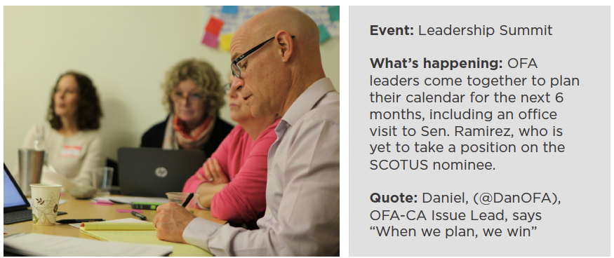
5 minutes
You are at this action planning meeting. Write a tweet that is
short and that shows what is happening at the meeting.
Notes:
Let’s try this out!
Imagine you are at this action planning meeting. Write a tweet that is short and that shows what is happening at the meeting.

Slide 37
Pause for activity 1:
Draft tweet
Notes:
Here you’ll walk through the example of social media posts – what do you see operating; what stands out to you

Slide 38
You might not be a
professional photographer
But you can be a good one
Notes:
You might not be a professional photographer, but you can be a good photographer—and you don’t need a fancy camera. Combined with free apps, today’s camera phones are convenient enough and perform well enough to capture excellent photos. Our phones make this so easy! Also we fully have a toolkit on this so check it out.

Slide 39
The photographer’s mantra
1
Fill the frame
Notes:
These three rules should guide the photos you take
Make sure the frame (what you see through your viewfinder or on your phone screen) is filled with the elements you want a viewer to see. If an element doesn’t need to be in the photo, make sure it’s out of the frame

Slide 40
The photographer’s mantra
1
Fill the frame
2
Control the background
Notes:
Make sure the background doesn’t distract from the message you’re trying to convey in the image. The background should enhance the image—it should provide a viewer with more information about the place, time, story, or emotion of the scene.

Slide 41
The photographer’s mantra
1
Fill the frame
2
Control the background
3
Wait for moments
Notes:
Once your frame is filled and the background is controlled, wait to take the perfect shot. This could be when a crowd erupts in cheers, when two people hug, or when a speaker passionately raises their arms. If there’s a lot of action in your frame, take multiple shots—or bursts of photos—to increase your chances of catching that perfect freeze-frame.

Slide 42
Adjust for the
lighting in your surroundings.
Notes:
If they’re in front of a window or lamp they’ll come out dark. Move to the side to another angle where they will be better lit. If they’re in front of a window or lamp—or the sun—they’ll come out dark. So you should move to get another angle where they will be better lit. The number one reason by photos turn out blurry is because there isn’t enough light. So if your photos are blurry see what you can do to get where there is more light.

Slide 43
Adjust for the
lighting in your surroundings.
Move yourself to
get varied shots or compose a scene.
Notes:
“Crop with your feet”
Instead of using the zoom functionality of your camera—which can result in grainy or blurry photos—move your feet to get closer to your subject. If there’s something distracting on the side of the frame or in the background, move yourself up, down, le , or right to try to eliminate the distracting element.
Change your angles
Take photos from different heights and different angles. Get low and photograph a crowd of protesters from below. Get up high to show all the contents on a table of letter-writers during a letter-writing event.
Vary your head sizes
One good indicator of photo variety is if head sizes are different between your shots. Focus on getting a mix of detail, medium, and wide shots, crop with your feet, and change your angles to allow for more variety.

Slide 44
Take your best shot
Notes:
The type of photo you take can speak volumes about the action you’re documenting

Slide 45
Need more?
Check out OFA’s Toolkits & Resources
ofa.us/resources

Slide 46
ofa.us/resources
Notes:
More resources available here to make your work even better – we think about these things a lot, okay?

Slide 47
Agenda
Why digital?
Producing content
Peer review
Debrief & next steps
Notes:
Now let’s try putting all that together!

Slide 48
5 minutes
For this activity, we are going to craft the story of our training using the digital skills we just learned.
Spend the next 5 minutes taking photos and crafting tweets and a Facebook post about today’s training.
Remember to use #OFAction

Slide 49
Pause for activity 2:
Draft tweet
Notes:
Here you’ll walk through the example of social media posts – what do you see operating; what stands out to you

Slide 50
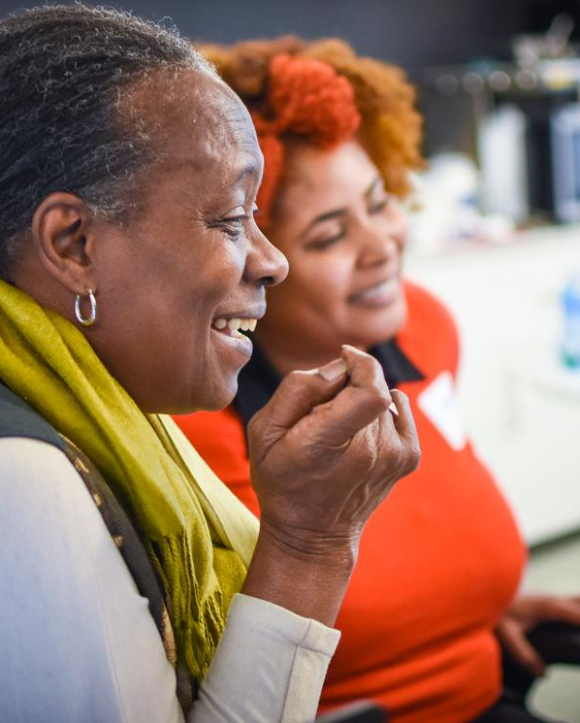
REPORT-BACK:
What
did you
come up
with?
Share your thoughts out loud!
Notes:
Take some time to share your draft and get feedback!

Slide 51
Agenda
Why digital?
Producing content
Peer review
Debrief & next steps

Slide 52
Debrief
How do you see digital organizing fitting into your organizing work?
What are you excited to try going forward?
Notes:
3 MINUTES
ADRIENNE
[TRACI pulls out some responses from the chat box]

Slide 53
Remember: using your Twitter account,
tweet your biggest takeaways using #OFAction & #OrganizingFor18
Notes:
Practice your new skills

Slide 54
Thank you!
Notes:
Thank you so much! See you on twitter!

