Slide 1
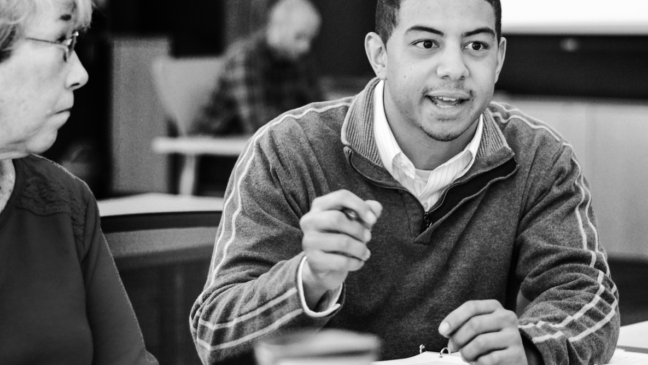


CAMPAIGN ORGANIZING BOOT CAMP
GOTV turnout conversations
Alex Tornato / OFA Training Manager / @atornato
Notes:
This work is licensed under the Creative Commons Attribution-NonCommercial 4.0 International License. To view a copy of this license, visit http://creativecommons.org/licenses/by-nc/4.0/ or send a letter to Creative Commons, PO Box 1866, Mountain View, CA 94042, USA.

Slide 2
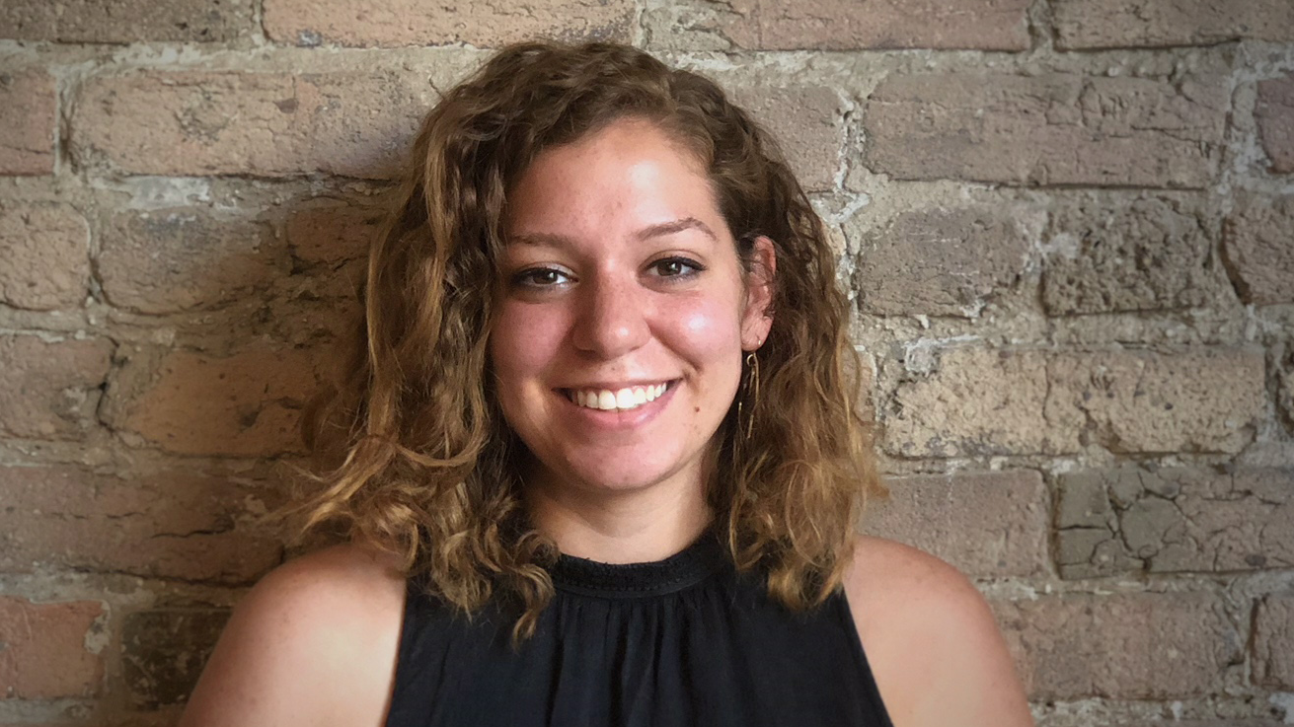

Alex Tornato
OFA Training Manager
@atornato

Slide 3
#OFAction
Notes:
As we go through this training, don’t be shy and tweet throughout the session using our hashtag. Let us know what you are taking away from this training, what is motivating you to organize, and follow me on twitter at @GriffenSaul

Slide 4

1
Internalize and apply the GOTV framework for effective conversations when talking to sporadic voters
Goals for this session
Notes:
Reformat

Slide 5
1
Internalize and apply the GOTV framework for effective conversations when talking to sporadic voters
Examine GOTV best practices
Goals for this session
2
Notes:
Reformat

Slide 6
1
Internalize and apply the GOTV framework for effective conversations when talking to sporadic voters
Examine GOTV best practices
Feel excited to implement these practices with voters in your community
Goals for this session
2
3
Notes:
Reformat

Slide 7
Agenda
Introduction
Voter universe
Elements of GOTV conversation
GOTV conversation framework
Next steps and close

Slide 8
Turnout conversations in a campaign are conversations focused on getting people out to vote.

Slide 9
Why do we have turnout conversations?

Slide 10
Pause for group share
Notes:
Pause here to share what’s worked and what’s been challenging

Slide 11
When more people vote our democracy is stronger.

Slide 12
Why do turnout conversations work?

Slide 13
Accountability to vote
Creates social pressure
Why do turnout conversations work?
*Source- Analyst Institute

Slide 14
Accountability to vote
Creates social pressure
Pledging to vote
Reminds voters of the norm of voting
Voters who pledge to vote are more likely to turnout than those who don’t
Why do turnout conversations work?
*Source- Analyst Institute

Slide 15
Accountability to vote
Creates social pressure
Pledging to vote
Reminds voters of the norm of voting
Voters who pledge to vote are more likely to turnout than those who don’t
Vote planning
Vote planning effectively cuts through the quick yes/no responses you might get from voters
Why do turnout conversations work?
*Source- Analyst Institute

Slide 16
Agenda
Introduction
Voter universe
Elements of GOTV conversation
GOTV conversation framework
Next steps and close

Slide 17

Voter universe

Slide 18
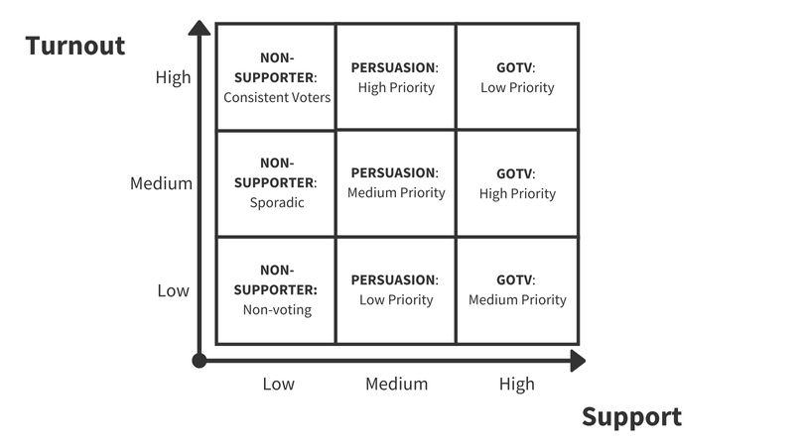

Slide 19
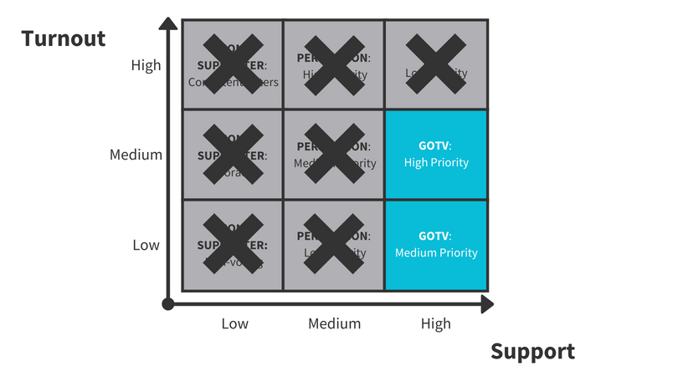

Slide 20
Focusing on these voters increases impact by THIS much…

Slide 21
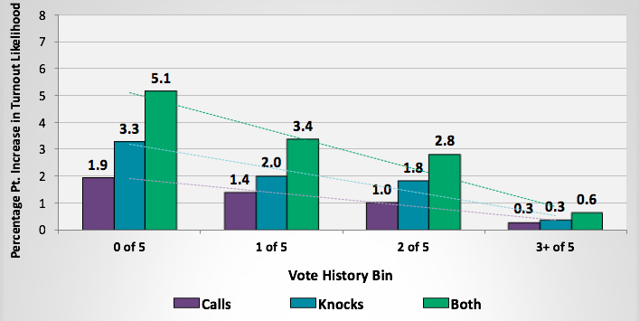
Impact was concentrated on more sporadic voters
Percentage pt. increase in turnout per attempt by vote history

Slide 22
Agenda
Introduction
Voter universe
Elements of GOTV conversation
GOTV conversation framework
Next steps and close

Slide 23
Elements of GOTV conversations

Slide 24
Elements of GOTV conversations
1
Getting a commitment to vote

Slide 25
Elements of GOTV conversations
1
Getting a commitment to vote
Making a plan to vote
2

Slide 26
Agenda
Introduction
Voter universe
Elements of GOTV conversation
GOTV conversation framework
Next steps and close

Slide 27
GOTV conversation framework

Slide 28
A GOTV CONVERSATION FRAMEWORK:
Confirm their support for your cause and remind them of key voting deadlines

Slide 30
A GOTV CONVERSATION FRAMEWORK:
Confirm their support for your cause and remind them of key voting deadlines
Make a plan with the voter

Slide 31
Impact was concentrated on more sporadic voters
Percentage pt. increase in turnout per attempt by vote history

Slide 32
A GOTV CONVERSATION FRAMEWORK:
Confirm their support for your cause and remind them of key voting deadlines
Make a plan with the voter
Get a commitment from the voter and ask them to verbalize their reasons

Slide 33
Voters commit and verbalize their reasons
Get voter commitment—they should verbalize that they will vote in their vote plan or you can have them sign a commit to vote card!
Verbalizing reasons for voting adds purpose for the voter and increases their likelihood to turnout.

Slide 34
A GOTV CONVERSATION FRAMEWORK:
Confirm their support for your cause and remind them of key voting deadlines
Make a plan with the voter
Get a commitment from the voter and ask them to verbalize their reasons
Don’t focus on issues or candidates

Slide 35
Don’t focus on candidates or issues
The goal is to increase turnout.
The Analyst Institute has found that voters view candidate/issue information as an attempt to get them to vote in a certain way and not as a reminder to vote!
Easy solution - confirm that they are supporter at the beginning of the conversation.

Slide 36
Watch video 1 on next slide

Slide 37
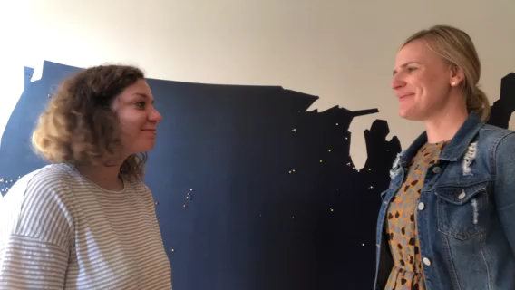

Slide 38
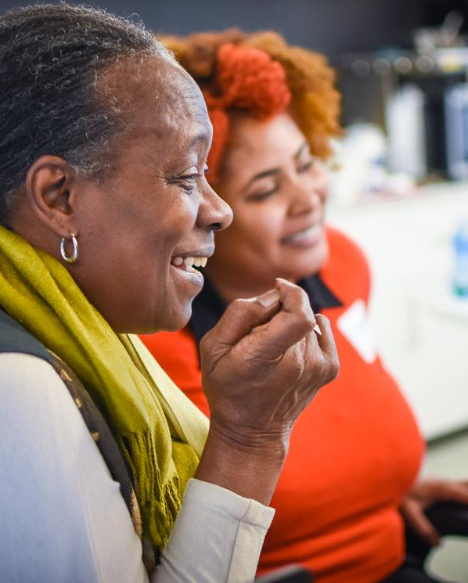
REPORT-BACK:
What is missing from the conversation you just watched?
Notes:
Take some time to share your thoughts with the group. What did you come up with? What was challenging? What did you or your partner do well?
What parts of the framework are they not following?

Slide 39
Watch video 2 on next slide

Slide 40
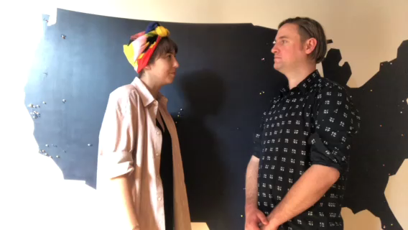

Slide 41
REPORT-BACK:
What went well in the conversation you just watched?
Notes:
Take some time to share your thoughts with the group. What did you come up with? What was challenging? What did you or your partner do well?

Slide 42
Pause for activity: Scenarios

Slide 43
Scenario 1:
Local touch
Voter accountability
Commitment to vote
Plan-making
Thanks for voting
Partner 1 should play the role of a hurried and busy sporadic voter
Partner 2 should play the role of the canvasser

Slide 44
Scenario 2:
Local touch
Voter accountability
Commitment to vote
Plan-making
Thanks for voting
Partners switch off!
Partner 1 is now the canvasser
Partner 2 is now the sporadic voter

Slide 45
Group debrief

Slide 46
REPORT-BACK:
What
did you
come up
with?
Share your thoughts out loud!
Notes:
Take some time to share your thoughts with the group. What did you come up with? What was challenging? What did you or your partner do well?

Slide 47
Agenda
Introduction
Voter universe
Elements of GOTV conversation
GOTV conversation framework
Next steps and close
Notes:
7:10- 7:11 (1 MINUTE)
This is our agenda for the day! It will help us to accomplish the goals we laid out in the previous slide. First, we’ll talk about what makes persuasion difficult and the challenges we face in having effective conversations. Next, we’ll begin to learn how to speak from our values using the “why, how, what” framework. We’ll then look at a few case studies and examples to see how this plays out in different areas of our life (not just politics!). Lastly, We’ll spend some time practicing and giving feedback, and then wrap up and close.

Slide 48
Next Steps
  Continue to practice the GOTV framework
  Rehearse connecting on shared values with two other people and ask for feedback
  Apply your GOTV skills to volunteering on campaigns
1
2
2
3
Notes:
Moving forward I hope you continue to practice this persuasion framework and work on connecting on shared values. It is always helpful to rehearse with a partner or small group and ask for feedback. And I hope you will work to apply your persuasion skills on the different campaigns you volunteer for.

Slide 49
Thank you!

