Slide 1
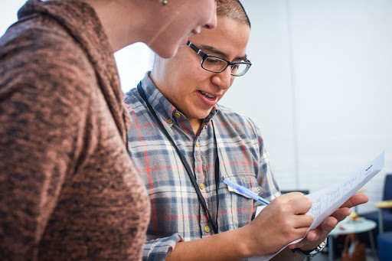
EFFECTIVE CONVERSATIONS
Knowing your why
Notes:
7:00- 7:05 (5 MINUTES)
Give folks a few minutes to hop on the call, make sure to check organizing@ofa.us for any technology issues. Once you’re ready, introduce yourself and the topic for this training.
This work is licensed under the Creative Commons Attribution-NonCommercial 4.0 International License. To view a copy of this license, visit http://creativecommons.org/licenses/by-nc/4.0/ or send a letter to Creative Commons, PO Box 1866, Mountain View, CA 94042, USA.

Slide 2
Our learning journey
Week 1: Effective listening
Week 2: Know your why
Week 3: Why, how, what
Week 4: Motivational interviewing
Week 5: Voter contact best practices
Notes:
7:05 – 7:07 (2 MINUTES)
Tie together this particular session (Week 2) with the overall series and how this particular topic will help in their organizing work. Knowing your why is the first and most powerful step in being able to speak powerfully from your values and motivating people to action.

Slide 3
Alexis Conavay
OFA Organizing Project Manager
@AlexConavay

Slide 4
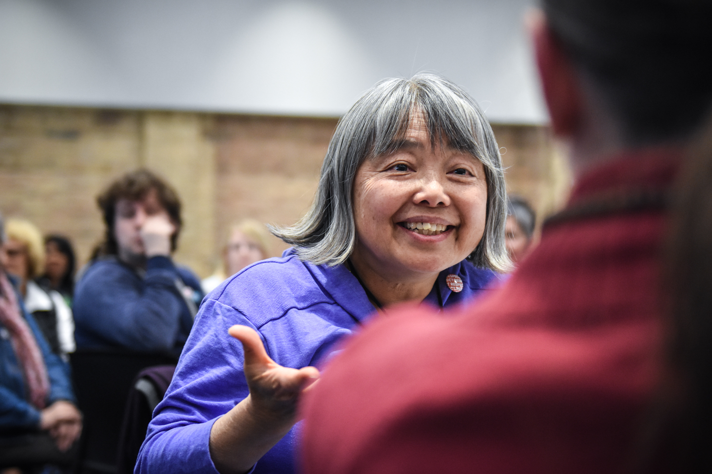
Starting effective
conversations
Notes:
7:07- 7:08 (1 MINUTE)
Why we need to have effective conversations – the time is NOW to understand our neighbors and understand the things that compel them, especially in 2018 as we head toward November.

Slide 5
#OFAction

Slide 6
1
Analyze underlying reasons why engaging in persuasive conversations is difficult, both individually and interpersonally.
Goals for
this session
2
Apply the theory of ‘knowing your why’ to people you will talk to in your organizing work.
3
Be ready to speak from our values and engage in challenging conversations during this incredibly important year!
Notes:
7:08- 7:10 (2 MINUTES)
We have three main goals for tonight! You should read the goals nearly word-for-word but also add in your talking points or way that you understand the goals as well. Don’t get caught up in spending too much time here though!
Connecting our values to theirs
Sense of community – relational organizing – these are our neighbors. - research and polling shows us that the people around us are exactly the folks we need and can get involved. Warmth of contact – more of an impact on people you are closer to. RELATIONSHIP – FOLKS FEEL SEEN AND HEARD AND LOVED
COMPELLING OTHERS WITH A VISION OF WHAT GUIDES AND DIRECTS YOU

Slide 7
Agenda
The challenge of persuasion
Speaking from values: The why, how, what
Case studies & examples
Practice and feedback
Putting it all together & next steps
Notes:
7:10- 7:11 (1 MINUTE)
This is our agenda for the day! It will help us to accomplish the goals we laid out in the previous slide. First, we’ll talk about what makes persuasion difficult and the challenges we face in having effective conversations. Next, we’ll begin to learn how to speak from our values using the “why, how, what” framework. We’ll then look at a few case studies and examples to see how this plays out in different areas of our life (not just politics!). We’ll spend some time practicing and giving feedback, and then wrap up and close.

Slide 8
Why is changing someone’s opinion so difficult?
FOLLOWING CLIP:
The Incredible Rarity of Changing Your Mind
from This American Life
Notes:
7:11- 7:13 (2 MINUTES)
Iour work as organizers, we want to have conversations with people so we can get them to do something to make a difference. Whether convince a supporter to make phone calls, or an elected official to vote a certain way on a piece of legislation or whatever the scenario, but we aren’t always successful.
We know from experience how challenging it is to change someone’s opinion, but here we will break down why that is and how we can begin to craft strategies to be more effective in our conversations.
To get our minds going, we have a clip ahead from the podcast, “This American Life.” Listen to the following clips with this thought in mind: why is it so difficult to change someone’s mind?
“Why is changing someone’s opinion so difficult?” We have all run into someone that we had trouble talking to and getting them to think about something that we really cared about.

Slide 9
Notes:
7:13- 7:15 (2 MINUTES)
Press play on the left hand corner of the orange squares. One at a time.

Slide 10
BRAINSTORM:
Why is it difficult to persuade someone to change?
Type your thoughts into the chat box.
Notes:
7:15- 7:18 (3 MINUTES)
So, as Ira Glass points out, it’s really difficult, why do you think that is? Why is it so difficult to persuade someone to change?
Type your thoughts into the chat box and we will read out some of your responses.

Slide 11
Challenges to persuasion
Personal Anxiety
Notes:
7:18 [0 minutes]
In these next few slides, we’ll point out and discuss some of the major buckets we identify that makes it challenging to persuade someone to change.
First, is personal anxiety. When we talk about opposing points of view, we are tapping into values and experiences that someone holds really deeply, and might be a source of anxiety to confront or change such tightly held beliefs. They are tied into our identity and the very way we walk in the world.

Slide 12
Challenges to persuasion
Personal Anxiety
Interpersonal differences
Notes:
7:18- 7:19 (1 MINUTE)
Next is “interpersonal differences” We all orient ourselves to the world differently based on our personal experiences. When conflicting values clash, because they are coming from different orientations, that makes it hard to find common ground.

Slide 13
Challenges to persuasion
Personal Anxiety
Interpersonal differences
Fractured political context
Notes:
7:19- 7:20 [1 MINUTE]
Third is a fractured political context. Particularly around politics there can be some serious challenges to persuading someone to a point of view. It’s hard to have a conversation when we don’t have shared facts or sources because then we can’t find common ground, which leads to polarization and the entrenched positions we find ourselves in today.
Feel free to give in an example

Slide 14
Challenges to persuasion
Personal Anxiety
Interpersonal differences
Fractured political context
The “ask” typically associated
Notes:
7:20- 7:21 [1 MINUTE]
Personally, I am always terrified by the ask – that’s it’s going to be something I really don’t want to do, like make phone calls. Just in general I don’t really like talking on the phone, especially to strangers, so the thought of making calls is stressful for me. But that is one of the “typical” asks, so – as a personal reflection – think about what you can do to help mitigate that kind of anxiety in your conversation.

Slide 15
Agenda
The challenge of persuasion
Speaking from values: The why, how, what
Case studies & examples
Practice and feedback
Putting it all together & next steps
Notes:
7:21 – 7:21 (0 MINUTE)
Now that we’ve covered the challenges we face in persuasive and effective conversations. Let’s move on to how we can overcome this by speaking from our values.

Slide 16
2018 is an important moment. We need to have thousands of effective conversations this year.
Notes:
7:21 – 7:22 [1 MINUTE]
2018 is a chance for our voice to be heard, to turn back the tide back towards progress and restore our democracy. OFA’s mission is to create a vibrant and participatory democracy, and to do that we need to have thousands of powerful conversations this year that motivate people to get involved and make a difference at the ballot box.

Slide 17
We can cut through the political noise when we have conversations that speak to the head and the heart.
Notes:
7:22 – 7:23 [1 MINUTE]
You don’t have to be an experienced policy maker and know all the ins and outs of legislation to discuss your “WHY” with your neighbor. We can cut through the noise when we have conversations that speak to the head and the heart.

Slide 18
But how do we have
powerful conversations?
Notes:
7:23 – 7:23 [0 MINUTE]
But how do we have conversations that speak to the head and to the heart?

Slide 19
Notes:
7:23 – 7:27 [4 MINUTES]
0:00 - 4:36: Theory of why, how, what and quick example of apple from author and marketing consultant, Simon Sinek It’s about 4 minutes long.

Slide 20
The Golden Circle
Notes:
7:27- 7:27 [0 minutes]
Let’s break down the golden circle!

Slide 21
Why
Notes:
7:27- 7:27 [0 minutes]
Let’s start with the why

Slide 22
Your why
1
This is your cause, your purpose, your belief. The thing that drives you most.
2
We are able to connect to each other more deeply through values and beliefs.
3
This is the hardest part of ourselves to understand clearly.
Notes:
7:27- 7:28 [1 minutes]
Spend a little time reading through each of these key points.

Slide 23
How
Notes:
7:28- 7:28 [0 minutes]
Now let’s talk about the How.

Slide 24
Your how
1
This is your strategy, the way that you bring your “why” into being.
2
Your how should explain the way in you which you or your organization live out your values.
3
We sometimes call this our “theory of change.”
Notes:
7:28 - 7:29 [1 minutes]
Spend a little time reading through each of these key points.

Slide 25
What
Notes:
7:29- 7:29 [1 minutes]
Now let’s talk about the what.

Slide 26
Your what
1
Your what is what you do; the actions you take each day.
2
This is the easiest part of ourselves to understand, but the least convincing to motivate others.
3
Use your “why” and “how” to motivate people to join your “what!”
Notes:
7:29 – 7:30 (0 Minutes)
Spend a little time reading through each of these key points.

Slide 27
Agenda
The challenge of persuasion
Speaking from values: The why, how, what
Case studies & examples
Practice and feedback
Putting it all together & next steps
Notes:
7:30 - 7:30 (0 MINUTE)
Now let’s move on to some case studies and examples of how to speak from our values.

Slide 28
Two case studies
Notes:
7:30 - 7:30 [0 minutes]
Let’s look at these two examples.

Slide 29
Speaking from the ‘why’
1
Watch these two commercials and pay attention to how each utilizes messaging.
2
Which one is speaking more from its why? What values do you hear being messaged?
3
Why does this example feel more powerful to you? How does it move you?
Notes:
7:30 - 7:31 [1 minutes]
Keep these things in mind as you watch.

Slide 30
Notes:
7:31 – 7:33 [2 MINUTE]
Chrysler car commercial “Imported from Detroit”

Slide 31
Notes:
7:33 - 7:35 [2 MINUTE]
Only play the first two minutes of this Chevy commercial.

Slide 32
Speaking from the ‘why’
1
Watch these two commercials and pay attention to how each utilizes messaging.
2
Which one is speaking more from its why? What values do you hear being messaged?
3
Why does this example feel more powerful to you? How does it move you?
Notes:
7:35 - 7:38 [3 minutes]
Debrief the commercials in the chat box, but don’t spend too much time on this slide!

Slide 33
How can we apply this framework to community organizing?
Notes:
7:38-7:40 [2 MINUTES]
Distinguish between personal story and your ‘why’: they serve different purposes!
When you know your why, it enables you to reflect on your values and connect with your neighbors to spark a different conversations
We don’t assume that every conversation we have will end with an ‘ask’

Slide 34
Key shifts in thinking:
1
What we mean by persuasion
2
Who we understand the audience to be
3
How this applies to community organizing
Notes:
7:40- 7:43 [3 minutes]
Persuasion: we want to understand the KEY values that drive our thinking, and why we do what we do. We want the answers to the questions, ‘What is your purpose? What is your cause? What is your belief?’ When we have the answers to these questions, we are motivated at a gut level to make a change in our society and communicate the change we so desperately wish to see as a reality.
People often think about this in the short term, but we want to stretch that out for the long term, to people we see regularly.
Audience: our audience is your neighbors. You are not talking to someone who necessarily lives so far outside your lived experience- the challenges you see in your community are the challenges they likely see in their community as well.
How this applies to community organizing: We are not at their door to necessarily ’make an ask’ – we are there to spark conversation, understand our neighbors, and create space to continued conversations to come. We are going to work on our LISTENING and uncover what people care about.

Slide 35
Agenda
The challenge of persuasion
Speaking from values: The why, how, what
Case studies & examples
Practice and feedback
Putting it all together & next steps
Notes:
7:43- 7:43 (1 MINUTE)
Let’s spend a few more minutes practicing!

Slide 36
How do we speak from
our values during our conversations with people?
Notes:
7:43- 7:43 (0 MINUTE)
So far we’ve seen examples of speaking from values in one way communication, but how do we have a dialogue?

Slide 37
First, you have to know
your why and also be
genuinely curious about
your neighbor’s why.
Notes:
7:43 – 7:43 (0 MINUTE)
Read the slide!

Slide 38
One method to identify your ‘why’
Critical incidents:
Critical incidents are events in your life that you can recall being an important moment for you in clarifying what you believe.
-Stephen Brookfield
Notes:
7:43 – 7:44 (1 MINUTE)
Take a minute to explain what we mean by critical incident but don’t spend too much time! The practice is what matters most.

Slide 39
My critical incident story
Notes:
7:50 – 7:53 (3 MINUTES)
Facilitator shares their critical incident.

Slide 40
WHOLE GROUP CHATBOX
From the critical incident
story you heard, what values do you hear being conveyed?
Notes:
7:53- 7:55 [2 minutes]
Group shares underlying values- types in chat box and people press one to share

Slide 41
One method to identify your ‘why’
Critical incident question:
When was the first time you remember standing up for something that you believed in?
Notes:
7:44 – 7: 45 [1 minutes]
Reference pre-work – you can share here if you are willing

Slide 42
Now it’s your turn
Remember: Having a clear, concise why keeps us connected to why we do what we do, helps us connect to others, and when shared, has the opportunity to build trust and community.
Type in the chat box to share
your critical incident
Notes:
7:45 - 7:50 [5 minutes]
It’s ok if that takes a second – this is hard! Really think about the FIRST time that happened because that was when you likely solidified your belief around a particular value.
This is hard and takes a lot of practice, so some
This is very personal, so if you feel comfortable sharing, we would love to hear.

Slide 43
WHOLE GROUP CHATBOX
In your own critical incident story, what values do you find?
Notes:
7:55- 7:57 [2 minutes]
Group shares underlying values- types in chat box and people press one to share

Slide 44
Putting it all together:
The framework of your why
Critical incident
What is a critical incident that leads to what you believe and why?
Notes:
7:57- 7:57 [0 minutes]
Very quick summary here!

Slide 45
Putting it all together:
The framework of your why
Critical incident
What is a critical incident that leads to what you believe and why?
Values
What values are present underneath your critical incident and why?
Notes:
7:57- 7:57 [0 minutes]
Very quick summary here!

Slide 46
Putting it all together:
The framework of your why
Critical incident
What is a critical incident that leads to what you believe and why?
Values
What values are present underneath your critical incident and why?
Practice
How will you practice communicating your values in way that resonates with diverse groups of people?
Notes:
7:58- 7:58 [0 minutes]
Very quick summary here!

Slide 47
What changes will you
make in conversations if you
are trying to identify and
understand their why?
Notes:
7:58 - 7:59 (0 minutes)
Take a minute to answer some questions!

Slide 48
Agenda
The challenge of persuasion
Speaking from values: The why, how, what
Case studies & examples
Practice and feedback
Putting it all together & next steps
Notes:
7:59 – 8:00
Let’s spend a couple minutes closing out!

Slide 49
Debrief
Which phase of the framework comes easily to you?
How will you use this framework in your conversations this year?
Notes:
3 MINUTES
Answer questions in the chat box!

Slide 50
Next steps
Notes:
1 MINUTE
TRACI + ADRIENNE
OFA -- TRACI
1) December 7: Redistricting call with NDRC
2) MLK DAY OF SERVICE = VR: Email organizing@ofa.us if you would like to get involved with voter registration
3) JOIN THE NEXT CALL
Link to put in chat box: https://zoom.us/webinar/register/WN_tUkjIhBnTGSSGPhQ1MQgaQ

Slide 51
EFFECTIVE CONVERSATIONS
Part 3: Your theory of change
Elizabeth Erickson/ OFA Training Director
Alexis Conavay/ OFA Organizing Project Manager
June 13th at 8 p.m. ET/7 p.m. CT
Notes:
way to make our assumptions out on the surface in a way that can be analyzed
Give date/time of next training

Slide 52
Team ’18
bit.ly/ofa18
Notes:
We will also run a Team’ 18 Leadership program, where you will have the opportunity to build volunteer teams on behalf of OFA. You will have the opportunity to coach, mentor, and develop organizers who live in target areas.
OFA will support you in your work by doing what we know best—providing training, coaching, and mentorship to make sure you are prepared to take on this fight.
Sign-up to join Team ‘18 now!!:http://bit.ly/ofa18
Canvassing, phone banking, talking to family and friends

Slide 53
OFA
Thank you for joining today’s webinar.
Please fill out the survey below and give us
your feedback on today’s training.
bit.ly/EC_training2

Slide 54
Thank you!

