Slide 1
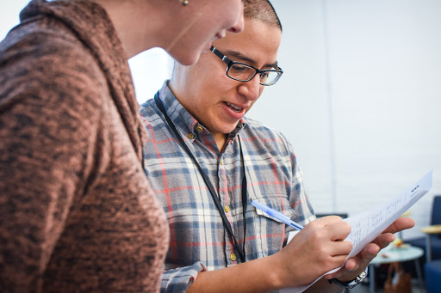

Arena Academy
Personal story
Elizabeth Erickson / OFA Training Director / @LizzErickson

Slide 2
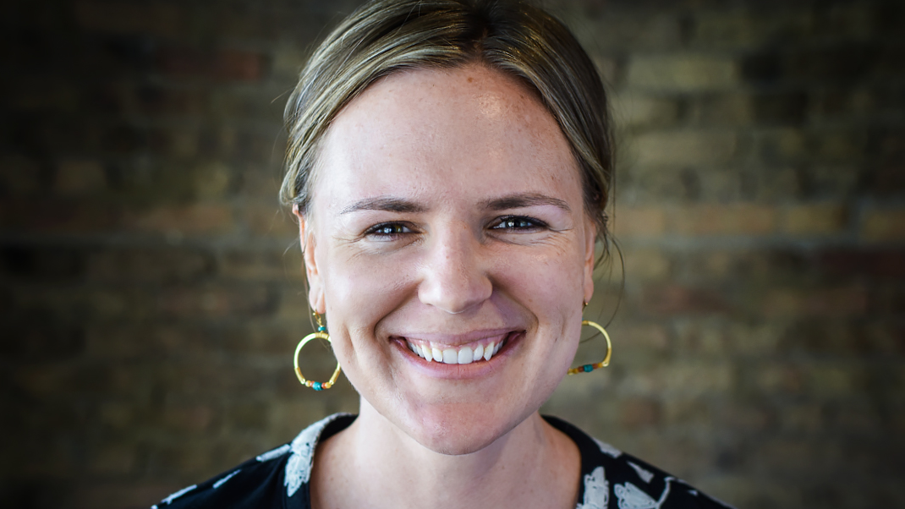
Liz Erickson
OFA Training Director
@LizzGErickson
Notes:
Liz, training director at OFA – have the honor of thinking about how people learn and grow for the betterment of their community
Logistical note – bathrooms are out here, feel free to get up and take care of your needs when you have them
Also! This is the first time you are together as a group and I am really excited for the journey you are taking together – you will rely on relationships in this room for emotional difficulties as well as practical resources. Couldn’t be more excited – the power of this group to lead change is exciting.

Slide 3
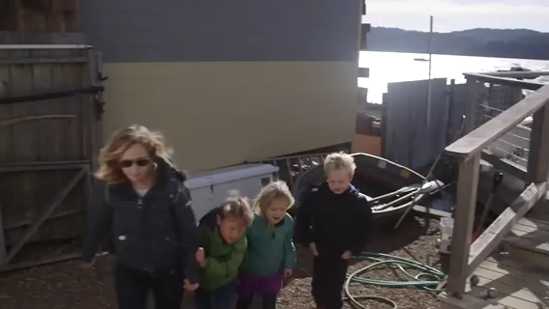
Notes:
Start with a video! After we watch, we are going to have a reflection question
Thank you for watching – this story was shared during enrollment – after the ACA had passed, hearts and minds still had to be swayed for people in the US to actually join a plan –what a MONUMENTAL TASK that was ahead for organizers.

Slide 4
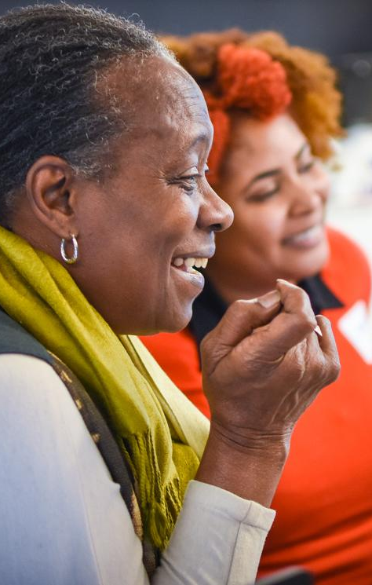

OPENING REFLECTION
What was the last thing you remember that deeply moved you?
Why did it move you?
Notes:
Talk with your tables – introduce your name, and your thoughts to the answer of this question
Place for notes in your binder

Slide 5
GROUP SHARE
What was the last thing you remember that deeply moved you?
Why did it move you?
Notes:
2- 3 people share the answers – share your name before you share your answer!
Key points – things that move us are usually relatable (a mom, kids), evoke our senses (the light in the video), hit right note of provocative (she talks about concept of dying but leaving children without a mother), might jar us from our preconceived thoughts (pre-existing condition)
Connection to personal story – these are foundations for a tool for organizers that you will have for the rest of your organizing career – your personal story
Like you saw in the movie, personal stories transform issues and candidates from complicated, abstract policy or people to real life, relatable experiences
On a final note – there are different poles of stories – we have polished ones (like the one in the video), but also RAW – like the women in the elevator confronting Jeff Flake

Slide 6
Goals for our time
1
Identify the components of a compelling personal story

Slide 7
Goals for our time
1
Identify the components of a compelling personal story
2
Craft your personal story and be adept in sharing it in a variety of scenarios

Slide 8
Goals for our time
1
Identify the components of a compelling personal story
2
Craft your personal story and be adept in sharing it in a variety of scenarios
3
Believe in the power of shared connection through personal story

Slide 9
Agenda
Opening
Thinking about your values
Components of personal story
Adapting your personal story to your audience
Debrief and close

Slide 10
Agenda
Opening
Thinking about your values
Components of personal story
Adapting your personal story to your audience
Debrief and close

Slide 11
Compelling personal stories
are built on values.
Notes:
All good stories are built on our values – to communicate with others well, we have to know ourselves well, and also know the audience we are talking to

Slide 12

Notes:
2004 Democratic national convention speech that catapulted Obama into the spotlight – as you watch, think through, ‘what values do you hear him communicating to the audience?’

Slide 13
GROUP SHARE
What values do you hear President Obama communicating?
How do they land for you?
Notes:
Listen to whole group answers – take 3 people
You don’t have to be a masterful orator like Obama to share your personal story – but it is important to know that you need self-awareness and communicate with drives and compels you
When we share what compels us, and relay that – people are hooked and motivated. Personal stories are a way to share our motivations and values in an authentic way that allows us to bring people into our work for the long-term
Look on the back page of your notes – before we head into the personal story framework, choose 3 values that stick out to you. Circle them! We will need them for later.

Slide 14
Agenda
Opening
Thinking about your values
Components of personal story
Adapting your personal story to your audience
Debrief and close

Slide 15
Stories are powerful
Notes:
How do we do all these things? How do we share our stories in a way that connects with people, shows our values, and translates abstract policy or candidates into an actual lived experience? We use personal stories
One framework for story telling is the challenge, choice, outcome, ask – and we are going to go through it now

Slide 16
Elements of a personal story
Challenge
Choice
Outcome
Ask

Slide 17
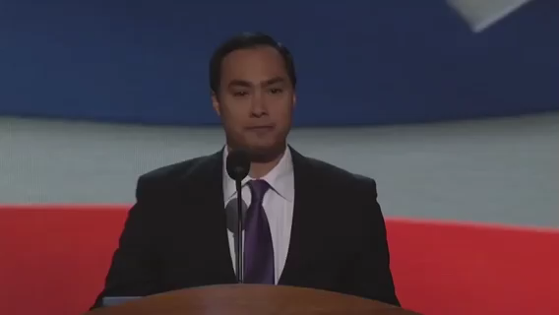
Notes:
Julian Castro – san Antonio mayor at the time
We will use this as an example, so get his story down!

Slide 18
Elements of a personal story
Challenge
Choice
Outcome
Ask

Slide 19
The challenge is the central
reason for taking action. Without challenges, there would be no need
to organize. Everyone would just
be happy with the status quo.

Slide 20
Sample
personal
story
Challenge
I grew up in the Central Valley of California -- next to peach orchards, cotton fields, and the vast Sierra Nevada mountains looming in the distance. I was raised on the beliefs of “You can do whatever you dream” and “If you work hard enough, you can achieve anything”.
I thought this applied to everyone. My unlearning of how the world worked hit me like a train when I taught 160 seventh grade boys in Charlotte, North Carolina. Faced with systemic injustices of poverty, failing education, and the color of their skin considered criminal, I knew dreams weren’t enough for my students.
Notes:
Address question of, ‘what if I don’t have a compelling conflict?’ – I adapt stories all the time – you become more adept at finding out key moments
Some of us have the privilege of choosing, some issues choose us

Slide 21
Now it’s your turn!

Slide 22
Elements of a personal story
Challenge
Choice
Outcome
Ask

Slide 23
This is the choice you made
to confront your challenge. What
is the choice you made in that
moment of adversity?

Slide 24
For most organizers, your choice
was action. Your choice was change—
to stand up and do something,
no matter how big or small.

Slide 25
Sample
personal
story
Choice
I grew up in the Central Valley of California -- next to peach orchards, cotton fields, and the vast Sierra Nevada mountains looming in the distance. I was raised on the beliefs of “You can do whatever you dream” and “If you work hard enough, you can achieve anything”.
I thought this applied to everyone. My unlearning of how the world worked hit me like a train when I taught 160 seventh grade boys in Charlotte, North Carolina. Faced with systemic injustices of poverty, failing education, and the color of their skin considered criminal, I knew dreams weren’t enough for my students -- they needed structural changes, backed by sound policy with politicians that cared about the future opportunities of my students.

Slide 26
Now it’s your turn!

Slide 27
Elements of a personal story
Challenge
Choice
Outcome
Ask

Slide 28
What were the results of your decision?
The outcome shows how taking
action can lead to something good.
If you’re telling the story in an effort
to move someone to take action,
they need to know that taking action
can have positive results.

Slide 29
Sample
personal
story
Outcome
I grew up in the Central Valley of California -- next to peach orchards, cotton fields, and the vast Sierra Nevada mountains looming in the distance. I was raised on the beliefs of “You can do whatever you dream” and “If you work hard enough, you can achieve anything”.
I thought this applied to everyone. My unlearning of how the world worked hit me like a train when I taught 160 seventh grade boys in Charlotte, North Carolina. Faced with systemic injustices of poverty, failing education, and the color of their skin considered criminal, I knew dreams weren’t enough for my students -- they needed structural changes, backed by sound policy with politicians that cared about the future opportunities of my students.
Since that year, I have committed to understanding what a powerful education looks like for students in our country, supporting local schools in their efforts for success, and constantly re-evaluating who I am as a white woman in this world.

Slide 30
Now it’s your turn!

Slide 31
Elements of a personal story
Challenge
Choice
Outcome
Ask

Slide 32
The ask is when you give
your audience a chance to
join you and become part
of the story.

Slide 33
Sample
personal
story
Ask
I grew up in the Central Valley of California -- next to peach orchards, cotton fields, and the vast Sierra Nevada mountains looming in the distance. I was raised on the beliefs of “You can do whatever you dream” and “If you work hard enough, you can achieve anything”.
I thought this applied to everyone. My unlearning of how the world worked hit me like a train when I taught 160 seventh grade boys in Charlotte, North Carolina. Faced with systemic injustices of poverty, failing education, and the color of their skin considered criminal, I knew dreams weren’t enough for my students -- they needed structural changes, backed by sound policy with politicians that cared about the future opportunities of my students.
Since that year, I have committed to understanding what a powerful education looks like for students in our country, supporting local schools in their efforts for success, and constantly re-evaluating who I am as a white woman in this world.
This weekend, there will be a community panel at our local school, discussing different alderperson approaches to education -- would you join me in attending?

Slide 34
Now it’s your turn!

Slide 35
Elements of a personal story
Begin writing your personal story. Think of a key life moment–it doesn’t need to be dramatic–in which you began to care about the issue you wrote about in the previous exercise. Consider the following:
  What was the specific challenge you faced?
  What was the specific choice you made?
  What happened as a result of your choice?
  How can your listener join you in taking action?
C
C
O
A
A
Notes:
What values underpinned Castro’s story?
Going back to the original question of the session, how did it move the audience?
What values underpinned my story?
What values underpin your story?
Address the question of time – we are sometimes in pressure situations and need to shorten, sometimes we have more time to connect
2 people

Slide 36
Agenda
Opening
Thinking about your values
Components of personal story
Adapting your personal story to your audience
Debrief and close
Notes:
7:10- 7:11 (1 MINUTE)
[LIZ]

Slide 37
Adapting your personal story to different audiences
Notes:
We need to be able to adapt our personal story to the audience and the ask we are maing
You will have numerous audiences over your life cycle as an organizer, and we want to get comfortable listening and adapting to who we are talking to

Slide 38
GROUP SHARE
Who are the likely audiences you interact with as an organizer?
Notes:
People you might need resources from (their space to host an event), potential coalition partner, a voter, 1:1, MOC
We adapt quickly a few ways – responding to values that you hear them saying (“I hear you saying your frustrated, which makes me think you care about XYZ thing); connect their values to the values of the campaign

Slide 39
Scenario 1: During a 1:1
You are an organizer who needs to find a team leader for a neighborhood team that you are building in your turf. You have identified a volunteer who you think would be a really committed person to lead this team, but before you ask them to do that, you need to make sure they have the skill and desire to do that. The ask of this 1:1 is to organize, host, and recruit for a house party. This will be their first test.
Values of the person you are speaking to: fairness, equity, hard work
FRAMEWORK
Challenge
Choice
Outcome
Ask
Notes:
Continuing to keep this framework in mind and the information you learned from scenario one. Here is another example of what you might encounter at the doors or on the phones (READ SCENARIO 1)

Slide 40
Scenario 2: Canvassing
You are an organizer knocking doors. The voter that you are speaking to is undecided about your candidate, but did indicate they voted for Trump in 2016 because they thought there would be better business opportunity with Trump being in office. Your ask is to get their email address, so the voter can receive more information about the candidate you are canvassing for.
Values of the person you are speaking to: safety, loyalty, respect
FRAMEWORK
Challenge
Choice
Outcome
Ask
Notes:
Continuing to keep this framework in mind and the information you learned from scenario one. Here is another example of what you might encounter at the doors or on the phones (READ SCENARIO 2)

Slide 41
Group share

Slide 42
Agenda
Opening
Thinking about your values
Components of personal story
Adapting your personal story to your audience
Debrief and close
Notes:
7:10- 7:11 (1 MINUTE)
[LIZ]

Slide 43

Debrief
What are your next steps for your personal story?
How can you continue to re-center on the values that drive your work?
What do you predict will be difficult?

Slide 44
Key shifts in thinking:
1
Personal stories transform issues and candidates from complicated, abstract policy to real life experiences
Personal stories are a way to share our motivations and values in an authentic way that allows us to bring people into our work for the long-term
We need to be able to adapt our personal stories to a variety of audiences at any given time (in 1:1s, with our members of congress, when we are recruiting, when we are canvassing)
2
3

Slide 45
Next steps:
  Continue to practice and refine your personal story
  Share your personal story your coach and ask for feedback
1
2

Slide 46
Thank you!

