Slide 1
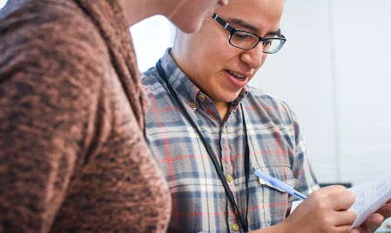


CAMPAIGN ORGANIZING BOOT CAMP
Personal story
Elizabeth Erickson / OFA Training Director / @LizzGErickson
Notes:
[1 min]
Welcome people to the training
This work is licensed under the Creative Commons Attribution-NonCommercial 4.0 International License. To view a copy of this license, visit http://creativecommons.org/licenses/by-nc/4.0/ or send a letter to Creative Commons, PO Box 1866, Mountain View, CA 94042, USA.

Slide 2
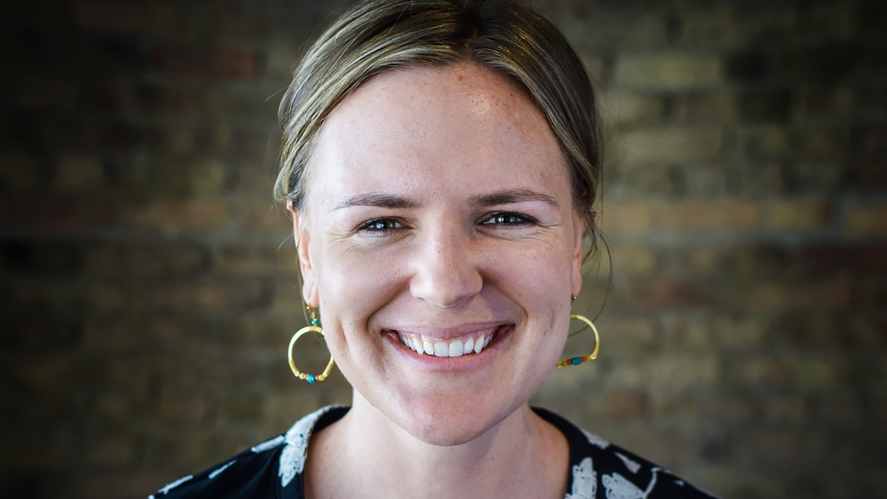
Liz Erickson
OFA Training Director
@LizzGErickson
Notes:
“We have people joining us from all across the country that are wanting to make a difference in their communities. Type in your city and state into the chat box, and give others some appreciation for being on the call!”

Slide 3
#OFAction
#OrganizingFor18
Notes:
As we go through this training, don’t be shy and tweet throughout the session using our hashtag. Let us know what you are taking away from this training, what is motivating you to organize, and follow me on twitter at @GriffenSaul

Slide 4

Goals for our time
1
Analyze underlying reasons why engaging in persuasive conversations is difficult, both individually and interpersonally
Notes:
Our goals for today include the following: We want you to be able to

Slide 5
Goals for our time
1
Analyze underlying reasons why engaging in persuasive conversations is difficult, both individually and interpersonally
2
Apply the theory of ‘knowing your why’ to people you will talk to in your organizing work

Slide 6
Goals for our time
1
Analyze underlying reasons why engaging in persuasive conversations is difficult, both individually and interpersonally
Describe the framework for effective persuasion conversations
2
Apply the theory of ‘knowing your why’ to people you will talk to in your organizing work
3
Use the challenge, choice, outcome, ask framework to develop your personal story

Slide 7
Agenda
The incredible rarity of changing your mind
Theory building with Simon Sinek
Critical incident
Personal story framework
Debrief and close
Notes:
7:10- 7:11 (1 MINUTE)
[LIZ]

Slide 8
Why is changing someone’s opinion so difficult?
FOLLOWING CLIP:
The Incredible Rarity of Changing Your Mind
from This American Life
Notes:
So, in our work as organizers, we want to have conversations with people so we can get them to do something we want them to do. Whether convince a supporter to make phone calls, or an elected official to vote a certain way on a piece of legislation or whatever the scenario, but we aren’t always successful. As we learned in the last two weeks, we need to be good listeners and understand what motivates someone’s position.
We know from experience how challenging it is to change someone’s opinion, but we will break down why that is and how we can begin to craft strategies to be more effective in our conversations.
To get our minds going, we have a clip ahead from the podcast, “This American Life.” Listen to the following clip with this thought in mind.” As you listen to this, think about why it’s so difficult to change someone’s mind.
“Why is changing someone’s opinion so difficult?” We have all run into someone that we had trouble talking to and getting them to think about something that we really cared about.

Slide 9
Listen to clip on
following slide

Slide 10




Slide 11
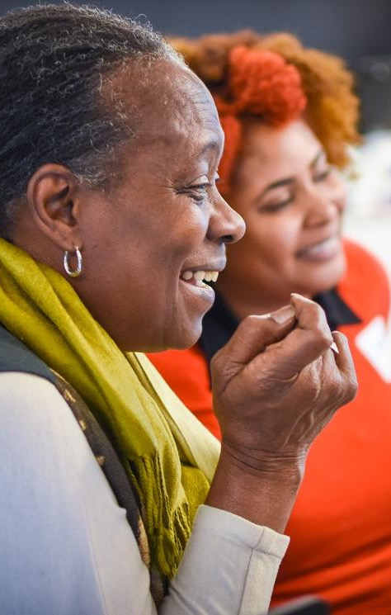
GROUP SHARE
Why is it difficult to persuade someone to change?
Notes:
Personal anxiety, people’s opinions are based on their experiences of how the world is

Slide 12
Pause for group discussion

Slide 13
Agenda
The incredible rarity of changing your mind
Theory building with Simon Sinek
Critical incident
Personal story framework
Debrief and close
Notes:
7:10- 7:11 (1 MINUTE)
[LIZ]

Slide 14
We can cut through the clutter when we have conversations that speak to the head and the heart.
Notes:
You don’t have to be an experienced policy maker and know all the ins and outs of a bill to discuss your “WHY” with your neighbor. We can cut through the clutter when we have conversations that speak to the head and the heart.

Slide 15
Watch video clip on
following slide

Slide 16

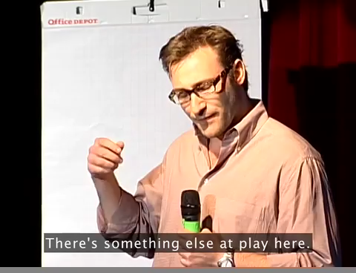
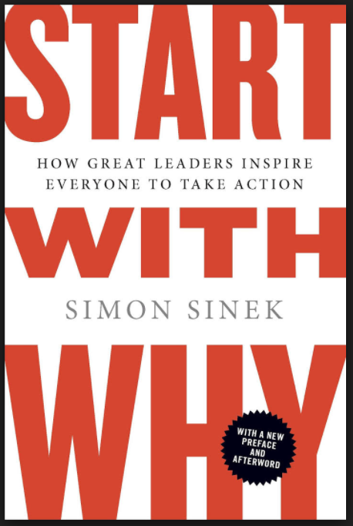
Notes:
1:36- 4:36: Theory of why, how, what and quick example of apple from author and marketing consultant, Simon Sinek It’s about 3 minutes long.

Slide 17
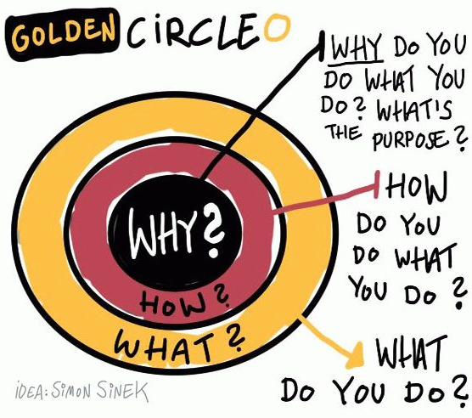
Notes:
Discussion of WHY, HOW, WHAT
What we to convey is that if you start with your belief and communicate your WHY, it will resonate with people in the way a WHAT never can. So, the order is important here as well – you need to start with your WHY in order to be able to start to build a connection based on shared values, then move outward.
Because the WHY is what moves YOU – it is the core thing that makes you tick. It is your reason to get out of bed. It’s the thing that you might have subconsciously operated with but not likely articulated out loud
HOW: ‘How’ is your theory of change – it is the way that you believe your why can come into the world
WHAT: ‘What’ is the thing that you are now doing as a result of your how – it is your specific actions associated with your theory of change.
In politics, we frequently start with WHAT which is not how you can easily connect with people – it tends to be superficial and can feel inauthentic.
If we take this model presented by Simon, then you can see how it shakes out with organizations as well. Here’s a couple of examples to compare and contrast.

Slide 18
Agenda
The incredible rarity of changing your mind
Theory building with Simon Sinek
Critical incident
Personal story framework
Debrief and close
Notes:
7:10- 7:11 (1 MINUTE)
[LIZ]

Slide 19
Narrowing in on our values
and beliefs aid us in understanding our ‘why.’

Slide 20
One method to identify your ‘why’
Critical incidents:
Critical incidents are events in your life that you can recall being an important moment for you in clarifying what you believe.
-Stephen Brookfield

Slide 21
One method to identify your ‘why’
Critical incident question:
When was the first time you remember standing up for something that you believed in?
Write:
Write down that story – tell us all of the details of when, where, people involved, and what the outcome was
Notes:
7:43 – 7: 45 [2 minutes]
Reference pre-work – you can share here if you are willing

Slide 22
2 minutes
Write down the story of your critical incident
Using the values list on your worksheet, identify 2- 3 values operating in your ‘critical incident’ exercise
Individual reflection

Slide 23
Pause to write personal critical incident

Slide 24
2 minutes
Share your critical incident with your partner
Partners should listen for the values that are underneath the critical incident
What feedback do you have for your partner?
Partner share

Slide 25
Pause for partner reflection

Slide 26
Group share

Slide 27
How does this apply to your organizing work?
Notes:
Most people start at the level that is not at the level of values -- looking for an emotionally resonant experience; real lived experience with emotional weight
Why -- leading into critical incident piece
Then depends on your audience and who you talk to -- connect on something and then build up to policy discussions -- applies to canvassing and with personal relationships, also with volunteer recruitment
Personal story
1:1s
Deep canvassing

Slide 28
Agenda
The incredible rarity of changing your mind
Theory building with Simon Sinek
Critical incident
Personal story framework
Debrief and close
Notes:
7:10- 7:11 (1 MINUTE)
[LIZ]

Slide 29
Stories are powerful

Slide 30
Elements of a personal story
Challenge
Choice
Outcome
Ask

Slide 31
Sample
personal
story
      Growing up in Central California, I have seen firsthand the importance of water in our community. As we speak right now, firefighters are risking their lives to contain deadly fires that are ravaging the Sierra Nevadas and surrounding communities, and I am truly terrified at the thought of my family - my parents, brothers, nieces, and nephews having to evacuate because the air they are breathing is toxic. Access to the quantity of water we need helps us contain these fires, as well as helps our local economy thrive with agriculture, jobs for farmers, and drinkable water from the ground table.”
      In 2016, I voted for officials that would represent my beliefs about water access to government. I want our community’s future access to water to be guaranteed. If we continue on our current track, we know that the future of our community is shaky.”
      Unfortunately, our pleas for creative solutions about the future of water in Fresno have gone unheard in Washington, which is why I am organizing with OFA and volunteers in our community to think of how we can address this critical problem.
      Would you join me for a house meeting with other volunteers to brainstorm how we can make sure our member of Congress protects families from fearing about water safety in the future?

Slide 32
Elements of a personal story
Challenge
Choice
Outcome
Ask

Slide 33
The challenge is the central
reason for taking action. Without challenges, there would be no need
to organize. Everyone would just
be happy with the status quo.

Slide 34
Sample
personal
story
Challenge
      Growing up in Central California, I have seen firsthand the importance of water in our community. As we speak right now, firefighters are risking their lives to contain deadly fires that are ravaging the Sierra Nevadas and surrounding communities, and I am truly terrified at the thought of my family - my parents, brothers, nieces, and nephews having to evacuate because the air they are breathing is toxic. Access to the quantity of water we need helps us contain these fires, as well as helps our local economy thrive with agriculture, jobs for farmers, and drinkable water from the ground table.”
      In 2016, I voted for officials that would represent my beliefs about water access to government. I want our community’s future access to water to be guaranteed. If we continue on our current track, we know that the future of our community is shaky.”
      Unfortunately, our pleas for creative solutions about the future of water in Fresno have gone unheard in Washington, which is why I am organizing with OFA and volunteers in our community to think of how we can address this critical problem.
      Would you join me for a house meeting with other volunteers to brainstorm how we can make sure our member of Congress protects families from fearing about water safety in the future?

Slide 35
Elements of a personal story
Challenge
Choice
Outcome
Ask

Slide 36
This is the choice you made
to confront your challenge. What
is the choice you made in that
moment of adversity?

Slide 37
For most organizers, your choice
was action. Your choice was change—
to stand up and do something,
no matter how big or small.

Slide 38
Sample
personal
story
Choice
      Growing up in Central California, I have seen firsthand the importance of water in our community. As we speak right now, firefighters are risking their lives to contain deadly fires that are ravaging the Sierra Nevadas and surrounding communities, and I am truly terrified at the thought of my family - my parents, brothers, nieces, and nephews having to evacuate because the air they are breathing is toxic. Access to the quantity of water we need helps us contain these fires, as well as helps our local economy thrive with agriculture, jobs for farmers, and drinkable water from the ground table.”
      In 2016, I voted for officials that would represent my beliefs about water access to government. I want our community’s future access to water to be guaranteed. If we continue on our current track, we know that the future of our community is shaky.
      Unfortunately, our pleas for creative solutions about the future of water in Fresno have gone unheard in Washington, which is why I am organizing with OFA and volunteers in our community to think of how we can address this critical problem.
      Would you join me for a house meeting with other volunteers to brainstorm how we can make sure our member of Congress protects families from fearing about water safety in the future?

Slide 39
Elements of a personal story
Challenge
Choice
Outcome
Ask

Slide 40
What were the results of your decision?
The outcome shows how taking
action can lead to something good.
If you’re telling the story in an effort
to move someone to take action,
they need to know that taking action
can have positive results.

Slide 41
Sample
personal
story
Outcome
      Growing up in Central California, I have seen firsthand the importance of water in our community. As we speak right now, firefighters are risking their lives to contain deadly fires that are ravaging the Sierra Nevadas and surrounding communities, and I am truly terrified at the thought of my family - my parents, brothers, nieces, and nephews having to evacuate because the air they are breathing is toxic. Access to the quantity of water we need helps us contain these fires, as well as helps our local economy thrive with agriculture, jobs for farmers, and drinkable water from the ground table.”
      In 2016, I voted for officials that would represent my beliefs about water access to government. I want our community’s future access to water to be guaranteed. If we continue on our current track, we know that the future of our community is shaky.”
      Unfortunately, our pleas for creative solutions about the future of water in Fresno have gone unheard in Washington, which is why I am organizing with OFA and volunteers in our community to think of how we can address this critical problem.
      Would you join me for a house meeting with other volunteers to brainstorm how we can make sure our member of Congress protects families from fearing about water safety in the future?

Slide 42
Elements of a personal story
Challenge
Choice
Outcome
Ask

Slide 43
The ask is when you give
your audience a chance to
join you and become part
of the story.

Slide 44
Sample
personal
story
Ask
      Growing up in Central California, I have seen firsthand the importance of water in our community. As we speak right now, firefighters are risking their lives to contain deadly fires that are ravaging the Sierra Nevadas and surrounding communities, and I am truly terrified at the thought of my family - my parents, brothers, nieces, and nephews having to evacuate because the air they are breathing is toxic. Access to the quantity of water we need helps us contain these fires, as well as helps our local economy thrive with agriculture, jobs for farmers, and drinkable water from the ground table.”
      In 2016, I voted for officials that would represent my beliefs about water access to government. I want our community’s future access to water to be guaranteed. If we continue on our current track, we know that the future of our community is shaky.”
      Unfortunately, our pleas for creative solutions about the future of water in Fresno have gone unheard in Washington, which is why I am organizing with OFA and volunteers in our community to think of how we can address this critical problem.
      Would you join me for a house meeting with other volunteers to brainstorm how we can make sure our member of Congress protects families from fearing about water safety in the future?

Slide 45
Now it’s your turn!
Notes:
Press 1 to share, upload your video to [LINK] or submit to the form by Friday, we will follow up with personalized feedback by June 16th

Slide 46
Elements of a personal story
Begin writing your personal story. Think of a key life moment–it doesn’t need to be dramatic–in which you began to care about the issue you wrote about in the previous exercise. Consider the following:
  What was the specific challenge you faced?
  What was the specific choice you made?
  What happened as a result of your choice?
  How can your listener join you in taking action?
C
C
O
A
A

Slide 47
Pause to write
personal story

Slide 48
Pause to share personal story

Slide 49
Next Steps
  Continue to practice and refine your personal story
  Share your personal story with two other people and ask for feedback
  Learn all the tactics that incorporate your personal story on our next training
1
2
3

Slide 50
Key shifts in thinking:
  Talking with others at a values level
  Seeking emotionally resonant experiences
  Knowing your audience and adapting to them: personal story, 1:1s, deep canvassing, volunteer recruitment
1
2
3
Notes:
Most people start at the level that is not at the level of values -- looking for an emotionally resonant experience; real lived experience with emotional weight
Why -- leading into critical incident piece
Then depends on your audience and who you talk to -- connect on something and then build up to policy discussions -- applies to canvassing and with personal relationships, also with volunteer recruitment
Personal story
1:1s
Deep canvassing

Slide 51
Agenda
The incredible rarity of changing your mind
Theory building with Simon Sinek
Critical incident
Personal story framework
Debrief and close
Notes:
7:10- 7:11 (1 MINUTE)
[LIZ]

Slide 52

Debrief
What are your next steps for your personal story?
How can you continue to re-center on the values that drive your work?
What do you predict will be difficult?

Slide 53
Thank you!

