Slide 1
CAMPAIGN ORGANIZING BOOT CAMP
Persuasion conversations
Liz Erickson / OFA Training Director / @LizzGErickson
Notes:
This work is licensed under the Creative Commons Attribution-NonCommercial 4.0 International License. To view a copy of this license, visit http://creativecommons.org/licenses/by-nc/4.0/ or send a letter to Creative Commons, PO Box 1866, Mountain View, CA 94042, USA

Slide 2
Liz Erickson
OFA Training Director
@LizzGErickson
Notes:
“We have people joining us from all across the country that are wanting to make a difference in their communities. Type in your city and state into the chat box, and give others some appreciation for being on the call!”

Slide 3
#OFAction
#OrganizingFor18
Notes:
As we go through this training, don’t be shy and tweet throughout the session using our hashtag. Let us know what you are taking away from this training, what is motivating you to organize, and follow me on twitter at @GriffenSaul

Slide 4
By what percentage
point did George W. Bush
win re-election in 2004?
Notes:
To get us started, I wanted to take a moment to ask a question that will set the stage for the rest of this training

Slide 5
Take a guess!
Notes:
Take a moment to pause and guess your answer

Slide 6
2.46%
Notes:
Folks, decisions are made by those that show up! This slim margin is demonstrative of the fact that every vote does count. Keep this statistic in the back of your mind as we go through our persuasion framework, as it highlights the importance of doing both persuasion and turnout work.

Slide 7
Goals for our time
1
Describe the framework for effective persuasion conversations
Describe the framework for effective persuasion conversations
Notes:
Our goals for today include the following: We want you to be able to

Slide 8
Goals for our time
1
Describe the framework for effective persuasion conversations
Describe the framework for effective persuasion conversations
2
Use the persuasion conversations framework for talking to undecided voters

Slide 9
Goals for our time
1
Describe the framework for effective persuasion conversations
Describe the framework for effective persuasion conversations
2
Use the persuasion conversations framework for talking to undecided voters
3
Feel motivated to apply the framework to organizing work

Slide 10
Agenda
Why persuasion?
Persuasion framework
Practice
Debrief and close

Slide 11
We always need to
understand the audience
Notes:
Campaigns always need to understand their audience when working for a candidate or ballot initiative. There are several competing narratives about how campaigns should allocate their time, and with a finite amount of time, there are a few strategies campaigns implore to help elect a certain candidate or win on a certain issue. If you are working or volunteering on a ballot initiative or a campaign One of the two different ways to spend your time to get the necessary votes to win is by getting people to turnout to vote who may not be a likely voter during an election cycle. This is known as a GOTV program (which will be discussed in another training that I encourage you to participate in). The other way is by talking to people who are already likely to turn out to vote but aren’t necessarily sure which candidate they will vote for or how they will vote on a specific ballot initiative. In this training we will discuss the ladder.
At the end of the day, research shows that campaigns need to address both groups of people to win, however, in this training we are going to concentrate on the significance of persuasion conversations.

Slide 12
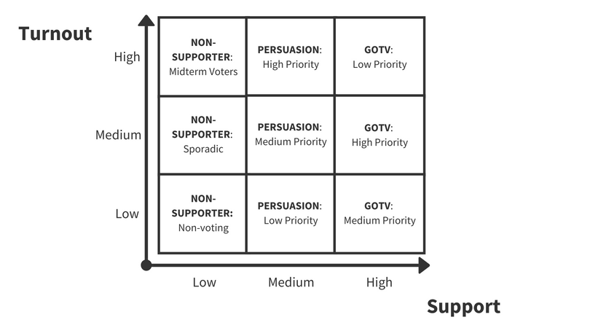
Notes:
This graph helps us to visualize the different types of voters there are and what they may look like in your community. The y axis represents turnout – this is referencing a voter’s likelihood to vote in a election ….The x axis represents support - this refers to the likelihood of the voter to support the candidate or issue your are canvassing or phonebanking for.
If you are volunteering for a campaign or initiative, they will already have identified and targeted specific audiences based on similar models. However when we are talking about specifically a persuasion audience, they represent a historically significant and particular group of people who have been seen as necessary to win on a given issue-area.

Slide 13
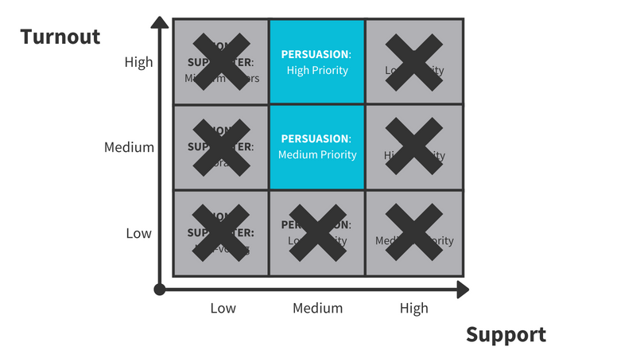
Notes:
So again on the y axis we can see a voter’s likelihood to vote in a election and on the x axis we can see the likelihood of the voter to support the candidate or issue your are canvassing for.
Our persuasion audience is Medium support and high/medium turnout. These are folks who are likely to turnout to vote but aren’t necessarily sure who they plan to support or if they agree with out ballot initiative.
We saw this play out in real life during the fight for marriage equality. In 2008, an LGBTQ+ rights group lost the Proposition 8 campaign, which would have granted Californians the right to same sex marriage. After this loss, volunteers set out to understand where they went wrong and between 2008 and 2009 volunteer-collected data found that values-based conversations were moving 25% of all undecided and opposed voters to be more supportive of marriage equality.
Voters in california and across the US saw the influence of persuasion conversations and why it is so important for canvassers to use. Campaigns started to use this tactics to help push their candidate or ballot initiative across the finish line. Persuasion conversations have the capacity to change opinions on issues people care about in the long term – one of the ways this can manifest is through electing candidates that support your values. Here at OFA we have volunteers who have been working to implement this framework in their everyday organizing, and are seeing real change in the fight for fair democracy.
What really excites me about this is that you are watching this training likely because you want to see change in your community and persuasion conversations are a big way that we can move the needle to affect progress in our communities. So with that, let’s develop more of an understanding for as to why persuasion is so important.

Slide 14
Persuasion is necessary
There simply aren’t enough voters to win on GOTV alone The margins in many states and districts are very close
Persuasion
*Source- Analyst Institute
Notes:
Our friends at the Analyst Institute have presented us with three main arguments for persuasion. The first is that persuasion is necessary.
There simply aren’t enough voters to win on GOTV alone, and Whether we’re talking to voters about an issue advocacy campaign or knocking doors for a candidate, the fact is that in many states and districts have incredibly close margins. Let’s remember the example from earlier, President Bush only won re-election by 2.46%,

Slide 15
Persuasion is necessary
There simply aren’t enough voters to win on GOTV alone The margins in many states and districts are very close
Persuasion is challenging
You’re trying to change or shape opinions Partisanship has deep roots
Persuasion
*Source- Analyst Institute
Notes:
Persuasion is also challenging, and It’s challenging precisely because you’re trying to present someone with your views and shape their opinions
In addition, Partisanship has deep roots—people’s upbringings, families, friends, religion’s, social clubs, etc… all are tied to their identity. A contrasting opinion can sometimes feel like your identity is being challenged!

Slide 16
Persuasion is necessary
There simply aren’t enough voters to win on GOTV alone The margins in many states and districts are very close
Persuasion is challenging
You’re trying to change or shape opinions Partisanship has deep roots
Thoughts on persuasion are still evolving!
Creative methods are being tested in the field Organizing best practices are ever-evolving
Persuasion
*Source- Analyst Institute
Notes:
Finally, thoughts on persuasion are still evolving
Creative methods are constantly being tested in the field and organizing best practices are ever-evolving. There is no proven algorithm for persuasion. As people continue to practice persuasion tactics, and as it continues to be studied by groups like the analyst institute, some methods are found not to work, while others are.
Let’s take a look at a picture highlighting the importance of persuasuin

Slide 17
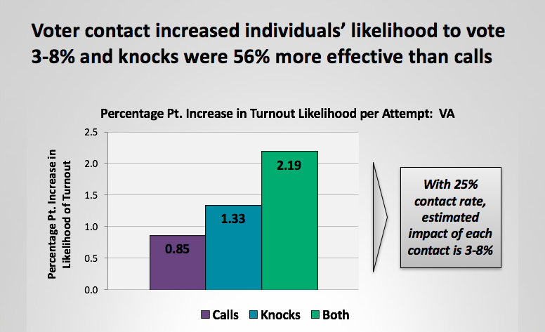
Voter contact increases likelihood to vote
2.19%
1.33%
0.85%
Calls
Knocks
Both
Notes:
Here we can see a graph that depicts voter contact rates from a Virginia election. On the y-axis we have the percentage point increase in the likelihood of turnout and the x-axis is a key to the bar graph representing three different forms of voter contact making phone calls, knocking on doors, or some variation of both.
This graph is a clear representation for why it is so important we knock doors and make phone calls—studies show that with a 25% contact rate, the estimated impact of each contact increases a voter’s likelihood to vote by 3-8% (with knocking on doors being 56% more effective) This is why traditional voter contact methods are so important. But increasing research shows that having an effective conversation is the most effective thing we can do and Persuasion is one of the best options because it adds two votes to your side (the vote you persuaded and the one you took from the other side), while increasing turnout and registration will only add one vote.
Knowing how important persuasion is to the outcome of an election, let’s start to synthesize that with conversations with voters.

Slide 18
Let’s synthesize the connection between persuasion conversations and voters
Notes:
In our work as organizers, we want to have conversations with people so we can get them to do something to make a difference. Whether it is convincing a supporter to make phone calls, or urging an elected official to vote a certain way on a piece of legislation or trying to get someone to turn-out or persuade someone to vote for your candidate…whatever the scenario, but we aren’t always successful.
We know from experience how challenging it can be to change someone’s opinion, so here we are going to try and break this down by synthesizing the connection between persuasion conversations and voters

Slide 19
Values
Notes:
One of the most important responsibilities of a Campaign is to connect the values that drive their campaign to their agenda and the voter. They need to clearly articulate why the voter should care about their candidate or the issue they are supporting.
We’ll walk through a couple of examples too: After a multitude of failures at ballot boxes across the nation, it became clear to marriage equality advocates that their strategy needed to be revamped. In 2009, marriage equality organizations, including Equality California, the Leadership LAB, and the National Gay and Lesbian Task Force, with the assistance of think tanks, such as Grove Insight, set about to study the problems facing the movement and to try to devise a solution. The end result of this process is known as “persuasion canvassing,” which utilizes in-depth, one-on-one conversation and complex messaging designed to target voters’ emotions in order to alter the perceptions and attributions of supporters and opponents alike.

Slide 20
Connecting on values
Campaign
You
Voter
Notes:
To help articulate this idea, consider 3 points of a triangle: you, the up-for-grabs voter, and the candidate.
The line between you and the candidate is strong (that is why you work or volunteer for OFA).
The line between you and the voter is what you are establishing using your personal story and the little person exercise.
Then, you have to use the connection you establish with the voter to establish a connection between the voter and the candidate. In other words, the voter establishes a connection to the candidate through you and with your help via a connection over core values.
Once you have established a connection with the voter, you have to ties that connection to the core traits and values of the candidate.

Slide 21
Connecting on values
Campaign
You
Voter
Notes:
To help articulate this idea, consider 3 points of a triangle: you, the up-for-grabs voter, and the candidate.
The line between you and the candidate is strong (that is why you work or volunteer for OFA).
The line between you and the voter is what you are establishing using your personal story and the little person exercise.
Then, you have to use the connection you establish with the voter to establish a connection between the voter and the candidate. In other words, the voter establishes a connection to the candidate through you and with your help via a connection over core values.
Once you have established a connection with the voter, you have to ties that connection to the core traits and values of the candidate.
Marriage equality: Canvassers were taught that they were most effective when they both used their personal narratives of why marriage for same-sex couples was important to them and listened to and incorporated the personal stories of the individuals to whom they were talking. Persuasion canvasses focused on using individuals’ stories to elicit an emotional response. Their job was to make the issue as human as possible, such that voters could more easily connect with it.

Slide 22
Connecting on values
Campaign
You
Voter
Notes:
To help articulate this idea, consider 3 points of a triangle: you, the up-for-grabs voter, and the candidate.
The line between you and the candidate is strong (that is why you work or volunteer for OFA).
The line between you and the voter is what you are establishing using your personal story and the little person exercise.
Then, you have to use the connection you establish with the voter to establish a connection between the voter and the candidate. In other words, the voter establishes a connection to the candidate through you and with your help via a connection over core values.
Once you have established a connection with the voter, you have to ties that connection to the core traits and values of the candidate.
Marriage equality: Real stories connect better, so canvassers practiced crafting and telling stories about people they knew—whether about themselves, family, friends, or others—in order to appeal to many different kinds of voters. Canvassers even received specific training sessions in which they practiced telling these stories to their colleagues to gauge the emotional impact. All content has potential emotional impact, but knowing how and when to tell which pieces was important. Some voters are deeply touched by narratives that involve the loss of a loved one, while others are moved more by the vision of two people trying to build a supportive, protective home for a child.
The most essential aspect of delivery, however, was the conveyance of authentic emotional ties that the canvasser had to a particular individual. People rarely want to discuss legal codes; instead, they want to hear human stories. In general, the most effective stories centered on the themes of love and commitment, emphasizing that same-sex couples could and did have the same love and commitment for each other that some straight couples did.

Slide 23
Connecting on values
Campaign
You
Voter
Notes:
To help articulate this idea, consider 3 points of a triangle: you, the up-for-grabs voter, and the candidate.
The line between you and the candidate is strong (that is why you work or volunteer for OFA).
The line between you and the voter is what you are establishing using your personal story and the little person exercise.
Then, you have to use the connection you establish with the voter to establish a connection between the voter and the candidate. In other words, the voter establishes a connection to the candidate through you and with your help via a connection over core values.
Once you have established a connection with the voter, you have to ties that connection to the core traits and values of the candidate.
Marriage equality: Clearly, there was a tremendous shift in pro-marriage equality movement’s approach to policy enactment. It went from using the rhetoric of rights and benefits, which appealed to people’s intellects, to language surrounding love and commitment, which was intended to resonate with people emotionally. It also went from trying to solely mobilize supporters to reaching out to opponents, especially those who supported some form of legal recognition, but who were initially hesitant to apply the term “marriage” to same-sex couples. This shift was a product of greater experience in trying to pass legislation. The movement started with a moral vision, developed a particular political goal (i.e. marriage equality), and tried to create organizational forms and tactics that coincided with that vision and that would eventually bring about the realization of that goal.
http://pacificcenter.org/messaging-in-the-movement-for-marriage-equality

Slide 24
Agenda
Why persuasion?
Persuasion framework
Practice
Debrief and close

Slide 25
A PERSUASION CONVERSATION FRAMEWORK:
Acknowledge
and relate
Notes:
So let’s deep dive into our framework for effective persuasive conversations
The first step in the framework is to acknowledge what the voter is saying and relate what they are saying to a value

Slide 26
Acknowledge and relate
Listen to the voter and find common ground on issues that you care about
Use your personal story to deepen the connection—Remember your ‘why’
Validate the voter’s concern. The goal is to build trust and rapport with the voter
Pro-tip: Connect issues with a local lens
Notes:
During this step in the framework, you want to make sure you listen to the voter and find common ground on issues that you both care about, use your personal story to deepen the connection – remember your “why”* (and we do have a very powerful training that is a part of this Campaign organizing bootcamp series on developing your personal story and understanding your “why” that will augment your ability to connect with voters. I highly encourage you to check it out if you have not already had the chance).
Also it is important to validate the voter’s concern. The goal is to build trust and rapport with the voter. And as a pro-tip, your conversation will be much more effective if you connect with the voter on issues that are at a hyper-local. What issue(s) have a direct impact on both of your lives? Is it the low access to quality education, racial segregation, water quality, affordable housing? You have an inherent connection with the voter as it relates to the community you both live in! And this will signal to the voter that your are invested in what they have to say.
During these conversations, you want to listen for a piece of information that will allow you to empathize with the vote to some degree. For instance, let’s imagine that I am from Florida, and I am canvassing to try and gain support for the second chance ballot initiative in Florida which would give formally incarcerated men and woman the opportunity to vote after fulfilling their sentence. if someone at the door said to me “I don’t know if I support this ballot initiative, I unsure what the consequences of this legislation would be” I would acknowledge and relate to what they have to say by stating something along the lines of, “I hear what you are saying, and it sounds like you are feeling conflicted about how this will impact our community” … These responses are not formulaic but should give you an idea of the type of things to say if placed in a similar situation.

Slide 27
A PERSUASION CONVERSATION FRAMEWORK:
Connect on values
Notes:
After you have acknowledged what the voter has to say, the next phase of the framework is to connect on values.

Slide 28
Connect on values
Surface what the underlying values are in what the voter is saying
Focus the conversation around the values you hear the voter expressing and relate those values to yourself
Remember—You understand more about who they are through non-judgmental probing questions and sharing your personal story!
Notes:
When you are connecting on values with an undecided voter, you want to surface the underlying values in what the voter is saying. Focus the conversation around the values you hear the voter expressing and relate those values to yourself. This is the part of the conversation where you’re connecting with the heart of what someone cares about—are they a parent? What values do you have in common? Are they a small business owner? (this is the perfect opportunity to affirm them!)
Remember – you will understand more about who they are through non-judgmental probing questions and sharing your personal story and if you get nervous, just breathe and circle back to your “why.”
To continue modeling the second chance ballot initiative in Florida, I could ask them a probing question like, ”how would you feel if your child or children didn’t have the right to vote?” If the voter gave an answer exclaiming how they would feel discriminated against for example, then I could begin to dissect their answer and affirm them by saying “it sounds like you like care about keeping our democracy safe, that is a value I also care about and really respect you for it.” Again, these are just examples of the types of questions you can ask and you can go about responding to them.

Slide 29
A PERSUASION CONVERSATION FRAMEWORK:
Pivot to persuasion language
Notes:
The third step in this framework is to pivot the conversation towards persuasion language

Slide 30
Connect the values you have identified to the work that you’re doing and the candidate or cause
Explain the benefits and impact of ‘winning’ or electing Candidate X as it pertains to the voter and your shared values
Pivot to persuasion language
Notes:
This is really the heart of the conversation where you explain to the voter why they should support your candidate or ballot initiative. Connect the values you have identified to the work that you’re doing and the candidate or cause.
I would continue my conversation with the voter by stating that “We are better than the worst things that we have done. Our country does not thrive when men and women are left out of the democratic process. We all deserve an opportunity to raise our voice for issues and values we care about. I can sense that you hold similar values, and hope to have your support in preserving the strength of our democracy.”

Slide 31
A PERSUASION CONVERSATION FRAMEWORK:
Contrast
Notes:
Finally, you want to remember to contrast what will happen if the campaign or ballot initiative you support does not win

Slide 32
Contrast
Draw an appropriate contrast with opponent candidates on those values and issues
Answer the questions – “What will happen if we don’t elect Candidate X or win on our issue?” and “How will it hurt the value we both share?”
Notes:
Draw an appropriate contrast with opponent candidates on those values and issues. Answer the questions - What will happen if we don’t elect candidate X, don’t act, don’t vote, do nothing, or the other side wins? How will that hurt the value we share?
To conclude my example, I would tell the voter at the door that If this ballot initiative doesn’t pass we are effectively silencing millions of voters, and the strength of our democracy will be questioned. This why it is so important we support this initiative…..

Slide 33
A PERSUASION CONVERSATION FRAMEWORK:
1. Acknowledge and relate
2. Connect to values
3. Pivot to persuasion language
4. Contrast
Notes:
Let’s bring the entire framework together now. When implementing this framework either at the doors or on the phone, t is important to go through it in this order. So to quickly demonstrate what that looks like, I’d like to share a personal example from my life.
The example I’d like to share is centered around the issue of Healthcare. Imagine I am at the doors canvassing for the affordable care act. I knock on the door and tell the voter I am here canvassing to make sure the affordable care act is protected, and I hope to have your support. They tell me about how confusing and expensive the Healthcare system is. Here is where I dive into the persuasion framework by saying "I hear what you are saying -- the health care system is expensive and it doesn't seem that a lot of it is conducive for patients to navigate. It seems like you do care for other people to have a good experience with health care in our country, and I do too – even before I was born my father was diagnosed with advances Multiple sclerosis. When I was in high school, my dad was in and out of the hospital frequently, and I can say firsthand that it was difficult to navigate, but he wouldn't have been able to sustain the longevity of life he had if it hadn't been for Obamacare. It is really important that all Americans have access to quality, affordable healthcare because if they don’t, then millions of families will be put at risk of losing people they care about”
It may be helpful to pause this video for a moment and try and piece apart the four components of this framework embedded within my example. And just to hammer home this framework, we have a short video that demonstrates this model too.

Slide 34
Watch the clip on
following slide

Slide 36
Agenda
Why persuasion?
Persuasion framework
Practice
Debrief and close

Slide 37
Now it’s your turn to practice this persuasion framework!
Notes:
We will go through a couple activities that will allow you to practice the framework we just went over for youself.

Slide 38
Pause for activity 1:
Stick figure

Slide 39
Scenario 1:
“I hear all these things that you’re saying…I don’t really like what’s going on, but the economy seems to be doing alright. After the 2008 economic crash, I lost everything, and this
is the first time I feel like I’m on good footing. It’s
a tough choice.”
PROBE
Acknowledge
Values
Accomplishments
Contrast
Notes:
This is an example of something that may hear when you are on the phone or at the doors (READ SCENARIO 1) keep the framework on the left hand side of this slide in mind as you are going through this scenario

Slide 40
Scenario 2:
PROBE
“I really can’t stand this administration or this congress. But I don’t really understand how your candidate is going to make it any better—there doesn’t seem to be any real message.”
Acknowledge
Values
Accomplishments
Contrast
Notes:
Continuing to keep this framework in mind and the information you learned from scenario one. Here is another example of what you might encounter at the doors or on the phones (READ SCENARIO 2)

Slide 41
Pause for activity 2: Scenarios

Slide 42
REPORT-BACK:
What
did you
come up
with?
Share your thoughts out loud!
Notes:
Take some time to share your thoughts with the group. What did you come up with? What was challenging? What did you or your partner do well?

Slide 43
Agenda
Why persuasion?
Persuasion framework
Practice
Debrief and close
Notes:
Sadly, we are nearing the end of this training, but before we conclude. I want to take an opportunity to debrief and wrap up our discussion.

Slide 44
Debrief
What are common values in your community
that you might hear at the door?
How will you adapt your communication style
when talking to voters?
What do you predict the biggest challenges in implementing
this persuasion framework will be?
Notes:
Either individually or In groups, pause for a moment to think about and answer these questions. What are common values in your community that you might here at the door? How how will you adapt your communication style when talking to voters? What do you predict the biggest challenges in implementing this persuasion framework will be?

Slide 45
Next Steps
Continue to practice the persuasion framework
Rehearse connecting on shared values with two other people and ask for feedback
Apply your persuasion skills to volunteering on campaigns
1
2
2
3
Notes:
Moving forward I hope you continue to practice this persuasion framework and work on connecting on shared values. It is always helpful to rehearse with a partner or small group and ask for feedback. And I hope you will work to apply your persuasion skills on the different campaigns you volunteer for.

Slide 46
Thank you!
Notes:
Thank you all so much for joining me through this training, I hope you enjoyed it. We at OFA are always looking to improve so if you could please fill out this short survey, I would love to hear your feedback. And finally, Remember to tweet out your key takeaways from today and give me a follow on twitter at @GriffenSaul.
I look forward to seeing all the amazing work you all day!

