Slide 1

Project Management
Stefan Schaffer, Special Projects Director
@schafferstefan
Notes:
This work is licensed under the Creative Commons Attribution-NonCommercial 4.0 International License. To view a copy of this license, visit http://creativecommons.org/licenses/by-nc/4.0/ or send a letter to Creative Commons, PO Box 1866, Mountain View, CA 94042, USA
0:00-0:03 (3 min)
[Trainer should give a two-minute version of their personal story as relevant to this module. If possible, try to weave project management into your story. Don’t forget to share challenge - choice - outcome and practice it like any other section!]

Slide 2
Goals
Understand the definition and challenges of project management
Understand the habits of strong project managers
Acquire two new tools for managing projects
Get excited to apply these habits and tools to future projects!
Notes:
30 seconds

Slide 3

Agenda
Introduction and Goals
Challenges of Project Management
Seven Habits of Effective Project Managers
My Favorite Tools: M.O.C.H.A. and Taskmaster
Debrief and Closing
Notes:
30 seconds

Slide 4

What is project management?
The discipline of planning, organizing, motivating, and controlling resources to achieve specific goals associated with a temporary endeavor with a defined beginning and end.
Getting important work done well by empowering others.
Project Management = Organizing
Notes:
3 minutes

Slide 5
What is a project manager?
Responsible for the success or failure of the project
Does not do it all herself
Leads a team of people who are often peers not directly managed by the project manager
Notes:
1 minute

Slide 6

What are the challenges of project management?
Notes:
6 minutes
Thinks of things you would consider projects.
What might make them difficult to manage?

Slide 7

What is lateral management?
Doing the parts of your job which you can only do well with help from people you don’t manage.

Slide 8
Silent Reflection
What are the 3 most important projects that you are responsible for overseeing in your job?
Which one relies most on you working well with your colleagues?
Which colleague(s)?
What are the greatest challenges you face with this working relationship?

Slide 9
Breakout Discussions
Breakout into groups of two or three, and:
1. Discuss the challenge you wrote down, and explore potential solutions and best practices.
2. Come up with one solid tip (per group) for developing effective work relationships around your project. Try to make it unique – you will report out to the group.

Slide 10
Report-back
Each team will share one solid tip for developing effective work relationships around your particular projects. If another team takes yours, come up with another one!

Slide 11
Agenda
Introduction and Goals
Challenges of Project Management
Seven Habits of Effective Project Managers
My Favorite Tools: M.O.C.H.A. and Taskmaster
Debrief and Closing
Notes:
30 seconds

Slide 12
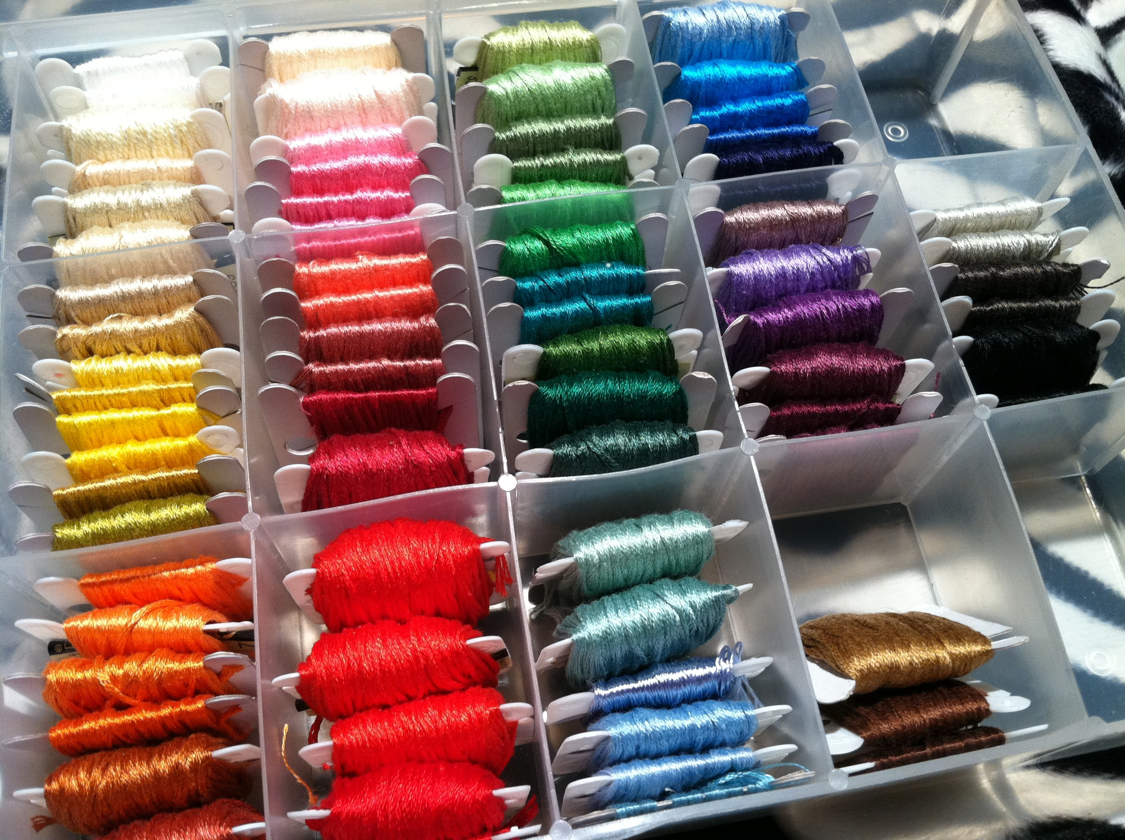
Seven habits of effective project managers
1. Be organized.
Notes:
1 minute

Slide 13

Seven habits of effective project managers
2. Define success and set clear expectations.
Notes:
1 minute

Slide 14

Seven habits of effective project managers
3. Build a strong team and earn their buy-in.
Notes:
1 minute

Slide 15

Seven habits of effective project managers
4. Use repeat-backs and operationalize language.
No, today is Friday.
It’s so windy today!
Fried eggs are gross. I like mine scrambled.

Slide 16
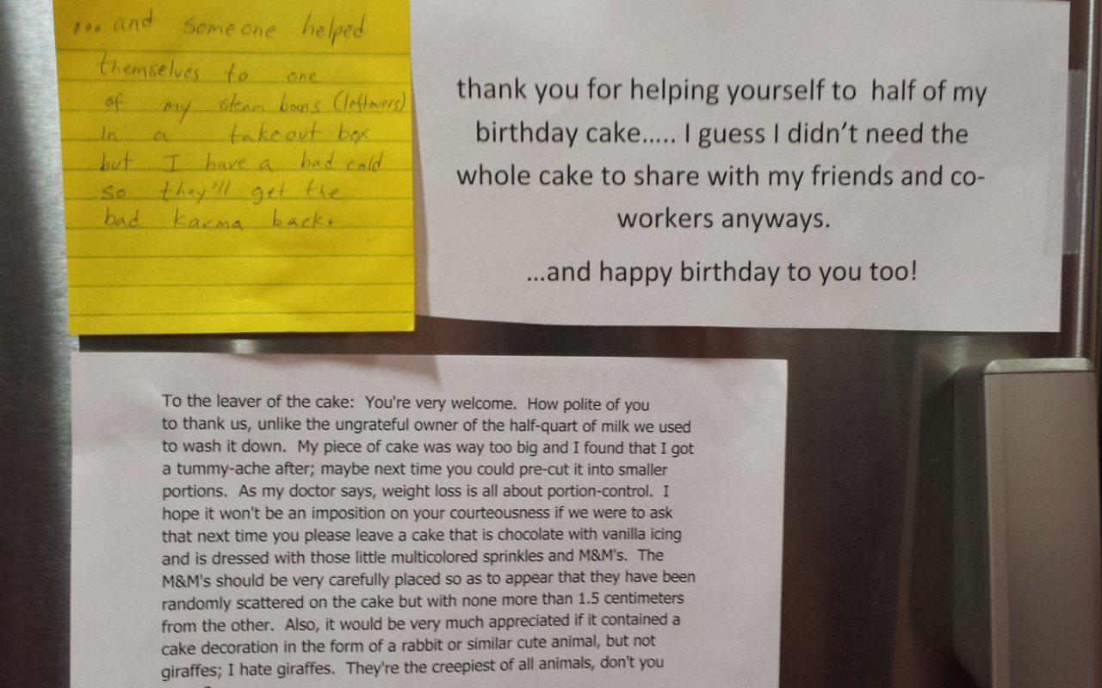
Seven habits of effective project managers
5. Be mindful of tone in emails.

Slide 17

Seven habits of effective project managers
6. Make it easy for your team members to deliver.
Notes:
1 minute

Slide 18

Seven habits of effective project managers
7. Track progress and adjust as needed.
Notes:
1 minute

Slide 19
Agenda
Introduction and Goals
Challenges of Project Management
Seven Habits of Effective Project Managers
My Favorite Tools: M.O.C.H.A. and Taskmaster
Debrief and Closing
Notes:
30 seconds

Slide 20
The MOCHA approach to defining responsibilities
Manager Assigns responsibility and holds owner accountable
Owner Has overall responsibility for the success or failure of the task or project
Consulted Should be asked for input or needs to be bought into the project
Helper Available to help do part of the work
Approver Signs off on decisions before they’re final
Notes:
10 minutes
Explain the roles, and explain that this can apply to a whole project OR a task
Ask people to reflect on a project or task that they have either done or assigned out, and see if they can identify who held each role.

Slide 21
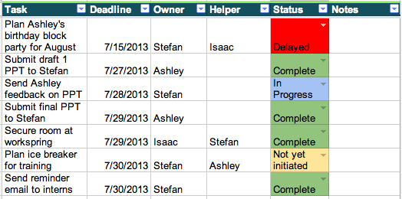
A taskmaster helps you keep track of what is due when from whom
PLACEHOLDER – WILL REPLACE WITH SOMETHING MORE TIMELY

Slide 22

A taskmaster only works if you work it
What are some ways you might use a tool like this to manage a project?
Notes:
10 minutes

Slide 23
Agenda
Introduction and Goals
Challenges of Project Management
Seven Habits of Effective Project Managers
My Favorite Tools: M.O.C.H.A. and Taskmaster
Debrief and Closing
Notes:
30 seconds

Slide 24
Thank you!
Notes:
1 min

