Slide 1



OFA TRAINING
Welcome to today’s webinar.
We will begin shortly.
For audio, please make sure to also join the call.
Dial-in here
Notes:
This work is licensed under the Creative Commons Attribution-NonCommercial 4.0 International License. To view a copy of this license, visit http://creativecommons.org/licenses/by-nc/4.0/ or send a letter to Creative Commons, PO Box 1866, Mountain View, CA 94042, USA
00:00 – 00:00 [General Opening Slide]

Slide 2





LOGISTICS
We will meet for 90 minutes
This is an interactive training. You will work in pairs today.
A recording of this video and call will be available on the
Access bookshelf
It’s cool if you Tweet --
#OFAFellows
Notes:
00:01 – 00:03 [2 min] – Aquiles
Before we get started, let’s review some logistics

Slide 3
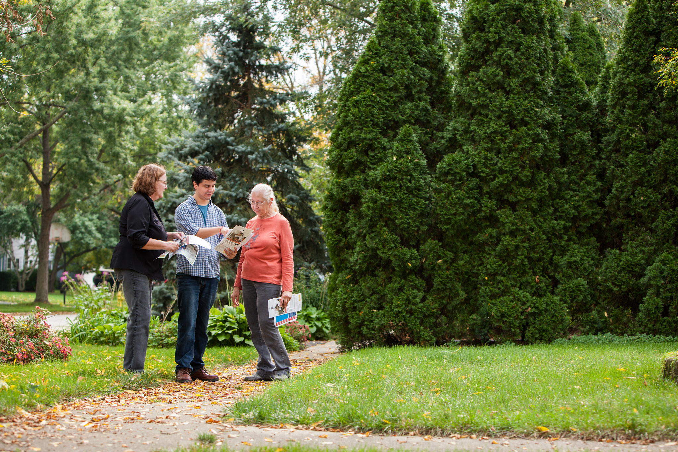
NEXT TUESDAY
GETTING TO YOUR TARGET UNIVERSE
W/ JUSTIN SOMMER

Slide 4
CLASS REVIEW
OVERVIEW
What is the case for your race? Why can you win?
WIN #
How many voters do you need to win?
TARGET UNIVERSE
Which voters will you focus on?
How will you prioritize your targets and monitor your progress?

Slide 5

What questions do you hope today’s class will address so you are able to cement what you have learned thus far?
Access workbook

Slide 6
GOALS FOR TODAY
Know what to consider to target voters and determine a voter contact strategy.

Slide 7
GOALS FOR TODAY
Be able to assess your program progress toward your Election Day goal using a vote calculator.

Slide 8
GOALS FOR TODAY
Feel confident writing a field plan that allows you to get to your continuously changing target universe.

Slide 9

Win Number Review
Segmenting Your Target Universe
Agenda for today
Types of Voter Contact
Vote Calculator
Debrief and Close

Slide 10
Expected Turnout

Slide 11
Win Number

Slide 12
Target Universe

Slide 13
Win Number Review
Segmenting Your Target Universe
Agenda for today
Types of Voter Contact
Vote Calculator
Debrief and Close

Slide 14
Voter Targeting Guide
Who should your target universe ignore?
TURNOUT HISTORY | ISSUE SUPPORT
 |  | Strongly Support | Undecided | Strongly Opposes
 | Always Vote
 | Sometimes Vote
 | Never Vote

Slide 15
Voter Targeting Guide
Who should your target universe ignore?
TURNOUT HISTORY | ISSUE SUPPORT
 |  | Strongly Support | Undecided | Strongly Opposes
 | Always Vote
 | Sometimes Vote
 | Never Vote

Slide 16
Voter Targeting Guide
Who should you target?
TURNOUT HISTORY | ISSUE SUPPORT
 |  | Strongly Support | Undecided | Strongly Opposes
 | Always Vote
 | Sometimes Vote
 | Never Vote

Slide 17

Voter Targeting Guide
Who should you get out to vote?
TURNOUT HISTORY | ISSUE SUPPORT
 |  | Strongly Support | Undecided | Strongly Opposes
 | Always Vote
 | Sometimes Vote
 | Never Vote
Super Voters -- Volunteers

Slide 18

Voter Targeting Guide
Who should you persuade?
TURNOUT HISTORY | ISSUE SUPPORT
 |  | Strongly Support | Undecided | Strongly Opposes
 | Always Vote
 | Sometimes Vote
 | Never Vote
Super Voters -- Volunteers
Supporters GOTV

Slide 19

Voter Targeting Guide
Who should you persuade?
TURNOUT HISTORY | ISSUE SUPPORT
 |  | Strongly Support | Undecided | Strongly Opposes
 | Always Vote
 | Sometimes Vote
 | Never Vote
Super Voters -- Volunteers
Persuasion 1
Supporters GOTV

Slide 20
Voter Targeting Guide
Who should you persuade?
TURNOUT HISTORY | ISSUE SUPPORT
 |  | Strongly Support | Undecided | Strongly Opposes
 | Always Vote
 | Sometimes Vote
 | Never Vote
Super Voters -- Volunteers
Persuasion 1
Supporters GOTV
Persuasion 2

Slide 21


How can you prioritize your target universe?
OR
Press 1 on the phone
Type in chat box

Slide 22
SEGMENTING YOUR TARGET UNIVERSE
Running a model of your universe helps you use known information to predict an expected behavior.
TIER 1
Best possible targets – will turnout if they hear from the campaign.
TIER 2
Less likely to vote given voting history.
TIER 3
Requires more effort to turnout to vote or persuade. Usually a cushion if everyone on previous tiers are contacted.

Slide 23
SEGMENTING YOUR TARGET UNIVERSE
Ideally, you should project to talk to everyone in your universe multiple times.
TIER 1
Pass 1
Pass 2
Pass 3
TIER 2
Pass 1
Pass 2
TIER 3
Pass 1
LESS TIME AND RESOURCES
MORE TIME AND RESOURCES

Slide 24

Your Turn!
Access the workbook, and find the tab with your team number.
Experiential Activity #1
10 Minutes
Open workbook
Notes:
00:11 – 00:16 [5 min] – Caleb
Trainer’s Notes: Learners will have 3 minutes to complete the activity. The facilitator will lead a pop-corn debrief for 2 minutes.
Review activity instructions
Set timer (Aquiles)
Debrief activity for 3 minutes (Caleb)
What was one of your key goals?
How would you accomplish that goal online?
Trainer’s Notes: Learners will likely provide wrong answers, since they have not been trained on digital tactics yet. But by throwing them in the deep end of the pool, they are realizing that there is a connection of sorts, which we will further explore throughout the training.

Slide 25
Your Turn!
DEBRIEF
OR
Press 1 on the phone
Type in chat box

Slide 26
Win Number Review
Segmenting Your Target Universe
Agenda for today
Types of Voter Contact
Vote Calculator
Debrief and Close

Slide 27

TYPES OF VOTER CONTACT
Overall, your voter contact strategies help you gather valuable information from expected voters, such as what issues they intend to vote yes on.
Most effective turning people out to vote
1 additional vote for every 14 people successfully contacted
More expensive, since more training is needed

Slide 28

TYPES OF VOTER CONTACT
Overall, your voter contact strategies help you gather valuable information from expected voters, such as what issues they intend to vote yes on.
Most effective turning people out to vote
1 additional vote for every 14 people successfully contacted
More expensive, since more training is needed
Contact rates are worse every cycle
Logistically easier, and more people willing to do it
Only one additional vote for every 35 people contacted
Less expensive, since less training is necessary

Slide 29

TYPES OF VOTER CONTACT
Overall, your voter contact strategies help you gather valuable information from expected voters, such as what issues they intend to vote yes on.
Most effective turning people out to vote
1 additional vote for every 14 people successfully contacted
More expensive, since more training is needed
Contact rates are worse every cycle
Logistically easier, and more people willing to do it
Only one additional vote for every 35 people contacted
Less expensive, since less training is necessary
Effective among persuasion targets previously contacted
Cheaper, but impact is lower
One additional vote for every 66 people successfully contacted

Slide 30
Win Number Review
Segmenting Your Target Universe
Agenda for today
Types of Voter Contact
Vote Calculator
Debrief and Close

Slide 31
VOTE CALCULATOR
Assess field activity given some assumptions about your outreach.
If you start with the wrong assumptions when calculating your win number, and do not test and validate your assumptions based on what is happening on the field, then you are less likely to win.
There is a story behind your numbers. Use your calculator to figure out what is happening before making assumptions.
Open calculator

Slide 32
Your Turn!
Access the workbook, and find the tab with your team number.
Experiential Activity #1
10 Minutes
Open workbook
Notes:
00:11 – 00:16 [5 min] – Caleb
Trainer’s Notes: Learners will have 3 minutes to complete the activity. The facilitator will lead a pop-corn debrief for 2 minutes.
Review activity instructions
Set timer (Aquiles)
Debrief activity for 3 minutes (Caleb)
What was one of your key goals?
How would you accomplish that goal online?
Trainer’s Notes: Learners will likely provide wrong answers, since they have not been trained on digital tactics yet. But by throwing them in the deep end of the pool, they are realizing that there is a connection of sorts, which we will further explore throughout the training.

Slide 33
Your Turn!
DEBRIEF
OR
Press 1 on the phone
Type in chat box

Slide 34
Win Number Review
Segmenting Your Target Universe
Agenda for today
Types of Voter Contact
Vote Calculator
Debrief and Close

Slide 35
GOALS FOR THIS SESSION
DEBRIEF
Know what to consider to target voters and determine a voter contact strategy.
What was your biggest takeaway?

Slide 36
GOALS FOR THIS SESSION
DEBRIEF
Know what to consider to target voters and determine a voter contact strategy.
What was your biggest takeaway?
Be able to assess your progress using a vote calculator.
How do you see yourself using a vote calculator?

Slide 37
GOALS FOR THIS SESSION
DEBRIEF
Know what to consider to target voters and determine a voter contact strategy.
What was your biggest takeaway?
Be able to assess your progress using a vote calculator.
How do you see yourself using a vote calculator?
Feel confident writing a field plan that allows you to get to your continuously changing target universe.
How does this contribute to the flow of your field plan?

Slide 38
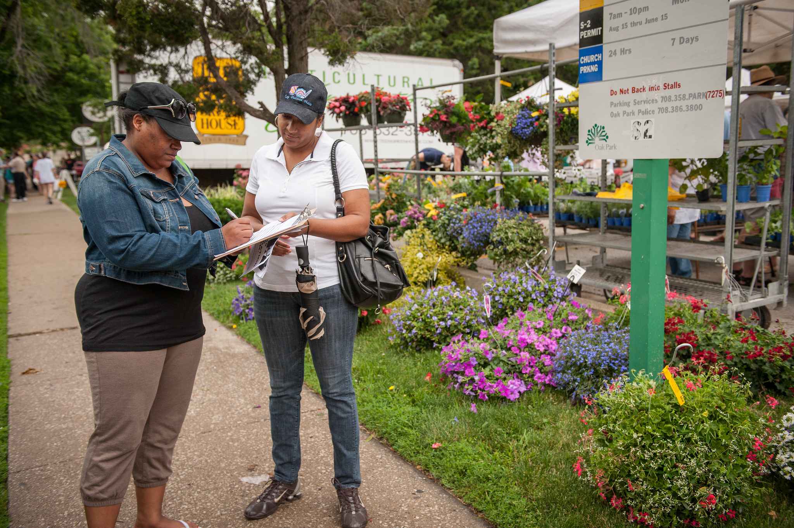
OCTOBER 27TH
CREATING CAPACITY
W/ JENNIFER WARNER

Slide 39

OFA TRAINING
Thank you for joining today’s webinar.
Find the materials we covered, including a video and audio recording of the webinar, on the bookshelf.
See bookshelf
Notes:
00:00 – 00:00 [General Closing Slide]

