Slide 1
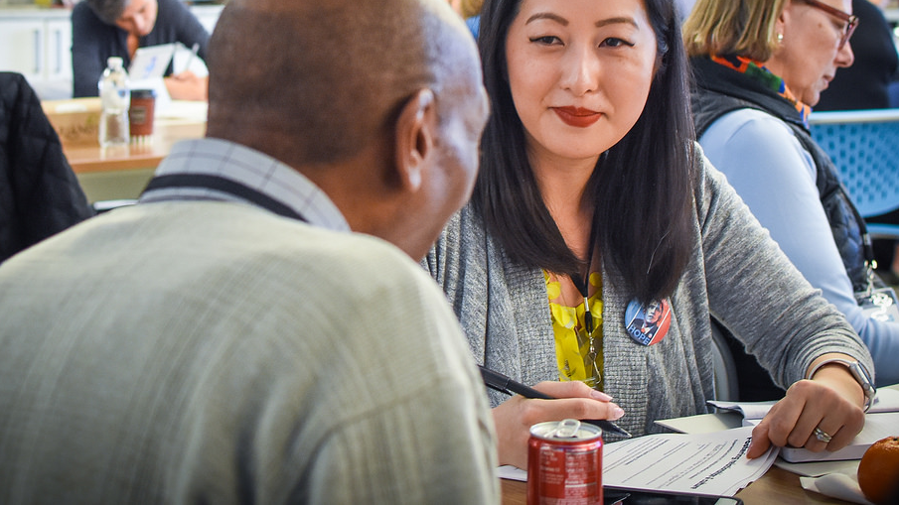


COACHES HUDDLE
FALL 2017
Notes:
This work is licensed under the Creative Commons Attribution-NonCommercial 4.0 International License. To view a copy of this license, visit http://creativecommons.org/licenses/by-nc/4.0/ or send a letter to Creative Commons, PO Box 1866, Mountain View, CA 94042, USA

Slide 2
#OFAcoaches

Slide 3
Point of contact: Jalakoi Solomon
757.344.5134

Slide 4
Meet today’s trainers

Slide 5
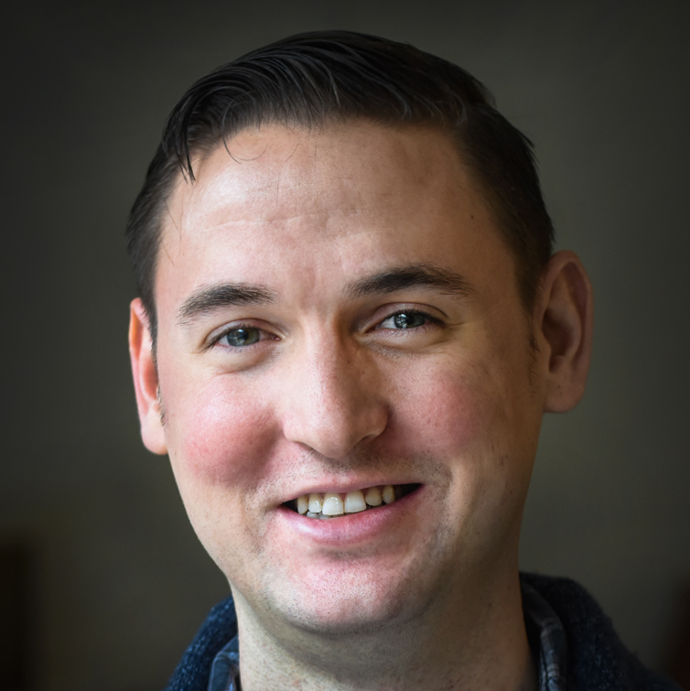
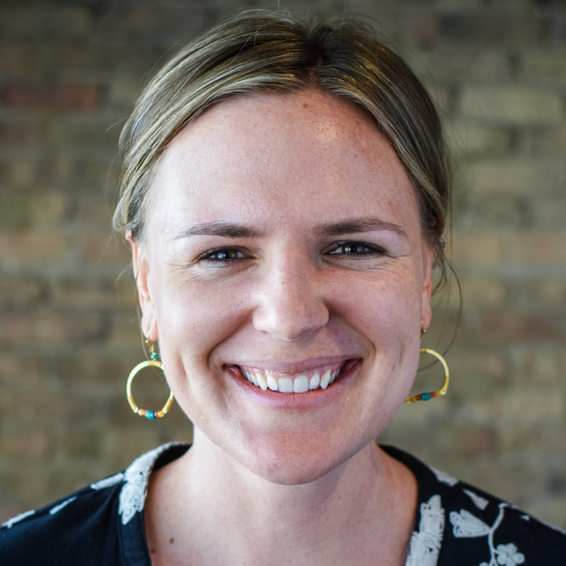
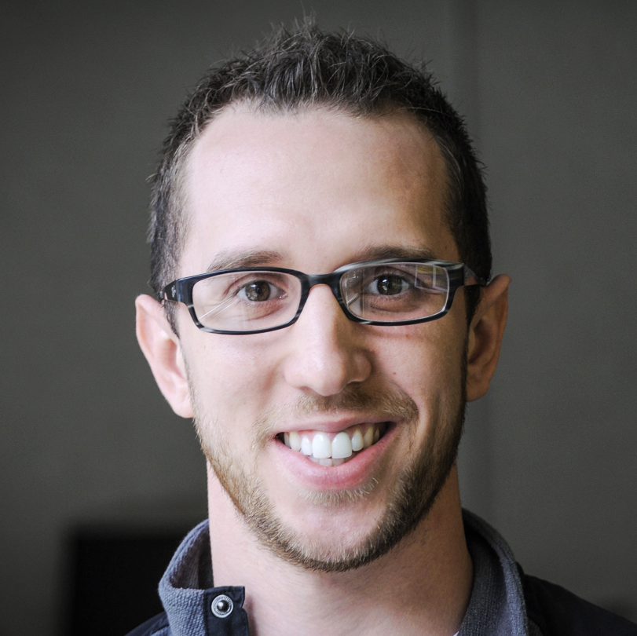
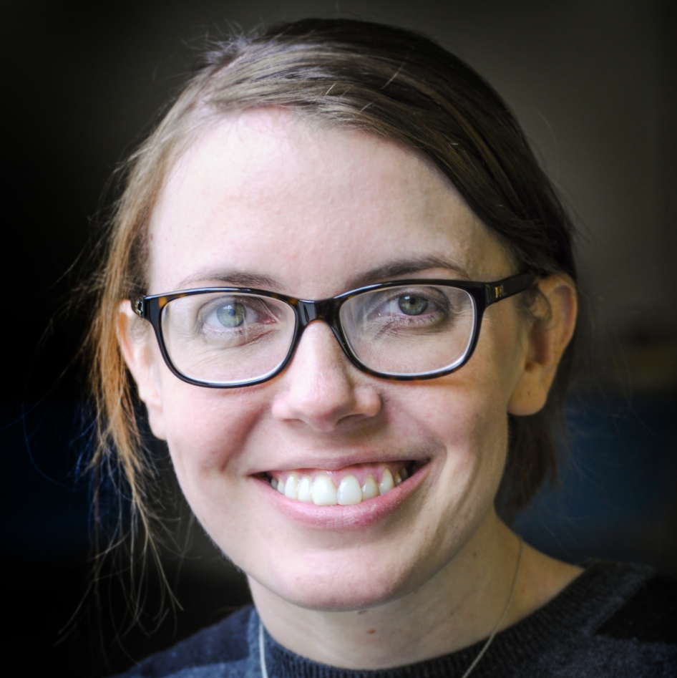

Bobby Brady-Sharp
Training Projects Manager
Liz Erickson
National Training Director
Kevin Lane
Training Projects Manager
Mary McInerney
Training Coordinator

Slide 6
Meet each other
1
We have 12 minutes for everyone to introduce themselves.
Stand up and say your name, where you’re from, and your superpower.
Remember we only have 12 minutes so let’s be quick!
2
3

Slide 7
Today’s goals
1
Know concretely your strengths, challenges, and leadership style.
Be able to apply leadership theory to your individual practice.
Feel confident, prepared, and ready to lead your teams in the fall.
2
3

Slide 8
Agenda
Welcome and introductions
Leadership simulation
StrengthsFinder I
Lunch
StrengthsFinder II
Archetypes of leadership
Debrief & closing

Slide 9
Our commitments

Slide 10
Respect. Empower. Include.
Always.
Notes:
Read through these norms. Take two to three more norms from the audience. Ask for applause to agree to living by these norms for the weekend.
Logistics should all be VERY well labeled (signs for bathrooms, wifi information, etc. EVERYWHERE) You can direct folks to the signs when referencing logistics.

Slide 11
We come from different places. What works in one area might not work in another—and that’s okay!
Respect other ideas and build off them rather than shoot them down.
Notes:
Read through these norms. Take two to three more norms from the audience. Ask for applause to agree to living by these norms for the weekend.
Logistics should all be VERY well labeled (signs for bathrooms, wifi information, etc. EVERYWHERE) You can direct folks to the signs when referencing logistics.

Slide 12
Step up & step back
If you find yourself doing a lot of talking, take
a step back to give space for others to share.
Notes:
Read through these norms. Take two to three more norms from the audience. Ask for applause to agree to living by these norms for the weekend.
Logistics should all be VERY well labeled (signs for bathrooms, wifi information, etc. EVERYWHERE) You can direct folks to the signs when referencing logistics.

Slide 13
Learn actively
You will get out of this training what you put in.
Ask questions, share your ideas, and work through
challenges you’re having!
Notes:
Read through these norms. Take two to three more norms from the audience. Ask for applause to agree to living by these norms for the weekend.
Logistics should all be VERY well labeled (signs for bathrooms, wifi information, etc. EVERYWHERE) You can direct folks to the signs when referencing logistics.

Slide 14
Snaps for agreement
If you hear someone say something that resonates strongly with you, give them a snap!
Notes:
Read through these norms. Take two to three more norms from the audience. Ask for applause to agree to living by these norms for the weekend.
Logistics should all be VERY well labeled (signs for bathrooms, wifi information, etc. EVERYWHERE) You can direct folks to the signs when referencing logistics.

Slide 15
What did we miss?
Notes:
Read through these norms. Take two to three more norms from the audience. Ask for applause to agree to living by these norms for the weekend.
Logistics should all be VERY well labeled (signs for bathrooms, wifi information, etc. EVERYWHERE) You can direct folks to the signs when referencing logistics.

Slide 16
Logistics
Bathrooms and water fountains: There are two bathrooms and two water fountains. Be respectful!
Snacks: Down the hallway, feel free to grab a snack as you need it.
Story booth: We’ll be taking photos and collecting stories throughout the day. Let us know if you want to share yours.
Today’s Hashtag: #OFAcoaches
Staff is here to help!
Notes:
Read through these norms. Take two to three more norms from the audience. Ask for applause to agree to living by these norms for the weekend.
Logistics should all be VERY well labeled (signs for bathrooms, wifi information, etc. EVERYWHERE) You can direct folks to the signs when referencing logistics.

Slide 17
What’s one thing
you’re hoping to learn
this weekend?
Shout out!
Notes:
This is where everyone ( volunteers) introduce themselves:
Everyone who is present this weekend is a teacher and everyone is a learner
Highlight the volunteers in each session
Roll call of staff– staff share their first and last name and title

Slide 18
Agenda
Welcome and introductions
Leadership simulation
StrengthsFinder I
Lunch
StrengthsFinder II
Archetypes of leadership
Debrief & closing

Slide 19
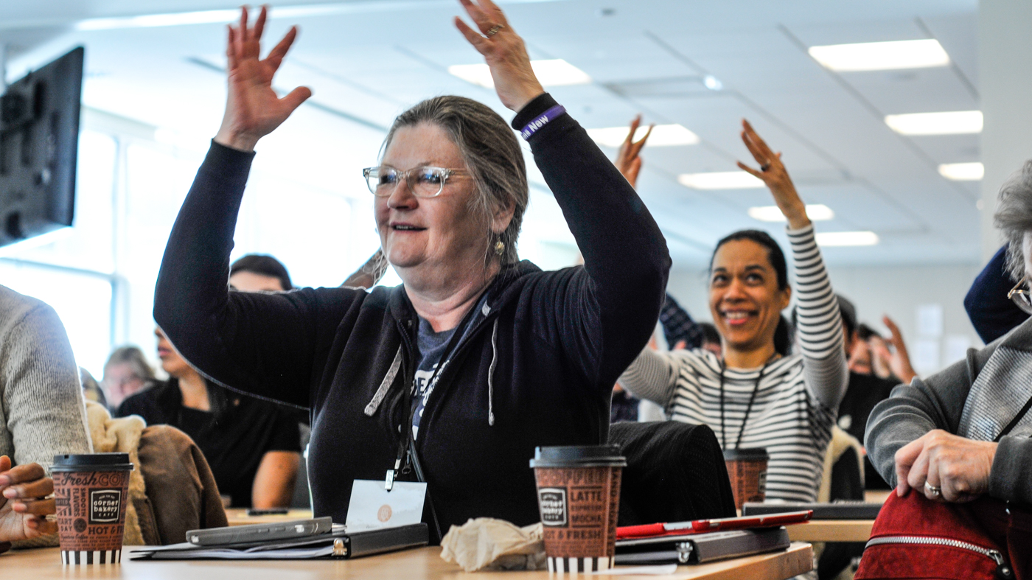
Leadership simulation

Slide 20
Goals
1
Understand the challenges and best practices to exercising leadership through a team.
Be able to learn new skills for communicating, leading, and directing a team to success.
Feel excited to embark on new path for defining effective leadership.
2
3

Slide 21
Leadership simulation
Notes:
This is where everyone ( volunteers) introduce themselves:
Everyone who is present this weekend is a teacher and everyone is a learner
Highlight the volunteers in each session
Roll call of staff– staff share their first and last name and title

Slide 22
Breakout groups
You should have a card with a group name and identifier—i.e. Team 1: Director.

Slide 23
Breakout groups
You should have a card with a group name and identifier—i.e. Team 1: Director.
Take a moment to look around the room and locate the group name you’ll go to when we breakout.

Slide 24
Breakout groups
You should have a card with a group name and identifier—i.e. Team 1: Director.
Take a moment to look around the room and locate the group name you’ll go to when we breakout.
The word after your group name is your role in this activity—you’ll be in groups of 5, where you’ll have a distinct role to play.

Slide 25
20 minutes
As a group of five, each member of the group will work as a team for 20 minutes to replicate a model.
The trick is that each person play a specific role to make the skills of communication, delegation, and management critical to your success.
Small Groups

Slide 26
20 minutes
Activity instructions:
Each group will breakout into groups of 5 with these roles: Director, Runner, Builder (2), and Observer.
Small Groups

Slide 27
1
The Director
The Director will examine the model and is the only person who can see it in the group.
Objective
Give the Runner clear and specific instructions on how to replicate the model.

Slide 28
1
The Director
2
The Runner
The Director will examine the model and is the only person who can see it in the group.
Objective
Give the Runner clear and specific instructions on how to replicate the model.
The Runner listens to the Director’s instructions, relaying them to the Builders.
Objective
Relay the Director’s instructions to the Builders as clearly as possible.

Slide 29
3
The Builders
The Builders receive instruction from the Runner and replicate the Director’s model.
Objective
Without showing anyone on the team, build the object according to the Runner’s instructions.

Slide 30
3
The Builders
4
The Observer
The Builders receive instruction from the Runner and replicate the Director’s model.
Objective
Without showing anyone on the team, build the object according to the Runner’s instructions.
The Observer watches all aspect of the game, keeping notes on how the team is doing.
Objective
Take detailed notes to share with your team about what is working and not working in accomplishing the goal.

Slide 31
20 minutes
Activity instructions:
Each group will breakout into groups of 5 with these roles: Director, Runner, Builder (2), and Observer.
The goal is to create an exact replica of the original model, as specific as it can be.
Small Groups

Slide 32
20 minutes
Activity instructions:
Each group will breakout into groups of 5 with these roles: Director, Runner, Builder (2), and Observer.
The goal is to create an exact replica of the original model, as specific as it can be.
Teams may use any communication system, as long as each team member follows the rules of their role.
Small Groups

Slide 33
20 minutes
Activity instructions:
Each group will breakout into groups of 5 with these roles: Director, Runner, Builder (2), and Observer.
The goal is to create an exact replica of the original model, as specific as it can be.
Teams may use any communication system, as long as each team member follows the rules of their role.
Remember, only the Director can see the original model, and only the Builders can see the replica.
Small Groups

Slide 34
Did your group
get something
like this…

Slide 36
7 minutes
As a small group, you should work on answering
the questions on your worksheet together.
Pay special attention to leadership, coaching, and communication skills that were used by your team to accomplish the goal.
What specific styles helped you accomplish the goal? What was challenging for your team?
How does this exercise relate to your leadership? How does it make you think differently about it?
Small group debrief

Slide 37
Debrief

Slide 38
Debrief
  What specific communication styles did you observe in your team?

Slide 39
Debrief
  What specific communication styles did you observe in your team?
  What leadership tactics did you observe being employed within your team?

Slide 40
Debrief
  What specific communication styles did you observe in your team?
  What leadership tactics did you observe being employed within your team?
  How did this activity make you think about coaching and leadership?

Slide 41
Key takeaways
With great responsibility comes great power.
Transition from “do-er” to “lead-er.”
Effective communication is an indispensable component of leadership.
Everyone has their own style, and that’s okay! But we need to understand it to wield it.
Great leaders are self-aware of their strengths, weaknesses, and areas of growth. They are also aware of their team’s strengths and weaknesses!

Slide 42
Break

Slide 43
Point of contact: Jalakoi Solomon
757.344.5134

Slide 44
Agenda
Welcome and introductions
Leadership simulation
StrengthsFinder I
Lunch
StrengthsFinder II
Archetypes of leadership
Debrief & closing

Slide 45
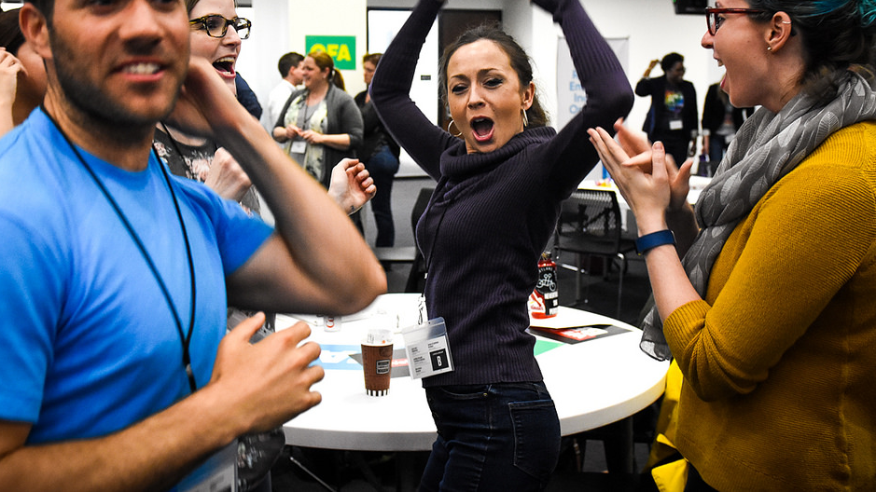
Knowing your strengths

Slide 46
Goals
1
Leaders will grow in their awareness of their strengths and weakness, both as individuals and as a group
2
Leaders will analyze values and assumptions they have that are barriers to living out their strengths
Notes:
7:11- 7:12

Slide 47
Agenda
Assessing your strengths
Thinking through StrengthsFinder
Lunch
Strengths in practice
Debrief

Slide 48
StrengthsFinder
Notes:
Based on a 40-year study of human strengths, Gallup created a language of the 34 most common talents and developed the Clifton StrengthsFinder assessment to help people discover and describe these talents.

Slide 49
Directions:
1
Go to the following sign in page: gallupstrengthscenter.com/register
2
Using your unique code, take the assessment
3
After you take the assessment, read through the PDF with your results.
Notes:
7:38- 7:41 [3 minutes]
Persuasion: we want to understand the KEY values that drive our thinking, and why we do what we do. We want the answers to the questions, ‘What is your purpose? What is your cause? What is your belief?’ When we have the answers to these questions, we are motivated at a gut level to make a change in our society and communicate the change we so desperately wish to see as a reality.
Audience: our audience is your neighbors. You are not talking to someone who necessarily lives so far outside your lived experience- the challenges you see in your community are the challenges they likely see in their community as well.
How this applies to community organizing: We are not at their door to necessarily ’make an ask’ – we are there to spark conversation, understand our neighbors, and create space to continued conversations to come. We are going to work on our LISTENING and uncover what people care about.

Slide 50
StrengthFinders
Case study: Liz
Notes:
7:41- 7:42 [1 minute]
Distinguish between personal story and your ‘why’: they serve different purposes!
When you know your why, it enables you to reflect on your values and connect with your neighbors to spark a different conversations
We don’t assume that every conversation we have will end with an ‘ask’

Slide 51
Let’s unpack
your results
Notes:
Based on a 40-year study of human strengths, Gallup created a language of the 34 most common talents and developed the Clifton StrengthsFinder assessment to help people discover and describe these talents.

Slide 52
  How do you feel about your strengths?
  How do they compare to what people have said about you?
  Where have you seen your strengths play out, both personally and professionally?
  Was there a strength you expected to see, but didn’t see?
  How might your strengths complement one another? How might they be in conflict?

Slide 53
Agenda
Assessing your strengths
Thinking through StrengthsFinder
Lunch
Strengths in practice
Debrief

Slide 54
8 minutes
Put a tally mark under the bucket where your strength falls
Look at the overall number of tally marks in each domain. Where are we strong as a group? Where are we weaker?
Tally your strengths

Slide 55
Lunch

Slide 56
Agenda
Assessing your strengths
Thinking through StrengthsFinder
Lunch
Strengths in practice
Debrief

Slide 57
Applying your strengths
Think of a situation
Strengths web
Animal
metaphor
Strengths & weaknesses
Passions
& dreams
Write the story of a time you saw all of your strengths play out
Word associations with each strength—make connections
If these strengths were an animal, what would it be?
Do you have stronger domains and weaker domains? How come?
What do your strengths reveal about things you care about?
What’s your dream based on that? How do your strengths affect that dream?

Slide 58
Partner up. Partner A = sooner birthday B = further birthday.
Partner A has 3 minutes to speak (uninterrupted) about their application. Partner B is listening and preparing questions.
Discuss for 3 minutes.
Switch! Partner B speaks while Partner A listens and prepares.
Discuss for 3 minutes.
12 minutes
Pair up!

Slide 59
Agenda
Assessing your strengths
Thinking through StrengthsFinder
Lunch
Strengths in practice
Debrief

Slide 60
Debrief

Slide 61
Break

Slide 62
Point of contact: Jalakoi Solomon
757.344.5134

Slide 63
Agenda
Welcome and introductions
Leadership simulation
StrengthsFinder I
Lunch
StrengthsFinder II
Archetypes of leadership
Debrief & closing

Slide 64
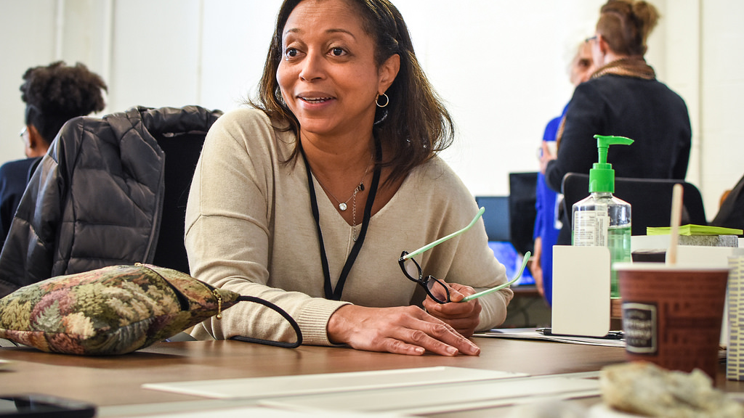
Archetypes of
leadership

Slide 65
Goals
1
Develop self-awareness and knowledge about your archetype of leadership.
Identify areas that, based on your archetypes, highlight how you want grow as a leader.
Feel ready and capable of developing into a great leader.
2
3

Slide 66
Agenda
Our day so far
Your five top leaders
Archetypes of leadership
Our conceptions of leadership
Debrief and close

Slide 67
Today’s goals
1
Coaches should develop a deeper understanding of the challenges and best practices to accomplishing goals through a team.
Coaches should learn new skills for communicating, leading, and directing a team to success.
Coaches should start deconstructing their definition of “effective leadership.”
2
3

Slide 68
Agenda
Our day so far
Your top five leaders
Archetypes of leadership
Our conceptions of leadership
Debrief and close

Slide 69
5 minutes
List the top five leaders you admire on butcher paper.
Identify why you chose these five leaders—think:
  Attributes
  Demographics
  What makes them a good leader
Reflection and writing

Slide 70
10 minutes
You will need to find a partner for this next activity.
For 5 minutes: One of you will share your list of leaders and explain why you chose them. Include demographics and attributes of your leaders.
After 5 minutes, switch and have the other partner share.
Partner activity

Slide 71
3 minutes
Reflect on your partner’s list of leaders and descriptions:
  What values are present in the list of leaders your partner chose?
  What potential leadership blind-spots do you see?
Reflection and writing

Slide 72
10 minutes
Each partner should come back together.
For 5 minutes each: Discuss your findings on the values you noticed in your partner’s leaders list and the potential blind-spots you were able to identify.
Partner activity

Slide 73
Debrief

Slide 74
Agenda
Our day so far
Your five top leaders
Archetypes of leadership
Our conceptions of leadership
Debrief and close

Slide 75
Archetype:
A recurrent symbol or motif of something, particularly in reference to your thoughts.

Slide 76
Stereotype:
A widely held but fixed and oversimplified image or idea of a particular type of person or thing.

Slide 77
Archetype of a plumber

Slide 78
Archetype of a teacher

Slide 79
Archetype of a businessperson

Slide 80
10 minutes
On a piece of butcher paper, write down reflections on these 3 questions:
  What is your archetype of leadership?
  How does your leadership archetype differ from you?
  Give an example of someone who has challenged your archetype.
Individual reflection

Slide 81
Discussion
What archetypes did you come up with?
Who challenged your archetype?
Were you surprised by the way you thought of leadership?

Slide 82
Agenda
Our day so far
Your five top leaders
Archetypes of leadership
Our conceptions of leadership
Debrief and close

Slide 83
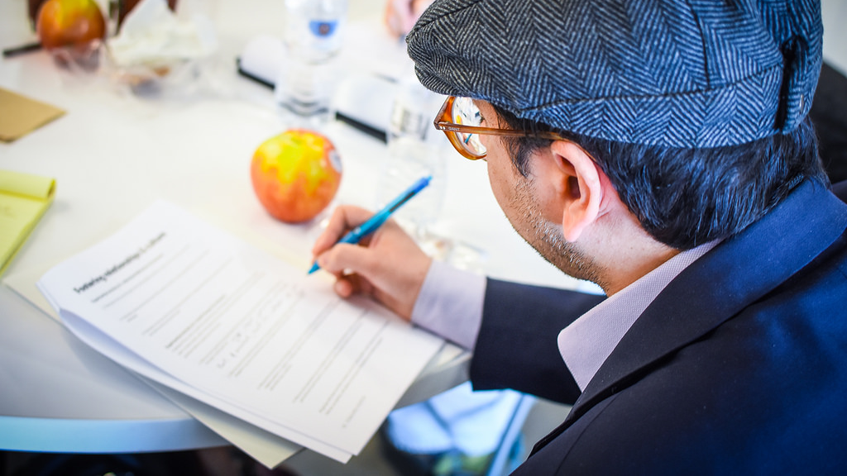
What leadership is
(and is not)

Slide 84
Our conception
of what leadership is
can be limiting.

Slide 85
Assigned Leadership:
Leadership that is based on occupying a position a position in an organization.
(Northouse, ”Leadership: Theory and Practice”, 08)

Slide 86
Emergent Leadership:
Perceiving an individual as the most influential member of a group, regardless of their title.
(Northouse, ”Leadership: Theory and Practice”, 08)

Slide 87
Management
(Abraham Zaleznik, 1977)
Leadership
(Abraham Zaleznik, 1977)

Slide 88
Management
(Abraham Zaleznik, 1977)
Leadership
(Abraham Zaleznik, 1977)
Impersonal about organizational goals.
Relate more in-line with role.
Authority granted from above (authorized).
Transactional.
Conditional.

Slide 89
Management
(Abraham Zaleznik, 1977)
Leadership
(Abraham Zaleznik, 1977)
Impersonal about organizational goals.
Relate more in-line with role.
Authority granted from above (authorized).
Transactional.
Conditional.
Personal about organizational goals.
Relate more intuitively.
Authority granted from below or from within.
Persistent.

Slide 90
Leadership is not…

Slide 91

Coercive or
telling people what to do.
Notes:
Coersion induces change, while leadership influences change

Slide 92
Trait-based or born
that way.
Notes:
Coersion induces change, while leadership influences change

Slide 93
Leadership is a process by which an individual uses influence with a group for positive change.

Slide 94
Key takeaways
Things great leaders do rarely corresponds to technical knowledge.
Process-oriented vs. trait-oriented or static.
Leadership requires emotional intelligence.

Slide 95
10 minutes
Technical: What stood out to you most?
Practical: How do you think your biggest key takeaway applies to how you’ve been applying leadership with fellows, groups, etc…
Emancipatory: Do you have any assumptions about leadership that need to be revised as a result of this session? If so, how will you actively work to revise them?
Debrief breakout

Slide 96
Agenda
Welcome and introductions
Leadership simulation
StrengthsFinder I
Lunch
StrengthsFinder II
Archetypes of leadership
Debrief & closing

Slide 97
Debrief

Slide 98
Debrief
What did you learn today about leadership?

Slide 99
Debrief
What did you learn today about leadership?
What did you learn about yourself?

Slide 100
Debrief
What did you learn today about leadership?
What did you learn about yourself?
How can you apply what you’ve learned?

Slide 101
Evaluations
bit.ly/ofacoaches1

Slide 102
Optional
Fun!
Picnic in Grant Park
Live music and snacks.
Tonight from 5:30–8:00pm
601 S Michigan Ave, Chicago, IL 60605
Tomorrow’s
Training
Breakfast and registration begins at 8:30am!
We will finish by 1:00pm. Make sure you check out of your hotel and bring your luggage!

Slide 103
Point of contact: Kevin Lane
810.931.6640

Slide 104
Tomorrow’s agenda
Breakfast & registration
Opening & recap from Saturday
Program breakouts: Campus & Fellowship
Debrief, closing, next steps

Slide 105
Questions?

Slide 106
Thank you!

Slide 107
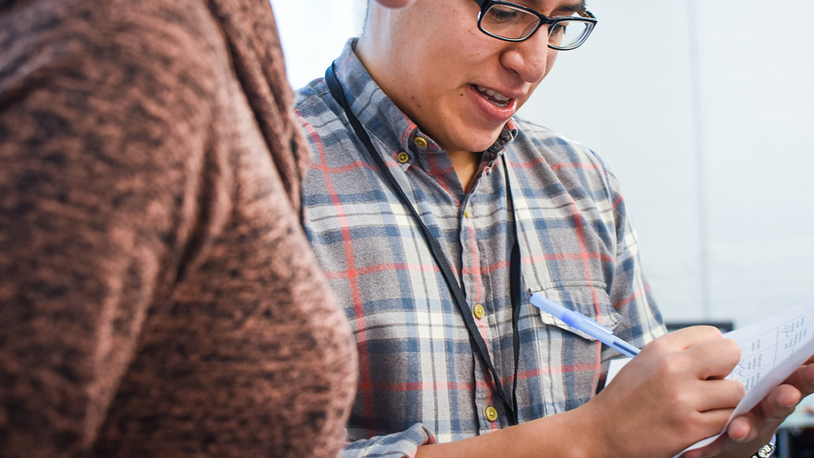
COACHES HUDDLE
FALL 2017

Slide 108
Agenda
Breakfast & registration
Opening & recap from Saturday
Program breakouts: Campus & Fellowship
Debrief, closing, next steps

Slide 109
Icebreaker!

Slide 110
Yesterday’s
agenda
Welcome and introductions
Leadership simulation
StrengthsFinder I
Lunch
StrengthsFinder II
Archetypes of leadership
Debrief & closing

Slide 111
Discussion
Some insights you had from yesterday’s training.
What your most excited about in starting your programs.
What your nervous about in these programs.

Slide 112
Program breakouts

Slide 113
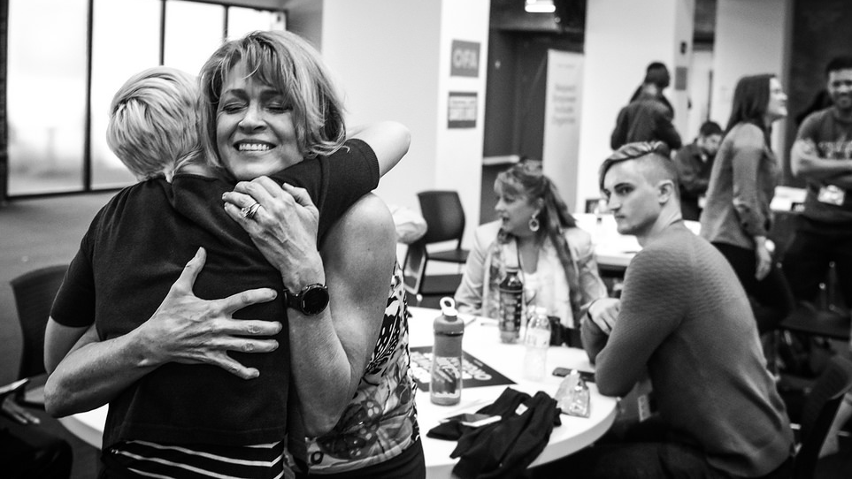
Community Engagement Fellowship

Slide 114
Managing the program

Slide 115
Community Engagement Fellowship
PHASE 1
PHASE 2
PHASE 3
Recruitment and selection

Slide 116
Community Engagement Fellowship
PHASE 1
PHASE 2
PHASE 3
Orientation and curriculum

Slide 117
Community Engagement Fellowship
PHASE 1
PHASE 2
PHASE 3
Event and
debrief

Slide 118
Goals
1
Learn the types of community engagement events your fellows will learn to organize.
Be able to guide fellows through the curriculum.
Feel comfortable supporting your fellows as they plan and organize community engagement events.
2
3
Notes:
00:14 – 00:16 [2 min] – Aquiles
[Broad Goals] Introduce three key goals for the day.
Who is overwhelmed by all these phases?
Today’s orientation will touch on every single phase of this program. If by 5:00 PM we have done a good job as trainers, you will know:
Review goals

Slide 119
Agenda
Community engagement events
Developing a learning journey
Debrief and close

Slide 120
Think about a
community engagement
or organizing event you
have participated in.
What was positive? What is something you’d like to try?

Slide 121
Community Engagement Events
Film screening
Speaker series
Community service

Slide 122
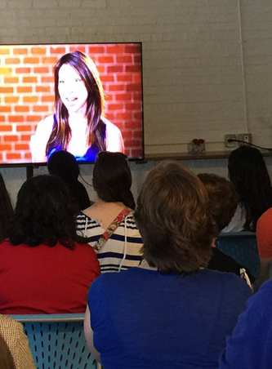
Film screenings
How do they engage people around an issue?
“Empowerment Project” film screening
Notes:
Katie

Slide 123
Organizing Events
Earned media events
Town hall meetings
Office visits to elected officials
Phone banks
Signature
drives
Community action meeting

Slide 124
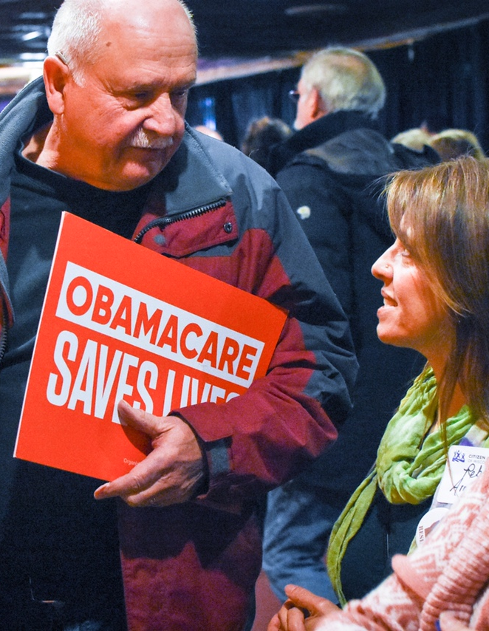
Town hall meeting
How does this engage people around an issue?
Wisconsin Obamacare rally
Notes:
Katie

Slide 125
10 minutes
On your worksheet, work as a group to review the different types of community engagement and organizing events.
Then, think about and discuss issues currently affecting your community, brainstorm what community engagement or action events you may hold, and how you will follow the 4 organizing steps to plan that event.
Small groups

Slide 126
Agenda
Community engagement events
Developing a learning journey
Debrief and close

Slide 127

Fellows curriculum overview
Notes:
00:11 – 00:16 [5 min] – Caleb
Trainer’s Notes: Learners will have 3 minutes to complete the activity. The facilitator will lead a pop-corn debrief for 2 minutes.
Review activity instructions
Set timer (Aquiles)
Debrief activity for 3 minutes (Caleb)
What was one of your key goals?
How would you accomplish that goal online?
Trainer’s Notes: Learners will likely provide wrong answers, since they have not been trained on digital tactics yet. But by throwing them in the deep end of the pool, they are realizing that there is a connection of sorts, which we will further explore throughout the training.

Slide 128
10 minutes
On your worksheet, work as a group to review the curriculum.
What about the curriculum excites you?
What questions do you have?
Small groups

Slide 129
Agenda
Community engagement events
Developing a learning journey
Debrief and close

Slide 130
Questions?

Slide 131
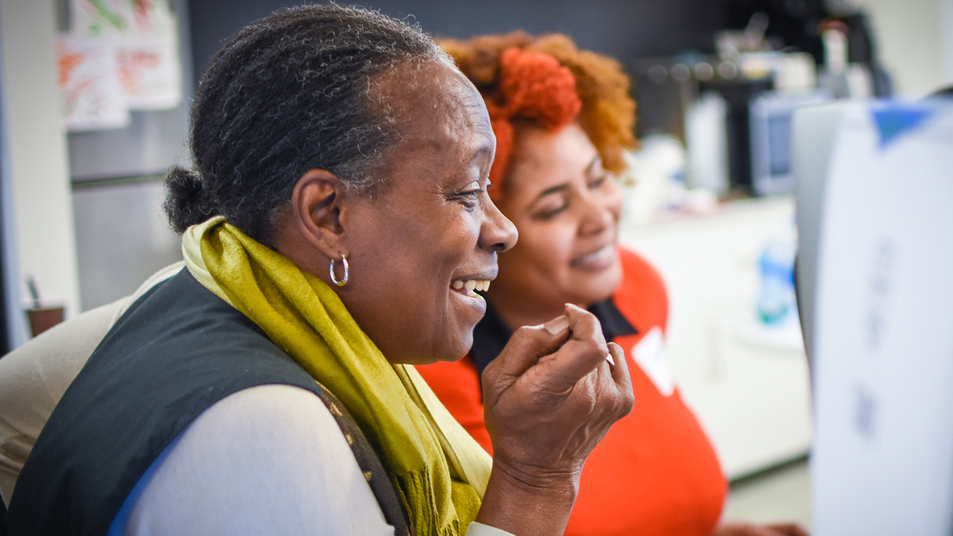
Open space

Slide 132
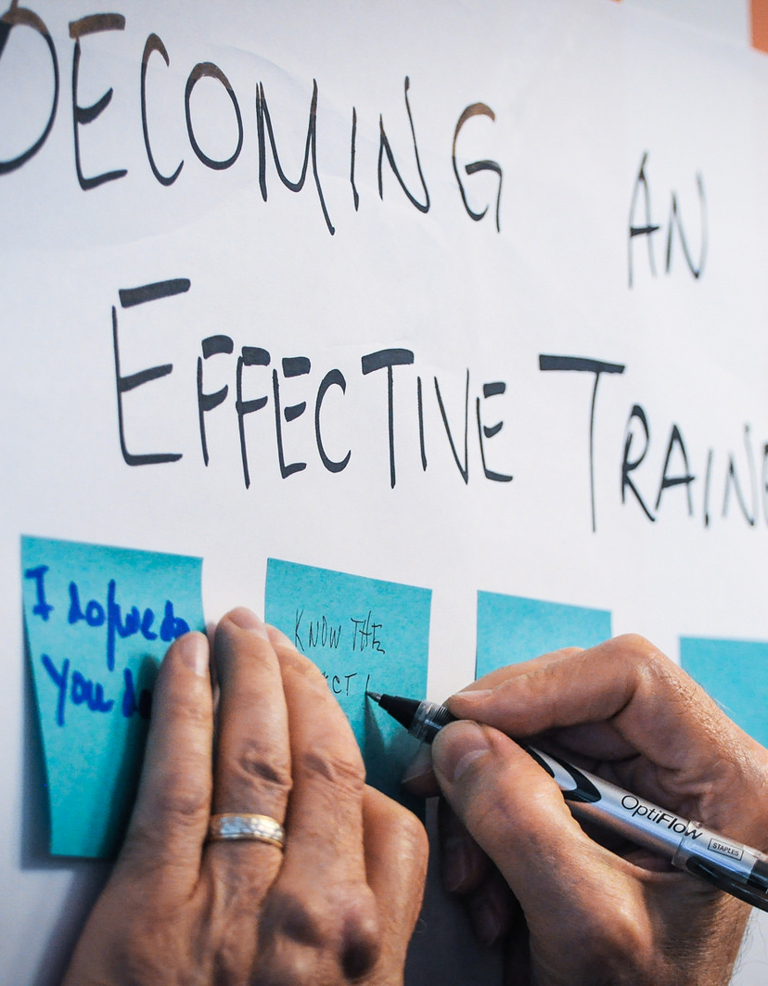
Training science
Whoever comes is the right people
Whatever happens is the only that could’ve
When is starts is the right time
When it’s over, it’s over
Law of two feet

Slide 133
Debrief

Slide 134
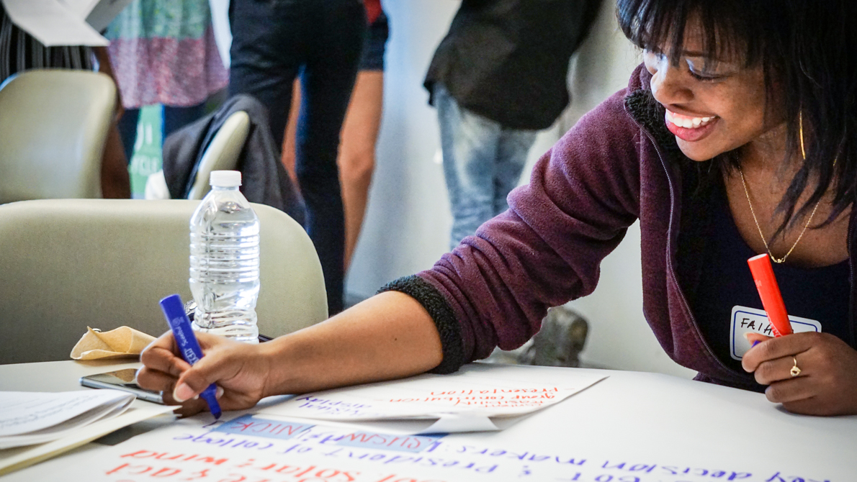
Campus Organizing
Academy

Slide 135
Agenda
Meet each other
Program vision
Curriculum overview
Logistics and things to know
Mentoring millennials
Final Q&A

Slide 136
Meet each other
1
Say your name, state, and why you joined as a campus coach.
What made you get involved in organizing?
Each coach gets 2 minutes each!
2
3

Slide 137
Program vision

Slide 138
Curriculum overview

Slide 139
Logistics & things to know

Slide 140
Mentoring millennials

Slide 141
Final Q&A

Slide 142
Agenda
Breakfast & registration
Opening & recap from Saturday
Program breakouts: Campus & Fellowship
Debrief, closing, next steps

Slide 143
Debrief
What did you learn today about your programs?

Slide 144
Debrief
What did you learn today about your programs?
What was your highlight of the weekend?

Slide 145
Debrief
What did you learn today about your programs?
What was your highlight of the weekend?
What is your new definition of leadership?

Slide 146
Fellows Leaders program
Jump on the September 12 weekly call!
Prepare for Fellows orientations
Campus Coaches program
Jump on the Campus Academy launch call!
September 14 at 8:00pm EST
Host first meetings with your students.

Slide 147
Evaluations
bit.ly/ofacoaches2

Slide 148
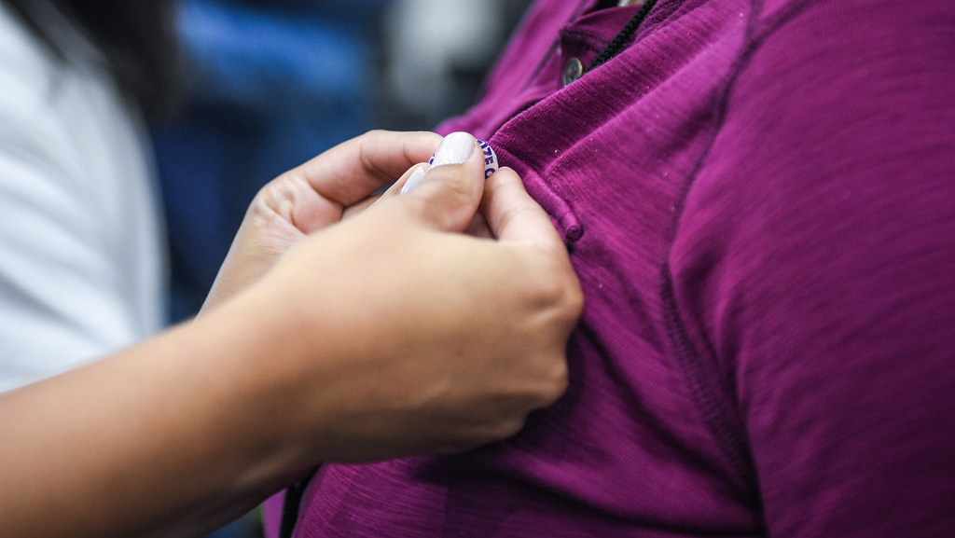
Notes:
2 minute silent reflection– everyone closes their eyes to think about what they learned over the weekend and how they want to use that going forward
Emcee: “Who wants to share their commitment?”

Slide 149
Thank you!
Notes:
Close with: Final inspiring words to wrap up the weekend then dismissal

