Slide 1
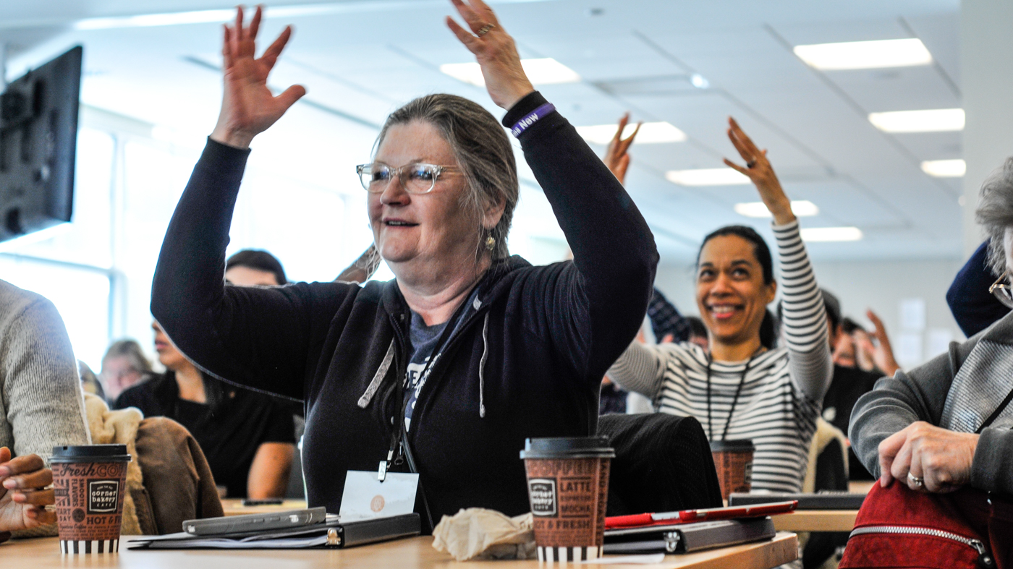


Welcome!
OFA Spring 2017 Coaches Huddle
Notes:
This work is licensed under the Creative Commons Attribution-NonCommercial 4.0 International License. To view a copy of this license, visit http://creativecommons.org/licenses/by-nc/4.0/ or send a letter to Creative Commons, PO Box 1866, Mountain View, CA 94042, USA

Slide 2
Meet today’s training team

Slide 3

Today’s Trainers
Bobby Brady-Sharp
Deputy National Training Director
Kevin Lane
Campus Programs Manager
Mary McInerney
Training Associate
Jennifer Warner
National Organizing Director
Traci Wile
Director of Community Programs

Slide 4
Meet each other!
Organizer Clap

Slide 5
Today’s
agenda
10:00 – 10:30 | Welcome and Introductions
10:30 – 11:00 | We are OFA
11:00 – 12:15 | Program Breakouts
12:15 – 1:15 | Lunch
1:15 – 2:45 | Managing Your Team: Fostering Relationships and Culture
2:45 – 3:00 | Break
3:00 – 4:15 | Managing Your Team: Coachable Moments
4:15 – 4:30 | Break
4:30 – 5:00 | Debrief & Close

Slide 6
Our Goals
1
Understand your program roles and the management tools to be successful
Be able to implement an array of coaching tools and strategies to support your team
Feel confident in managing your programs from start to finish
2
3

Slide 7

What’s your goal
for today?
Think about the key things you want to learn today or questions you want answered during this training. Share out when you’re ready!

Slide 8
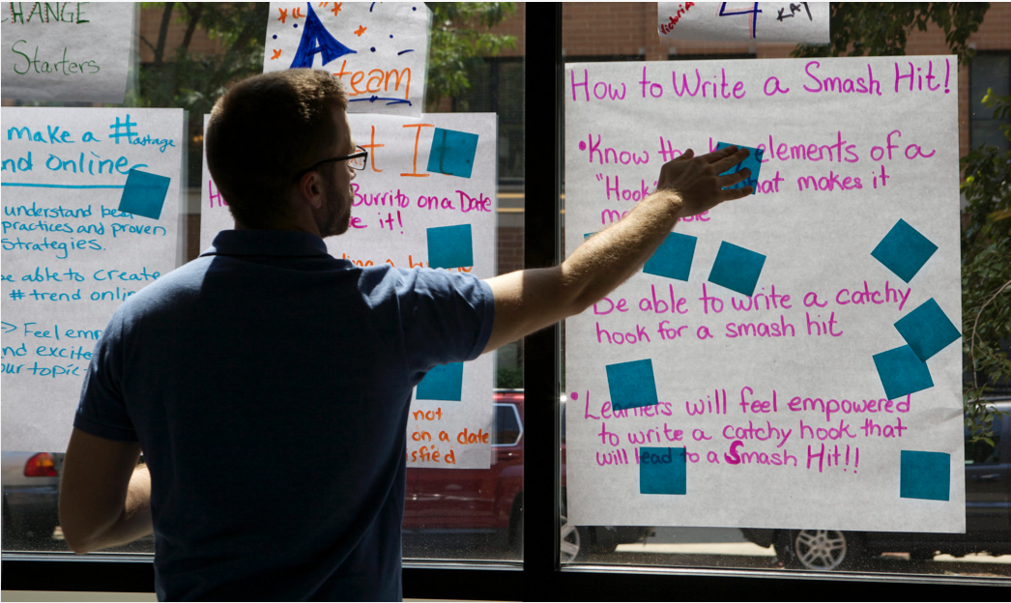
Parking Lot
Use the parking lot as a way to add and ask questions throughout the day. We’ll come back to these later in the training!

Slide 9
A few housekeeping items…

Slide 10
Today’s
agenda
10:00 – 10:30 | Welcome and Introductions
10:30 – 11:00 | We are OFA
11:00 – 12:15 | Program Breakouts
12:15 – 1:15 | Lunch
1:15 – 2:45 | Managing Your Team: Fostering Relationships and Culture
2:45 – 3:00 | Break
3:00 – 4:15 | Managing Your Team: Coachable Moments
4:15 – 4:30 | Break
4:30 – 5:00 | Debrief & Close

Slide 11
We are OFA
Where we’ve been & where we’re going

Slide 12
We organize.
We mobilize.
We recruit.

Slide 13
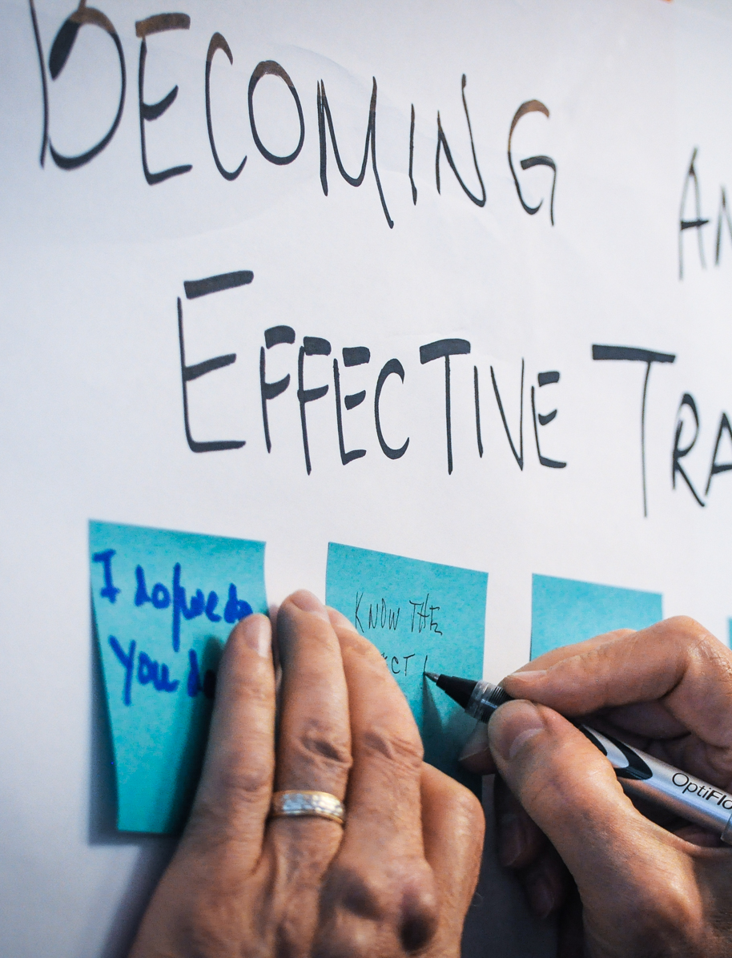
Organizing
OFA is the point of entry for new people looking to get involved.
We invest in finding, recruiting, and training people to turn activists into community leaders.
Specific issues move in and out of the spotlights, but the need for talented organizers—and a network that connects and empowers them—is universal.
Notes:
Katie

Slide 14

Mobilizing
OFA—working in concert with other progressive organizations—will run strategically placed digital and field campaigns that highlight the real-life consequences of policies.
OFA staff in states work alongside the grassroots chapter network that OFA has cultivated and will continue to grow over the long term.
Notes:
Katie

Slide 15
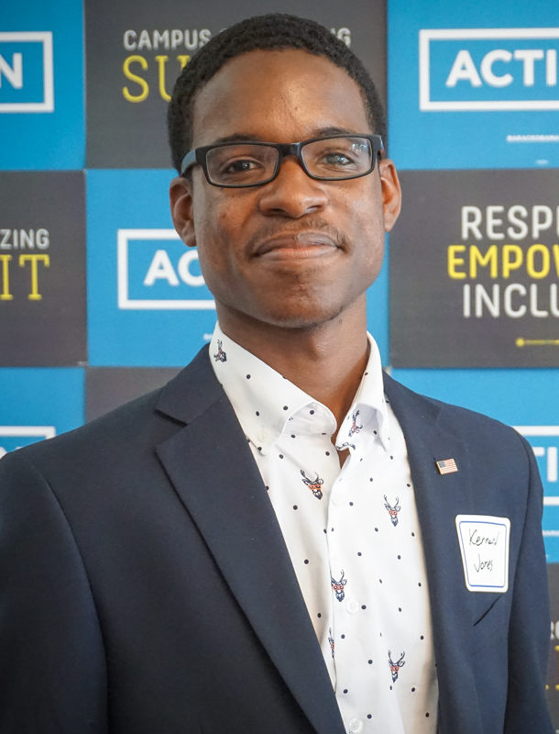
Recruiting
OFA will launch a new program this year that will identify and recruit community leaders who are exploring taking the next step and perhaps even running for local elected office.
There is no shortage of talent in the progressive movement–and we will recognize and develop that talent.
Notes:
Katie

Slide 16
2013 – 2014
Organize
Mobilize

Slide 17
2013 – 2014
2015 – 2016
Organize
Mobilize
Mobilize
Organize

Slide 18
2013 – 2014
2015 – 2016
2017 –
Recruit
Organize
Mobilize
Organize
Mobilize
Organize
Mobilize

Slide 19
What questions do you have?

Slide 20
Today’s
agenda
10:00 – 10:30 | Welcome and Introductions
10:30 – 11:00 | We are OFA
11:00 – 12:15 | Program Breakouts
12:15 – 1:15 | Lunch
1:15 – 2:45 | Managing Your Team: Fostering Relationships and Culture
2:45 – 3:00 | Break
3:00 – 4:15 | Managing Your Team: Coachable Moments
4:15 – 4:30 | Break
4:30 – 5:00 | Debrief & Close

Slide 21
Program breakouts
Community Engagement Fellowship & Campus Organizing Academy

Slide 22
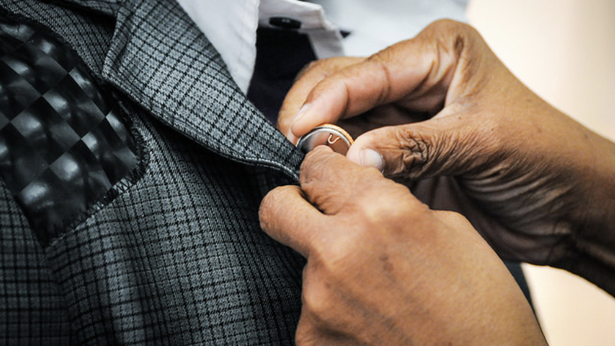
Managing the program

Slide 23
Community Engagement Fellowship
PHASE 1
PHASE 2
PHASE 3
Recruitment and Selection

Slide 24
Community Engagement Fellowship
PHASE 1
PHASE 2
PHASE 3
Orientation and Curriculum

Slide 25
Goals
1
Learn the types of community engagement events fellows will learn to organize
Be able to guide fellows through the curriculum
Feel comfortable supporting your fellows as they organize community engagement events from start to finish
2
3
Notes:
00:14 – 00:16 [2 min] – Aquiles
[Broad Goals] Introduce three key goals for the day.
Who is overwhelmed by all these phases?
Today’s orientation will touch on every single phase of this program. If by 5:00 PM we have done a good job as trainers, you will know:
Review goals

Slide 26
Agenda
Community Engagement Events
Developing a learning journey
Debrief and Close

Slide 27

Think about a community engagement event you have participated in.
What was positive? What is something you’d like to try?

Slide 28
Community Engagement Events
Film Screening
Speaker Series
Community Service

Slide 29
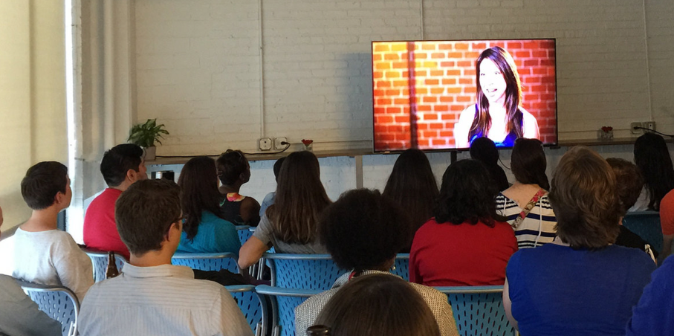
Film Screenings
How do they engage people around an issue?
Empowerment Project Film Screening
Notes:
Katie

Slide 30
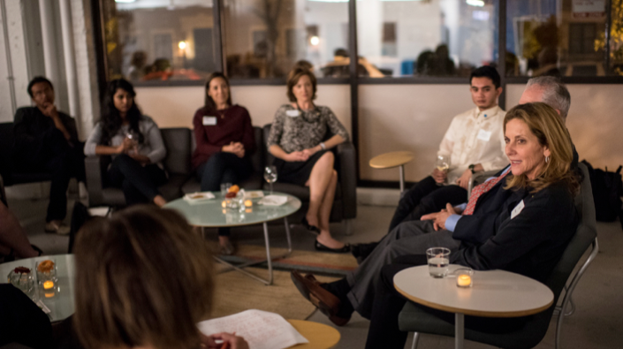
Speaker Series
How do they engage people around an issue?
Conversation with Ambassador Mandell
Notes:
Katie

Slide 31
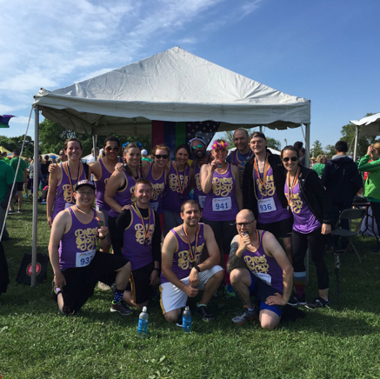
Community Service
How does this engage people around an issue?
Proud to Run
Notes:
Katie

Slide 32
Agenda
Community Engagement Events
Developing a learning journey
Debrief and Close

Slide 33
Community
Organizing:
Back to Basics
We’re a group of constituents in a community where the city council is debating a regional DREAM Act to help undocumented students attend community college.
Let’s discuss an organizing strategy in support of the resolution.

Slide 34
Community
Organizing:
Back to Basics
Plan
We’re a group of constituents in a community where the city council is debating a regional DREAM Act to help undocumented students attend community college.

Slide 35
Community
Organizing:
Back to Basics
Plan
Recruit
We’re a group of constituents in a community where the city council is debating a regional DREAM Act to help undocumented students attend community college.

Slide 36
Community
Organizing:
Back to Basics
Plan
Recruit
We’re a group of constituents in a community where the city council is debating a regional DREAM Act to help undocumented students attend community college.
Execute

Slide 37
Community
Organizing:
Back to Basics
Plan
Recruit
We’re a group of constituents in a community where the city council is debating a regional DREAM Act to help undocumented students attend community college.
Execute
Debrief

Slide 38


Fellows Curriculum Overview
Page 7
Notes:
00:11 – 00:16 [5 min] – Caleb
Trainer’s Notes: Learners will have 3 minutes to complete the activity. The facilitator will lead a pop-corn debrief for 2 minutes.
Review activity instructions
Set timer (Aquiles)
Debrief activity for 3 minutes (Caleb)
What was one of your key goals?
How would you accomplish that goal online?
Trainer’s Notes: Learners will likely provide wrong answers, since they have not been trained on digital tactics yet. But by throwing them in the deep end of the pool, they are realizing that there is a connection of sorts, which we will further explore throughout the training.

Slide 39
20 minutes
On page 9 in your workbook, work as a group to review the different types of community engagement events and fellows curriculum.
Then, think about and discuss issues currently affecting your community, brainstorm what community engagement or action events you may hold, and how you will follow the 4 organizing steps to plan that event.
Small Groups

Slide 40
What questions do you have?

Slide 41
Agenda
Community Engagement Events
Developing a learning journey
Debrief and Close

Slide 42
Debrief

Slide 43
Today’s
agenda
10:00 – 10:30 | Welcome and Introductions
10:30 – 11:00 | We are OFA
11:00 – 12:15 | Program Breakouts
12:15 – 1:15 | Lunch
1:15 – 2:45 | Managing Your Team: Fostering Relationships and Culture
2:45 – 3:00 | Break
3:00 – 4:15 | Managing Your Team: Coachable Moments
4:15 – 4:30 | Break
4:30 – 5:00 | Debrief & Close

Slide 44
Lunch

Slide 45
Today’s
agenda
10:00 – 10:30 | Welcome and Introductions
10:30 – 11:00 | We are OFA
11:00 – 12:15 | Program Breakouts
12:15 – 1:15 | Lunch
1:15 – 2:45 | Managing Your Team: Fostering Relationships and Culture
2:45 – 3:00 | Break
3:00 – 4:15 | Managing Your Team: Coachable Moments
4:15 – 4:30 | Break
4:30 – 5:00 | Debrief & Close

Slide 46
Managing your team
Fostering Relationships and Culture

Slide 47
Goals for this section
1
Understand best practices for good management by fostering relationships and building trust
Be able to encourage, challenge, and empower your team members
Feel confident in building your own management style to support your team
2
3

Slide 48
Agenda
Building relationships
Norms & Expectations
Team culture

Slide 49
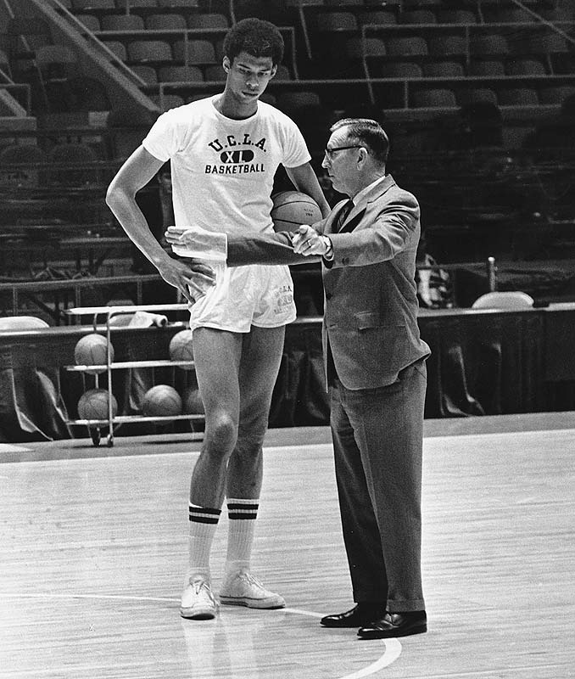
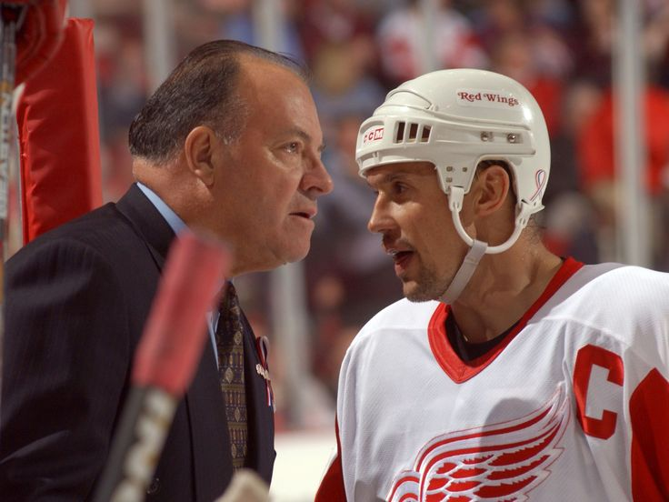
Coaches quotes
Notes:
Kareem Abdul Jabbar

Slide 50
Coaches quotes
"Make sure that team members know they are working with you, not for you." John Wooden
Notes:
Kareem Abdul Jabbar

Slide 51
Coaches quotes
"Make sure that team members know they are working with you, not for you." John Wooden
"Coaches have to watch for what they don't want to see and listen to what they don't want to hear.” John Madden
Notes:
Kareem Abdul Jabbar

Slide 52
Coaches quotes
"Make sure that team members know they are working with you, not for you." John Wooden
"Coaches have to watch for what they don't want to see and listen to what they don't want to hear.” John Madden
“I don't have bad relationships with my players. But I don't get into long conversations with them either.” Scotty Bowman
Notes:
Kareem Abdul Jabbar

Slide 53
10 minutes
On page 9 in your workbook, reflect on and answer these three questions:
Think about a time you had a good coach. What qualities made them a good coach?
Think about a time you had a bad coach. What qualities made their coaching style difficult for you?
Think about a time you had to hold someone accountable. How did you make sure they achieved the goal?
Individual Reflection

Slide 54
Debrief

Slide 55
Building relationships
1
Find your team members’ passions. What motivates them to succeed?
Find the right balance between collaboration and competition
Gain team members’ trust by following through and delivering on your own goals and objectives.
2
3

Slide 56
Agenda
Building relationships
Norms & Expectations
Team culture

Slide 57
What is a norm?
What is an expectation?

Slide 58
Something that is usual, typical, or standard
A strong belief that something will happen, or should happen

Slide 59
15 minutes
On page 9 in your workbook, work as a group to come up with collective norms and expectations for your programs.
The goal is to figure out the best ways we can establish a good team culture.
We will share out our ideas at the end of this activity.
Small Groups

Slide 60
Debrief

Slide 61
Agenda
Building relationships
Norms & Expectations
Team culture

Slide 62
Running your
program
While we can all buy-in to a collective culture across our programs and teams, each individual program will have it’s own norms and expectations.
We all love ice cream, but we prefer specific flavors!

Slide 63
15 minutes
On page 10 in your workbook, take some time to put into words the specific qualities you’ll develop in your team.
What matters most to you as a manager and team member? What type of coach will you be?
We will share and debrief with partners at the end.
Individual reflection

Slide 64
Debriefing
this section
1
What are some takeaways you have from this section?
Did you have any big “aha” moments?
How do you see yourself applying what you learned?
2
3

Slide 65
Break

Slide 66
Today’s
agenda
10:00 – 10:30 | Welcome and Introductions
10:30 – 11:00 | We are OFA
11:00 – 12:15 | Program Breakouts
12:15 – 1:15 | Lunch
1:15 – 2:45 | Managing Your Team: Fostering Relationships and Culture
2:45 – 3:00 | Break
3:00 – 4:15 | Managing Your Team: Coachable Moments
4:15 – 4:30 | Break
4:30 – 5:00 | Debrief & Close

Slide 67
Coachable moments

Slide 68
Goals for this section
1
Understand ways to reinforce team culture, goals, and expectations through coachable moments
Be able to encourage, challenge, and develop your team members
Feel comfortable and confident motivating your team and holding members accountable
2
3

Slide 69
Agenda
What is coaching?
Encouragement and Recognition
Challenging performance
Situational leadership
Effective Check-ins
Questions
Next Steps

Slide 70
Accountability
We seek to create a culture of accountability with our team where everyone knows the goals and expectations that ultimately define success.
But how do we hold team members accountable?
We hold team members accountable through coaching.

Slide 71
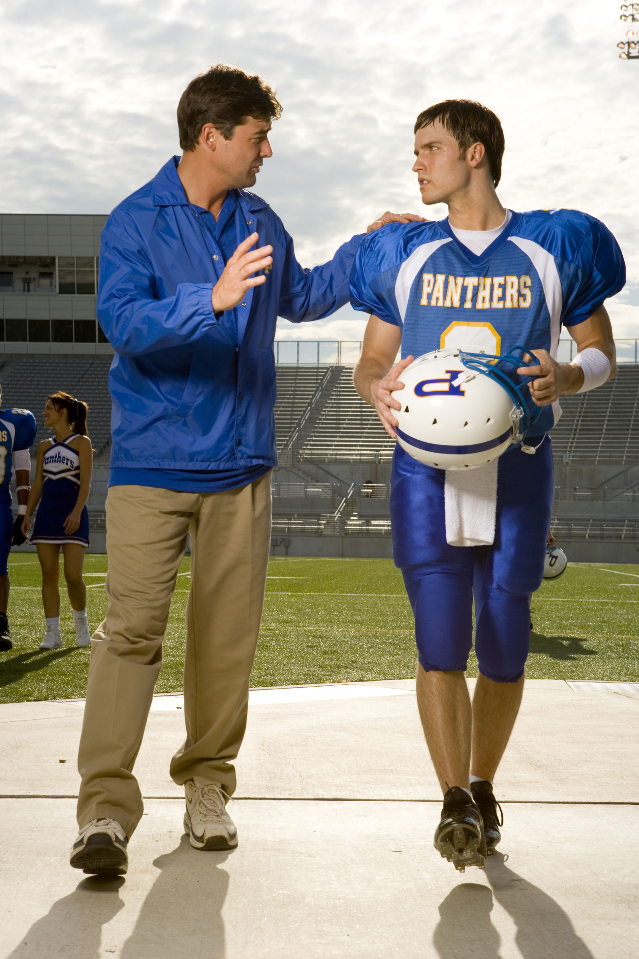
What is coaching?
Coachable moments are the everyday opportunities to encourage and challenge your team.
We encourage and challenge our team to create a culture of accountability.
Your role as a coach is to help your team reach their full potential.

Slide 72
Agenda
What is coaching?
Encouragement and Recognition
Challenging performance
Situational leadership
Effective Check-ins
Questions
Next Steps

Slide 73
Recognizing your team.
Look for specific ways to encourage and recognize each team member.

Slide 74
How do you like to be
recognized or encouraged?

Slide 75
Applause
Public praise for good performance Awards Celebration and parties
Types of recognition

Slide 76
Applause
Public praise for good performance Awards Celebration and parties
Appreciation
Personal or written thanks Recognized and valued experts Involvement in large indicatives
Types of recognition

Slide 77
Applause
Public praise for good performance Awards Celebration and parties
Appreciation
Personal or written thanks Recognized and valued experts Involvement in large indicatives
Access
More 1:1 time, review performance Commitment to work on concerns Coffee break, lunch or walk together
Types of recognition

Slide 78
Agenda
What is coaching?
Encouragement and Recognition
Challenging performance
Situational leadership
Effective Check-ins
Questions
Next Steps

Slide 79
What makes it difficult to have challenging conversations? Why do you feel this way?

Slide 80
Challenging conversations
in 5 easy steps

Slide 81
Observe
You state: “This is what I saw…”

Slide 82
Observe
You state: “This is what I saw…”
Respond
You wait for a response

Slide 83
Observe
You state: “This is what I saw…”
Respond
You wait for a response
Remind
You state: “This is what I need to see…”

Slide 84
Observe
You state: “This is what I saw…”
Respond
You wait for a response
Remind
You state: “This is what I need to see…”
Solve
You ask: “What can we do to make sure this happens?”

Slide 85
Observe
You state: “This is what I saw…”
Respond
You wait for a response
Remind
You state: “This is what I need to see…”
Solve
You ask: “What can we do to make sure this happens?”
Agree
You re-state: “So, we agree…”

Slide 86
10 minutes
1
Get into your groups (nametag). Review the scenarios on page 13-14 of your workbook.
For each scenario, follow the instructions to decide what encouragement method you would use, and whether you would need to have a challenging conversation.
With your partner, discuss and list the steps of your challenging conversation.
2
3

Slide 87
Debrief
Notes:
00:11 – 00:16 [5 min] – Caleb
Trainer’s Notes: Learners will have 3 minutes to complete the activity. The facilitator will lead a pop-corn debrief for 2 minutes.
Review activity instructions
Set timer (Aquiles)
Debrief activity for 3 minutes (Caleb)
What was one of your key goals?
How would you accomplish that goal online?
Trainer’s Notes: Learners will likely provide wrong answers, since they have not been trained on digital tactics yet. But by throwing them in the deep end of the pool, they are realizing that there is a connection of sorts, which we will further explore throughout the training.

Slide 88
Agenda
What is coaching?
Encouragement and Recognition
Challenging performance
Situational leadership
Effective Check-ins
Questions
Next Steps

Slide 89
Diagnosis and treatment

Slide 90
Conditions challenge
Access to necessary tools to meet goals
Common types of challenges

Slide 91
Conditions challenge
Access to necessary tools to meet goals
Attitude challenge
Team members don’t fully understand the goals, expectations, or vision of the program.
Common types of challenges

Slide 92
Conditions challenge
Access to necessary tools to meet goals
Attitude challenge
Team members don’t fully understand the goals, expectations, or vision of the program.
Training challenge
Team members lack specific skills to meet goals Team members weren’t trained properly Preventive solution
Common types of challenges

Slide 93
Supporting
Coaching
Delegating
Directing
Developing skills
High energy
Developing skills
Low energy
Mastered skills
Low energy
Mastered skills
High Energy
Notes:
Once the Team Member is confident in his/her ability to do the work, and know they can do it, they reach Development Stage 4: High Competence and High Commitment.
At this point the direction is low, and supportive behavior is minimal. You no longer have to tell the Team Member how to do the work, nor have to be constantly checking to make sure that the Team Member is encouraged. At this point you begin to Delegate. The Team Member and Manager agree on a project and the Team Member implements. The Manager checks-in, but do not provide step by step guidance b/c the Team Member knows what to do, and is confident in doing.

Slide 94
10 minutes
1
In partners, turn to page 16 and revisit the scenarios you previously discussed with a partner.
For each scenario, determine where on the grid each team member falls. Then, determine a management treatment to help the team member perform at their optimal level.
Partners
2

Slide 95
Debrief
Notes:
00:11 – 00:16 [5 min] – Caleb
Trainer’s Notes: Learners will have 3 minutes to complete the activity. The facilitator will lead a pop-corn debrief for 2 minutes.
Review activity instructions
Set timer (Aquiles)
Debrief activity for 3 minutes (Caleb)
What was one of your key goals?
How would you accomplish that goal online?
Trainer’s Notes: Learners will likely provide wrong answers, since they have not been trained on digital tactics yet. But by throwing them in the deep end of the pool, they are realizing that there is a connection of sorts, which we will further explore throughout the training.

Slide 96
Agenda
What is coaching?
Encouragement and Recognition
Challenging performance
Situational leadership
Effective Check-ins
Questions
Next Steps

Slide 97
Check-ins
We seek to create a culture of accountability with our team where everyone knows the goals and expectations that ultimately define success.
But how do we hold team members accountable?
Check-ins are our way of ensuring that we are communicating goals, priorities, and expectations. It is also an opportunity to listen to your team member and gain perspective as a manage.
Notes:
Remember when we first discussed accountability.

Slide 98
Before the check-in
1
Set the Agenda
Your agenda should be one where you give ample time for the team member to own their work!
Review goals and expectations
Review the goals, expectations, and priorities between you and your team. Did your team meet goals? Is your team where you want to be?
Decide your management approach
Using the coaching tools we just reviewed (encouragement, challenging conversations, situational leadership), list out what kind of conversation you need to have with your team member.
2
3
Notes:
Remember when we first discussed accountability.

Slide 99
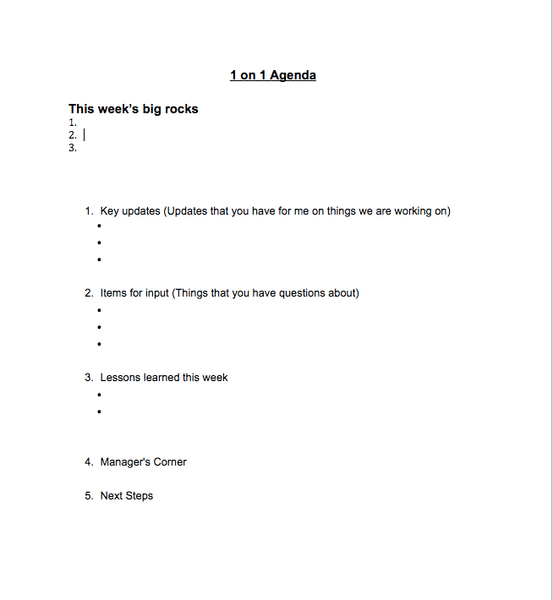
During the check-in
Sample Agenda
Notes:
Remember when we first discussed accountability.

Slide 100
After the
check-in
1
Provide a written recap of next steps
Provide a recap of everything you and the team agreed upon, listing next steps and due dates. Be as specific as possible!
2
Implement your management treatment Depending on where your team members fall on the situational grid, continue to implement your management treatments based on your conversation.
3
Check progress!
Management doesn’t end after the check-in. Make sure you’re touching base with your team member regularly to make sure both of you are meeting your next steps.
Notes:
Remember when we first discussed accountability.

Slide 101
20 minutes
1
In partners, turn to page 18 and revisit the scenarios you previously reviewed.
Decide which partner will be the team member in scenario 1, and which will be the team member in scenario 2.
Take 10 minutes to roleplay a management check-in with your partner. Then switch off for another 10 minutes!
Partner Activity
2
3

Slide 102
Debrief

Slide 103
Agenda
What is coaching?
Encouragement and Recognition
Challenging performance
Situational leadership
Effective Check-ins
Questions
Next Steps

Slide 104
Debrief
What was your biggest “aha” moment?
How does this change the way you think about coaching?

Slide 105
Break

Slide 106
Today’s
agenda
10:00 – 10:30 | Welcome and Introductions
10:30 – 11:00 | We are OFA
11:00 – 12:15 | Program Breakouts
12:15 – 1:15 | Lunch
1:15 – 2:45 | Managing Your Team: Fostering Relationships and Culture
2:45 – 3:00 | Break
3:00 – 4:15 | Managing Your Team: Coachable Moments
4:15 – 4:30 | Break
4:30 – 5:00 | Debrief & Close

Slide 107
Debrief & Close

Slide 108
Debriefing today’s training
1
Butcher paper placed around the room for each training section.
Use markers to write down your biggest takeaway.
We’ll circle up and share our biggest takeaway and most interesting takeaway you saw from someone else
2
3

Slide 109
bit.ly/ofahuddle

Slide 110
Circle up and share!

Slide 111
Reception Details
The CrossRoads Bar & Grill
1120 W Madison St
Tonight from 5:30–7:30pm! Appetizers provided.
Tomorrow’s
Training
Breakfast and sign-in here at 9:00am!
We will finish by 1:30pm. Make sure you check out of your hotel and bring your luggage!

Slide 112
Thank you!

Slide 113
Welcome!
OFA Spring 2017 Coaches Huddle

Slide 114
Organizer Bingo

Slide 115
Our Goals
1
Understand your program roles and the management tools to be successful
Be able to implement an array of coaching tools and strategies to support your team
Feel confident in managing your programs from start to finish
2
3

Slide 116
Yesterday’s
agenda
10:00 – 10:30 | Welcome and Introductions
10:30 – 11:00 | We are OFA
11:00 – 12:15 | Program Breakouts
12:15 – 1:15 | Lunch
1:15 – 2:45 | Managing Your Team: Fostering Relationships and Culture
2:45 – 3:00 | Break
3:00 – 4:15 | Managing Your Team: Coachable Moments
4:15 – 4:30 | Break
4:30 – 5:00 | Debrief & Close

Slide 117
Today’s
agenda
9:30 – 10:00 | Welcome and Introductions
10:00 – 11:15 | Managing Your Team: Managing Project Managers
11:15 – 11:30 | Break
11:30 – 1:00 | Program Breakouts
1:00 – 1:30 | Debrief & Close

Slide 118
Today’s
agenda
9:30 – 10:00 | Welcome and Introductions
10:00 – 11:15 | Managing Your Team: Managing Project Managers
11:15 – 11:30 | Break
11:30 – 1:00 | Program Breakouts
1:00 – 1:30 | Debrief & Close

Slide 119
Managing Your Team
Managing Project Managers

Slide 120
Goals for this section
1
Understand how to manager a team of project managers using organizational tools
Be able to manage your team to success while allowing them to own the projects they execute
Feel confident in holding team members accountable through successful empowerment
2
3

Slide 121
Agenda
Goals & Delegation
Project Plans
Organization Tools
Debrief

Slide 122
Lets talk about MOCHA

Slide 123
Lets talk about MOCHA
Not the coffee!

Slide 124
Manager
Notes:
MANAGER
Assigns responsibility and holds owner accountable. Makes suggestions, asks hard questions, reviews progress, serves as a resource, and intervenes if the work is off-track.
OWNER
Has overall responsibility for the success or failure of the project. Ensures that all the work gets done (directly or with helpers) and that others are involved appropriately. There should only be one owner.
CONSULTED
Should be asked for input or needs to be bought into the project.
HELPER
Assists with or does some of the work.
APPROVER
Signs off on decisions before they’re final. May be the manager, though might also be the executive director, external partner, or board chair.
After roles and responsibilities are delegated to your team, the next step is to have team members create and submit a project plan for you to review. This is what we’ll do in the next activity.

Slide 125
Manager
Owner
Notes:
MANAGER
Assigns responsibility and holds owner accountable. Makes suggestions, asks hard questions, reviews progress, serves as a resource, and intervenes if the work is off-track.
OWNER
Has overall responsibility for the success or failure of the project. Ensures that all the work gets done (directly or with helpers) and that others are involved appropriately. There should only be one owner.
CONSULTED
Should be asked for input or needs to be bought into the project.
HELPER
Assists with or does some of the work.
APPROVER
Signs off on decisions before they’re final. May be the manager, though might also be the executive director, external partner, or board chair.
After roles and responsibilities are delegated to your team, the next step is to have team members create and submit a project plan for you to review. This is what we’ll do in the next activity.

Slide 126
Manager
Owner
Consultant
Notes:
MANAGER
Assigns responsibility and holds owner accountable. Makes suggestions, asks hard questions, reviews progress, serves as a resource, and intervenes if the work is off-track.
OWNER
Has overall responsibility for the success or failure of the project. Ensures that all the work gets done (directly or with helpers) and that others are involved appropriately. There should only be one owner.
CONSULTED
Should be asked for input or needs to be bought into the project.
HELPER
Assists with or does some of the work.
APPROVER
Signs off on decisions before they’re final. May be the manager, though might also be the executive director, external partner, or board chair.
After roles and responsibilities are delegated to your team, the next step is to have team members create and submit a project plan for you to review. This is what we’ll do in the next activity.

Slide 127
Manager
Owner
Consultant
Helper
Notes:
MANAGER
Assigns responsibility and holds owner accountable. Makes suggestions, asks hard questions, reviews progress, serves as a resource, and intervenes if the work is off-track.
OWNER
Has overall responsibility for the success or failure of the project. Ensures that all the work gets done (directly or with helpers) and that others are involved appropriately. There should only be one owner.
CONSULTED
Should be asked for input or needs to be bought into the project.
HELPER
Assists with or does some of the work.
APPROVER
Signs off on decisions before they’re final. May be the manager, though might also be the executive director, external partner, or board chair.
After roles and responsibilities are delegated to your team, the next step is to have team members create and submit a project plan for you to review. This is what we’ll do in the next activity.

Slide 128
Manager
Owner
Consultant
Helper
Approver
Notes:
MANAGER
Assigns responsibility and holds owner accountable. Makes suggestions, asks hard questions, reviews progress, serves as a resource, and intervenes if the work is off-track.
OWNER
Has overall responsibility for the success or failure of the project. Ensures that all the work gets done (directly or with helpers) and that others are involved appropriately. There should only be one owner.
CONSULTED
Should be asked for input or needs to be bought into the project.
HELPER
Assists with or does some of the work.
APPROVER
Signs off on decisions before they’re final. May be the manager, though might also be the executive director, external partner, or board chair.
After roles and responsibilities are delegated to your team, the next step is to have team members create and submit a project plan for you to review. This is what we’ll do in the next activity.

Slide 129
Project Plans

Slide 130
Project Plans
Shout out how you would describe a project plan. (But raise your hand though)

Slide 131
Project Plans
Shout out how you would describe a project plan. (But raise your hand though)
“...a formal, approved document used to guide both project execution and project control.”

Slide 132
22 minutes
On page 20 in your workbook, review the organize plan and analyze its strengths and weaknesses.
Things to look out for:
Proper delegation (MOCHA)
Reasonable deadlines
Tactics
Overall timelines
Strength of content
What’s missing?
Group Activity

Slide 133
12 minutes
On page 20 in your workbook, review the organize plan and analyze its strengths and weaknesses.
Things to look out for:
Proper delegation (MOCHA)
Reasonable deadlines
Tactics
Overall timelines
Strength of content
What’s missing?
Read to the plan and answer the questions in your workbook.
10 minutes
To debrief and share thoughts with your group.

Slide 134
Project Plan
Overview
Event Goals
Have good turnout and lots of people sign up to get involved for future events.
Diverse speakers who can each reach the audience in unique ways.
Get earned media coverage for the event.
Communication Plan
Have regular check-ins with each other and the project manager.
Submit weekly reports to make sure we make consistent progress.
Written by: Avery Lucas and Carlos Mena
Project: Host a speaker panel event about the positive impacts of Obamacare
Event Date: Mid-May 2017

Slide 135
Debrief

Slide 136
Agenda
Goals & Delegation
Project Plans
Organization Tools
Debrief

Slide 137
Organizational tools
1
Planning Calendar

Slide 138
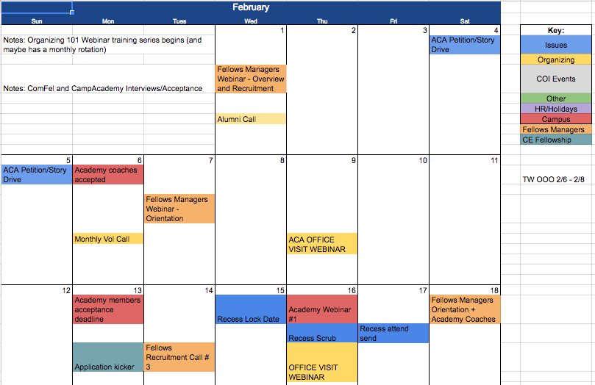
Organizational tools
1
Planning Calendar

Slide 139
Organizational tools
2
Project Taskmaster

Slide 140
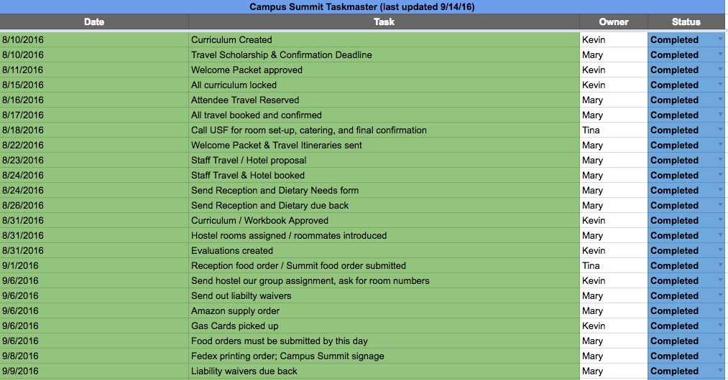
Organizational tools
2
Project Taskmaster

Slide 141
Organizational tools
3
Event Checklist

Slide 142
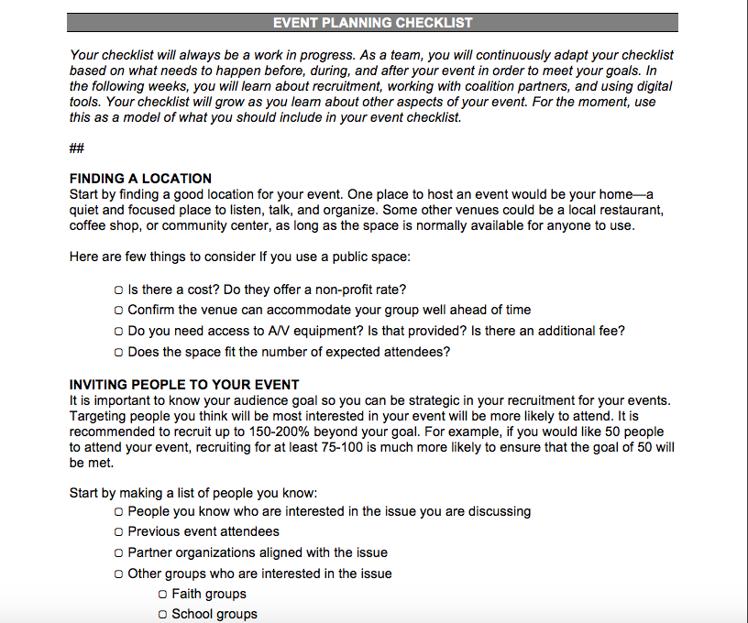
Organizational tools
3
Event Checklist

Slide 143
12 minutes
On page 23 in your workbook, review the organizational tools and how they could be used to improve the project plan.
What organizational tools would you recommend the organizers implement? Why?
What is your coaching plan to get your team members to utilize these tools?
Partner Activity

Slide 144
Debrief

Slide 145
Today’s
agenda
9:30 – 10:00 | Welcome and Introductions
10:00 – 11:15 | Managing Your Team: Managing Project Managers
11:15 – 11:30 | Break
11:30 – 1:00 | Program Breakouts
1:00 – 1:30 | Debrief & Close

Slide 146
Break

Slide 147
Today’s
agenda
9:30 – 10:00 | Welcome and Introductions
10:00 – 11:15 | Managing Your Team: Managing Project Managers
11:15 – 11:30 | Break
11:30 – 1:00 | Program Breakouts
1:00 – 1:30 | Debrief & Close

Slide 148
Planning your Orientation

Slide 149
Goals
1
Become familiar with the orientation training curriculum and logistics
Be able to review, distribute, and practice orientation training curriculum
Be excited about your orientations coming up in two weeks!
2
3

Slide 150
Agenda
Recruitment Overview
Orientation Logistics
Digital and your orientations
Curriculum overview
Debrief and Close

Slide 151

Goals Tracker
Bit.ly/GoalsTracker

Slide 152
Key dates
January 23
Application Launch

Slide 153
Key dates
January 23
February 20
Application Launch
Application Deadline

Slide 154
Key dates
January 23
February 20
February 27
Application Launch
Application Deadline
Interviews Conclude

Slide 155
Key dates
January 23
February 20
February 27
February 28
Application Launch
Application Deadline
Interviews Conclude
Fellows Accepted

Slide 156
Key dates
January 23
February 20
February 27
February 28
March 4
Application Launch
Application Deadline
Interviews Conclude
Fellows Accepted
Orientation Training

Slide 157
Agenda
Recruitment Overview
Orientation Logistics
Digital and your orientations
Curriculum overview
Debrief and Close

Slide 158
Orientation Logistics
1
Secure and lock training location, date, and time
Page 24

Slide 159
Orientation Logistics
1
Secure and lock training location, date, and time
2
Secure materials needed
Page 24

Slide 160
Orientation Logistics
1
Secure and lock training location, date, and time
2
Secure materials needed
Page 24
3
Training team

Slide 161
Orientation Logistics
1
Secure and lock training location, date, and time
2
Secure materials needed
Page 24
3
Training team
4
Stipends

Slide 162
Orientation Logistics
1
Secure and lock training location, date, and time
2
Secure materials needed
Page 24
3
Training team
4
Stipends
5
Recruiting and confirming fellows

Slide 163
10 minutes
On page 24 in your workbook, work with your local fellows managers. If you do not have other fellows managers around you, join a group.
Use the checklist to review what you have completed and still need to complete in terms of logistics for your orientation. Assign dates and persons responsible for completing each outstanding task.
Small Groups

Slide 164
Agenda
Recruitment Overview
Orientation Logistics
Digital and your orientations
Curriculum overview
Debrief and Close

Slide 165
Why digital?

Slide 166

Digital Goals
1
Every fellows has a Twitter handle and knows how to tweet.
Take high quality, candid photos – not group shots.
Create a list of Twitter handles.
Profile your new fellows.
2
3
4

Slide 167
10 minutes
On page 25 in your workbook, work with your local fellows managers. If you do not have other fellows managers around you, join a group.
Review the tick tock for your orientation training. Together, brainstorm how you will collect digital content and what you will need to meet your digital goals.
Small Groups

Slide 168
Agenda
Recruitment Overview
Orientation Logistics
Digital and your orientations
Curriculum overview
Debrief and Close

Slide 169
40 Mins
Welcome and Intro
Orientation Training Agenda
45 Mins
We’re OFA
Saturday, March 4, 2017
Half-day training
10 Mins
Break
90 Mins
Sharing Personal Stories
10 Mins
Break
30 Mins
Planning Your Learning Journey
15 Mins
Debrief and Close

Slide 170


4 Training Modules
Slides
Workbooks
Agenda

Slide 171

Training Science
Modules are designed using adult learning theory
Customize it to make it local
Trust the process

Slide 172
Annotated Agendas

Slide 173
20 minutes
On page 26 in your workbook, work with your local fellows managers. If you do not have other fellows managers around you, join a group.
Review the curriculum, taking a moment to think about who will train on each module, by when they will review the material, and when you will schedule a dry-run.
Small Groups

Slide 174
Agenda
Recruitment Overview
Orientation Logistics
Digital and your orientations
Curriculum overview
Debrief and Close

Slide 175
Debrief

Slide 176
Today’s
agenda
9:30 – 10:00 | Welcome and Introductions
10:00 – 11:15 | Managing Your Team: Managing Project Managers
11:15 – 11:30 | Break
11:30 – 1:00 | Program Breakouts
1:00 – 1:30 | Debrief & Close

Slide 177
How did it go?
Bit.ly/coacheshuddle

Slide 178
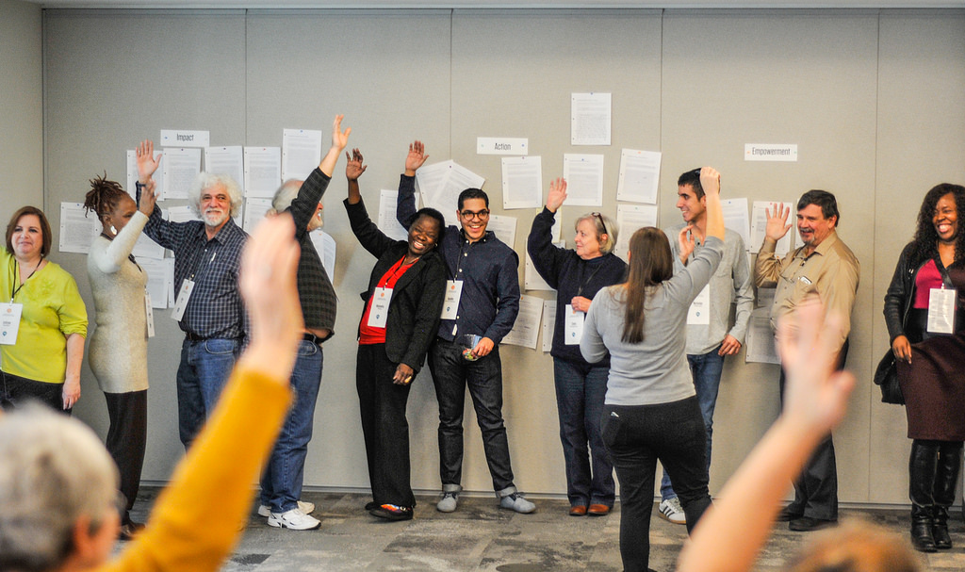
Debriefing today’s training
Think of one word of how you word describe your training experience to someone back home. We’ll circle up and share!

Slide 180
Thank you!

